Slide 1

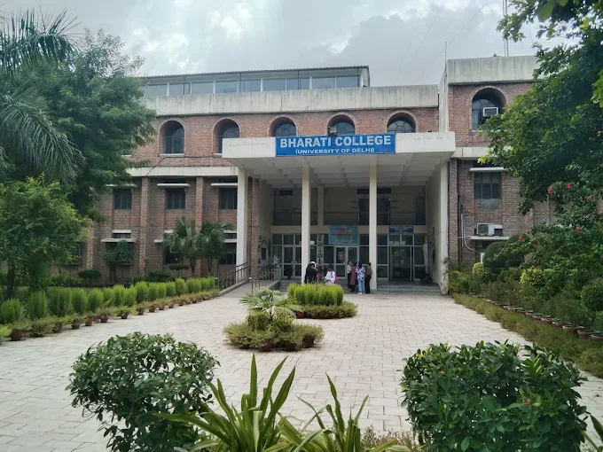

ACADEMIC AUDIT REPORT
(2023-2025)
BHARATI COLLEGE
UNIVERSITY OF DELHI
Presenting by
Dr. Deepti Singh
Assistant Professor
Department of Sanskrit

Slide 2
ABOUT THE DEPARTMENT
The Department of Sanskrit is one of the oldest departments of Bharati College that was established in the year of 1971, by late. Dr. Kumudani Sudhir. It is operated by a galaxy of Seven teachers. The department has devoted itself in spreading the traditional knowledge systems of India and revitalizing the Sanskrit language. Our undergraduate courses are aimed at familiarizing different streams of knowledge specially language and literature to the students and generating a lasting interest in our native knowledge systems in them that will help them in pursuing further studies in this field.

Slide 3
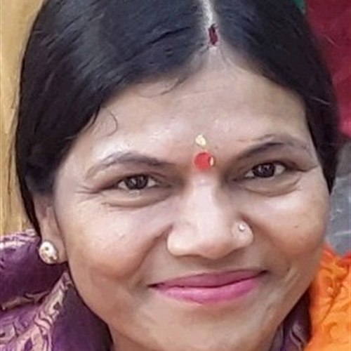
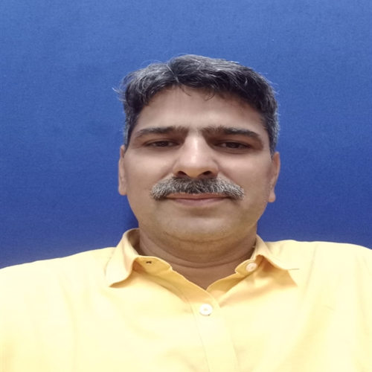
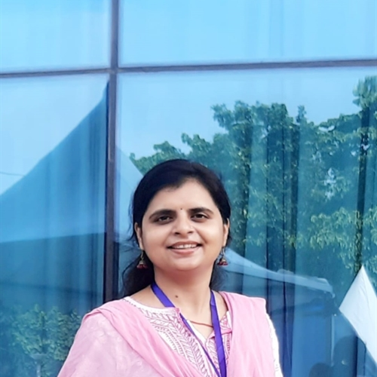
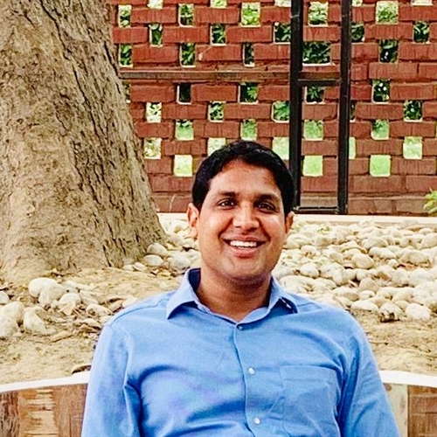
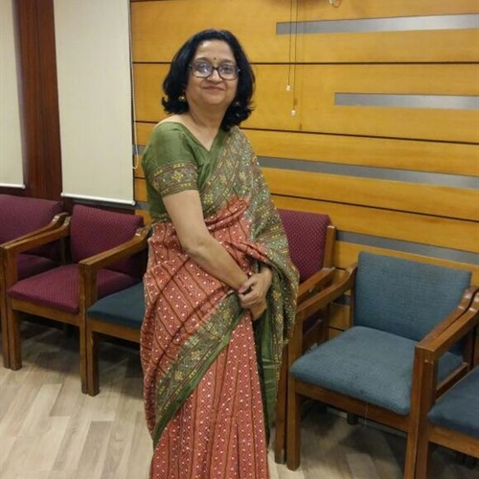
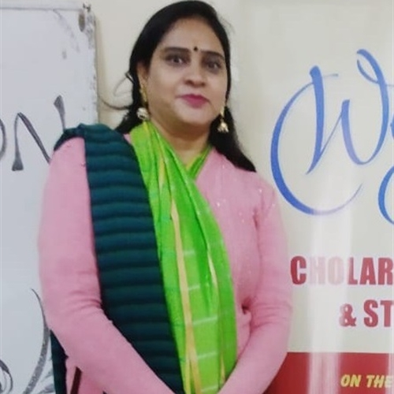
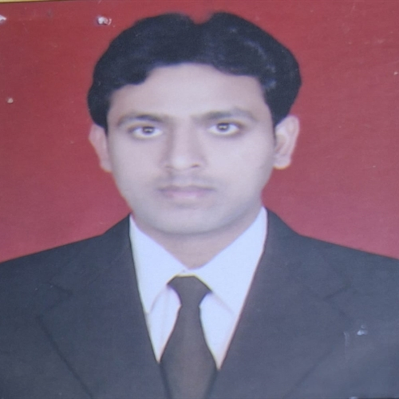
FACULTY PROFILE
Dr. Asha Tiwari
Associate Professor
Dr. Ajit Kumar
Assistant Professor
Dr. Deepti Singh
Assistant Professor
Dr. Bindia Trivedi
Assistant Professor
Dr. Prem Vallabh Dwivedi
Assistant Professor
Dr. Suman Rani
Assistant Professor
Dr. Shailendra Vikram
Assistant Professor

Slide 4
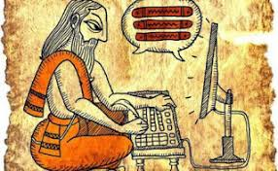
VISION OF SANSKRIT DEPARTMENT
to preserve, promote, and advance the study of Sanskrit language, literature, culture and manuscripts
to impart knowledge and skills that enable students to engage with Sanskrit texts, philosophy, and linguistic principles, thereby contributing to the preservation of this ancient language and the perpetuation of its relevance in contemporary society
to provide a comprehensive and rigorous academic program that equips students with a strong foundation in Sanskrit language, literature, and related disciplines. This includes the study of classical texts, grammar, phonetics, poetics, and historical linguistics, among other areas too

Slide 5
STUDENTS INTAKE
PROGRAM/COURSE | TOTAL SANCTIONES STRENGTH | NO. OF STUDENTS ADMITTED IN PRESENT ACADEMIC YEAR
Hons. 1st YEAR | 78 | 13
Hons. 2nd YEAR | 78 | 26
Hons. 3rd YEAR | 78 | 13
B.A. PROGRAM 1st YEAR | 35 | 19
B.A. PROGRAM 2nd YEAR | 35 | 20
B.A. PROGRAM 3rd YEAR | 35 | 13

Slide 6
STUDENTS IN DEFFERENT COURSES
PROGRAM | 1st YEAR | 2nd YEAR | 3rd YEAR
Hons. | 13 | 26 | 13
B.A. Program (Major) | 5 | 6 | 6
B.A. Program (Minor) | 16 | 14 | 7

Slide 7
STUDENT DEMAND RATIO
PROGRAM | RATIO
Hons. | 78/29 (2023-24) 78/13 (24-25)
B.A. Program | 35/19 (2024-25)

Slide 8
STUDENT TEACHER RATIO
PROGRAM | RATIO
B.A. Hons. (2024-25) | 7.8 (55/7)
B.A. Program (2024-25) | 7.71 (54/7)

Slide 9
STUDENTS DIVERSITY
PROGRAM | FROM DELHI ONLY | FROM OTHER STATES OF INDIA | TOTAL
B.A. Hons. 1st Year 2nd Year 3rd Year | 10 22 7 | 3 4 6 | 52
B.A. Program 1stYear 2nd Year 3rd Year | 3 14 10 | 2 2 3 | 34

Slide 10
SUBJECTS OFFERED
DSC
Applied Sanskrit,
Classical Sanskrit literature poetry,
Indian social institutions
SEM 1
Classical Sanskrit literature Prose, critical survey of Shastric literature, Sanskrit epics
SEM 2
Classical Sanskrit literature drama,
Sanskrit linguistics
Indian epigraphy
SEM 3
Modern Sanskrit literature,
world Sanskrit literature, epigraphy 2
SEM 4
Veda & Upanishad, Sanskrit grammer,
Introduction to Nyaya Vaisheshik
SEM 5
Vedic Samhita & grammer, Sanskrit gramer & composition,
Poetics & literary criticism
SEM 6

Slide 11
Introduction to Sanskrit poetics,
Research methodology for Sanskrit studies,
DSE
GE
Basic principle of Ayurveda,
Fundamental of Indian philosophy,
Philosophy of yoga,
Fundamental of Buddhist philosophy,
Ancient Indian polity,
Unveiling the richness of IKS
VAC
Panchkosha,
Panchkosh,
Yoga philosophy & practice,
Yoga philosophy & practice
SEC
Yoga in practice,
Yoga in practice,
Reading & writing skills in Brahmi script,
Practices in horoscope,
Script writing in Sanskrit dramaturgy,
Fundamentals of Sanskrit manuscript ology
AECC
Upanishad & Gita,
Upanishad & Gita,
Ancient Indian economy

Slide 12
PUBLICATIONS
PUBLICATION TYPE | JOURNAL/BOOK /OTHERS NAME | TITLE | ISSUE | VOLUME |  | PUBLICATION
JOURNAL | INTERNATIONAL JOURNAL OF SANSKRIT RESEARCH गुरुकुल पत्रिका शोध-दिशा शोध दिशा शब्दार्नव वाक् सुधा वेदांजलि | प्राचीन ज्ञान परम्परा में गुरु –शिष्य परम्परा दयानन्दीय पाणिनिशिक्षा एवं ऋग्वैदिक शिक्षा में अन्तर आयुर्वेदशास्त्र में मन का स्वरूप प्राचीन शिक्षा प्रणाली में गुरु-शिष्य सम्बन्ध सुश्रुत साहित्य में प्रतिपादित नेत्र विज्ञान आधुनिक संस्कृत साहित्य मे बाल् साहित्य का योगदान- आधुनिक दृष्टि से The relevance of uttararam-charitam in reference to sita | 6 | 9 18 38 20 | 0976-8017 0975-735X 0975-735X 2395-5104 23476605 2349-364X | 2023 2023 2023 2023 2023 2023

Slide 13
BOOKS
NAME | ISSN/ISBN/UGC CARE LIST | VOLUME | PUBLICATION HOUSE
ADVAITIC CRITICS OF PANCHRATRA & PASHUPAT IN DOCTRINS | 978-93-93765-12-3 | 1 | INTELECTUAL PUBLISHING HO2023
Consciousness as contend in Tripura rahasya | 978-93-93765-87-1 | 1 | Intellectual publishing house 2023
संस्कृत काव्यशास्त्र का परिचय | 978-81-965022-7-0 | 1 | विद्यानिधि प्रकाशन, 2024

Slide 14
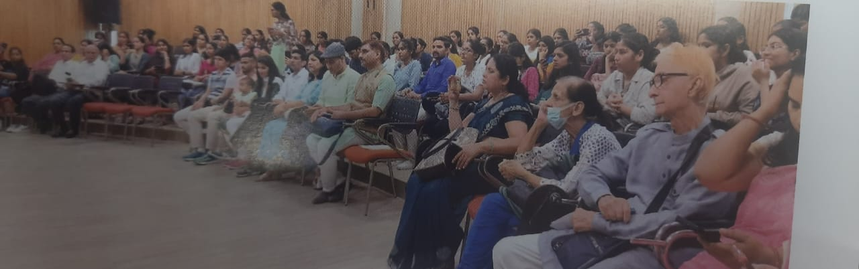
ACTIVITIES ORGANISED
Name of event- सम्मेलन
Date of event- 19/10/2023
Organizing convenor- संस्कृत साहित्य में निहित योग,आयुर्वेद और प्राकृतिक चिकित्सा का स्वरुप
संजोजिका - Dr.Asha Tiwari
Source of fund- अध्यात्मयोग संस्थान
Collaboration with - अध्यात्मयोग संस्थान एवं भारती महाविद्यालय
PARTICIPATION OF STUDENTS- 86

Slide 15
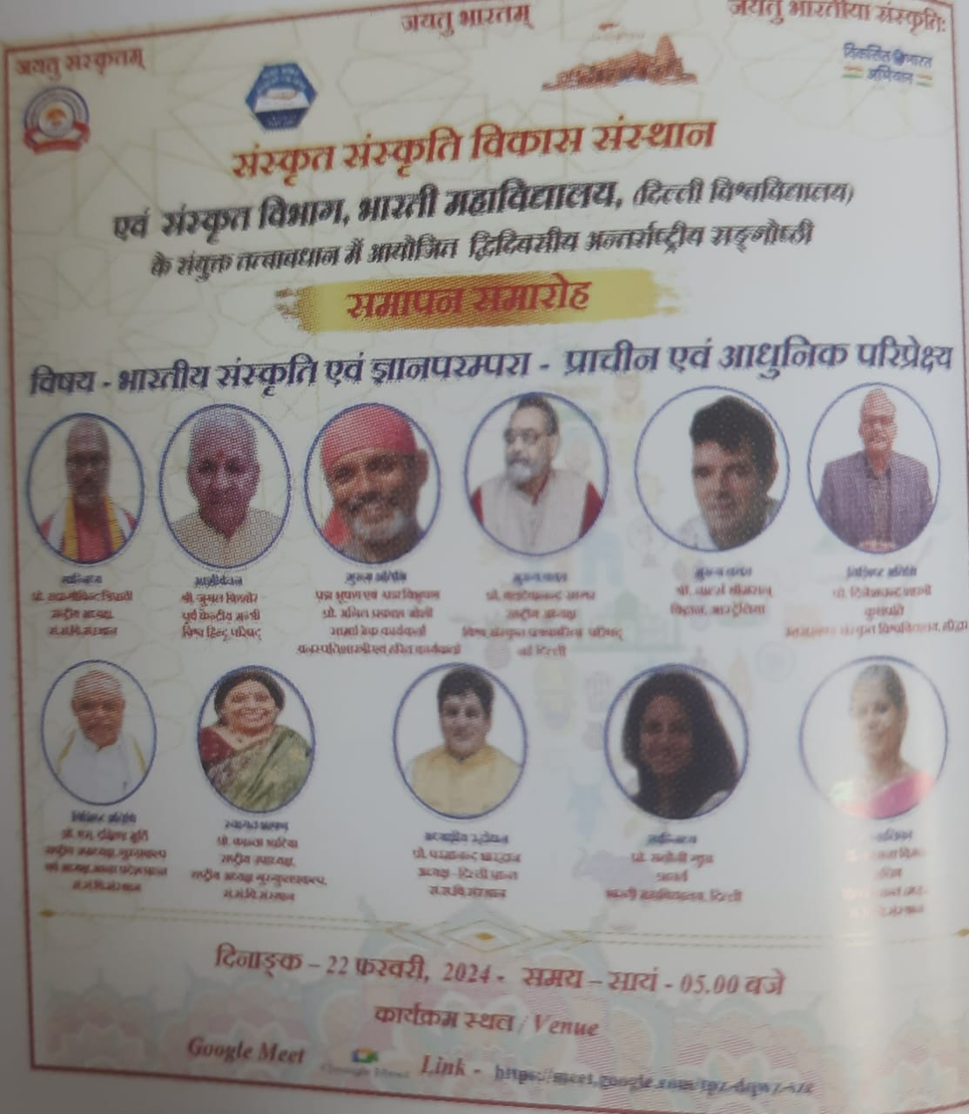
अन्तर्राष्ट्रीय संगोष्ठी
Date Of Event – 22.02.2024
Title of event - भारतीय संस्कृति एवं ज्ञान परम्परा - प्राचीन एवं आधुनिक परिप्रेक्ष्य
संजोजिका - Dr.Asha Tiwari
Source of fund- भारती महाविद्यालय एवं संस्कृत संस्कृति विकास संस्थान
Collaboration with - संस्कृत संस्कृति विकास संस्थान
PARTICIPATION OF STUDENTS- 75

Slide 16
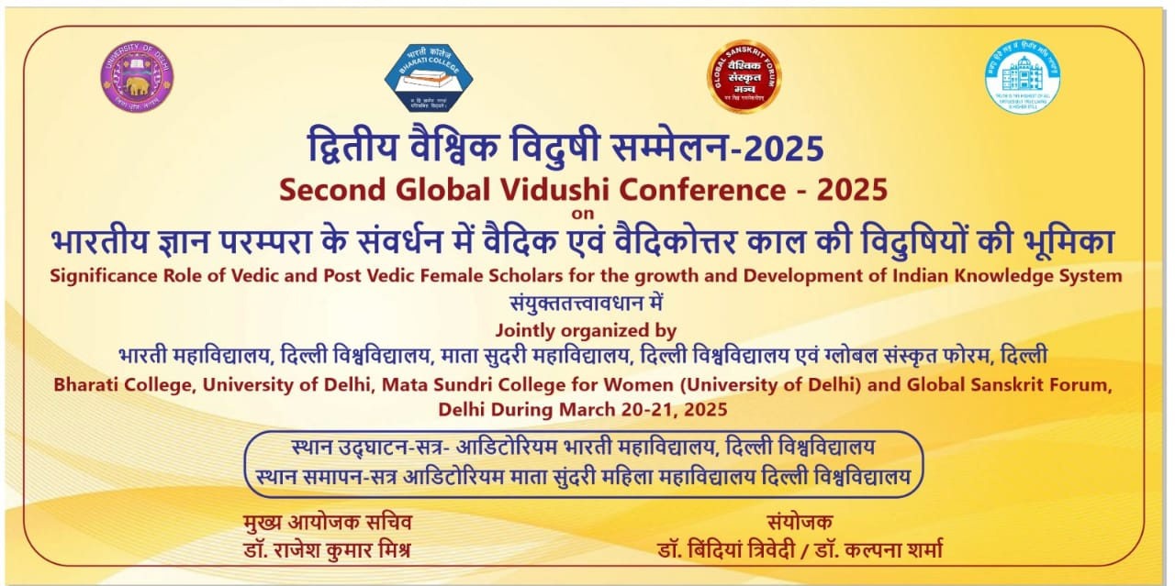
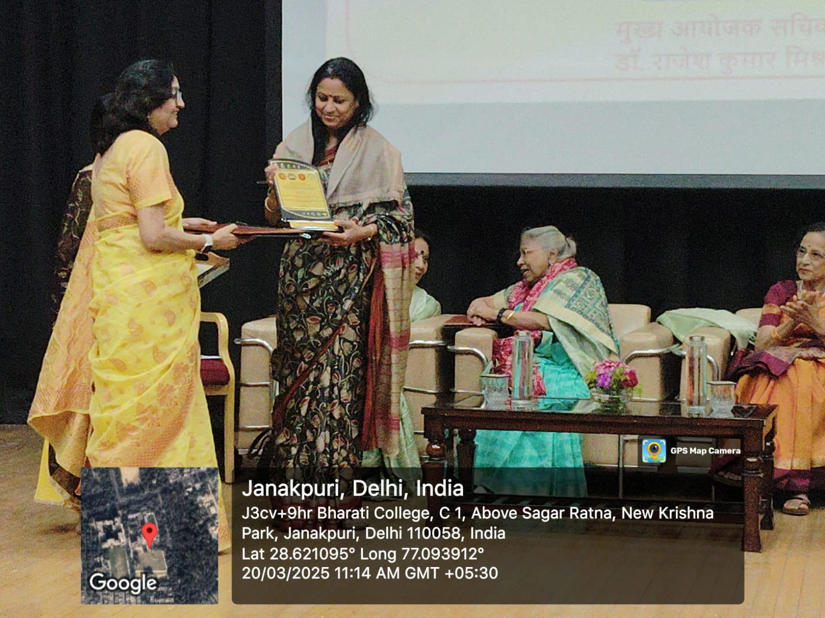
सम्मेलन
Date of event- 20-21 march 2025
Title Of Event- द्वितीय वैश्विक विदुषी सम्मेलन- 25
Convener - Dr. Bindia Trivedi
Source Of Fund- Bharati College &Global Sanskrit Forum
Collaboration With – Global Sanskrit Forum
Participation Of Students- 50
Report Link -

Slide 17
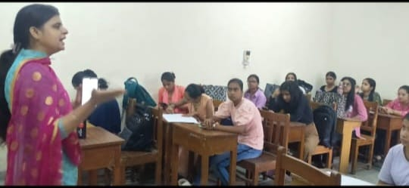
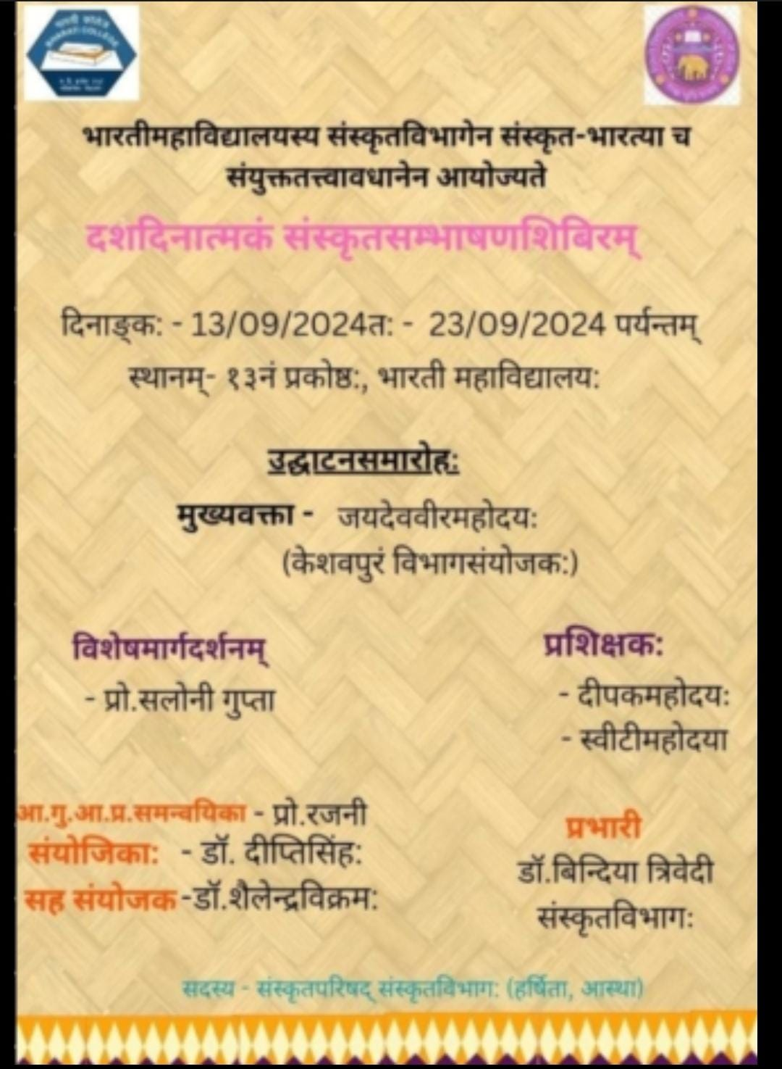
कार्यशाला
Date of event- 13 sep-24sep 2024
TITAL OF EVENT- 10 days Sanskrit Sambhashan
Organizing convenor- Dr. Deepti Singh
Source of fund- BHARATI COLLEGE
Collaboration with - SANSKRIT BHARATI
PARTICIPATION OF STUDENTS- 25
Report link -

Slide 18

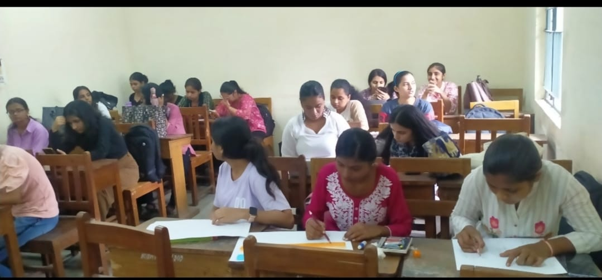
प्रतियोगिता
Date of event- 27.09.2023
TITAL OF EVENT- श्लोक गायन प्रतियोगिता
Organizing convenor- Dr. Suman Rani
Source of fund- Bharati College
Collaboration with – Sansktit Bharati
Participation Of Students- 18
Report link -

Slide 19
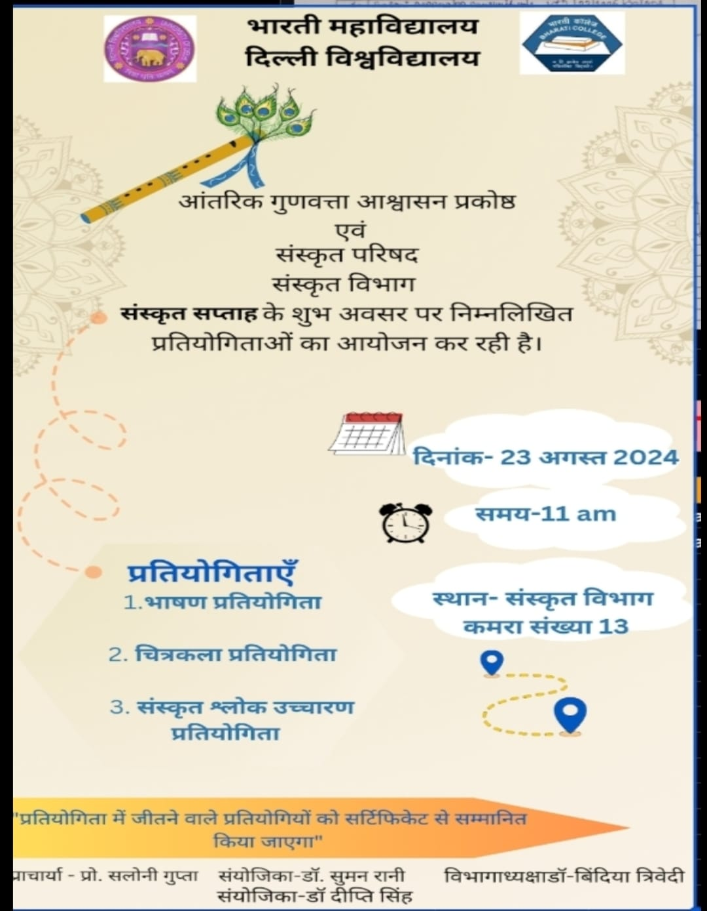
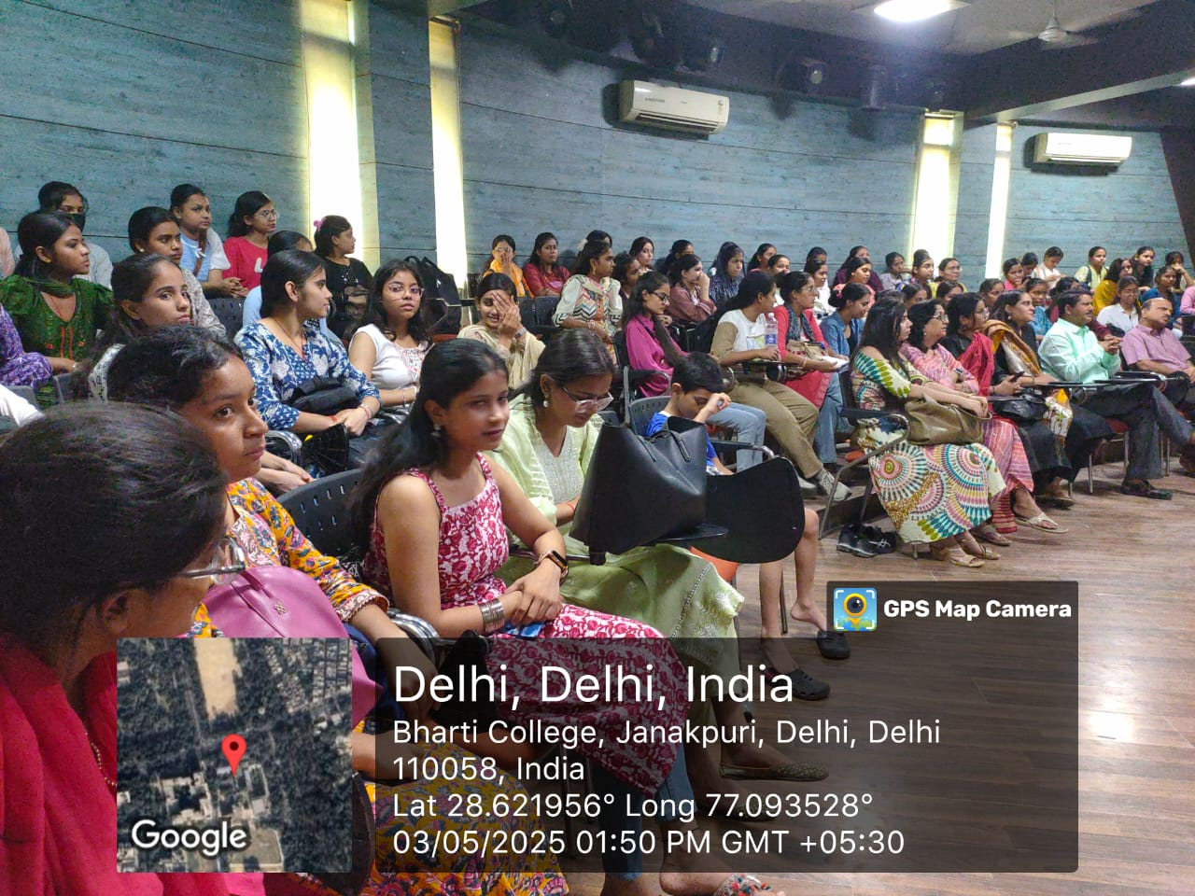
प्रतियोगिता
Date of event- 23.08.24
Title Of Event-संस्कृत सप्ताह
Organizing Convenor- Dr.Suman Rani
Source Of Fund- Bharati College
Collaboration With – Sanskrit Bharati
Participation Of Students- 12
Report Link -

Slide 20
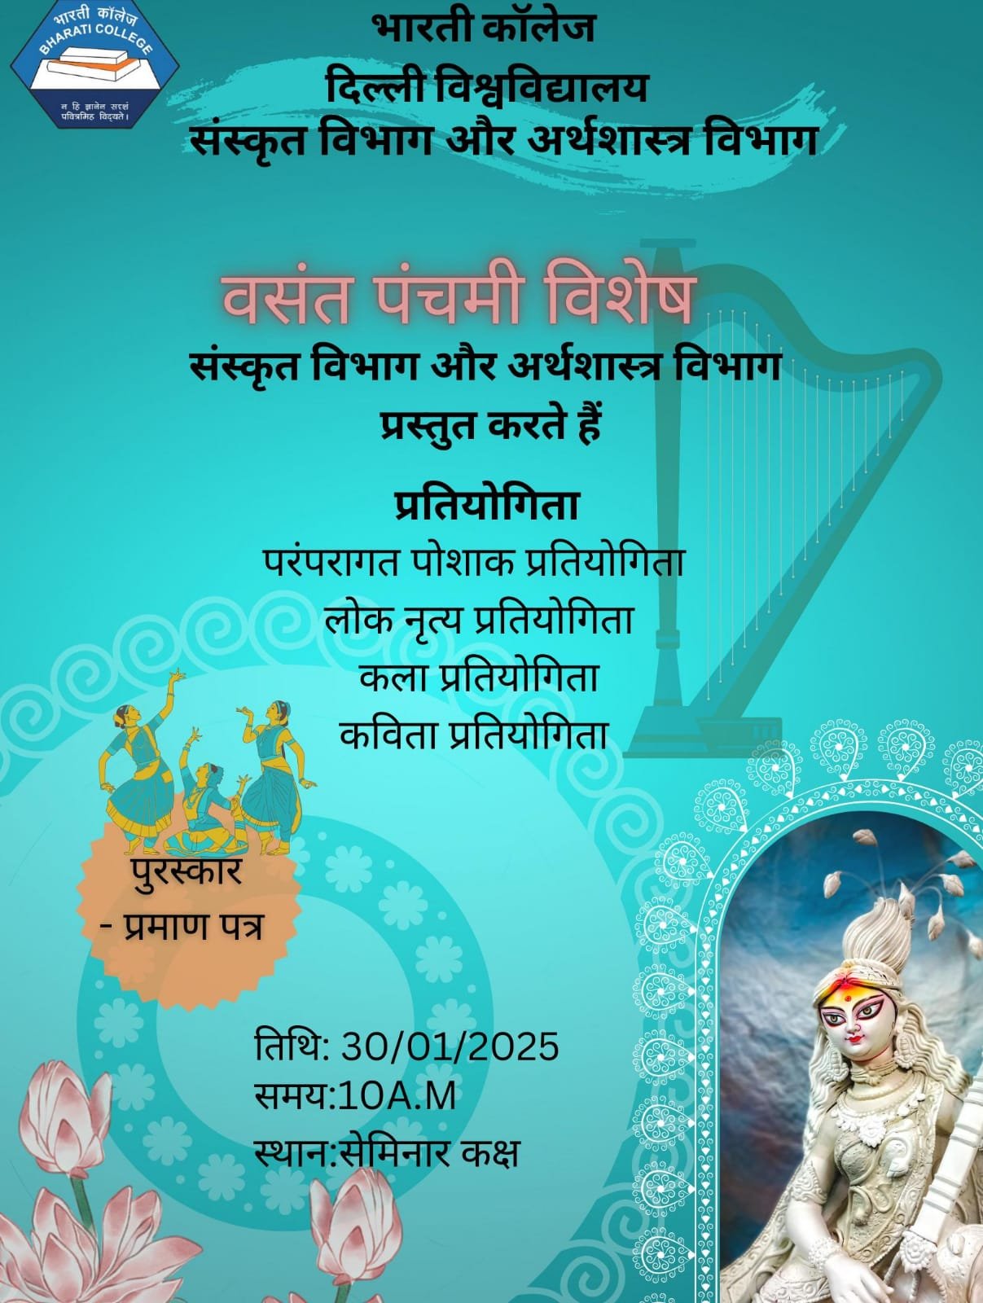
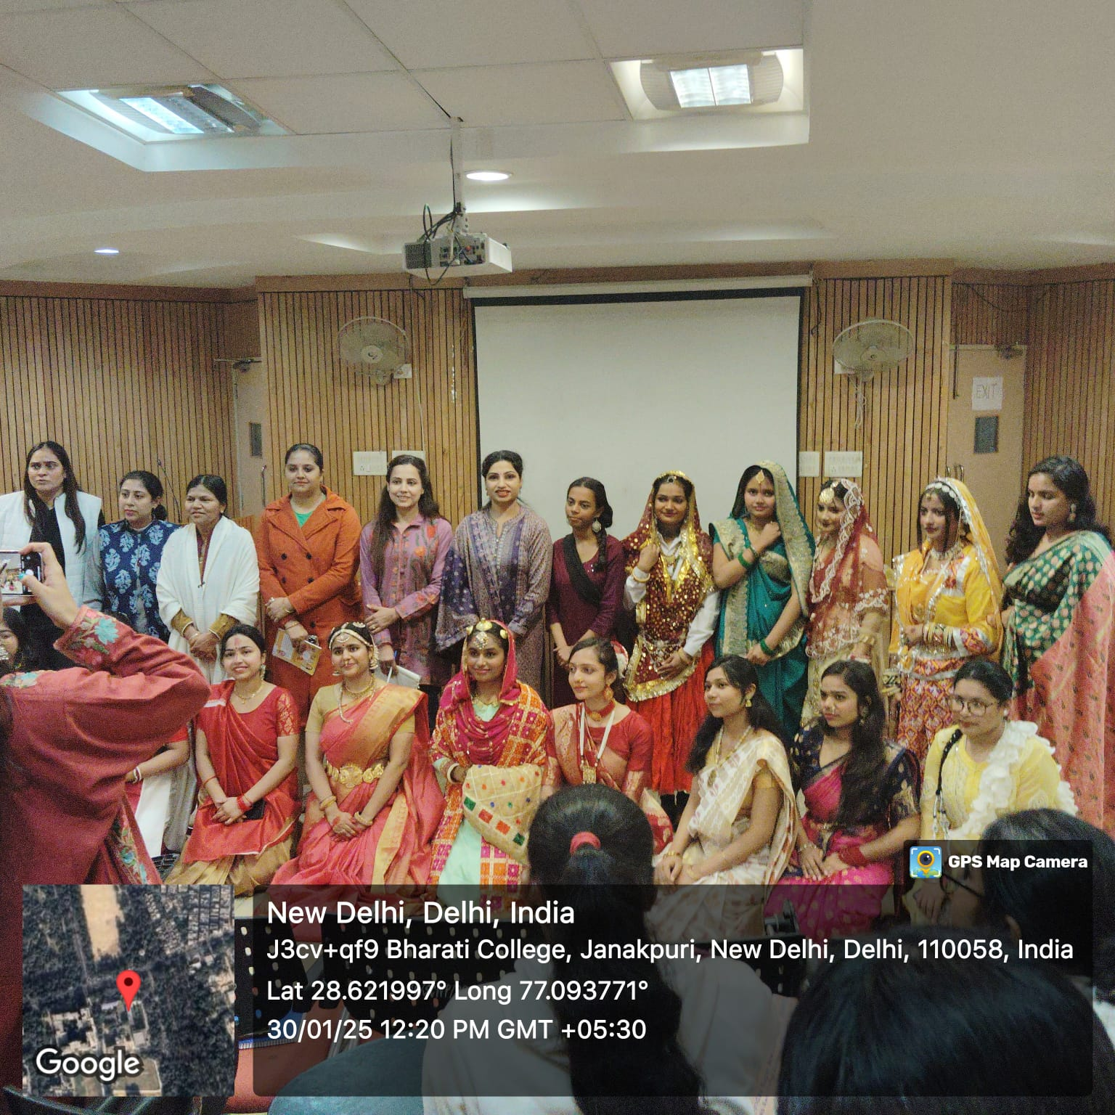
वसंत पंचमी विशेष
Date of event- 30.01.25
Participation Of Students- 23
Report Link -

Slide 21
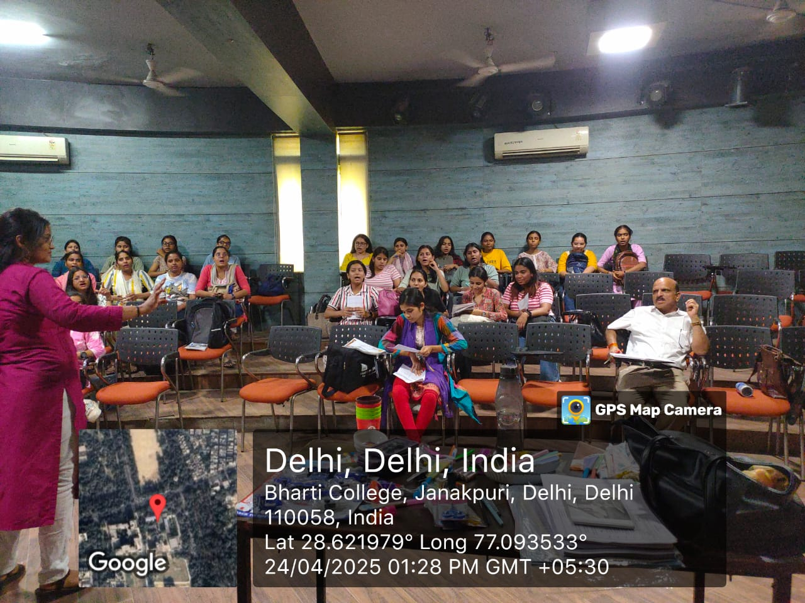

Date of event- 23.04.2023
Total Of Event- संस्कृत सम्भाषणम्
Organizing Convenor- डॉ. सुमन रानी
Source Of Fund- भारती कॉलेज
Collaboration With – संस्कृत भारती
Participation Of Students- 30
Report Link -

Slide 22
STUDENT PROGRESSION IN HIGHER STUDIES
Total Students Appeared | Total Student Passed | Students Passed With Above 80% Or 8 CGPA | Students Passed With Above 60% Or 6 CGPA | Below 60% Or 6 CGPA | Total Student Admitted In Higher Studies | Percentage Of The Students Enrolled In Higher Studies
SKT HONS. 28 | 19 | 0 | 12 | 7 | 12 | 60%

Slide 23
Details
NAME OF STUDENT | COURSE COMPLETED IN BHARATI COLLEGE | PASSING YEAR | CURRENT ENROLLED IN COURSE | UNIVERSITY/COLLEGE/INSTITUTION | CONTACT
Swati Jha | Skt. hons. | 2024 | M.A. | JDMC, DU | 8586823343
Anchal | Skt. hons. | 2024 | B.S.Ed. | IGIPESS, DU | 9582771932
SANSKRITI | Skt. hons. | 2024 | M.A. | LSR, DU | 8470934741
Ritika | Skt. hons. | 2024 | M.A. | Skt. Department, DU | 9582546112
Priyanka Saxena | Skt. hons. | 2024 | M.A. | KNC, DU | 9582546112
Tanu Swati Sharma | Skt. hons. Skt. hons. | 2024 2024 | M.A. M.A. | S.O.L. DU S.O.L. DU | 9543807337 9717929447

Slide 24
STUDENT ACADEMIC ACHIEVEMENT DATA
NAME OF STUDENTS | BATCH | EXAM QUILIFIED | PASSING YEAR
DISHA | 2011-14 | NET | 2014
SHWETA TULSI SUNITA | 2014-17 2014-17 2013-16 | TGT TEACHER (BIHAR Govt.) TGT TEACHER (DELHI Govt.) TGT TEACHER (DELHI Govt.) | 2017 2017 2017

Slide 25
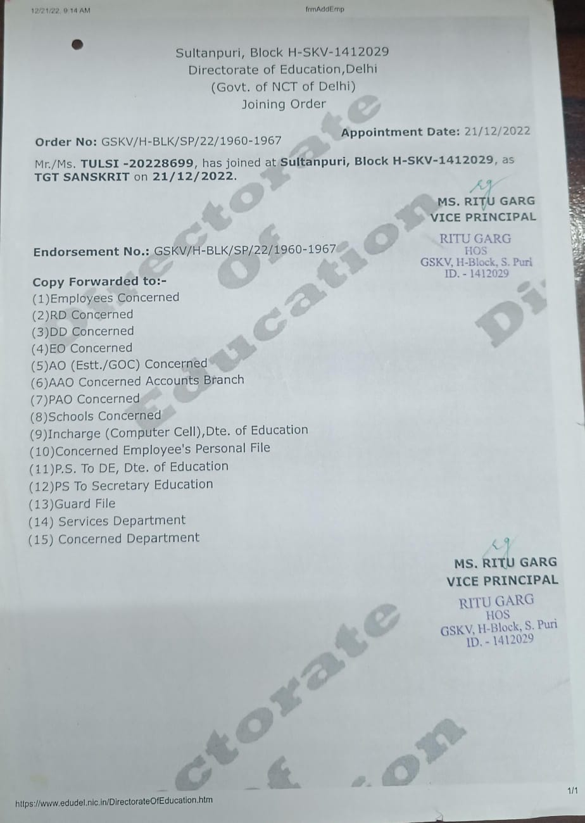
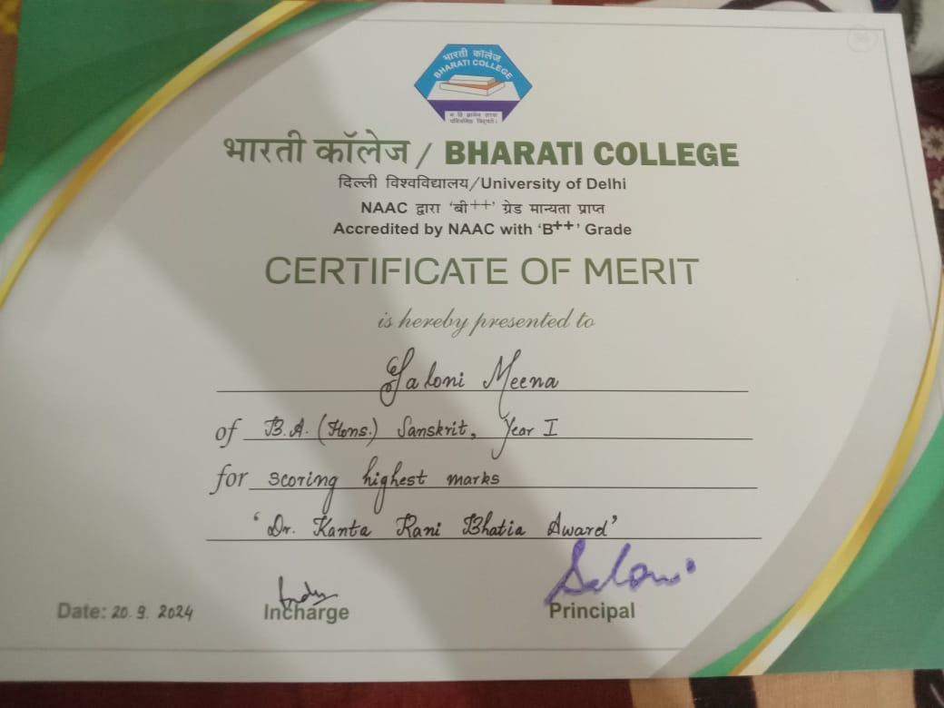
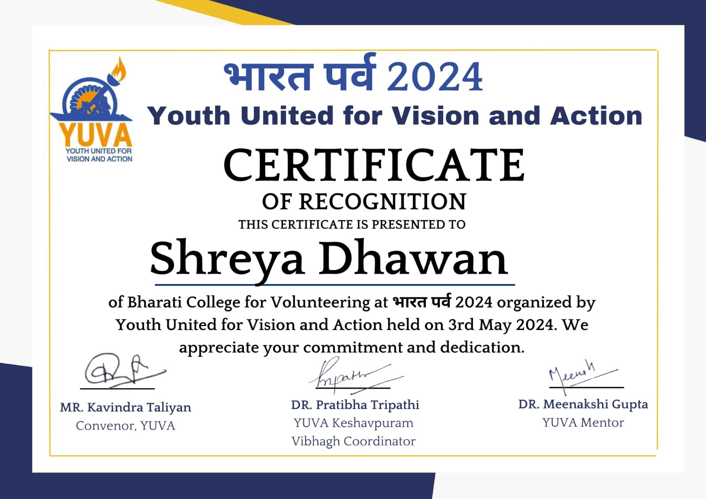
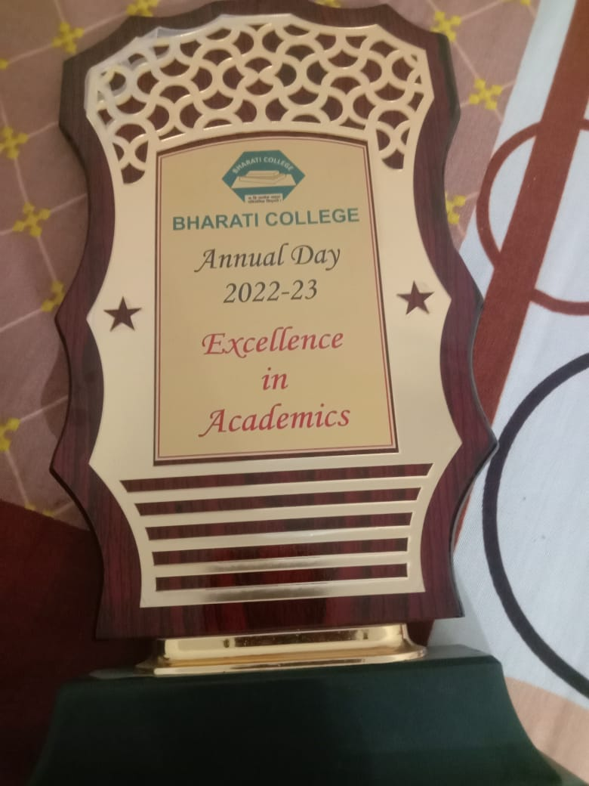
OTHER ACHIEVEMENTS OF THE STUDENTS (AWARDS AND

Slide 26
PLACEMENT
NAME | BATCH | PLACED( COMPANY/ORGANISATION) | CONTACT DETAIL
ISHA ARORA | 2019-22 | SAMSUNG INDIA WEBSITE & SHOP APP | 8130654859

Slide 27

Sanskrit department have actively contributed to the Sanskrit Parishad by holding key leadership positions such as President, Vice President, Treasurer, and Event Coordinators etc.. Through their involvement in planning and executing departmental events Under the teachers supervision, they demonstrated initiative, teamwork, and organizational capabilities. These roles not only enriched the cultural and academic environment of the department but also provided students with valuable opportunities to develop leadership skills, responsibility, and effective communication—qualities that are essential for their holistic growth and future endeavors

Slide 28

The department experiences relatively low enrollment every year ,with many students joining the programme not out of a genuine interest in Sanskrit, but due to limited choices or lower academic performance in other subjects. This often results in an initial lack of motivation and engagement with the subject matter. Inspiring interest in Sanskrit and elevating the academic performance of such students demands considerable effort, patience, and innovative teaching strategies. This remains an ongoing challenge and area of concern for the department.

Slide 29

FUTURE PLANS
Skill Development Workshops
Digital Integration of Sanskrit
Regular Departmental Competitions
Project-Based Learning
Participation in National-Level Events

Slide 30

तेजस्विनावधीतमस्तु

