Slide 1
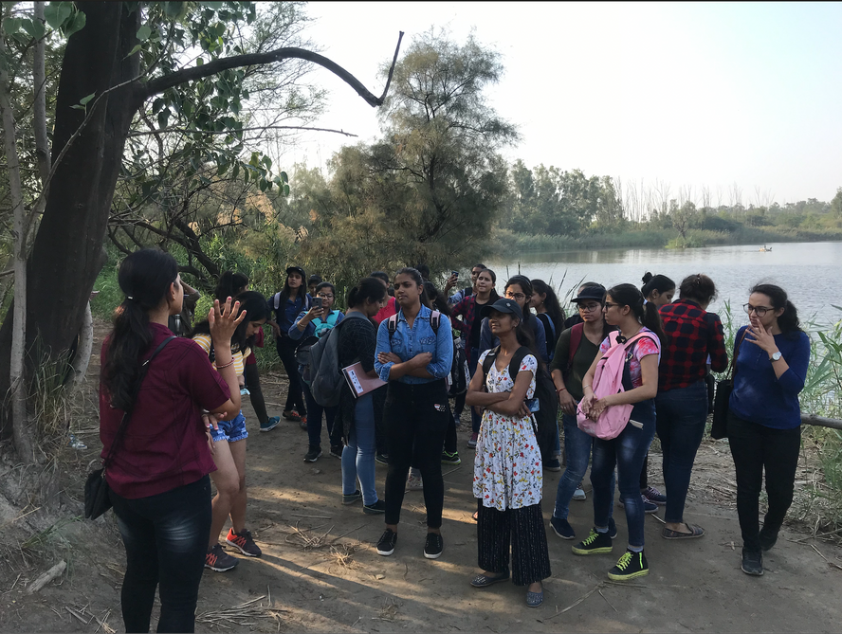


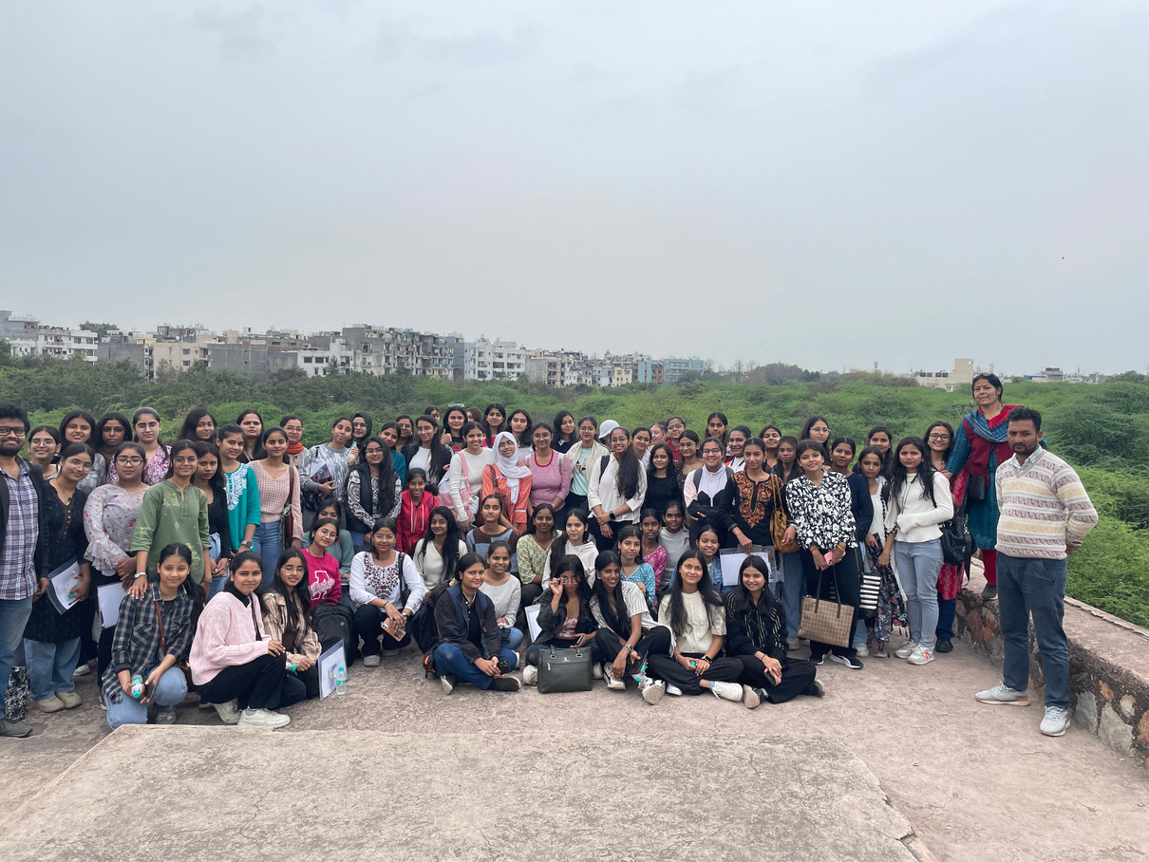

Department of
Environmental Studies
Academic Audit 2023-25
Bharati College, University of Delhi
1

Slide 2
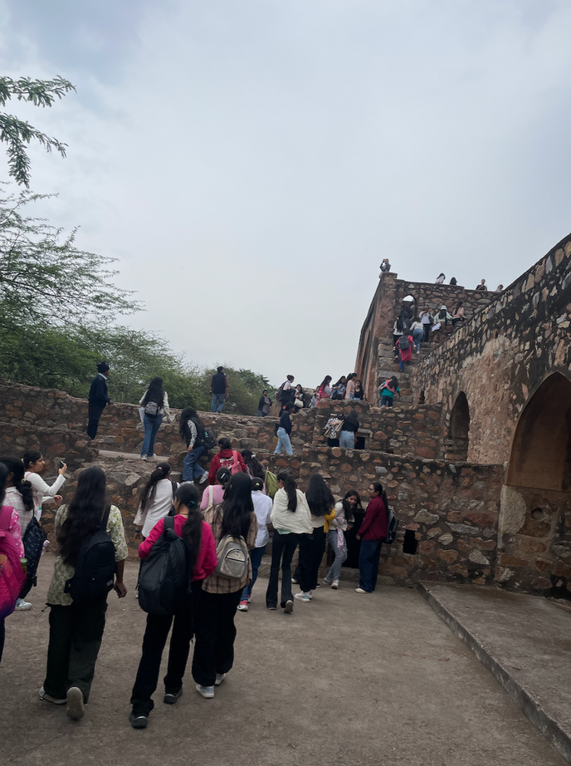
Content
Vision
Total faculties
H Index
Student of different courses Subjects offered
Faculty Profile
Resource Mobilisation
Total Publication
Activities Organised
Achievements-(Conference/seminar)
Students Progression, Awards
Innovative pedagogy/Best Practices
Weakness of the Department
Future Plan
01
02
03
04
05
06
07
08
09
10
11
12
2

Slide 3

Vision
Aims to foster environmental awareness, education and action towards sustainability.
Introduce the Department. Provide a quick background and rationale. Briefly share its overall scope as well as expected outcomes.
01
To develop skill, knowledge and changing attitude towards mindful consumption and conservation
02
Providing scientific and practical understanding of Natural systems and challenges to make environmentally conscious citizens
03
To help the learners
to protect the
environment at any cost
Encouraging values and ethics that support environmental conservation.
04
3

Slide 4


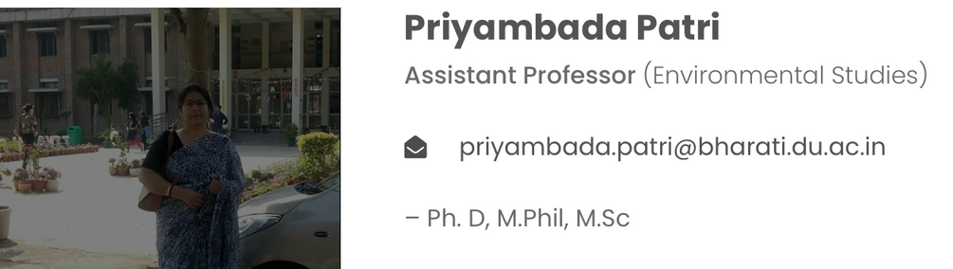
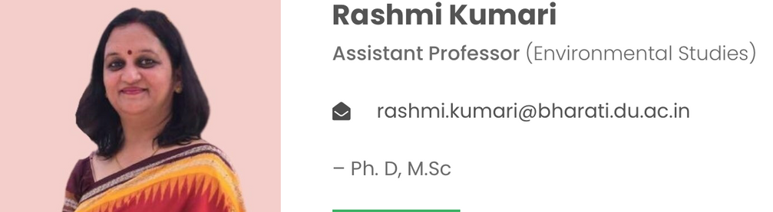
Total faculties(2)
Specialization in Microbial ecology, Limnology, Wastewater treatment by Aquaculture, Bioremediation
Specialization in Renewable Energy
4

Slide 5
H-index of the Department
Students Intake= 1100-1500
Program/course
 | I st sem | IInd sem | IIIrd sem | IV sem
Courses | B Com Hons B Com Prog BA Hons. Hindi BA Hons. Sanskrit BA Hons Journalism BA Hons. Sociology | BA Hons. English BA Hons. Political Science BA Hons History BA Hons Psychology B SC Hons. Mathematics BA programme | B Com Hons B Com Prog BA Hons. Hindi BA Hons. Sanskrit BA Hons Journalism BA Hons. Sociology | BA Hons. English BA Hons. Political Science BA Hons History BA Hons Psychology B SC Hons. Mathematics BA programme
Total | 550 approx | 550 approx | 550 approx | 550 approx
Teacher Student Ratio | 1/275 | 1/275 | 1/275 | 1/275
5

Slide 6
Number of Research Scholars who have obtained Master degree from other Univ: NA
Number of Research Scholars receiving fellowships viz., NET-JRF,NFST, Project Fellows, UGC- MZU Fellows, any other: NA
Number of students qualifying in state/ national/ international level examinations: NA
NET/SLET/GATE/GMAT/CAT/GRE/TOEFL/ Civil services/State government examinations): NA
Number of outgoing students placed during the year: NA
Number of awards received by students: NA
Students Progression to Higher Studies: NA
Syllabus revision: Yes CBCS to UGCF
The National Education Policy (NEP)underlines the importance of making environmental education an integral part of Curricula and encouraging environmental awareness and sensitivity towards its conservation and sustainable development. It also advocates the attainment of holistic and multidisciplinary education through flexible and innovative curricula to sensitise the students of diverse disciplinary backgrounds and to sensitize them about the commitment of our Nation towards achieving SDG goals and addressing global environmental challenges. The syllabus of Environmental Science-Theory into Practice is designed as a 2 credit course in one semester of first and second years.
6

Slide 7





SUBJECT OFFERED-AEC
Ist semester
IIIrd Semester
AEC- Environmental Science-Theory into Practice-I
AEC-Environmental Science-Theory into Practice-II
IInd Semester
IV Semester
AEC- Environmental Science-Theory into Practice-I
AEC-Environmental Science-Theory into Practice-II
7

Slide 8
Courses | Total Strength | Admission Taken | Courses | Total Strength | Admission taken
BA Prog | 305 |  | BA Sociology | 72
BA English | 97 |  | BSC Mathematics | 72
BA Hindi | 96 |  | B Com Hons | 190
BA Sanskrit | 94 |  | B Com Prog | 243
BA History | 98
BA Pol Science | 98
BA Journalism | 72 |  | Total | 1526
BA Psychology | 72
8

Slide 9
FACULTY PROFILE
NAME | DATE OF JOINING | HIGHEST DEGREE | SPECIALISATION | TOTAL EXPERIENCE | NO OF RESEARCH PAPER PUBLISHED | H-INDEX | ORCHID ID/GOOGLE SCHOLAR | NO OF BOOK PUBLISHED | VIDWAN ID
Dr Priyambada Patri | 07/01/2015 | PhD | Microbial ecology, Fishery Biology, Wastewater Treatment by Aquaculture | 11 | 9 | 39 | 0009-0000-4764-64 | 1 | https://vidwan.inflibnet.ac.in/profile/519316
Dr Rashmi Kumari | 01/08/2015 | PhD | Renewable Energy | 11 | 10 | 16 | 0009-0007-6793-8465 |  | https://vidwan.inflibnet.ac.in/profile/520087
9

Slide 10
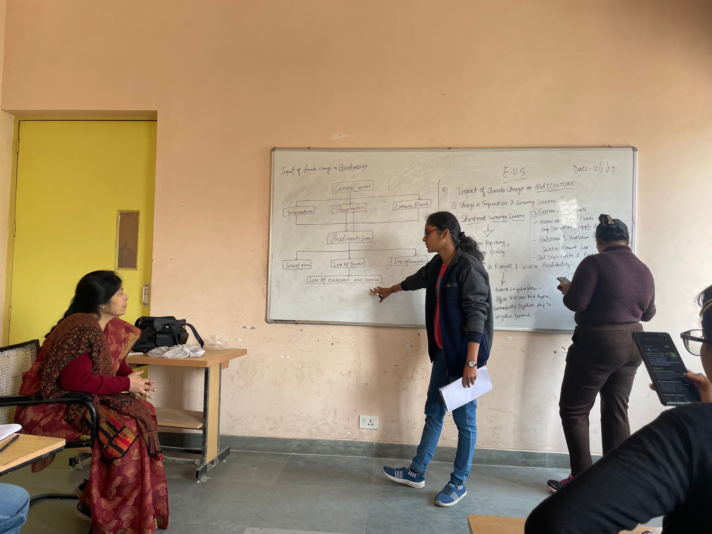



Collaborate the programmes with Delhi Government, NMNH, MoEFCC CMS Vatavaran and other NGO
Other funds generated=0
Resource mobilisation
Externally funded Conference/Workshop/Event=0
Research Project= 0
10

Slide 11
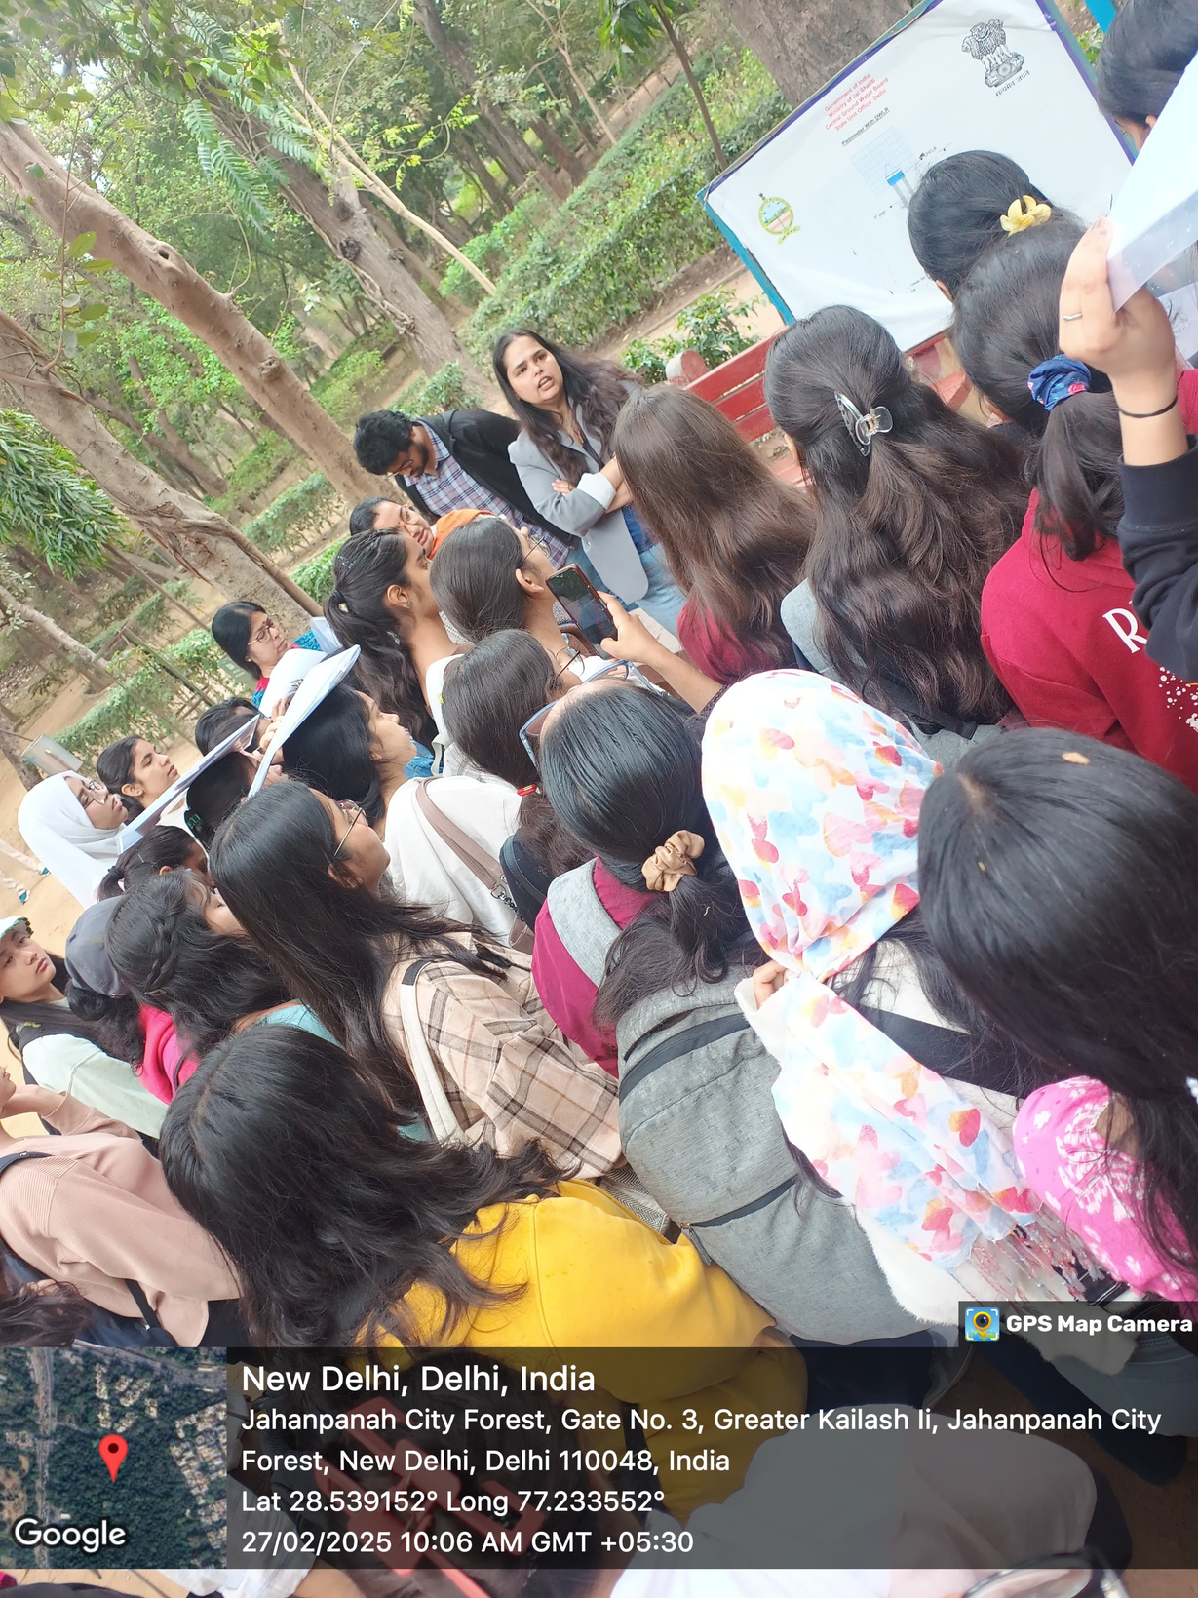
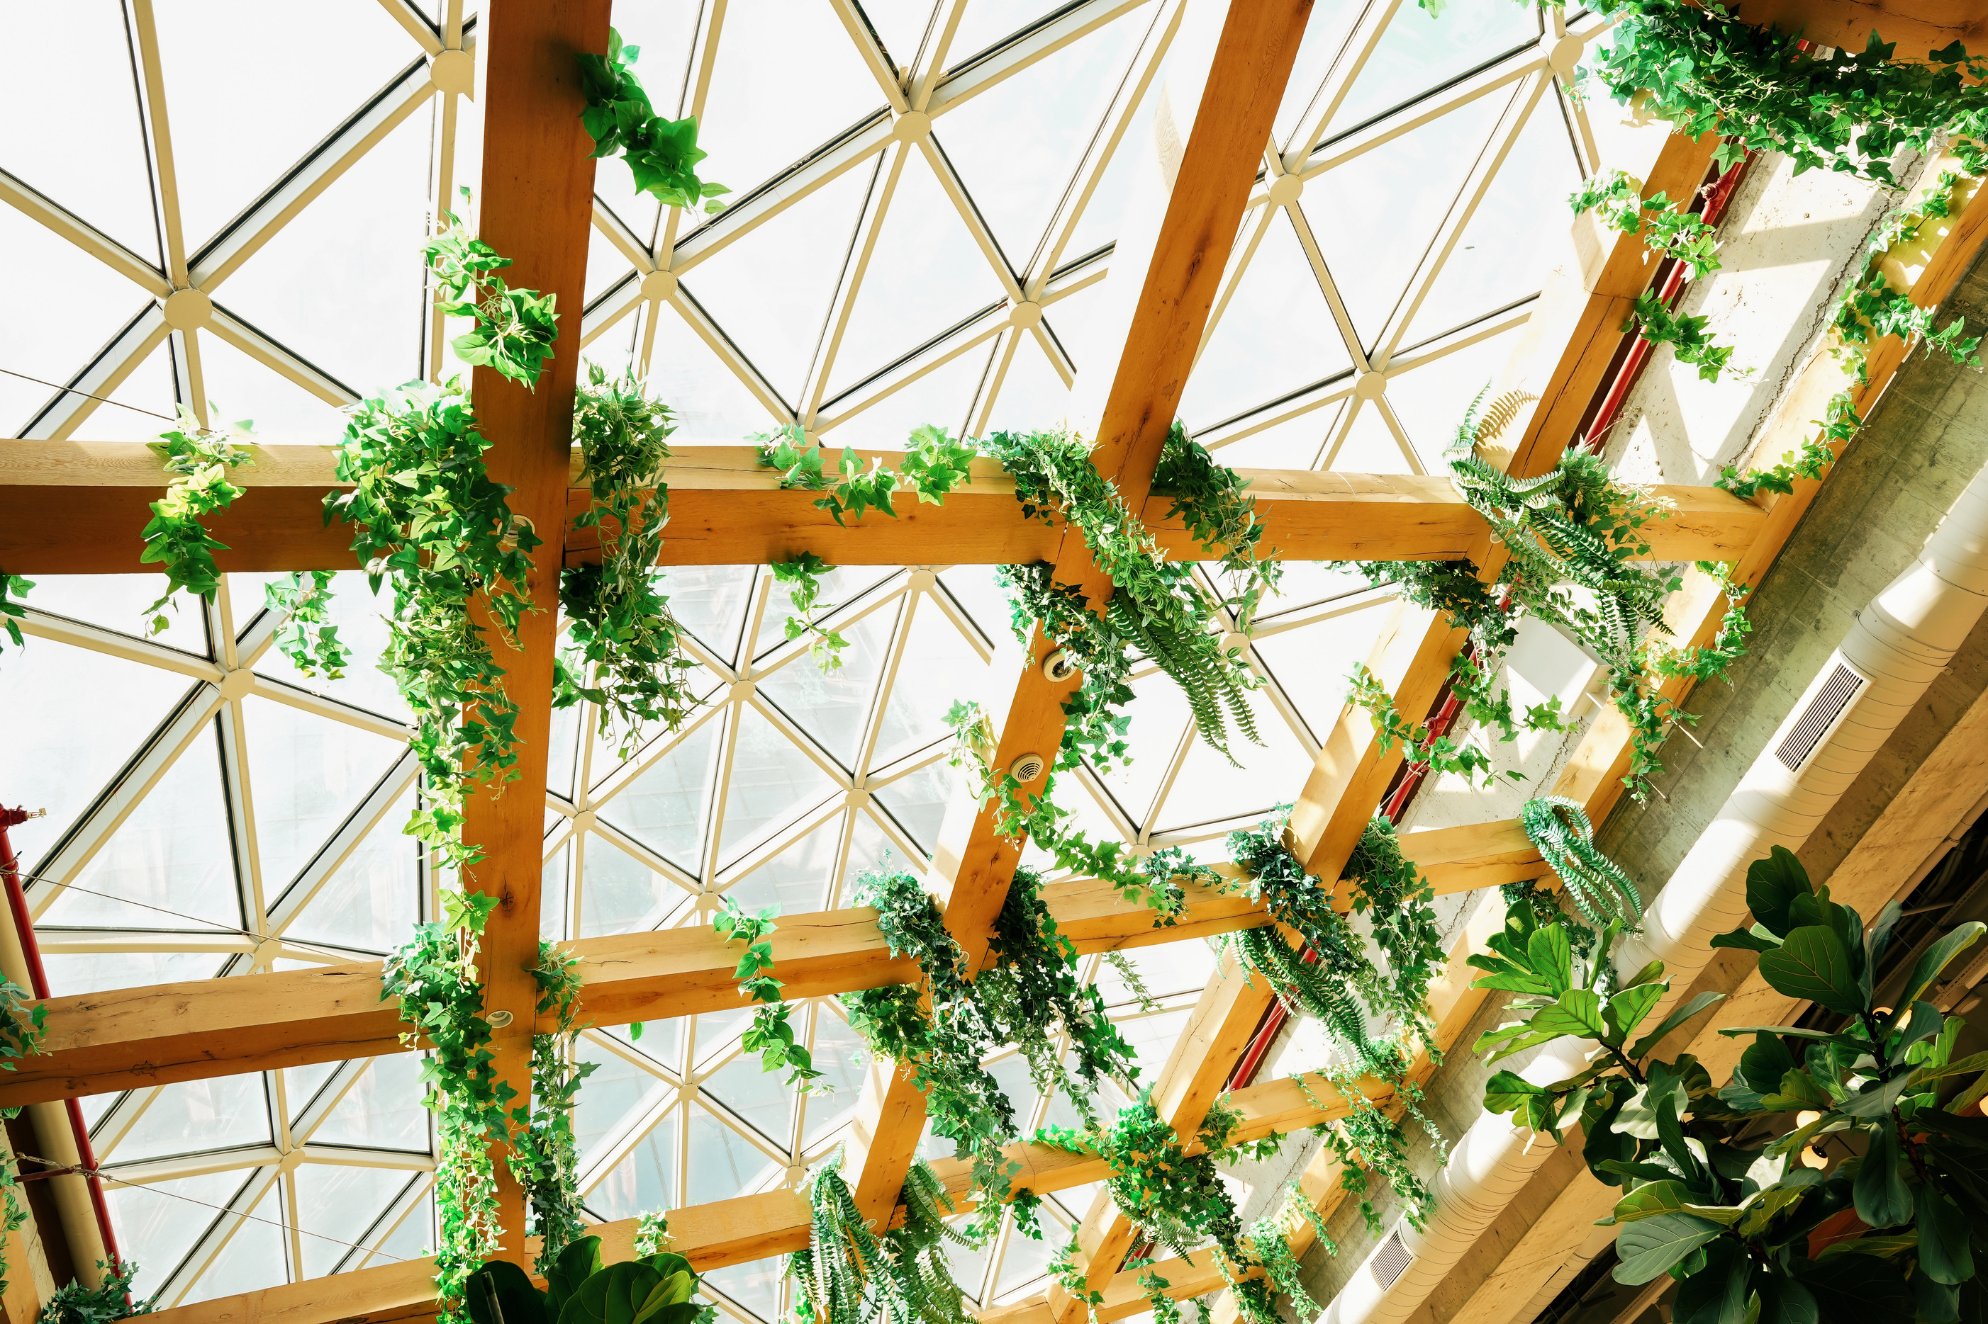



TOTAL PUBLICATION 2023-2025
Journals = 0
Book = 0
Other Publication = 0
11

Slide 12






Activities
Academic talk
Seminar on waste management on occassion of Green Consumer Day
Presentation
Group Discussion
Ecofriendly practices
30 days Environmental Challenge with National Edu Trust of India
Photography
Movie Screening on Water Crisis, Climate Change
Vrikshya Rakhya Bandhan
Awareness, skill, Knowledge
Green Quiz
Participated International Film festival by CMS Vatavaran
Plantation
Poster making/Rangoli competition
Extempore speech
12

Slide 13

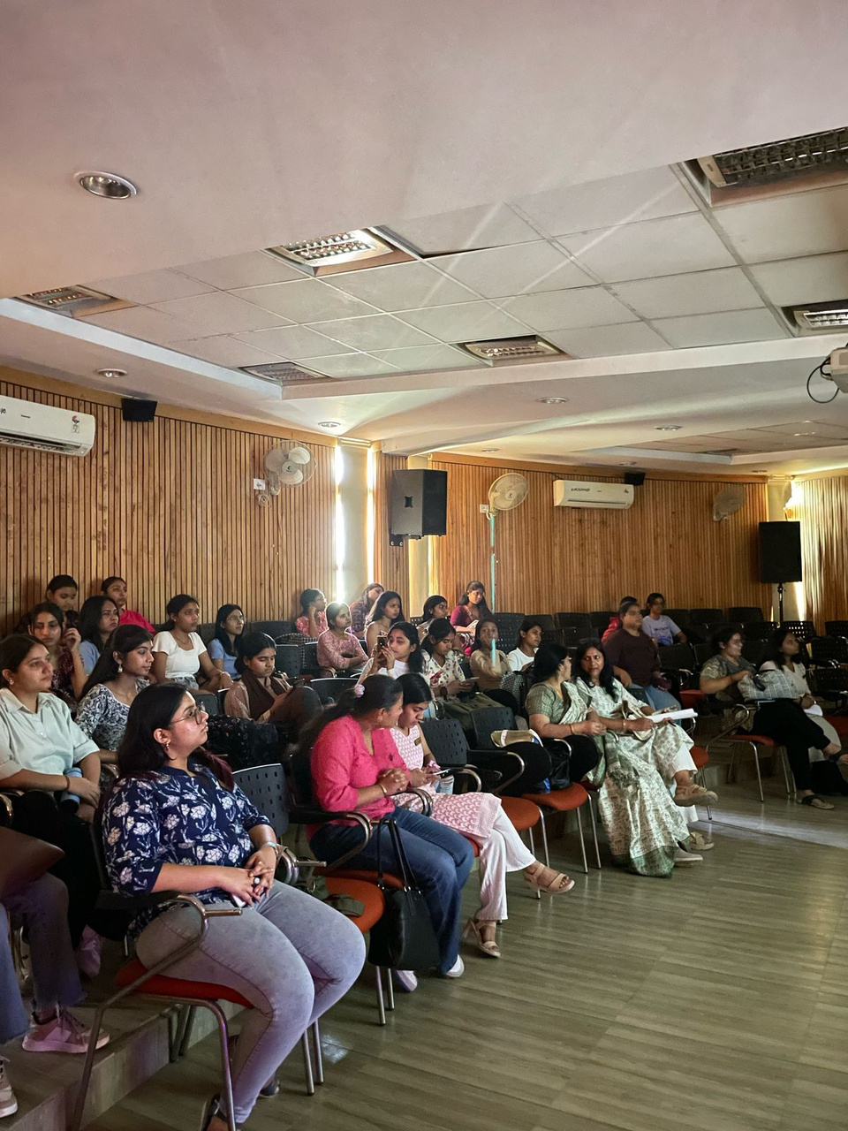


Activities Organised with Palaash-The Ecoclub
Street play
Cleanliness drive
Plantation Drive
Mass Awareness Program on Vehicular Pollution, Mission LiFE
Rally
Exposure visit to Biodiversity Park, Jahanpanah Forest, Aravali Biodiversity Park
Workshop on solution to Plastic Pollution
Study Trip to Chandu Budhera Water Treatment Plant
Save Yamuna Campaign
Best out of Waste
Poster making
Quiz
30-days Environmental Challenge
Film Screening
Pakshi-Fest of Ecoclub Palaash
13

Slide 14




CONFERENCE/SEMINAR/TRAINING
Attended by Dr Priyambada Patrii
5th and 6th International Conference on
Sustainability Education , 2023, 2024,
AI and Google Tools in Education
Learning Conclave -Planning water conservation for climate -resilient cities (23/2/24)
important to establish the science of climate change 'Climate policies and politics’
on 26/9/24
8th India Water Week, 17-20, Sept, 2024
FIP for faculty of Univ/colleges (2-31st December, 2023)
FI
NDTV World Summit on 21-22, Oct, 2024
Online Programme on Green Skills and
Gender Equity on 6/3/2025 by CMS Vatavaran
International Conference on Sustainability Education 2023 at India Habitat Centre from 19-20th September, 2023
NEP Orientation and Sensitisation Programme
Capacity Building Programme for Climate Smart
Governance Immersive Learning Workshop
By IIPA on 25/02/25
Waste Characterisation and quantification by CSE (22-24 May, 2024)
World Sustainable Development Summit, 2023, 2024, 2025
‘Society and Sustainability for vision Viksit Bharat@2047' pon 31/01/2025
Delhi Youth For Climate Summit: Participated on 10th & 11th August 2023
Sujalam-II: Clear solutions: Resource recovery from reclaimed Water on 25/7/2024
International
National
14

Slide 15
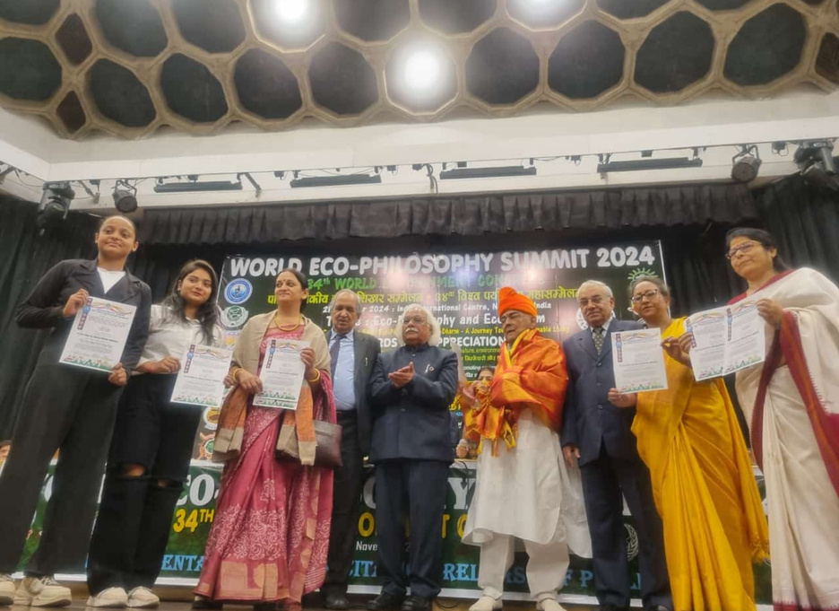

AWARDS/RECOGNITION
Ecofriendly College Campus Award by National Edu Trust of India
Zero waste Campus by MCD, Delhi
GREEN GUIDE AWARD BY
NATIONAL EDU TRUST OF INDIA
Green Ambassador Certificate to 30 Students
by National Edu Trust of India
Ecological Education Award, 2022-24 at Ecophilosophical Summit, 2022, 2023 and 2024
15

Slide 16
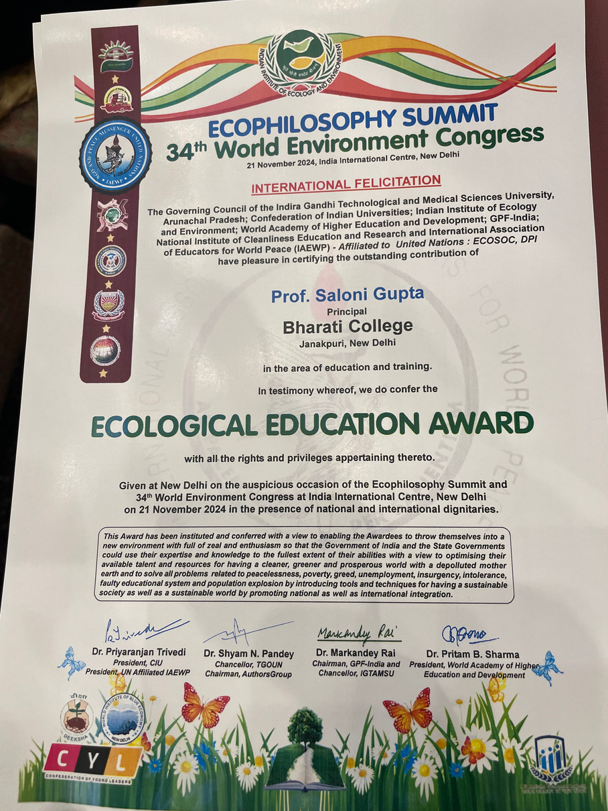
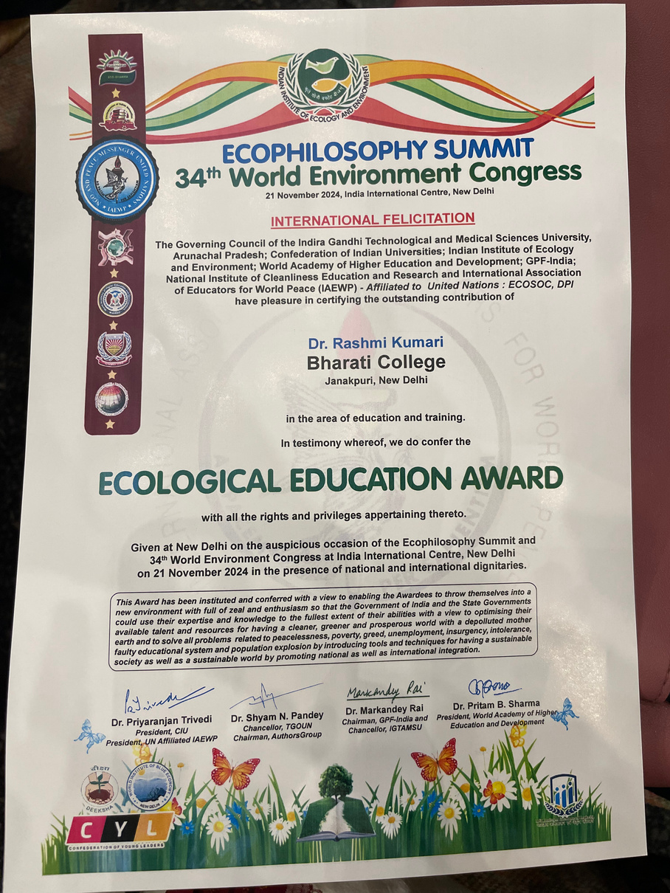
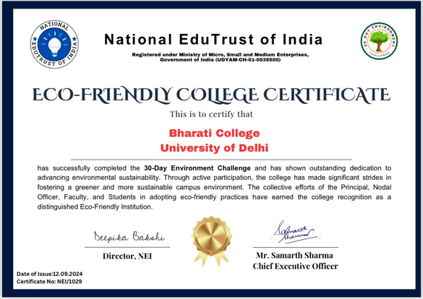
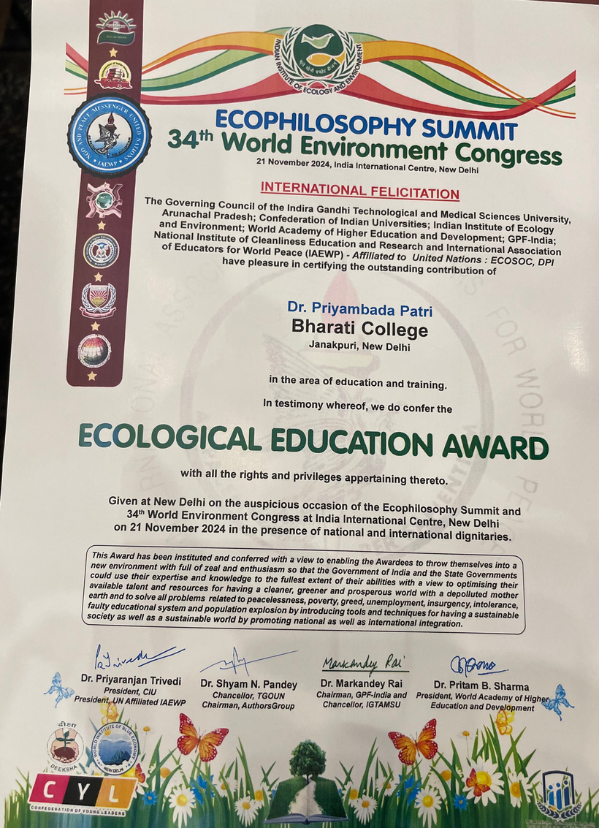
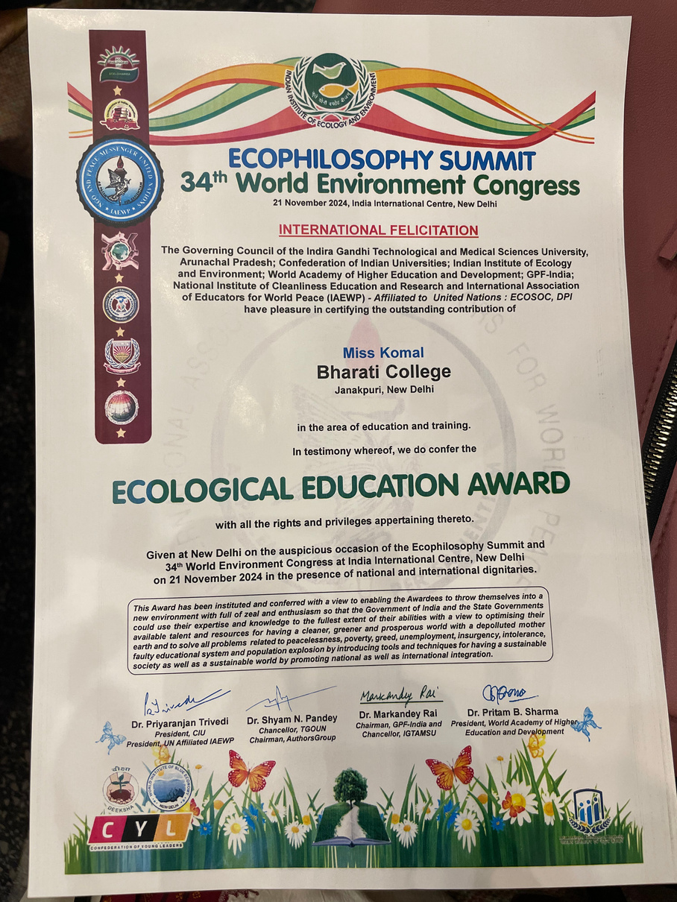
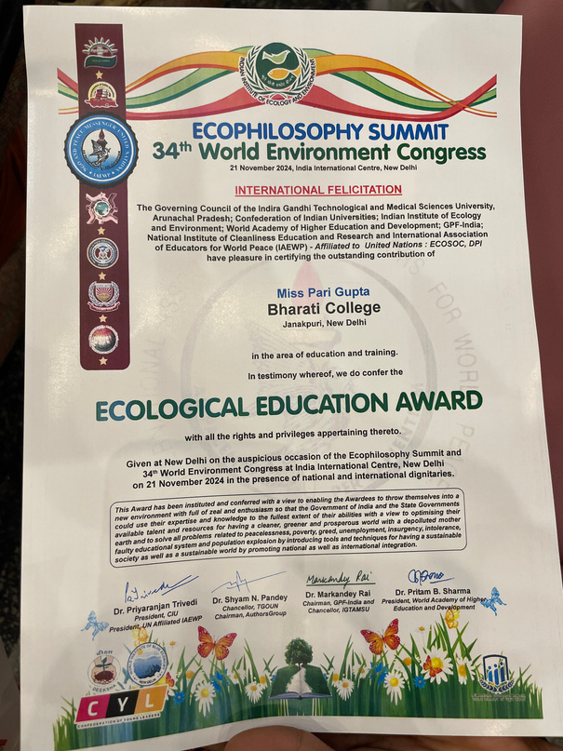
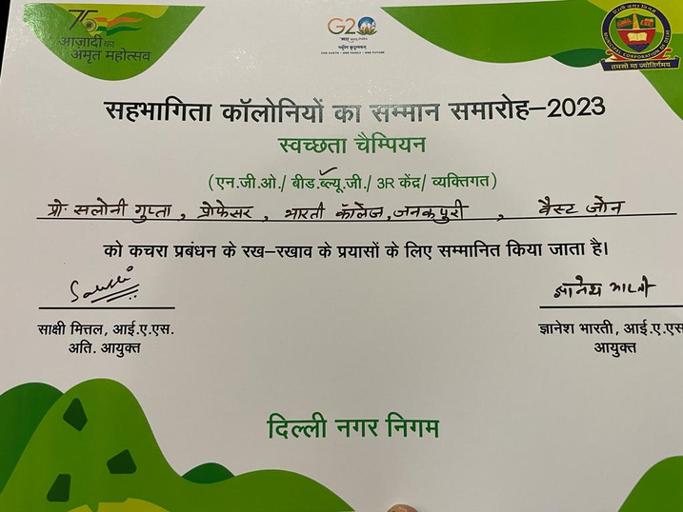
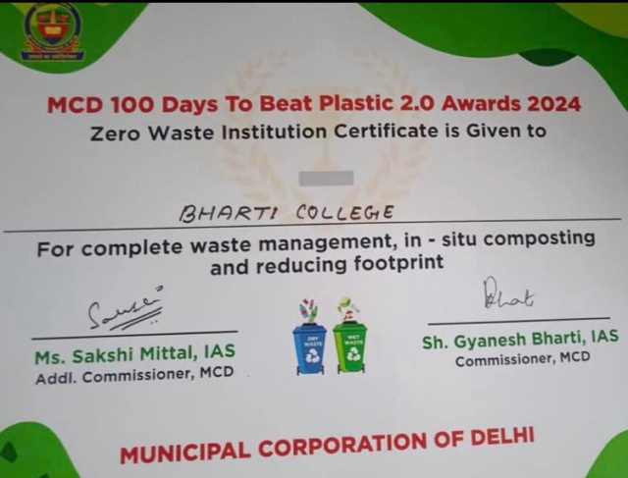
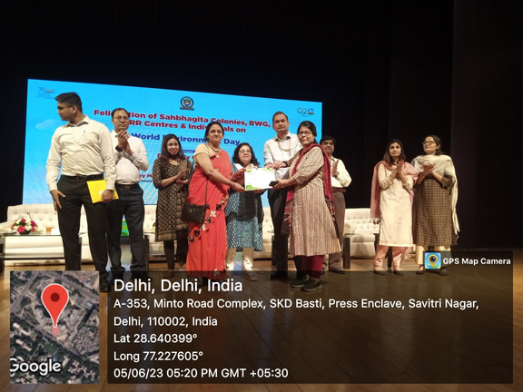
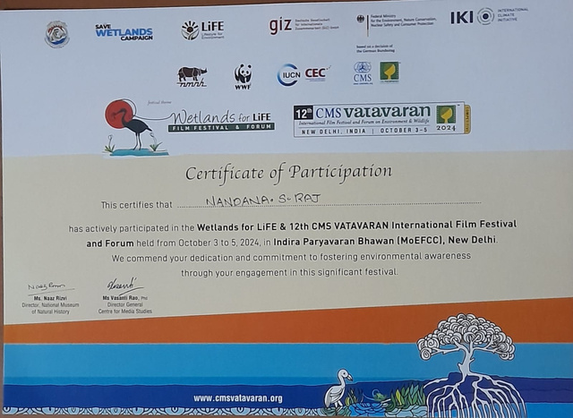
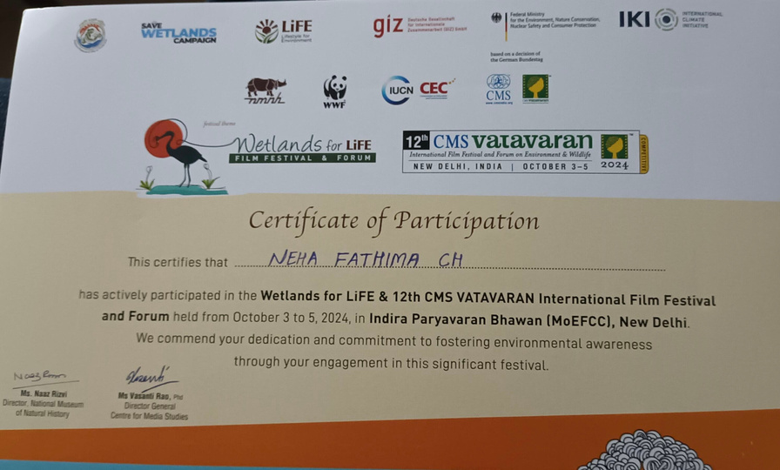
16

Slide 17
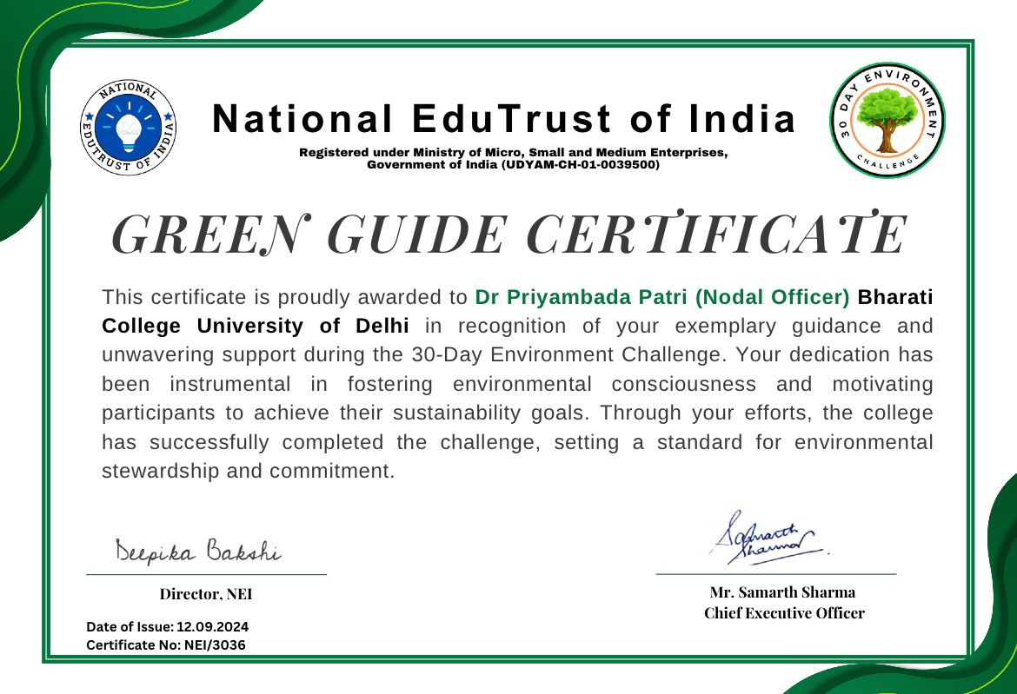
17

Slide 18



National EduTrust of India
(Registered under Ministry of Micro, Small and Medium Enterprises, Government of India (UDYAM-CH-01-0039500)
Certificate of Appreciation
This is to certify that Bharati College, University of Delhi has actively participated in the Vriksh Raksha Bandhan initiative organized by the National Edutrust of India. The college engagement in tying Rakhi on trees highlights its commitment to environmental conservation and community involvement.
This activity was made possible due to the extraordinary leadership of
Principal Prof. Saloni Gupta, the dedicated efforts of Dr Priyambada
Patri Nodal Officer, supportive faculty members, and the enthusiastic
participation of students.
Mr. Samarth Sharma Chief Executive Officer
Certificate No: NEI/VRB/8179 Date of Issue:19.08.2024
18

Slide 19





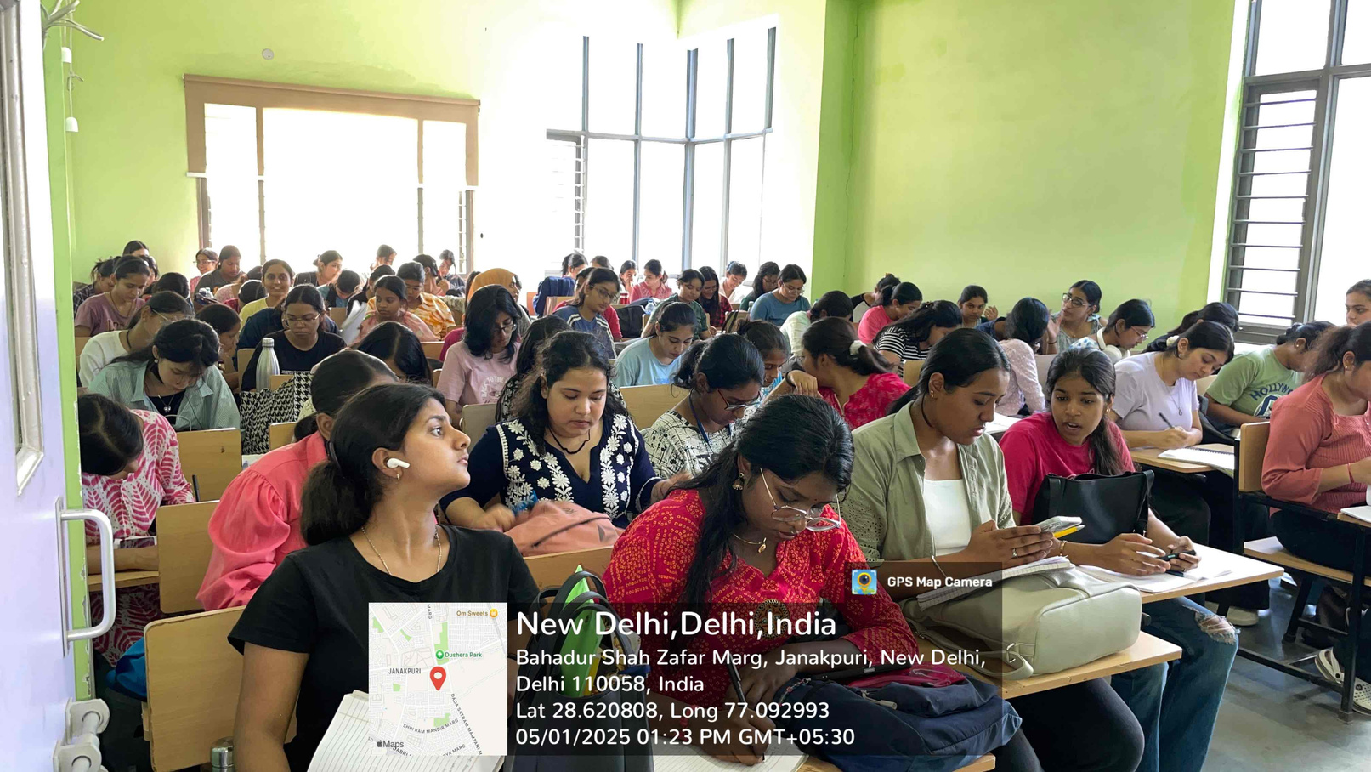
Innovative Teaching Pedagogy
Problem-based learning
01
Project-based learning
02
Experiential learning through field visit, hands-on activities, Field work, Sustainability projects
03
Technological Integration
04
Partnering with communities and civic engagement-Each one teach 10 for Climate Action
19

Slide 20


Weakness
Handling of a large group for practicals with minimum workload
Teacher/Student Ratio = 1/550
Less than 50%
More than 75%
Interested for Outdoor activities
Students Active participation
Students’ access to internet and technology
Scientific temperament
20

Slide 21



Future Plan
Academic excellence, imbibe the environmental values, holistic development and to make environmentally responsible sensitive students
Publication of Guide books to handle environmental challenges
Sustainability education aligning with SDG-2030
Hands-on Conservation efforts in Collaboration with NGOs
Interns on Sustainability Project
21

Slide 22
Observation of the Last Academic Audit
Weakness
Suggestions
MoU with Indian Renewable Energy Development Authority will be held shortly for Solar Energy and other avenues
Faculty members have not been actively involved in undertaking environment related projects or research endeavours
Establish partnerships with research Institutions and environmental organisations to leverage expertise, resources and networks for collaborative Projects and initiatives
Challenging to handle around 600 students with their Assignments, project works, Practicals, Field visit, Continous Assessment, Practical exam and evaluation of End-term examination paper .
22

Slide 23
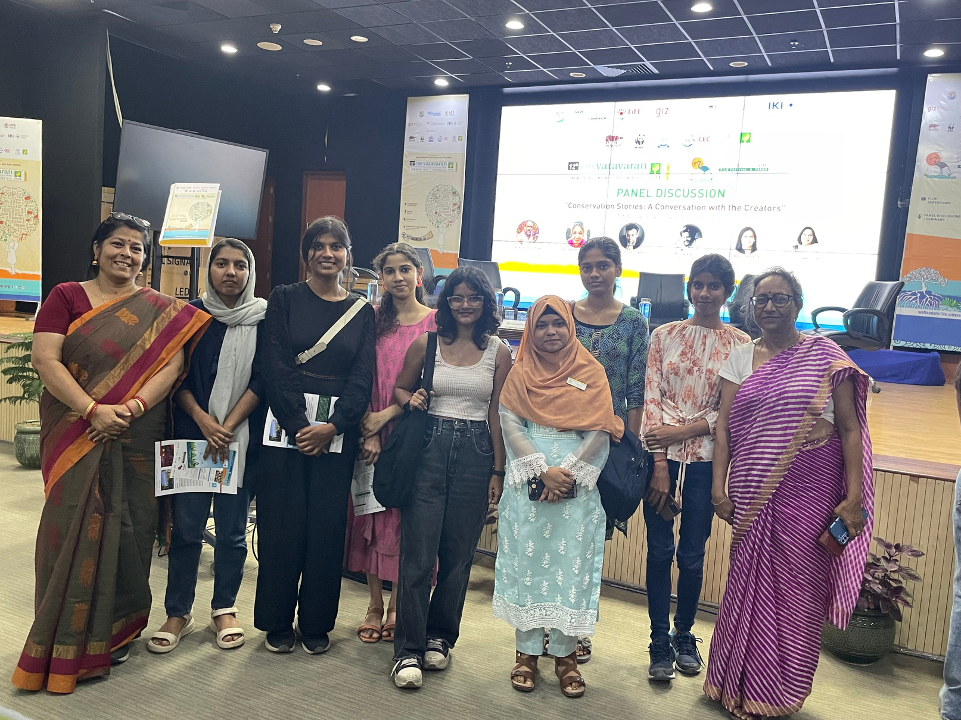
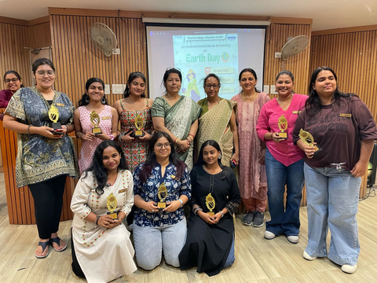




THANK YOU
Dr Priyambada Patri
+9868604256
priyambada.patri@bharati.du.ac.in
23

Slide 24
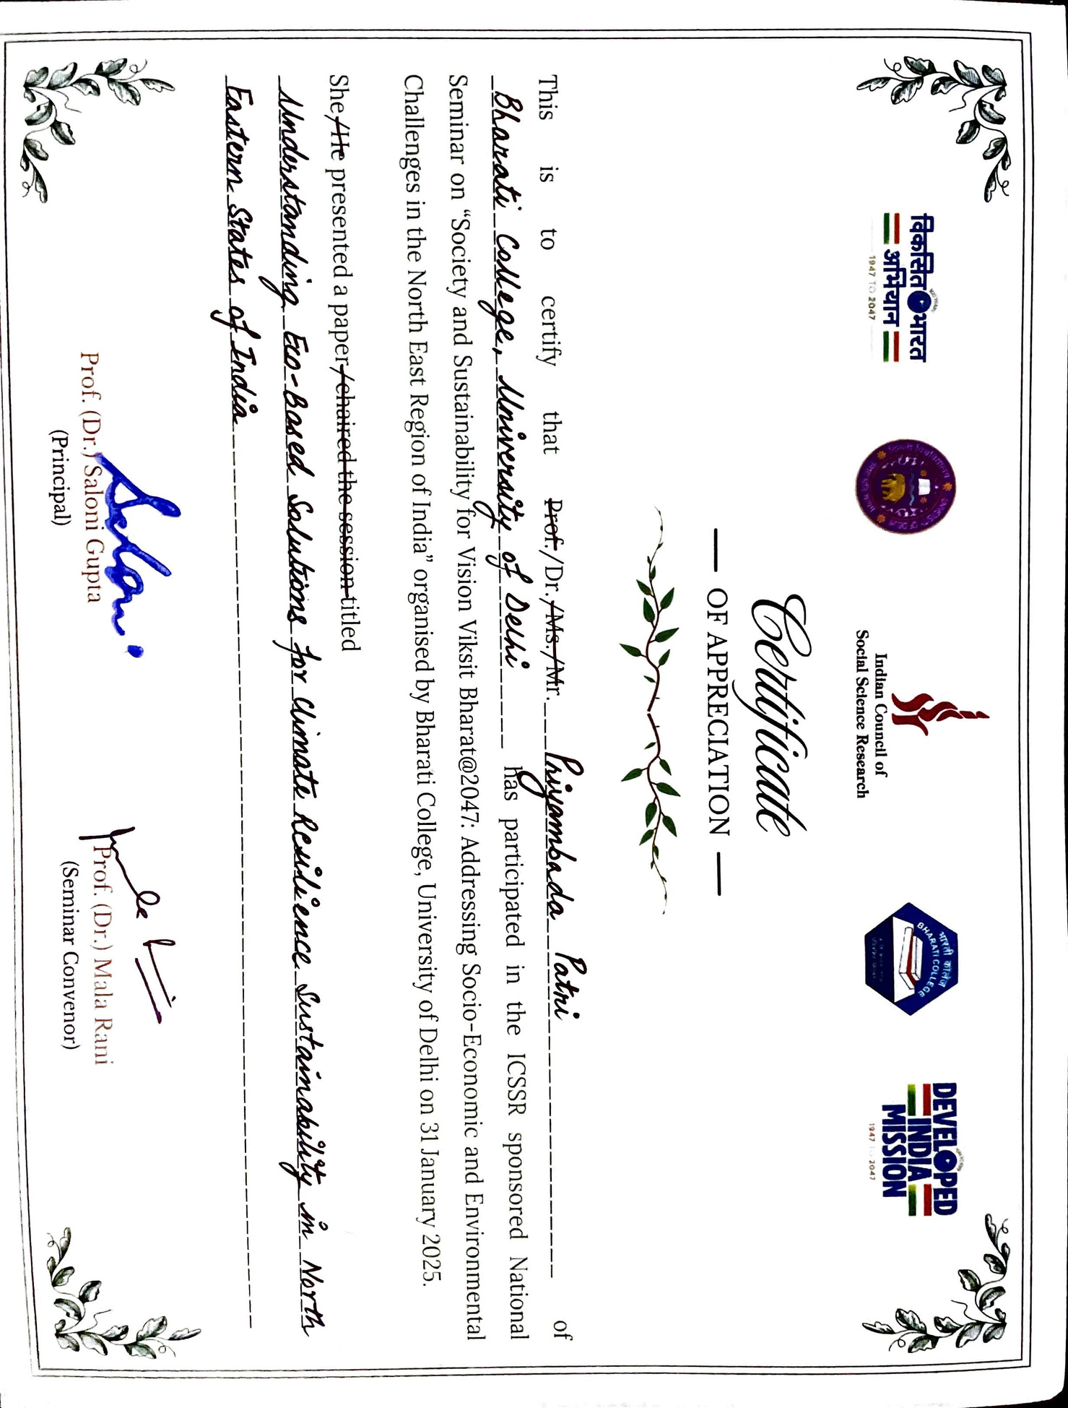
l
ft
Fc1
la
..... (1w,-,n::~.a
cl,
□
_ -~1. .. q1-,_
,,
.•
_.c:a.__
.
'
1U7
,lJ047
Ind.tan Council of
190
1041
Social Science Research
~~-
OF APPRECIATION -
,,------~
.
IS
to
certify
that
PreJf:-/Dr.f~4s. 'Mr
----------
of
This
U
-~j)~_ •_ __
uJNJ~IAM--~~~--/'Jfti _
_8~-WL~~~='""
- ---
---
--
participated in the ICSSR sponsored National
Seminar on "Society and Sustainability <for Vision Viksit Bharat@2047: Addressing Socio-Economic and Environmental
Challenges in the North East Region of India" organised by Bharati College, University of Delhi on 31 January 2025.
She~ presented a paper1ehaired the s@~~ion titled
7
~~o~-~~Yj-~--~
~•~~iq.._/io,_.,.
81J4
fUl.~fy
l:t,.4tM1,_b/MLi_-1~------------------------------------------------------
•
~
Prof. (Dr.fSalorii Gupta
(Principal)
rof. (Dr.)
Mat-1 Rani
(Seminar Convenor)
24
---------

Slide 25







www.cmsindia.org
Certificate of Participation
This certifies that
Dr Priyambada Patri
Bharati College, University of Delhi
........................................................................................................................................................................................
Has actively participated in the online programme on
“Green Skills & Gender Equity in Conservation: Bridging Knowledge Gaps”
Organized by
CMS VATAVARAN
in collaboration with the
.
March 06, 2025
IUCN CEC South & Southeast Asia
Held on
, this expert-led session explored women’s roles
in conservation, digital education gaps, and green skills.
We value the participant’s engagement in this discussion.
Ms Vasanti Rao, Phd
Director General, CMS & Co-Chair, IUCN CEC,
South & Southeast Asia
25

Slide 26
26

