Slide 1

Department of Commerce
Academic Report 2023-2025

Slide 2

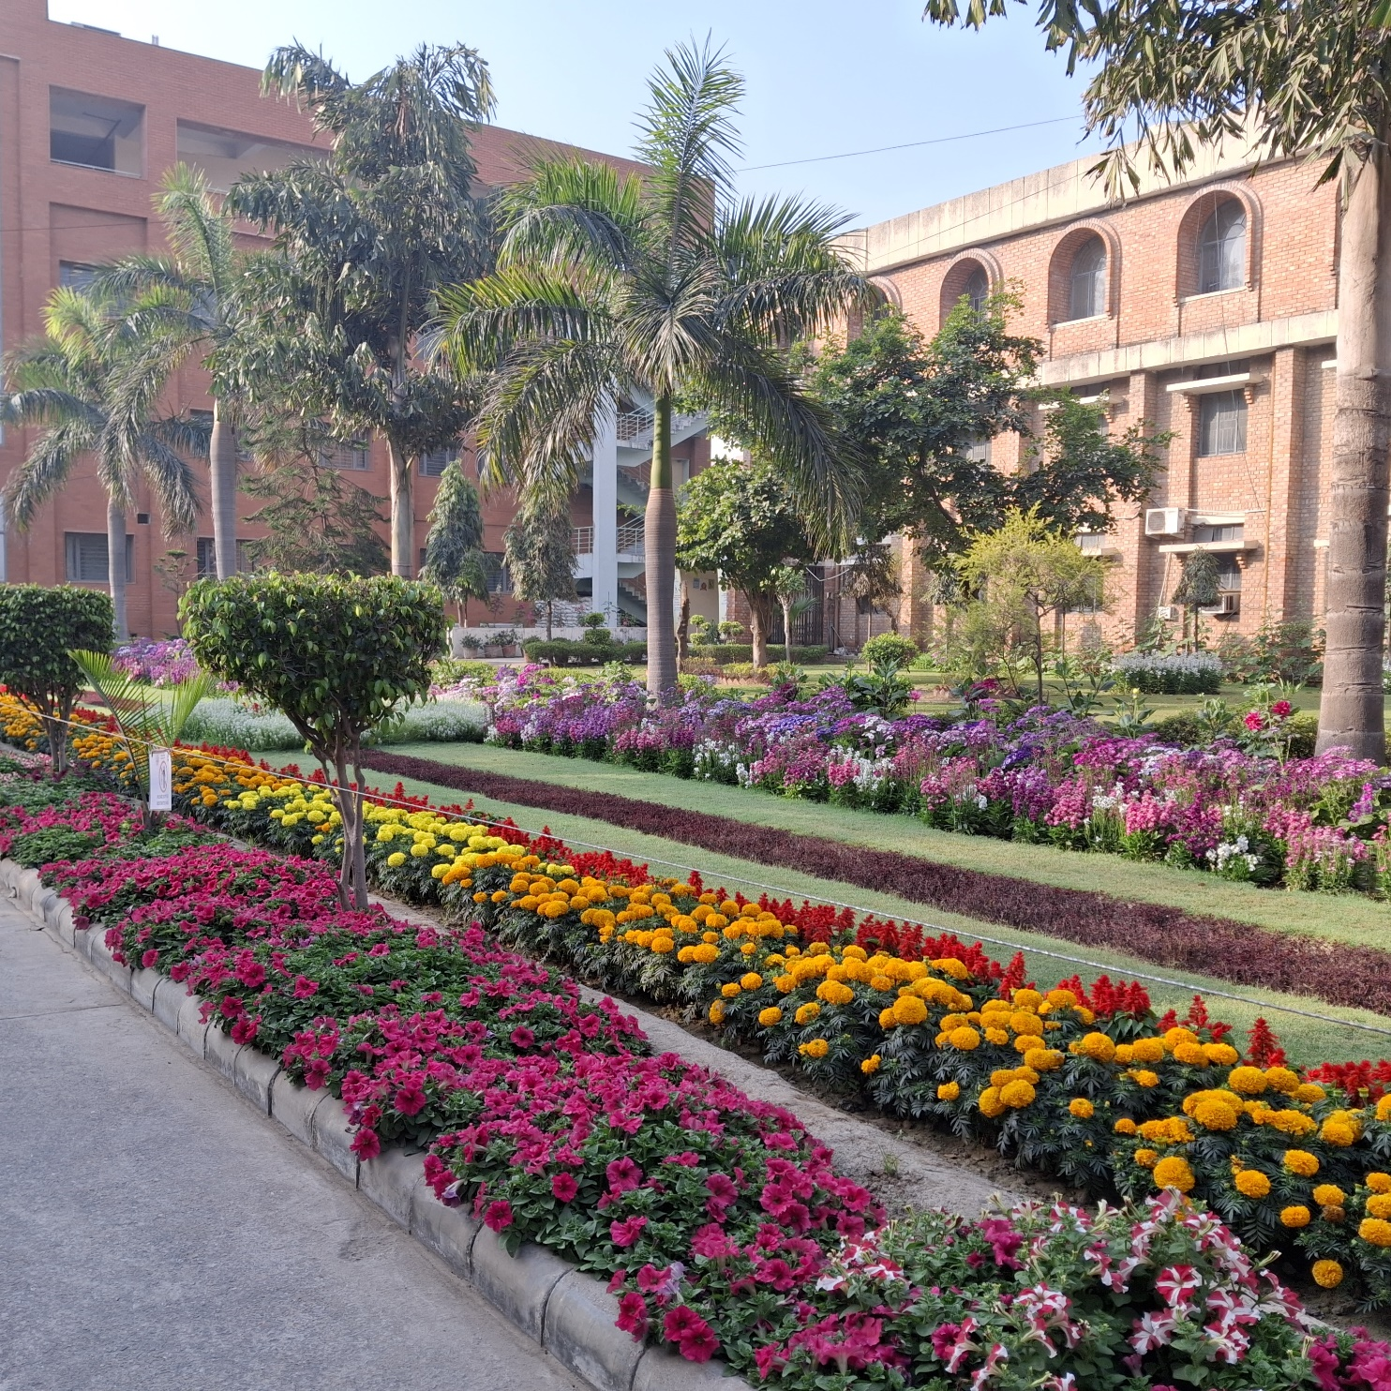
Vision of the Department
To be an institute of academic excellence with total commitment to quality education in Commerce, Management and related fields, with a holistic concern for a better life, environment and society.

Slide 3

Faculty Details
We are a team of 31 people having experience in different domains such as Finance, HRM, Marketing, Law, IB, Taxation, Advertising, Banking, Ethics etc.
Professors
Assistant Prof.
6
Associate Prof.
16
9
Prof. Saloni Gupta
Prof. Anupama Mahajan
Prof. Mala Rani
Prof. Rajni
Prof. Kamini Bhutani
Prof. Harikishni
Ms. Uma Grover
Dr. Poonam
Ms. Himanshu Garg
Dr. Vandana Bansal
Dr. Nishtha Bhushan
Ms. Monika Arya
Dr. Roopa Johri
Dr. Sonia Kaushik
Dr. Kalpana Kataria
Ms. Seema Kwatra
Dr. Arshi Zareen
Ms. Chitrangda
Dr. Arif Hussain Haidary
Dr. Divya Sharma
Dr. Sonali Jain
Ms. Alka Devi
Dr. Sakshi Mittal
Ms. Sunita
Dr. Monica Shokeen
Ms. Deepika Dewan
Dr. Shilpi Sahi
Ms. Swati Khanna
Ms. Laxmi Devi
Mr. Alok Aanand
Mr. Anil Kumar

Slide 4





Publications
Our faculty members have published various research articles in journals of repute with topics ranging from Ethics, Finance to Sustainability
Till Date
32
56
44
165
Scopus
UGC Care
Springer, ABDC & Others
Peer Reviewed
2023-24
5
4
27
-
2024-25
1
6
6
-

Slide 5



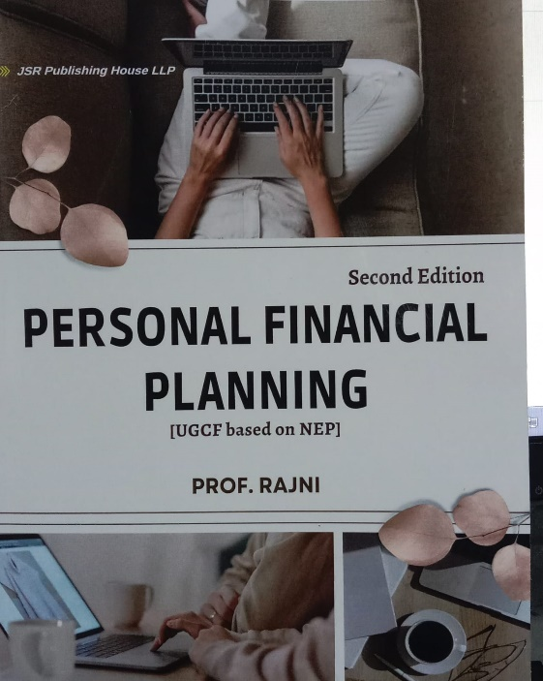
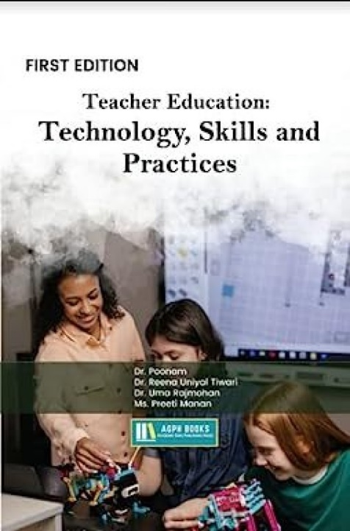


E-content & Books
30
40+
50+
10+
Till date
E-PG-Pathshala Modules
Youtube
Lectures
E-learning Modules
Modules on ILLL Website
Till date
38
44
1
6
Edited Chapters
Books
Patents
Research Papers in Books

Slide 6
Research Projects & Other Achievements
Name of Faculty | Title | Funding Agency | Funding Received
Prof. Mala Rani | Training for IKS Master Trainer | All expenses paid by UGC | TA & Accommodation for three level training in Delhi, Bhopal & Varanasi
Prof. Mala Rani | Traditional Food Crops & Minor Grain Crops in Indigenous Communities: Pathways to Socio-economic Prosperity through Sustainable Development in North-East Region of India | ICSSR | Rs. 10,00,000
Dr. Sonia Kaushik | Lack of Awareness and Other Dissonance Behind the Low Uptake of The New Income Tax Regime in India | ICSSR | Rs. 2,00,000
Prof. Mala Rani | Society & Sustainability for Vision Viksit Bharat @ 2047: Addressing Socio-Economic & Environmental Challanges in the North East Region of India | ICSSR | Rs. 1,00,000

Slide 7
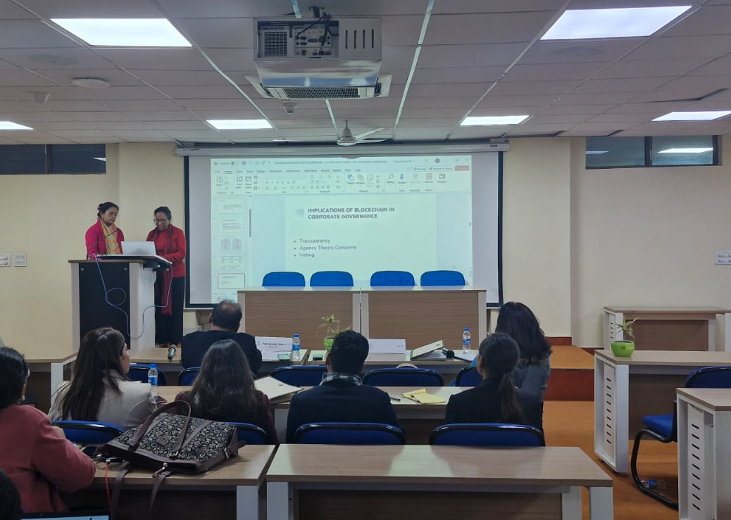
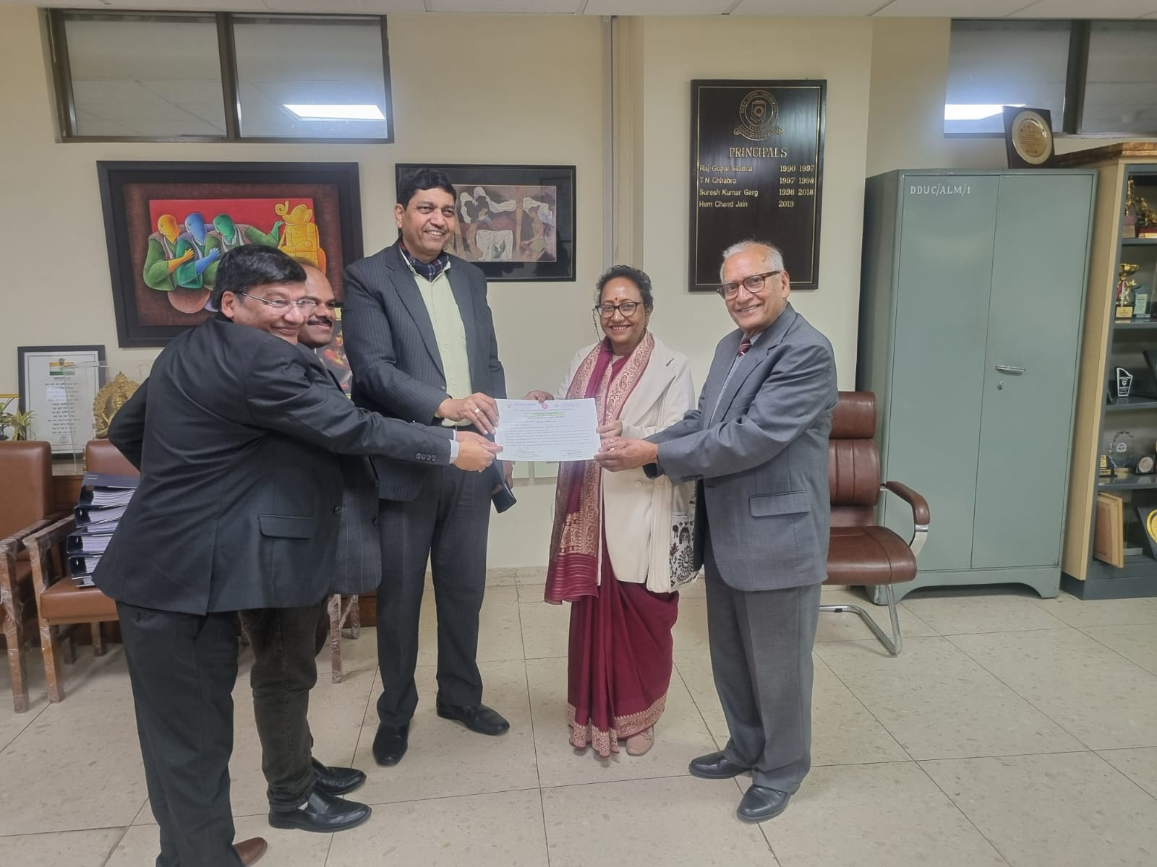
Best Paper Awards
Name of Faculty | Paper Title | Institution/Organization
Dr. Shilpi Sahi & Dr Roopa Johri | Blockchain Beyond Cryptocurrencies – A Study on its Impact on Corporate Governance Practices | X International Conference by Department of Commerce, Delhi School of Economics in collaboration with DDU college, University of Delhi
Dr. Shilpi Sahi | Developing Indigenous Cybersecurity Solutions & Reducing Reliance on Foreign Technologies | XXV Annual International Conference of DSPSR (IP University) in collaboration with DDU and Trinity University of Asia, Philippines
H-Index
Name of Faculty | H-Index
Prof. Saloni Gupta | 1(Scopus), 3(Google Scholar)
Prof. Mala Rani | 2
Prof. Anupama | 2
Prof. Rajni | 2
Dr. Nishtha Bhushan | 1
Prof. Harikishni | 3
Dr. Sonia Kaushik | 1
Dr. Kalpana Kataria | 2
Dr. Arshi Zareen | 2
Dr. Shilpi Sahi | 2
Dr. Arif Hussain Haidary | 1

Slide 8
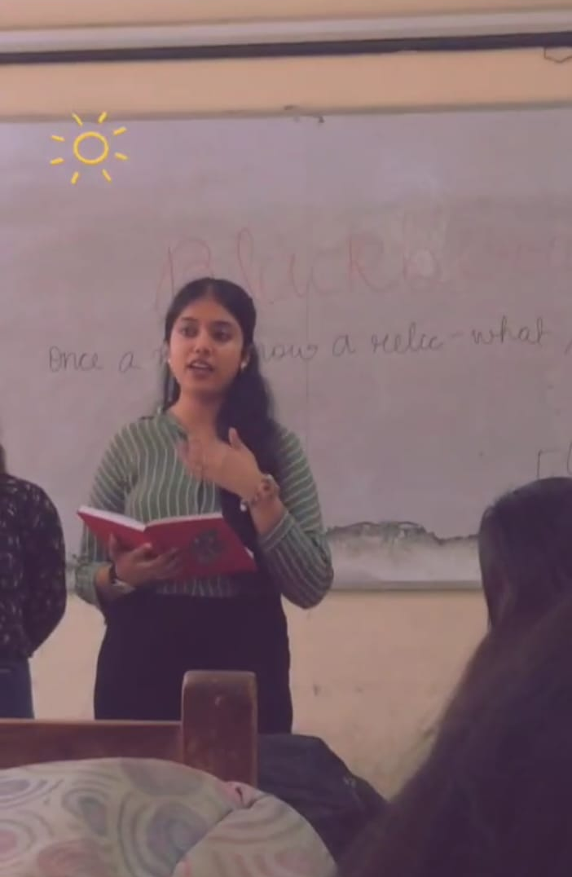
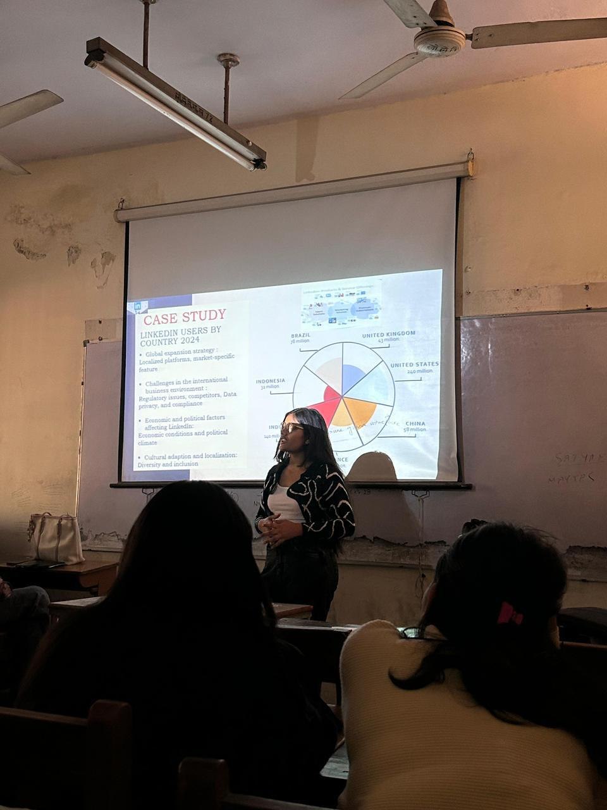

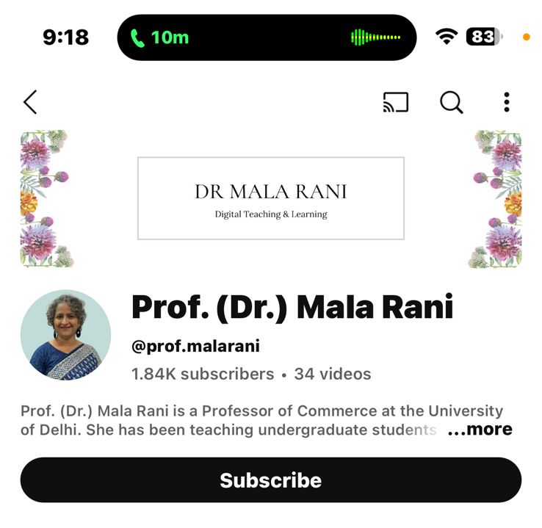
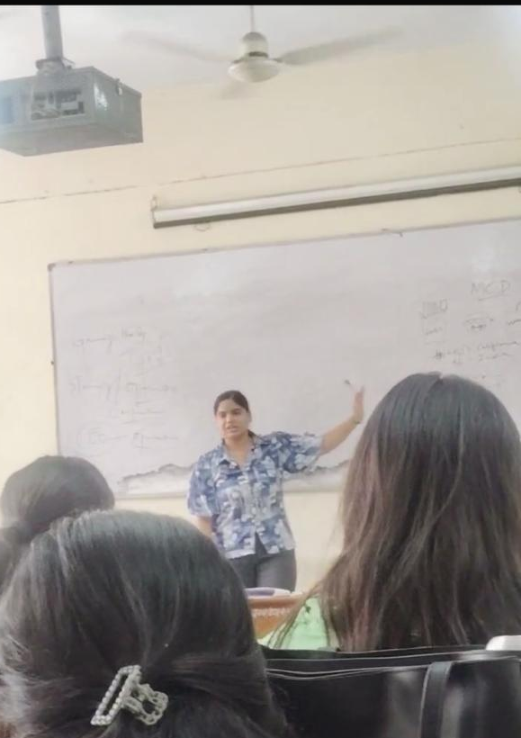
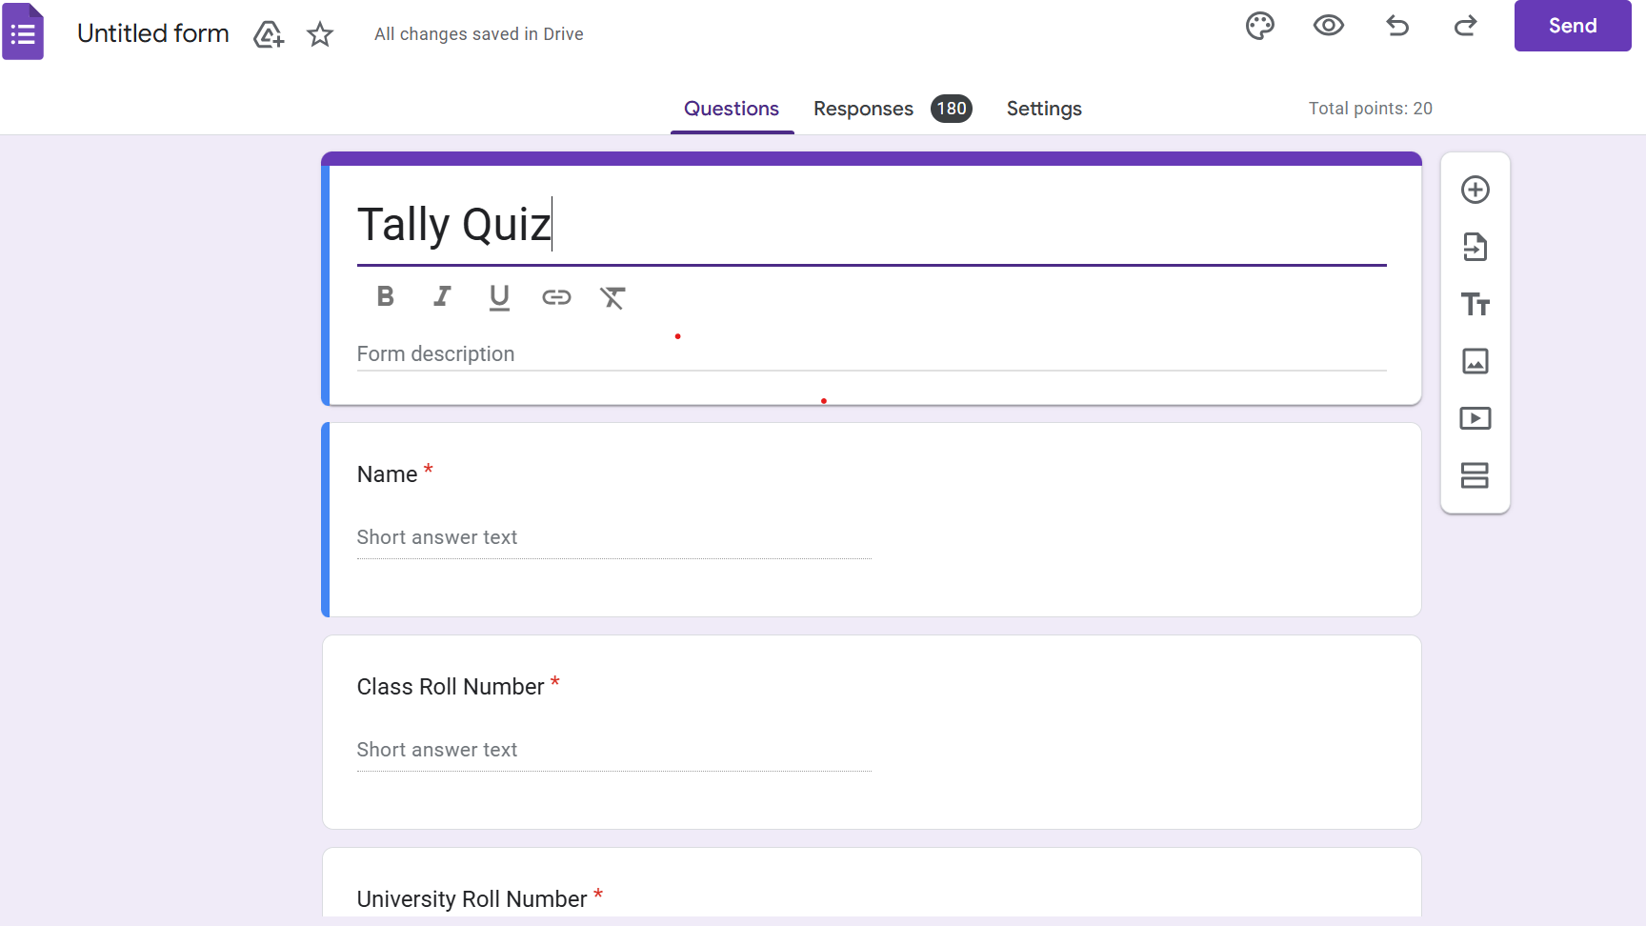
Teaching Pedagogy
Quiz on Google Forms
You Tube Channel
Case Study
Role Play
Presentations by students
Discussion on news Update
Debates
Flipped Classroom
Discussing topic related movies
Solving Unsolved numerical questions
Peer group discussions for solving similar problems/Questions
Sharing Advanced Study materials and Question Bank
Discussion on various policy Implications

Slide 9













Tutorials Methodology
Quiz on google forms
PYQ papers
Practical Problems and Hints
Doubts resolution
Writing practice of descriptive ques.
Developing answer writing skills
Surprise tests
Open Book Tests
Debate
Flipped Classroom
Case Studies
Discussing topic related movies
Solving unsolved numerical questions in the lectures
Peer group discussion for solving similar questions
Connecting topics to real life
Encouraging students to watch Shark tank to promote entrepreneurship
Reflection and self-assessment

Slide 10

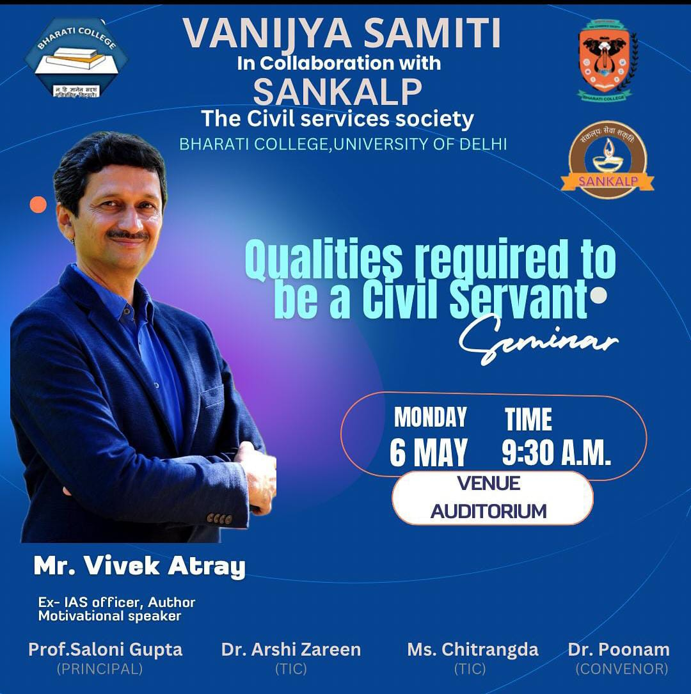
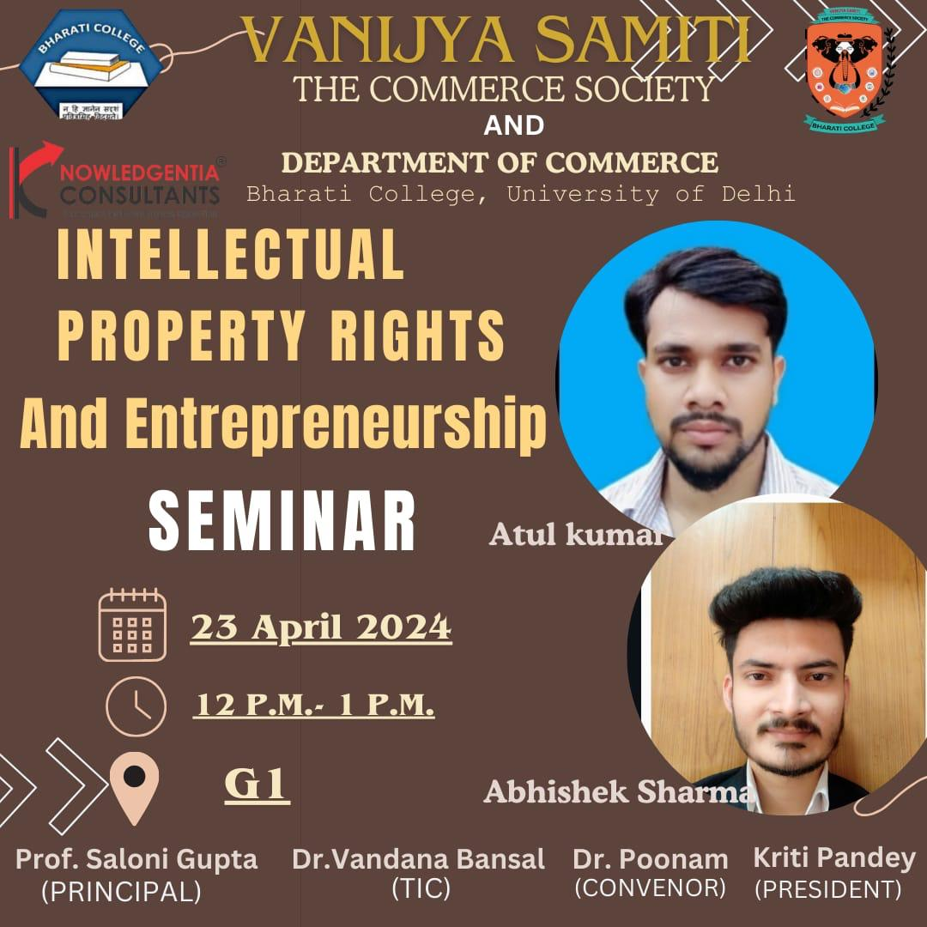
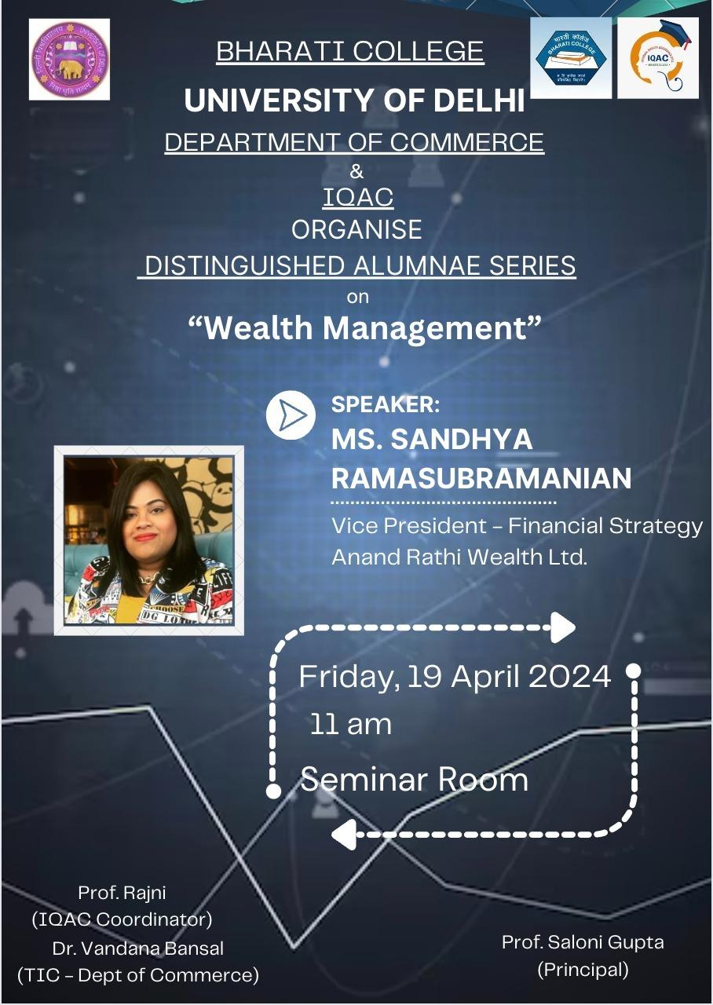



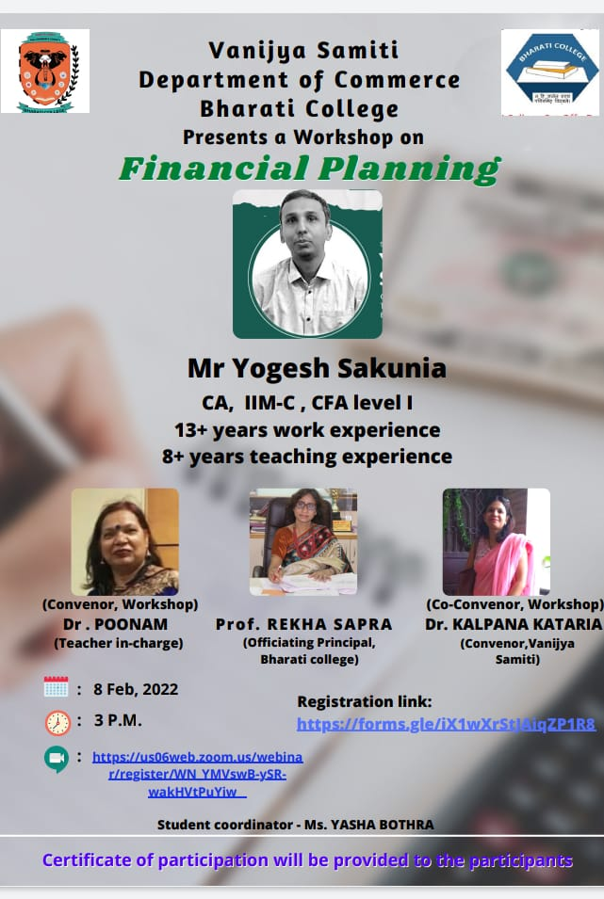
Seminars Year 2023-24
Qualities Required to be a Civil Servant
Intellectual Property Rights and Entrepreneurship
Overcoming the Glass-Ceiling Perspectives and Reality in Women led Corporates
Alumina Talk
International leadership summit
Department of Commerce has conducted over 15 seminars, workshops and webinars

Slide 11
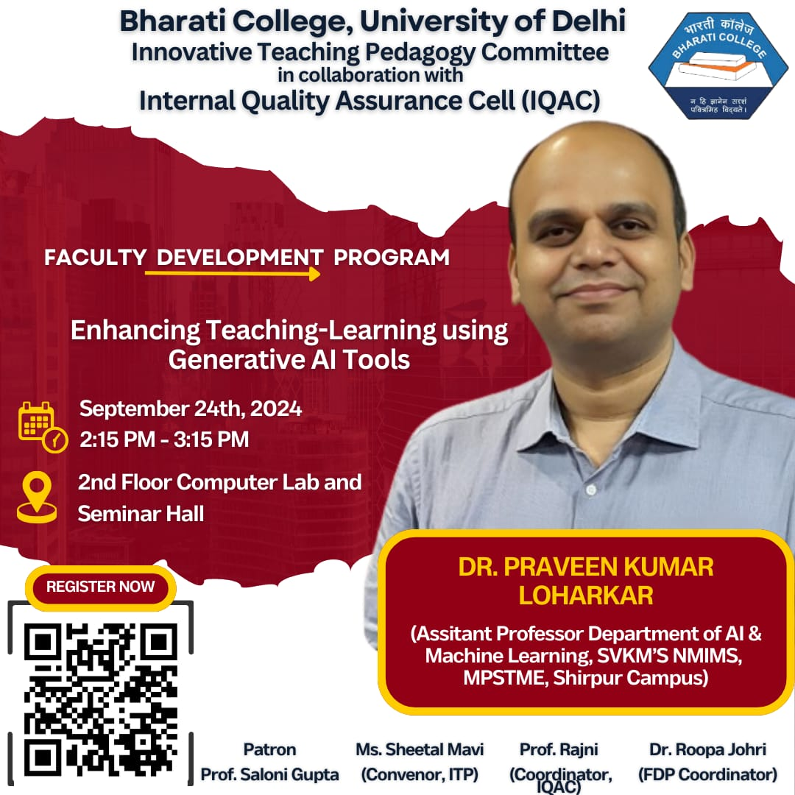
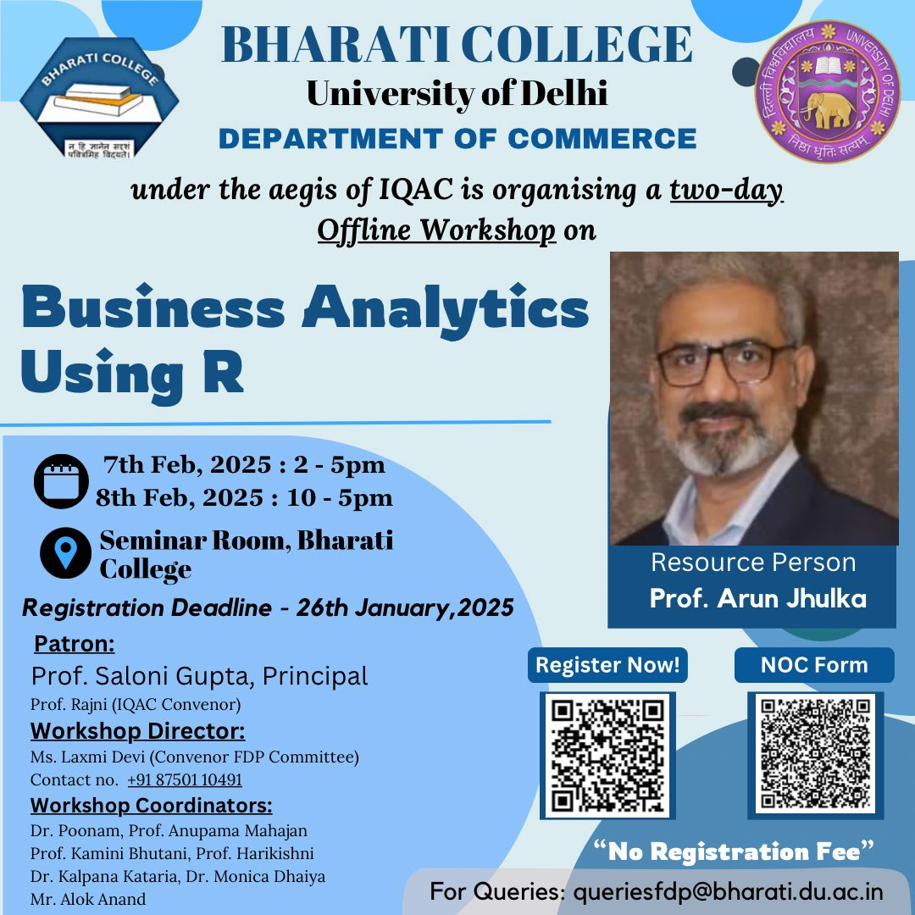
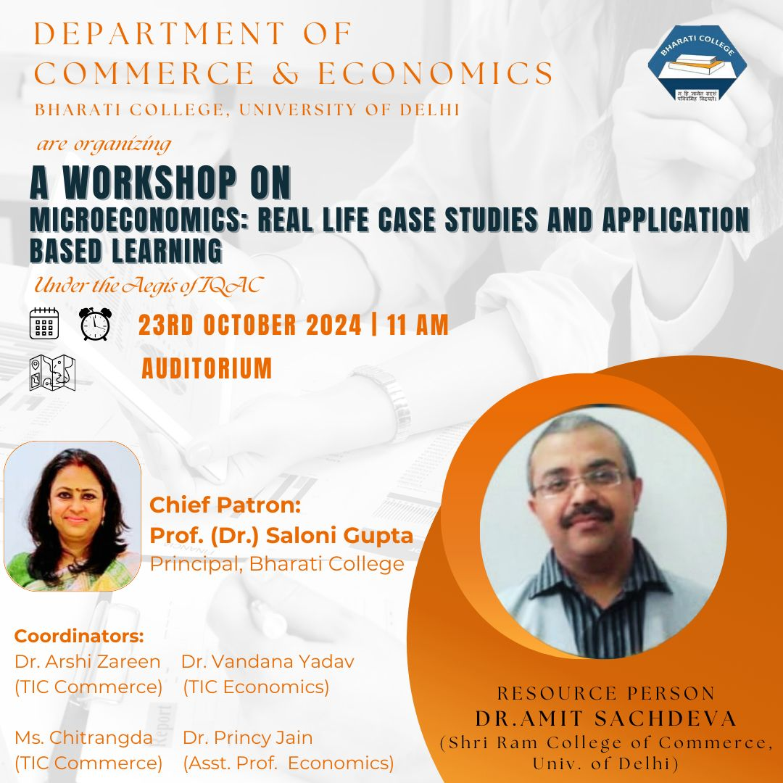
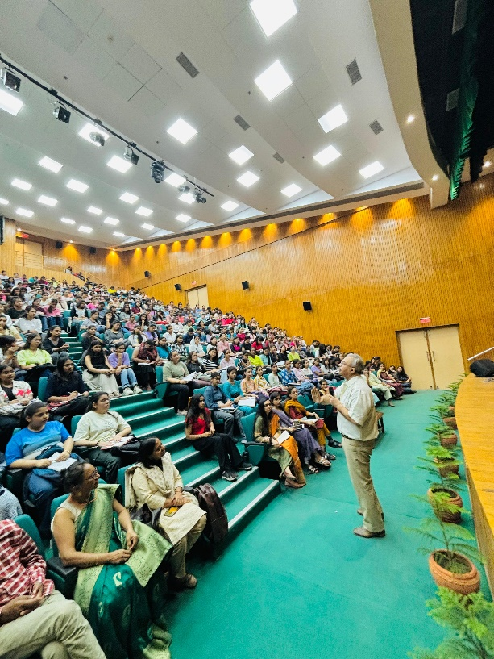


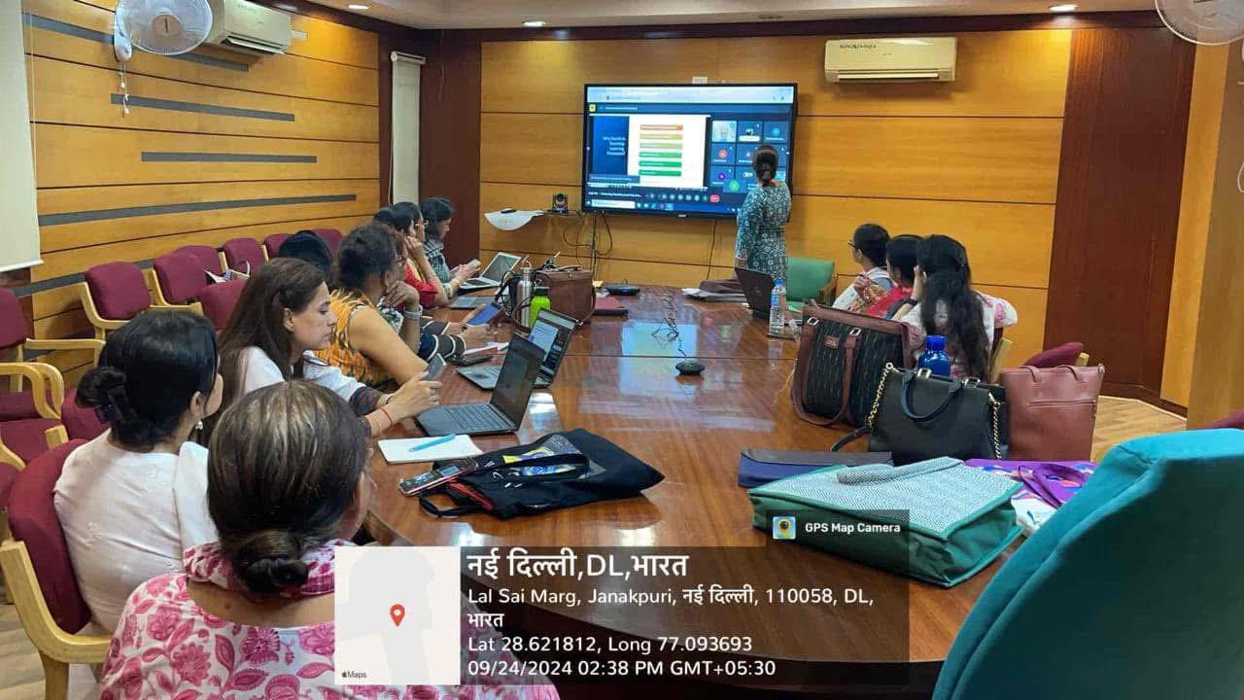
Seminars Year 2024-25
FDP on Enhancing Teaching Learning Using Generative AI Tools
Workshop on Micro Economics, Real Life Case Studies and Application Based Learning
Workshop on Business Analytics Using R
Leadership Summit 2.0
Alumina Talk
Commerce Fest Commercio
Department of Commerce has conducted over 17 seminars, workshops and webinars

Slide 12
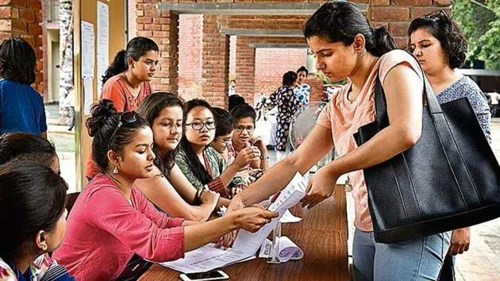
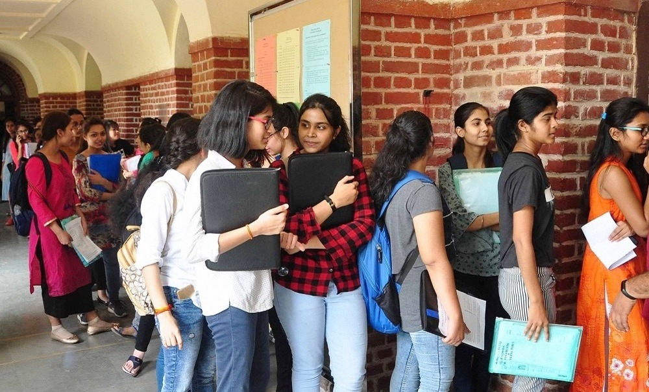
Sanctioned Strength and Admitted students
Program/ Course | Total Sanctioned Strength | Number of Students Admitted (2023-24) | Number of Students Admitted (2024-25)
B.Com | 192 | 177 | 167
B.Com(H) | 151 | 147 | 139
Student Demand
2023-24 |  |  | 2024-25
Program | Applied | Admitted | Applied | Admitted
B.Com | 399 | 177 | 448 | 167
B.Com (H) | 267 | 147 | 311 | 139
Overall Demand Ratio
2023-24 | 2024-25
194% | 221%

Slide 13
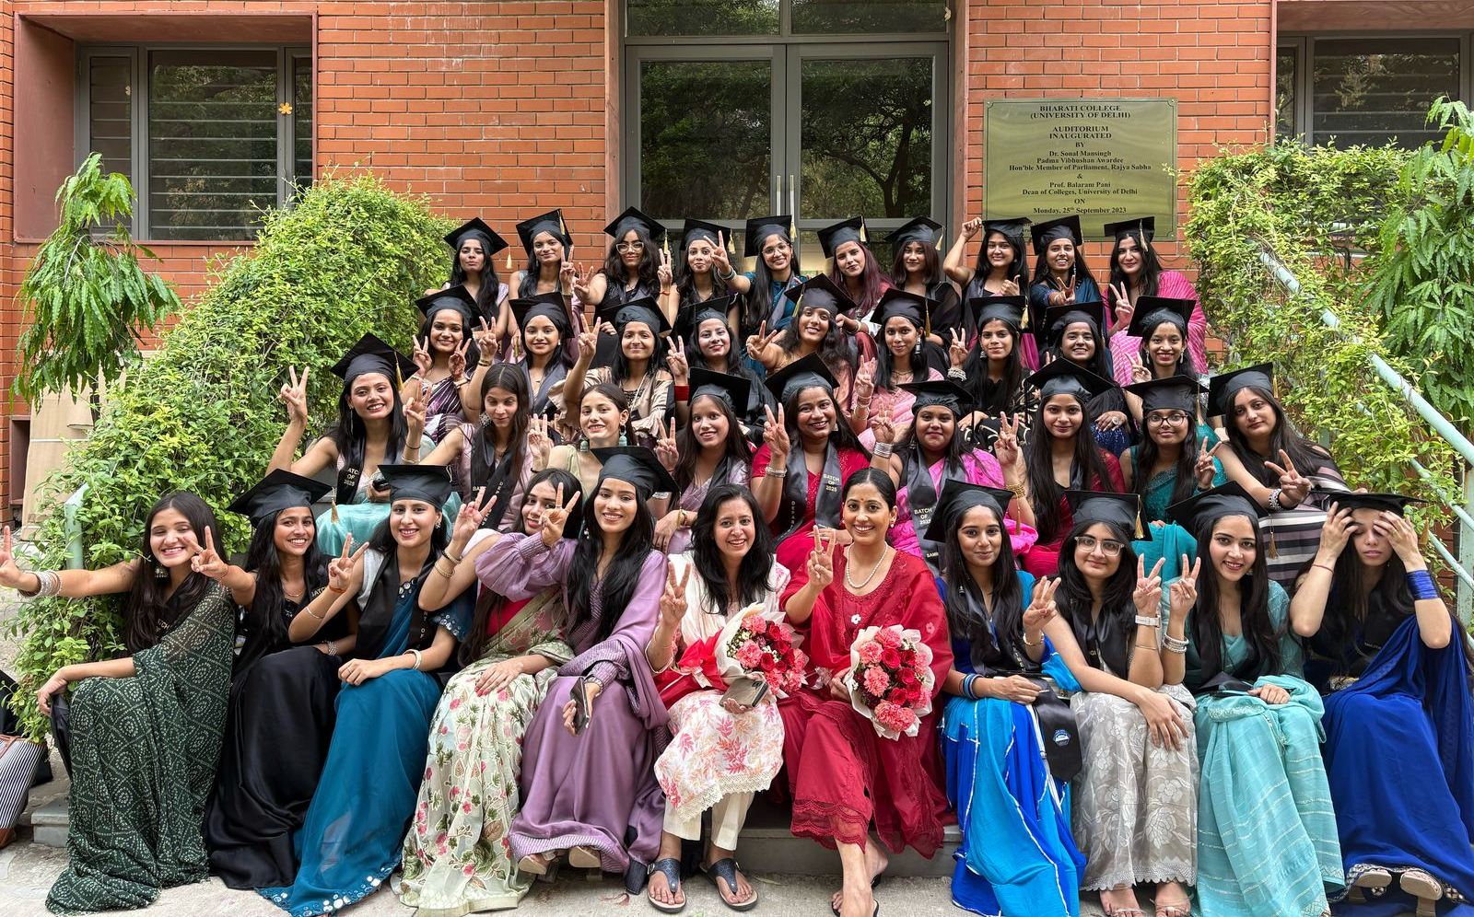
Results
Number of Students Graduated
Program | 2023-24
B.Com | 167
B.Com(H) | 100
Success Rate of Students
Program | 2023-24
B.Com | 90.76%
B.Com(H) | 91.74%
Program | CGPA (6.00-8.00) | CGPA (Above 8) | Average CGPA
B.Com | 95 | 3 | 6.908
B.Com(H) | 162 | 4 | 6.758
*Result is Awaited For 2024-25

Slide 14

Students Progression
Program | Students Pursuing Professional Courses (CA/CS/CMA/ACCA) | Budding Entrepreneurs
B.Com | 38 | 05
B.Com(H) | 24 | 01
* Many are preparing for entrance exams for Govt jobs & further higher studies

Slide 15

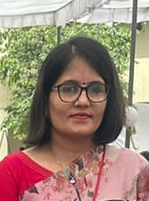
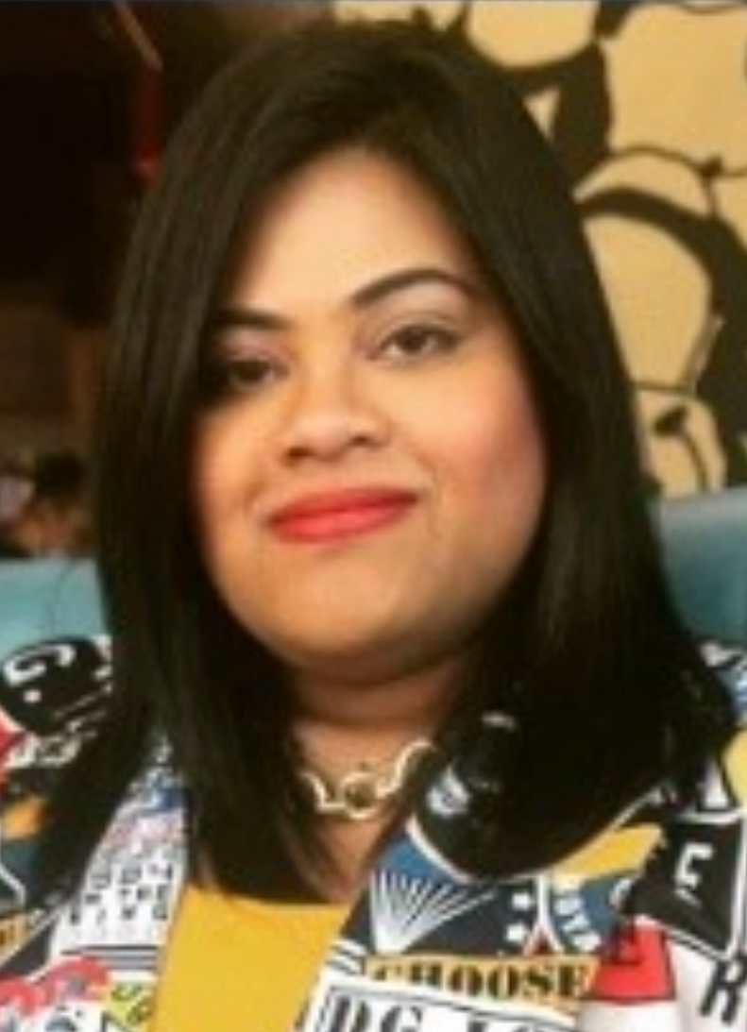
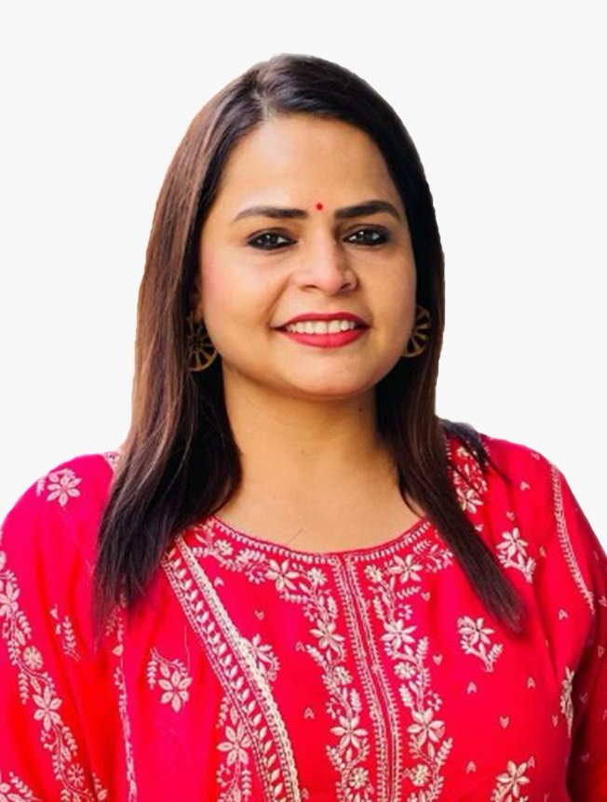
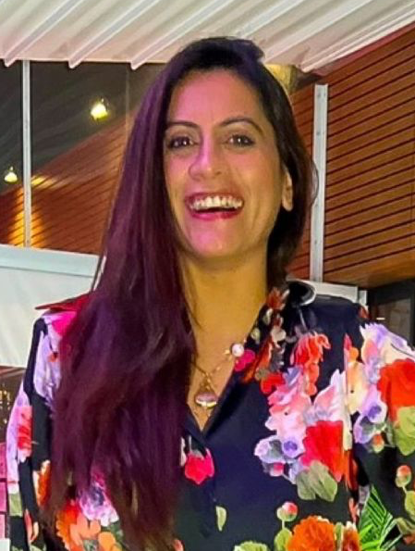
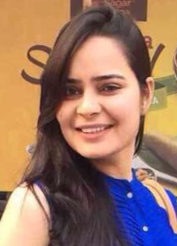






Notable Alumnae
Department of commerce has over 9000+ alumnus from different fields such as corporates, academics, politics, and even entrepreneurs
Sandhya
Ramasubramanian
Amrita
Dhawan
Swati
Arora
Tanu
Panwar
Ria
Malhotra
Dr. Sonia
Kaushik
Vice President @
Municipal Councillor @
Manager @
Asst. Vice President @
Entrepreneur @
Associate Prof. @

Slide 16
Other Distinguished Alumnae
S.No | Name | Designation
1 | Dr. Annu Aggarwal | Assistant Professor, University of Delhi
2 | Ms. Sunita | Assistant Professor, University of Delhi
3 | Ms. Shilpa | Assistant Professor, University of Delhi
4 | Ms. Laxmi Devi | Assistant Professor, University of Delhi
5 | Dr. Sarita Kadian | Assistant Professor, University of Delhi
6 | Ms. Deepika Dewan | Assistant Professor, University of Delhi
7 | Ms. Sweety Gupta | Assistant Professor, University of Delhi
8 | Ms. Bhoomi | Deputy Manager, ICICI Bank
9 | Ms. Lakshita Katyayan | Senior Financial Analyst, Silverskills Pvt. Ltd.
10 | Ms. Malvika Saxena | Assistant Vice President, Natwest Bank

Slide 17
Contd…
S.No | Name | Designation
11 | Ms. Shagun Sachdeva | Senior Executive- HR, OFB Tech Pvt. Ltd.
12 | Ms. Meenu Sharma | AO (Administrative Officer), British High Commission (Chanakyapuri)
13 | Ms. Mansi Singh | Probationary Officer, Baroda UP Gramin Bank
14 | Ms. Sheetal Sharma | Senior officer, DBS BANK INDIA LIMITED
15 | Ms. Nehal Bhardwaj | Social Media Influencer
16 | Ms. Shobha | Entrepreneur, Dhaaage – Hand Embroidery & Crochet Customized products
17. | Ms. Ritika | Market Research Analyst- Titan Biotech Ltd
18. | Ms. Meenakshi Sharma | NEP Executive, Automotive Skills Development Council
19. | Ms. Niyati Rustagi | Portfolio Manager ( Executive-Operations and research), Great Eastern Advisory Mart
20. | Ms. Yukta Sharma | Tax Consultant, Deloitte
21. | Ms. Kritika | English Language Assistant, Spanish Ministry of Education

Slide 18




SWOC Analysis
Strength
Weakness
Highly qualified, experienced & dedicated faculty.
Department has its own journal by the name of ARTHAVAAN.
A strong bond with a high level of interaction between the faculty and students.
Department contributes to overall development of college.
Good placement and student career progression in higher education
Active Mentor-Mentee Program
Lack of infrastructure like smart classrooms, and research facilities.
Non availability of workstations for faculty.
Lack of Industry exposure and academic trips due to limited time in semester system.
Opportunities
Challenges
Faculties need to keep updating themselves technologically with the rising AI tools that can be used.
Motivating students for good quality Research under NEP.
More Industry based exposure.
Availability of grants for research projects.
Organising More National & International Seminars.

Slide 19






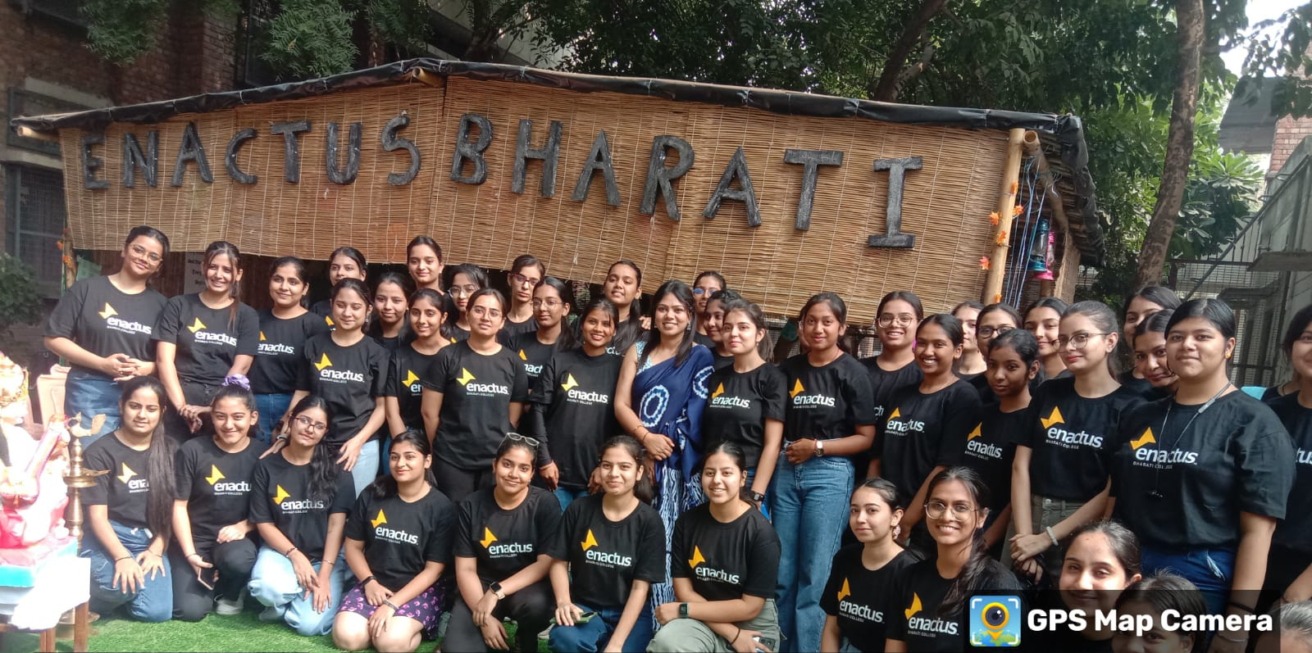
Way Forward
In order to fulfil its stated vision, mission and motto the department is committed to
Academic excellence
Professional Excellence
Total commitment
Holistic Development
Socially responsible Citizens
Value-based Development
We wish our students to become job givers rather than job seekers for this we have started with UPKRAM and Enactus Bharati, so that they develop entrepreneurial skills.

Slide 20
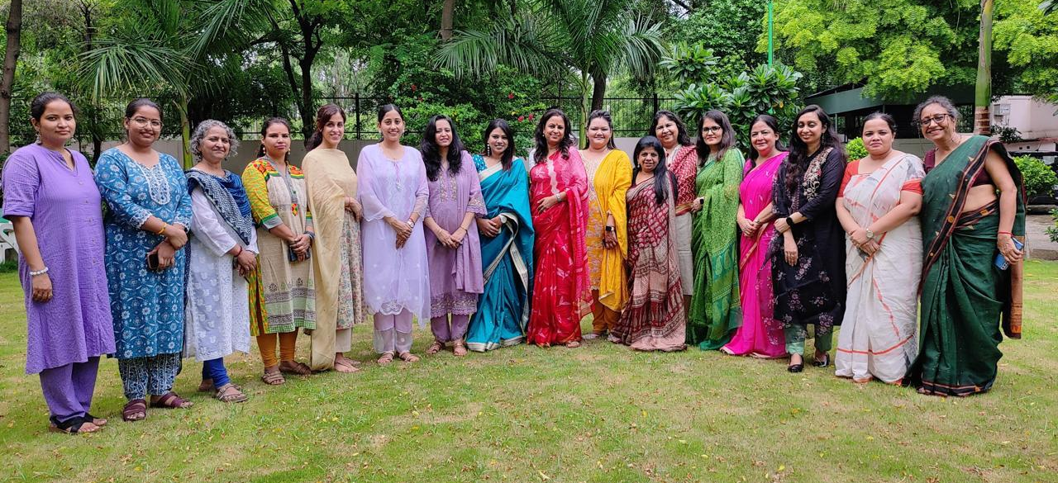
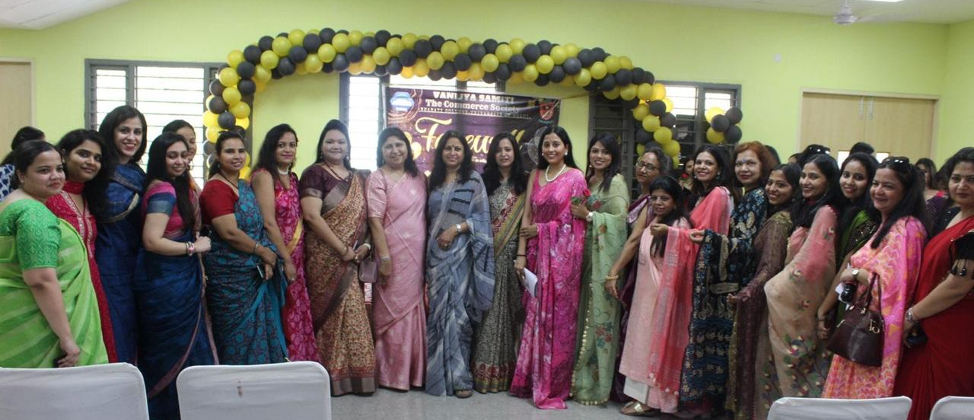
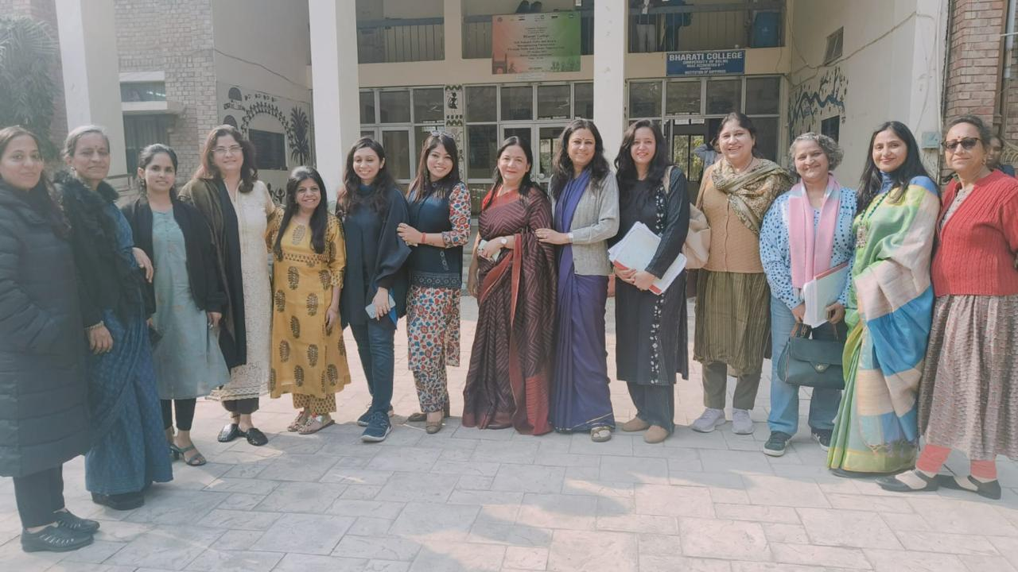
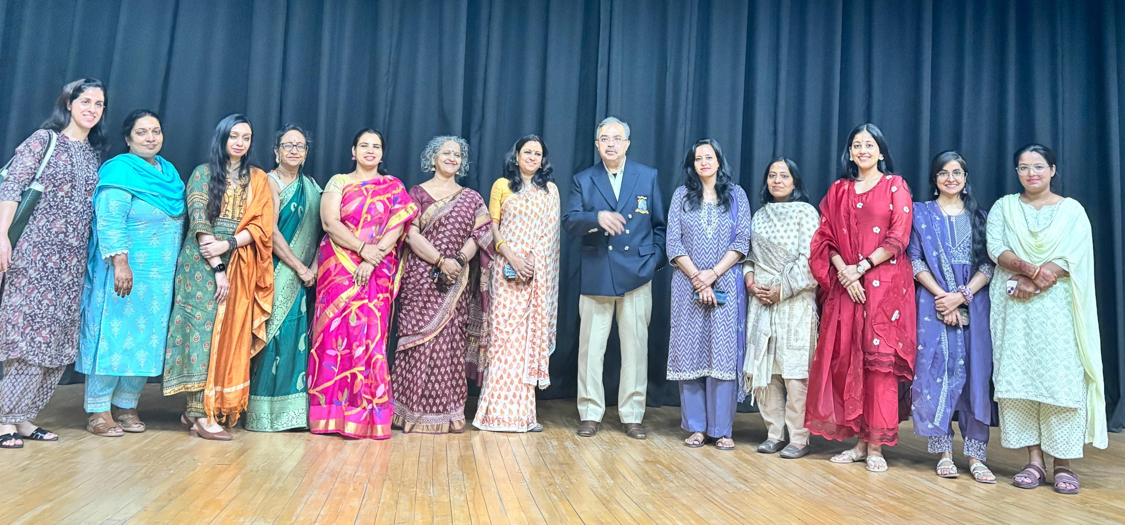
Thank You !!

