Slide 1
Portfolio Analysis and Financial Derivatives
UNIT-4

Slide 2
Portfolio risk &return
Portfolio construction
Financial derivatives
Mutual funds

Slide 3
Portfolio risk &return
Objective of portfolio construction
Maximization of return
Minimization of risk
Achieved through Diversification

Slide 4
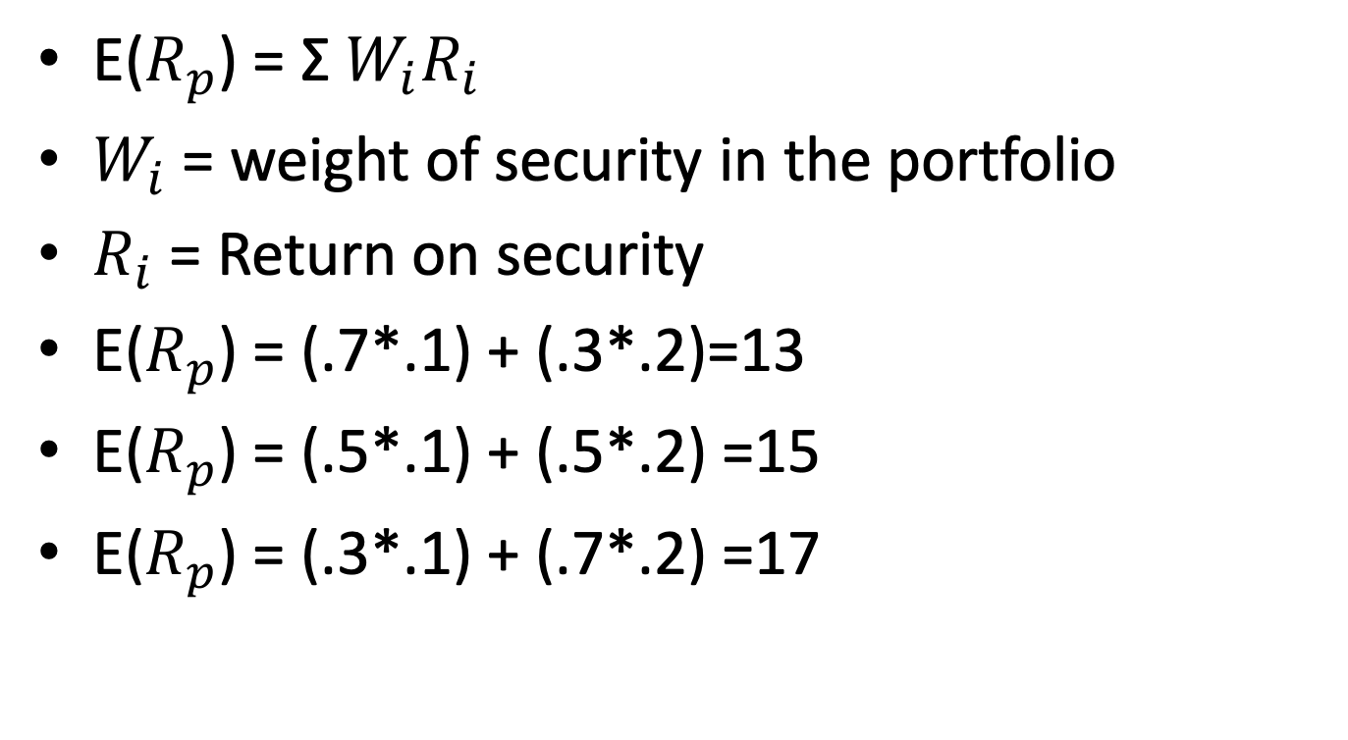
Portfolio return
E($R_{p}$) = Σ $W_{i}R_{i}$
$W_{i}$ = weight of security in the portfolio
$R_{i}$ = Return on security
E($R_{p}$) = (.7*.1) + (.3*.2)=13
E($R_{p}$) = (.5*.1) + (.5*.2) =15
E($R_{p}$) = (.3*.1) + (.7*.2) =17

Slide 5
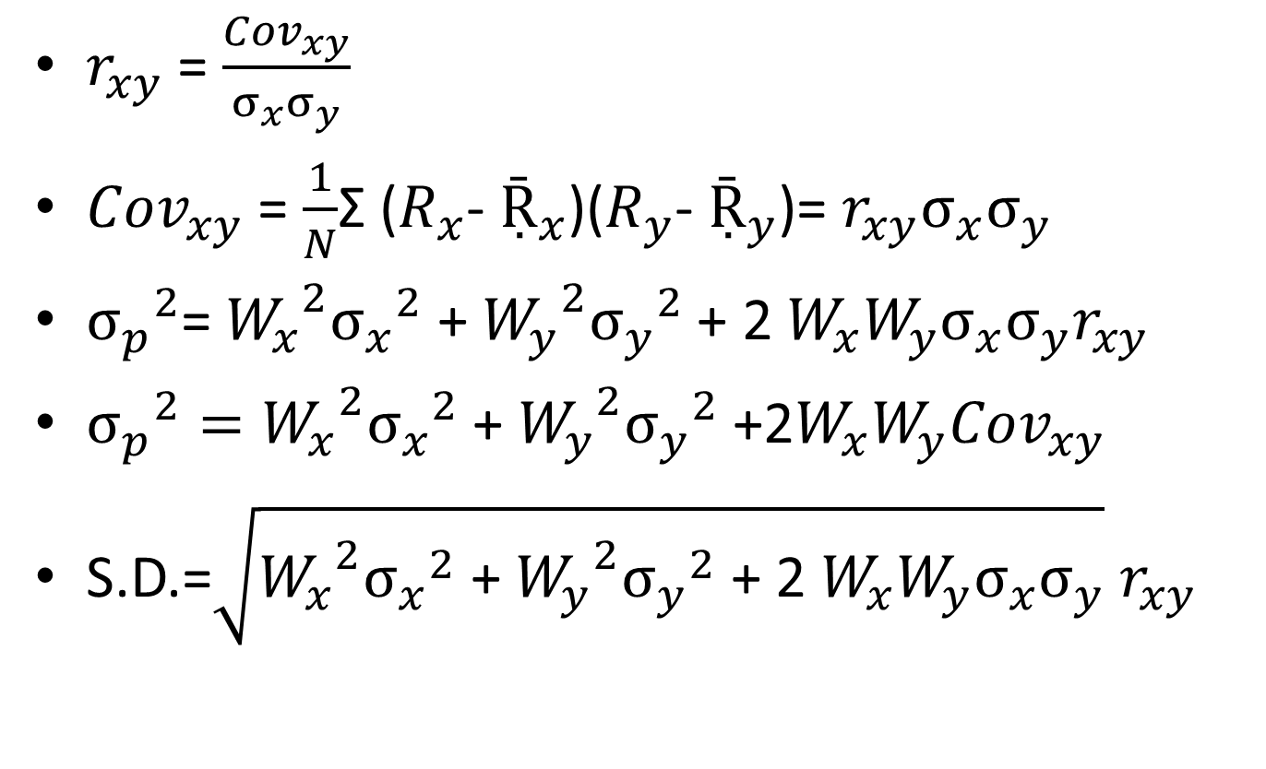
Portfolio Risk
$r_{xy}$ = $\frac{{Cov}_{xy}}{σ_{x}σ_{y}}$
${Cov}_{xy}$ = $\frac{1}{N}$Σ ($R_{x}$- $Ṝ_{x}$)($R_{y}$- $Ṝ_{y}$)= $r_{xy}σ_{x}σ_{y}$
${σ_{p}}^{2}$= ${W_{x}}^{2}{σ_{x}}^{2}$ + ${W_{y}}^{2}{σ_{y}}^{2}$ + 2 $W_{x}W_{y}σ_{x}σ_{y}r_{xy}$
${σ_{p}}^{2}={W_{x}}^{2}{σ_{x}}^{2}$ + ${W_{y}}^{2}{σ_{y}}^{2}$ +2$W_{x}W_{y}{Cov}_{xy}$
S.D.=$\sqrt{{W_{x}}^{2}{σ_{x}}^{2}\text{ + }{W_{y}}^{2}{σ_{y}}^{2}\text{ + 2 }W_{x}W_{y}σ_{x}σ_{y}}$ $r_{xy}$

Slide 6
Correlation=1,.5,0,-1.,-.5
securities | Return | Risk
A | 10 | 5
B | 20 | 12

Slide 7
weights | 70;30 | 50;50 | 30;70
Return | 13 | 15 | 17
Risk (r=1) | 7.1 | 8.5 | 9.9
Risk (r=0) | 5.02 | 6.5 | 8.5
Risk (r=-1) | .1 | 3.5 | 6.9
Risk (r=.5) | 6.15 | 7.5 | 9.24
Risk (r=-.5) | 3.5 | 5.2 | 7.76

Slide 8
A Portfolio is constructed by investing 70% of funds in Bajaj Auto ltd. and 30% in William Ltd. The following information regarding the two companies is given below:
Bajaj William
Expected return 20% 15%
Standard dev. 11% 8%
Compute the risk and return of above portfolio assuming:
(i) Correlation between two stocks is +1
(ii) Correlation between two stocks is 0
(iii) Correlation between two stocks is -1

Slide 9
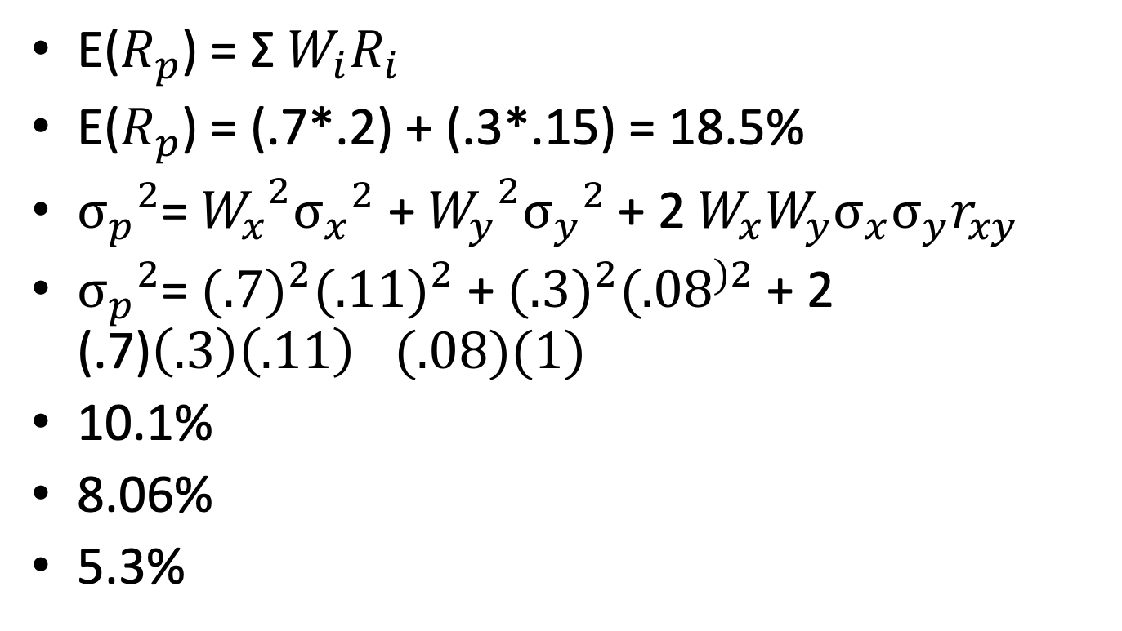
E($R_{p}$) = Σ $W_{i}R_{i}$
E($R_{p}$) = (.7*.2) + (.3*.15) = 18.5%
${σ_{p}}^{2}$= ${W_{x}}^{2}{σ_{x}}^{2}$ + ${W_{y}}^{2}{σ_{y}}^{2}$ + 2 $W_{x}W_{y}σ_{x}σ_{y}r_{xy}$
${σ_{p}}^{2}$= ${(.7)}^{2}{(.11)}^{2}$ + ${(.3)}^{2}{(.08}^{)2}$ + 2 (.7)$\left(.3\right){\left(.11\right)}_{}(.08)(1)$
10.1%
8.06%
5.3%

Slide 10
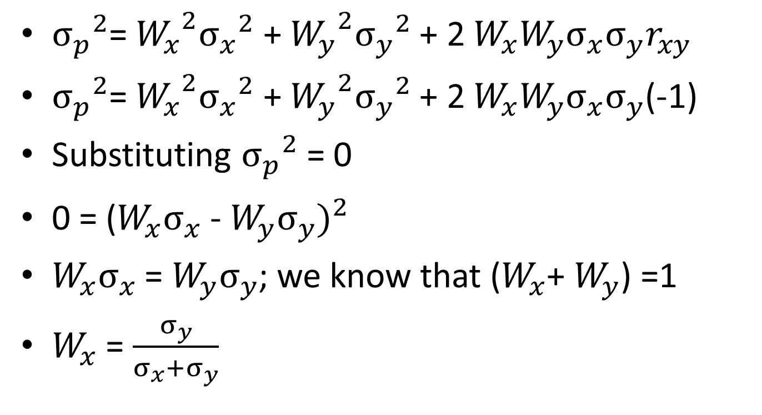
Weights with No risk
${σ_{p}}^{2}$= ${W_{x}}^{2}{σ_{x}}^{2}$ + ${W_{y}}^{2}{σ_{y}}^{2}$ + 2 $W_{x}W_{y}σ_{x}σ_{y}r_{xy}$
${σ_{p}}^{2}$= ${W_{x}}^{2}{σ_{x}}^{2}$ + ${W_{y}}^{2}{σ_{y}}^{2}$ + 2 $W_{x}W_{y}σ_{x}σ_{y}$(-1)
Substituting ${σ_{p}}^{2}$ = 0
0 = ${\text{(}W_{x}σ_{x}\text{ − }W_{y}σ_{y})}^{2}$
$W_{x}σ_{x}$ = $W_{y}σ_{y}$; we know that ($W_{x}$+ $W_{y}$) =1
$W_{x}$ = $\frac{σ_{y}}{σ_{x}+σ_{y}}$

Slide 11

$W_{x}$ = $\frac{σ_{y}}{σ_{x}+σ_{y}}$
$W_{x}$ = $\frac{.12}{.05+.12}$ =70%
$w_{Y}$ = $\frac{σ_{x}}{σ_{x}+σ_{y}}$ = 30%

Slide 12

OBE-2020
$W_{x}$ = $\frac{σ_{y}}{σ_{x}+σ_{y}}$
33.33%; 66.66%
.12 = .075(X) + .15( 1- X)

Slide 13
Portfolio construction
Traditional Approach
Modern Approach
Markowitz Approach
Capital Asset Pricing Model (CAPM)

Slide 14
Harry Markowitz Approach
(HM Model)
Assumptions:
The decision is based on expected return and risk
Investors prefer highest return for a given level of risk.
All investors have a common one-period investment horizon
All investors are risk averse. They will prefer lower risk for the same level of return.

Slide 15
Steps for optimal portfolio formation
Plot expected return and risk(S.D.) of each portfolio
XY Plane; x axis- risk; Y axis -return
Attainable or feasible portfolio
Find efficient portfolios and join them
Investor’s preference curve

Slide 16
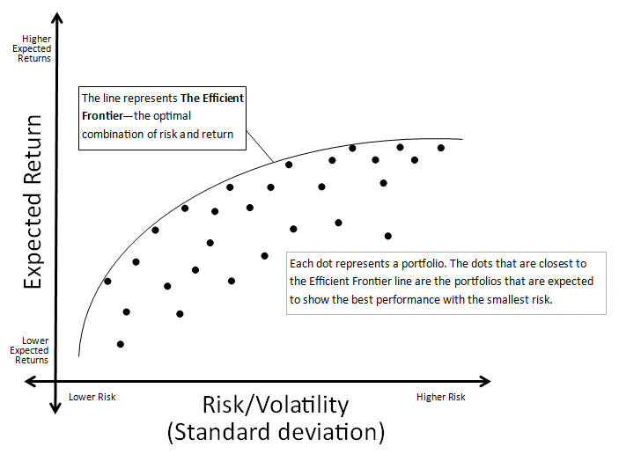
Step-1

Slide 17
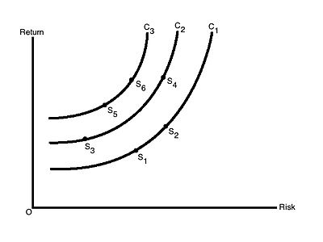
Step-2
Notes:
Convex : more than proportion; risk averser

Slide 18
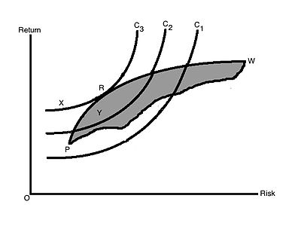
Step-3

Slide 19
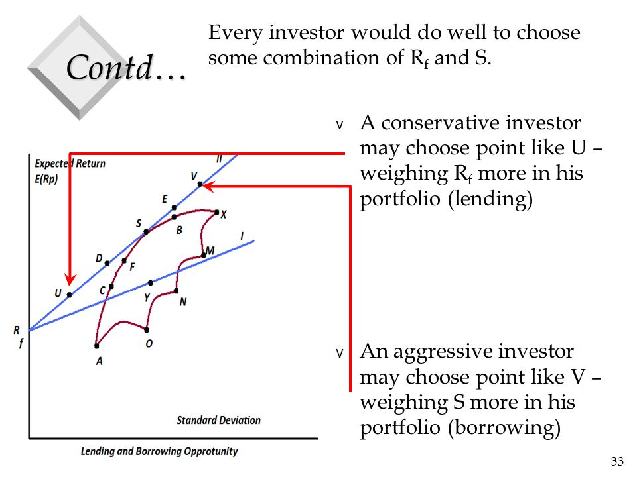
Introduction of risk free asset
(risk free borrowings and lendings)

Slide 20

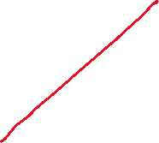
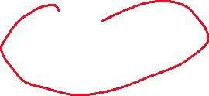



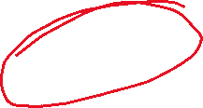

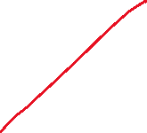
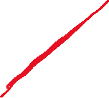

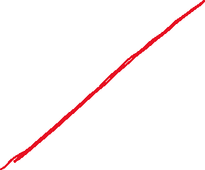


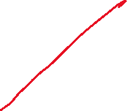

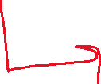

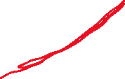
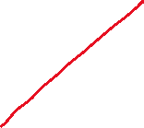

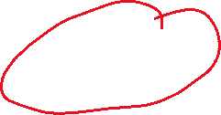
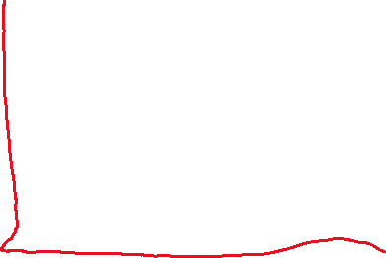
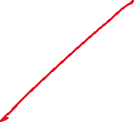
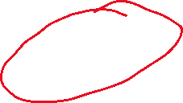
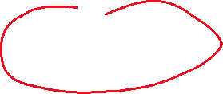

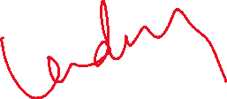
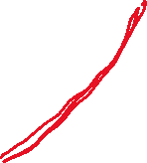
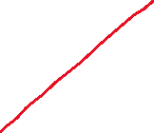
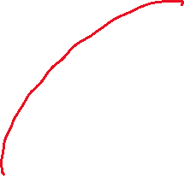






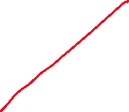








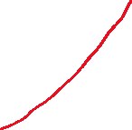

Slide 21


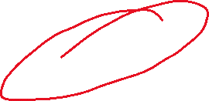

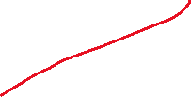

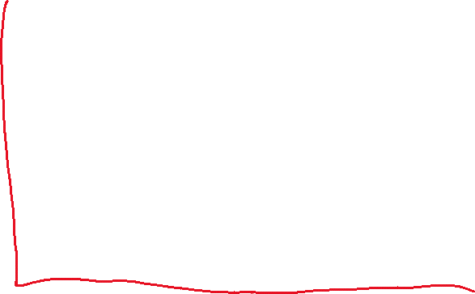





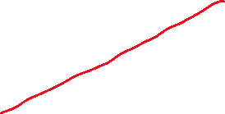


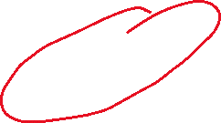

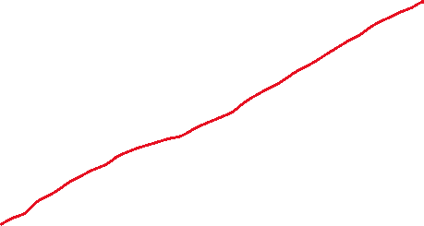
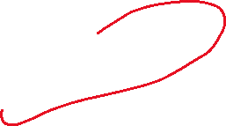


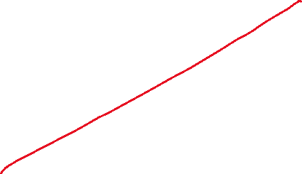
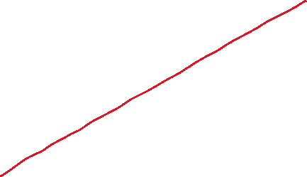



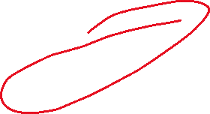
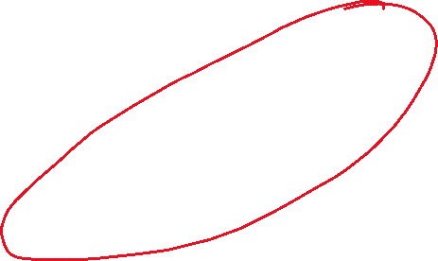
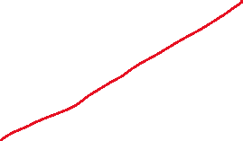


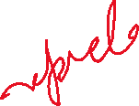
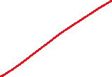
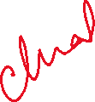

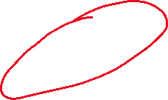


Slide 22












Slide 23



















Slide 24
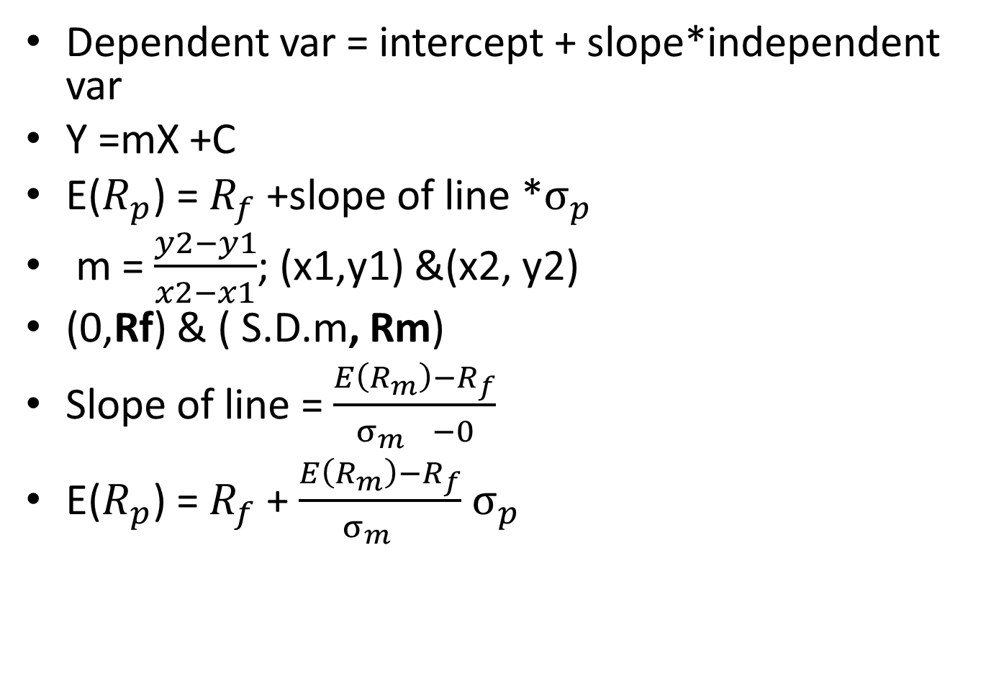
Capital Market Line(CML)
Dependent var = intercept + slope*independent var
Y =mX +C
E($R_{p}$) = $R_{f}$ +slope of line *$σ_{p}$
m = $\frac{y2−y1}{x2−x1}$; (x1,y1) &(x2, y2)
(0,Rf) & ( S.D.m, Rm)
Slope of line = $\frac{E\left(R_{m}\right)−R_{f}}{{σ_{m}}_{}−0}$
E($R_{p}$) = $R_{f}$ + $\frac{E\left(R_{m}\right)−R_{f}}{{σ_{m}}_{}}$ $σ_{p}$

Slide 25
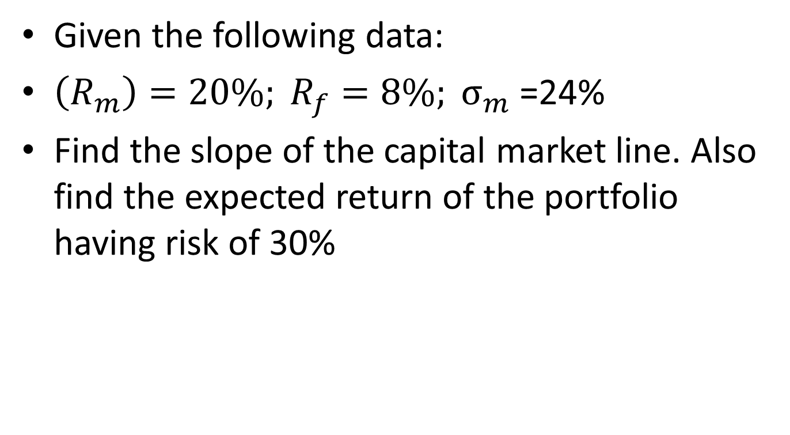
Given the following data:
$\left(R_{m}\right)=20\%; R_{f}=8\%; σ_{m}$ =24%
Find the slope of the capital market line. Also find the expected return of the portfolio having risk of 30%

Slide 26
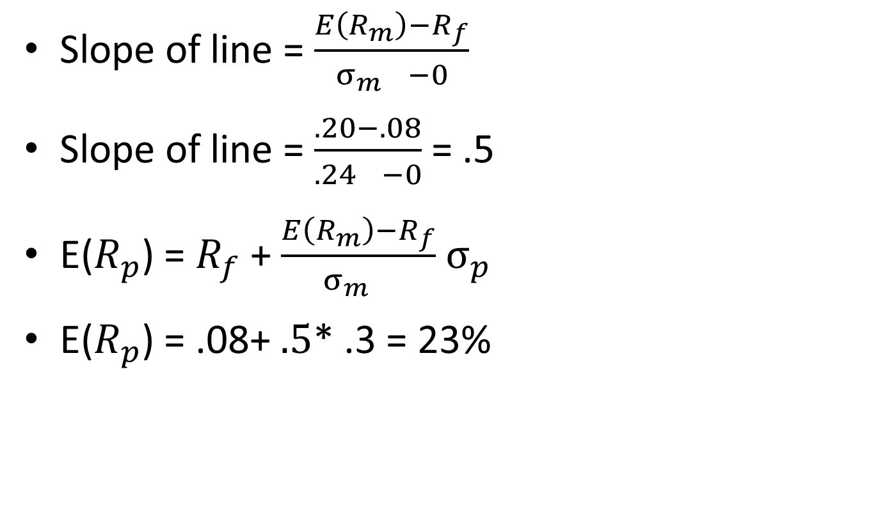
Solution
Slope of line = $\frac{E\left(R_{m}\right)−R_{f}}{{σ_{m}}_{}−0}$
Slope of line = $\frac{.20−.08}{{.24}_{}−0}$ = .5
E($R_{p}$) = $R_{f}$ + $\frac{E\left(R_{m}\right)−R_{f}}{{σ_{m}}_{}}$ $σ_{p}$
E($R_{p}$) = .08+ $.5$* .3 = 23%

Slide 27
Given the following data in respect of three portfolios
Portfolios | (observed)Return(%) | Risk(S.D.%) | Return as per CML
A | 26 | 30 | (Inefficient)
B | 29 | 18 | (efficient)
C | 19 | 16 | (inefficient)

Slide 28
The return on market Index =18% and the risk on market index =10%. If the risk free rate of return is 7%, find using capital market line which of the above portfolio are efficient and inefficient

Slide 29

Solution
E($R_{A}$) = $R_{f}$ + $\frac{E\left(R_{m}\right)−R_{f}}{{σ_{m}}_{}}$ $σ_{p}$ = 40%
E($R_{B}$) = $R_{f}$ + $\frac{E\left(R_{m}\right)−R_{f}}{{σ_{m}}_{}}$ $σ_{p}$= 26.8%
E($R_{C}$) = $R_{f}$ + $\frac{E\left(R_{m}\right)−R_{f}}{{σ_{m}}_{}}$ $σ_{p}$= 24.6%

Slide 30
Difficult problem
The return on market index is 18% and the risk in terms of standard deviation is 5%. If the risk free asset offer return of 10%.
A) in what proportion you will divide your funds between the market index and risk free asset so as to have portfolio offering return of 16%. What will be the risk of such portfolio?
B) in case you wish to earn expected return of 20%, is it feasible, how?
C) what will be the risk in situation (B)

Slide 31


















Slide 32

Solution
Rp = W1 R1 + W2R2;
W1 = Market index;W2=Risk free asset
.16 = W1(.18) + (1-W1)(.10)
W1 = .75 = 75%
W2 = .25 = 25%
${σ_{p}}^{2}$= ${W_{x}}^{2}{σ_{x}}^{2}$ + ${W_{y}}^{2}{σ_{y}}^{2}$ + 2 $W_{x}W_{y}σ_{x}σ_{y}r_{xy}$ = 3.75%
E($R_{p}$) = $R_{f}$ + $\frac{E\left(R_{m}\right)−R_{f}}{{σ_{m}}_{}}$ $σ_{p}$
.16= .10+ $\frac{E\left(.18\right)−.10}{{.05}_{}}$ $σ_{p}$ = 3.75%
.20 = W1(.18) + (1-W1)(.10)
W1 = 125%; Feasible; borrowing portfolio; W2= -25%
$σ_{p}$ = 6.25%

Slide 33
Capital Asset Price Model(CAPM)
Developed by Markowitz, WilliamSharpe, John Lintner and Jan Mossin
Generalised model to provide the relationship of Risk & Return of ANY capital asset.
Thus, finding price
Studying risk-return relationship of ANY portfolio (efficient as well inefficient)
Any security

Slide 34
Assumptions
The decision is based on expected return and risk
All investors have a common one-period investment horizon.
All investors are risk averse.
Perfect capital market: no taxes, transaction costs, no restriction on short sales, no problem of liquidity
Free flow of information

Slide 35

RISK
Systematic: due to Macro economic variable: Undiversified
Unsystematic: due to Micro economic variable: diversified
Total risk = Systematic risk +Unsystematic risk
${σ_{p}}^{2}$ = $β_{i}$ ${σ_{m}}^{2}$+ ${e_{i}}^{2}$
${σ_{p}}^{2}$ = Variance of potfolio (risk)
${e_{i}}^{2 }$= variation in Security’s market return not related to market

Slide 36

Beta
β = (% change in market price of security)/(percentage change in market index)
β = Cov(i,m)/ ${σ_{m}}^{2}$
Beta of the portfolio is weighted average of systematic risk of each security in the portfolio

Slide 37

Equation of return
Return = price for time + return for risk
Return = return on risk free asset + coefficient of risk*price of risk
$R_{i }$= $R_{f}$ + ($R_{m}$- $R_{f}$)$β_{i}$
$R_{i }$ = return on individual asset
$R_{f}$ = return on risk free asset
$R_{m}$ = return on market portfolio/index
$β_{i}$ = Beta coefficient of individual asset

Slide 38

CAPM & Security Market Line(SLM)
$R_{p }$= $R_{f}$ + ($R_{m}$- $R_{f}$)$β_{p}$

Slide 39

Security Market Line(SLM)

Slide 40
CML Vs SML
1. The CML is a line that is used to show the rates of return, which depends on risk-free rates of return and levels of risk for a specific portfolio. SML, which is also called a Characteristic Line, is a graphical representation of the market’s risk and return at a given time.
2. While standard deviation is the measure of risk in CML, Beta coefficient determines the risk factors of the SML.
3. While the Capital Market Line graphs define efficient portfolios, the Security Market Line graphs define both efficient and non-efficient portfolios.
4. The Capital Market Line is considered to be superior when measuring the risk factors.
5. Where the market portfolio and risk free assets are determined by the CML, all security factors are determined by the SML.

Slide 41
From the data given below, find which of the following securities are underpriced and overpriced using SML equation(CAPM). The return on market index is 16% and return on risk free asset is 5%.
securities | beta | Actual return | Expected return | Valuation
A | 1.6 | 20 | 22.6 | overpriced
B | .5 | 12 | 10.5 | underpriced
C | 1.8 | 22 | 24.8 | overpriced
D | 2.5 | 30 | 32.5 | overpriced
E | 0 | 8 | 5% | underpriced

Slide 42

The return on risk free asset is 7%. The return and standard deviation of the market index is 18% and 12% respectively. The covariance of return for the market and share of X Ltd is found to be 5%. Find the cost of equity of X Ltd.
$R_{x }$= $R_{f}$ + ($R_{m}$- $R_{f}$)$β_{x}$
$β_{i}$ = Cov(s,m)/ var of market return
$β_{i}$ = .05/${.12}^{2}$ =3.472
$R_{x }$= 45.17%

Slide 43
Find the return on risk free asset and market return presuming that the securities are correctly priced in accordance with Security market line?
Security | Return | beta
A | 14% | 1.2
B | 16% | 1.6
Notes:
Rm = 13% & Rf = 8%

Slide 44

$R_{i }$= $R_{f}$ + ($R_{m}$- $R_{f}$)$β_{i}$
.14 = $R_{f}$ + ($R_{m}$- $R_{f}$)1.2
.16 = $R_{f}$ + ($R_{m}$- $R_{f}$)1.6
Rm = 0.13 =13%
Rf = .08 = 8%

