Slide 1
UNIT -3
Equity Analysis and Valuation

Slide 2
UNIT -3
Equity Analysis
Equity Valuation

Slide 3
EQUITY ANALYSIS
Fundamental Analysis (E-I-C): Intrinsic value
Technical Analysis (Game stop corp from 1/1/2021 till date Stock price): Volume &price
Analysis of trend. History repeats itself. timing of investment
Efficient Market Hypothesis

Slide 4
Fundamental Analysis (E-I-C)
Economic Analysis
Industry Analysis
Company Analysis

Slide 5
Economic Analysis
GDP: 2020-2021 =3.88%
Inflation: 4.9%
Interest rates: 3% p.a.
FDI
Budget Announcements:
Balance of payment
Monsoon and agriculture
Infrastructure facility

Slide 6
Industry Analysis
CLASSIFICATION: Nature of growth
Growth industry: independent of economic situation. e. g. Information Technology
Cyclical industry: depends on business cycle. Luxury goods, automobiles, steal, infrastructure etc.
Defensive industry: constant rate of growth. Food & health
Cyclical growth industry: technology based

Slide 7
Life cycle of an industry
Stages of growth
Pioneer stage: online education, OTT
Growth stage: online shopping platforms
Maturity stage: computer hardware
Declining stage: Cable industry

Slide 8
Other factors
Product of the industry
Nature of competition
Government policy
Labour policy
R &D
The market share

Slide 9
Company Analysis
Qualitative factors;
Management; product of the company; raw material
Quantitative factors;
Profitability ratios: ROI, g = br = retention ratio*ROI
Stability of sales
Operating Leverage & Financial Leverage
Liquidity ratio
Solvency ratio

Slide 10
Technical analysis
Charts
Dow theory concept
Elliot wave theory concept
Support and resistance level &reversal patterns
Triangles
Moving average

Slide 11
Charts
(Trading cycles)
Line Chart: dates & closing price
Bar Chart: date, open, high, low &close price
Candle-stick Chart: date, open, high, low &close price
Point and Figure Chart: close price: symbols:
“X” (Increase) & “0”(decrease): BOX size

Slide 12
Bar Chart
Notes:
Lost during the day.

Slide 13
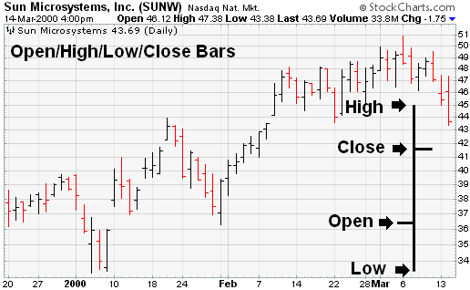
Bar chart

Slide 14
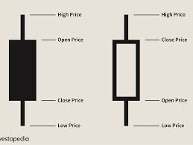
Candlestick chart

Slide 15
BSE(Candlestick chart)

Slide 16
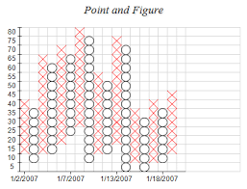
Point and Figure

Slide 17
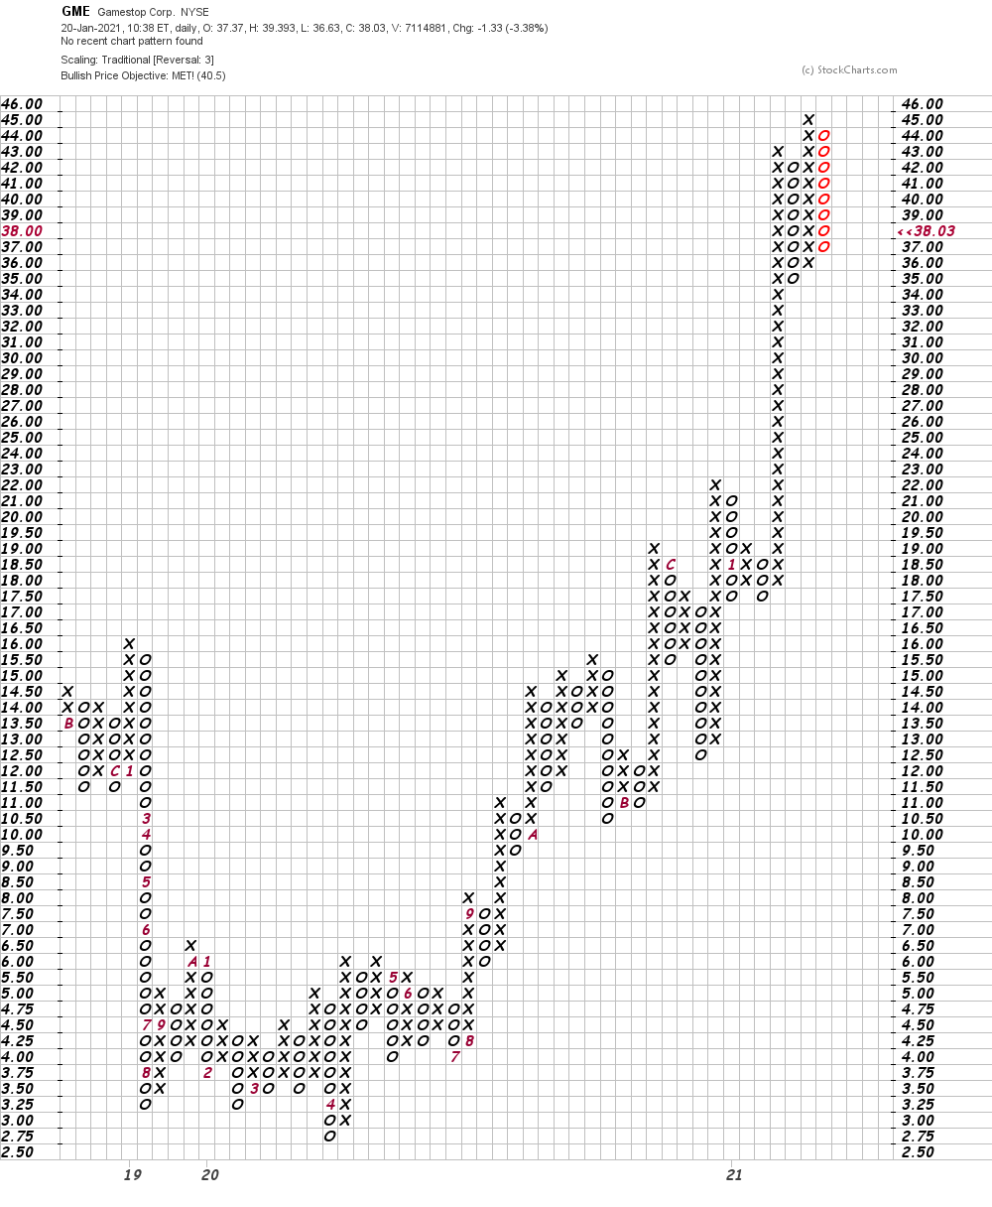
GME- 20,21,22,19,18, 19…

Slide 18
Support &Resistance level
Support’ and ‘resistance’ are terms for two respective levels on a price chart that appear to limit the market’s range of movement. The support level is where the price regularly stops falling and bounces back up, while the resistance level is where the price normally stops rising and dips back down

Slide 19
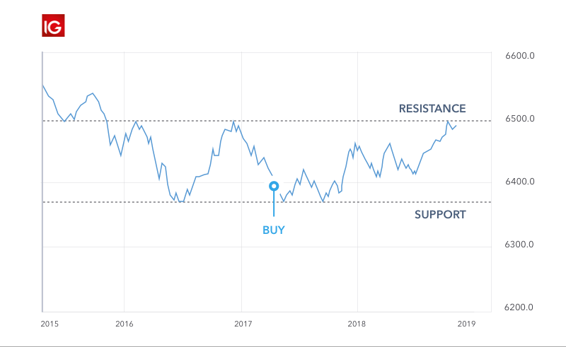
Support &Resistance level

Slide 20
Reversal Patterns
A price pattern that signals a change in the prevailing trend is known as a reversal pattern. These patterns signify periods where either the bulls or the bears have run out of steam. The established trend will pause and then head in a new direction as new energy emerges from the other side (bull or bear).

Slide 21
Examples of common reversal patterns include:
Double Tops: representing a short-term swing high, followed by a subsequent failed attempt to break above the same resistance level
Double Bottoms: showing a short-term swing low, followed by another failed attempt to break below the same support level
Head and Shoulders: signaling two smaller price movements surrounding one larger movement
Inverted Head And Shoulders: the price falls to a trough and then rises; the price falls below the former trough and then rises again; finally, the price falls again but not as far as the second trough.

Slide 22
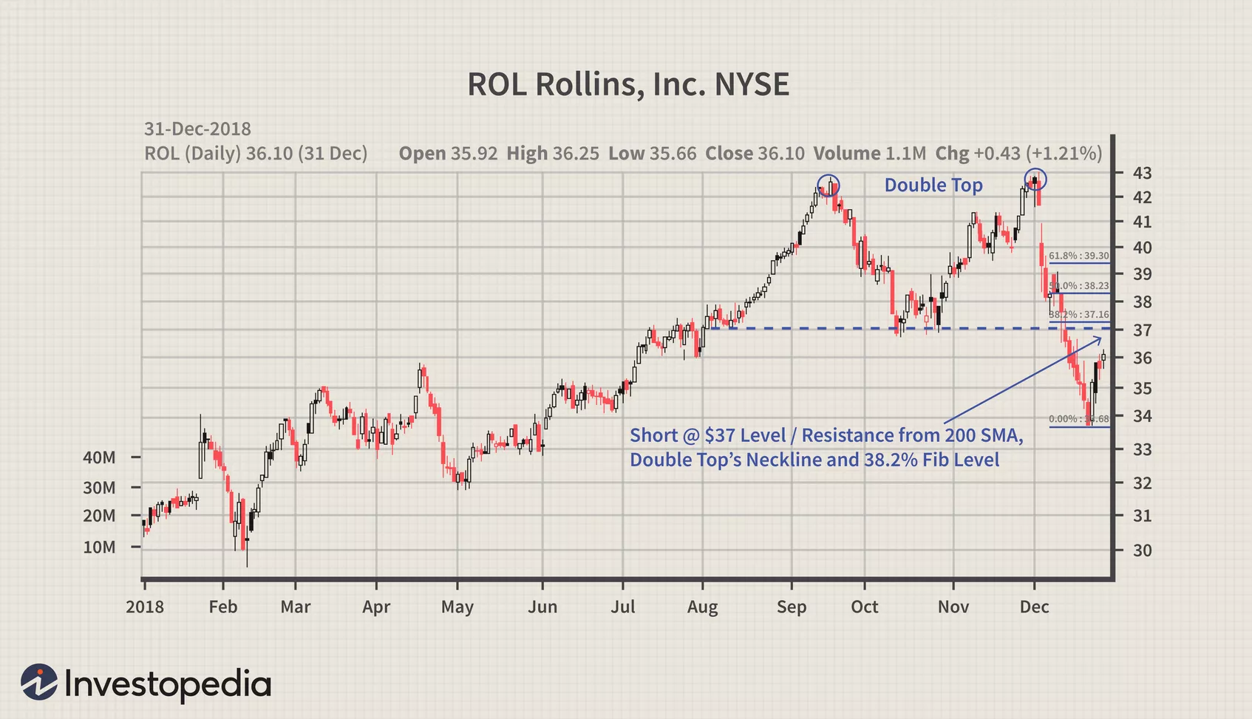
Double Tops : which often looks like the letter M, resulting in a trend reversal.

Slide 23
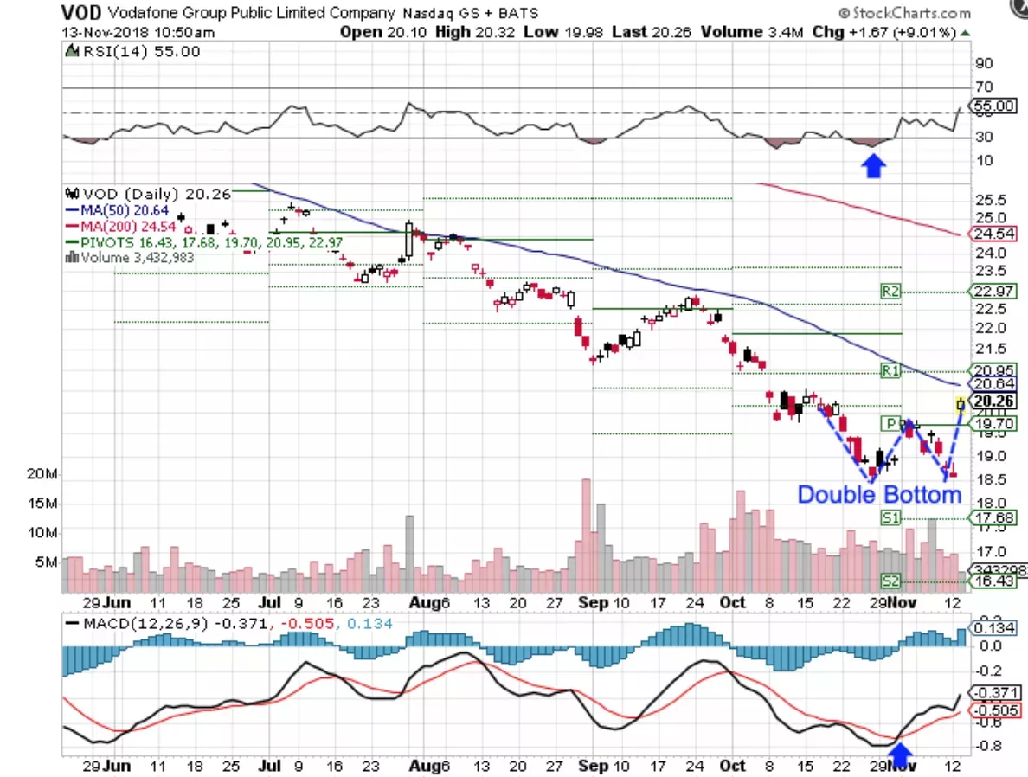
Double Bottoms: It looks like the letter W

Slide 24
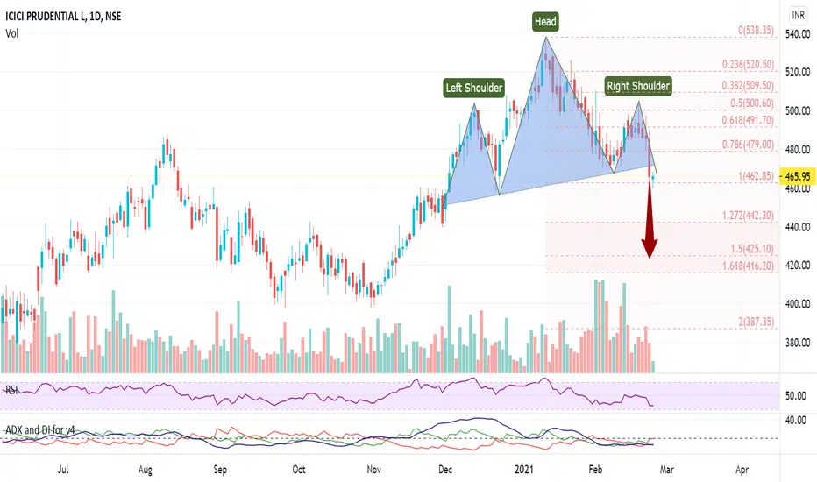
Head & Shoulder

Slide 25
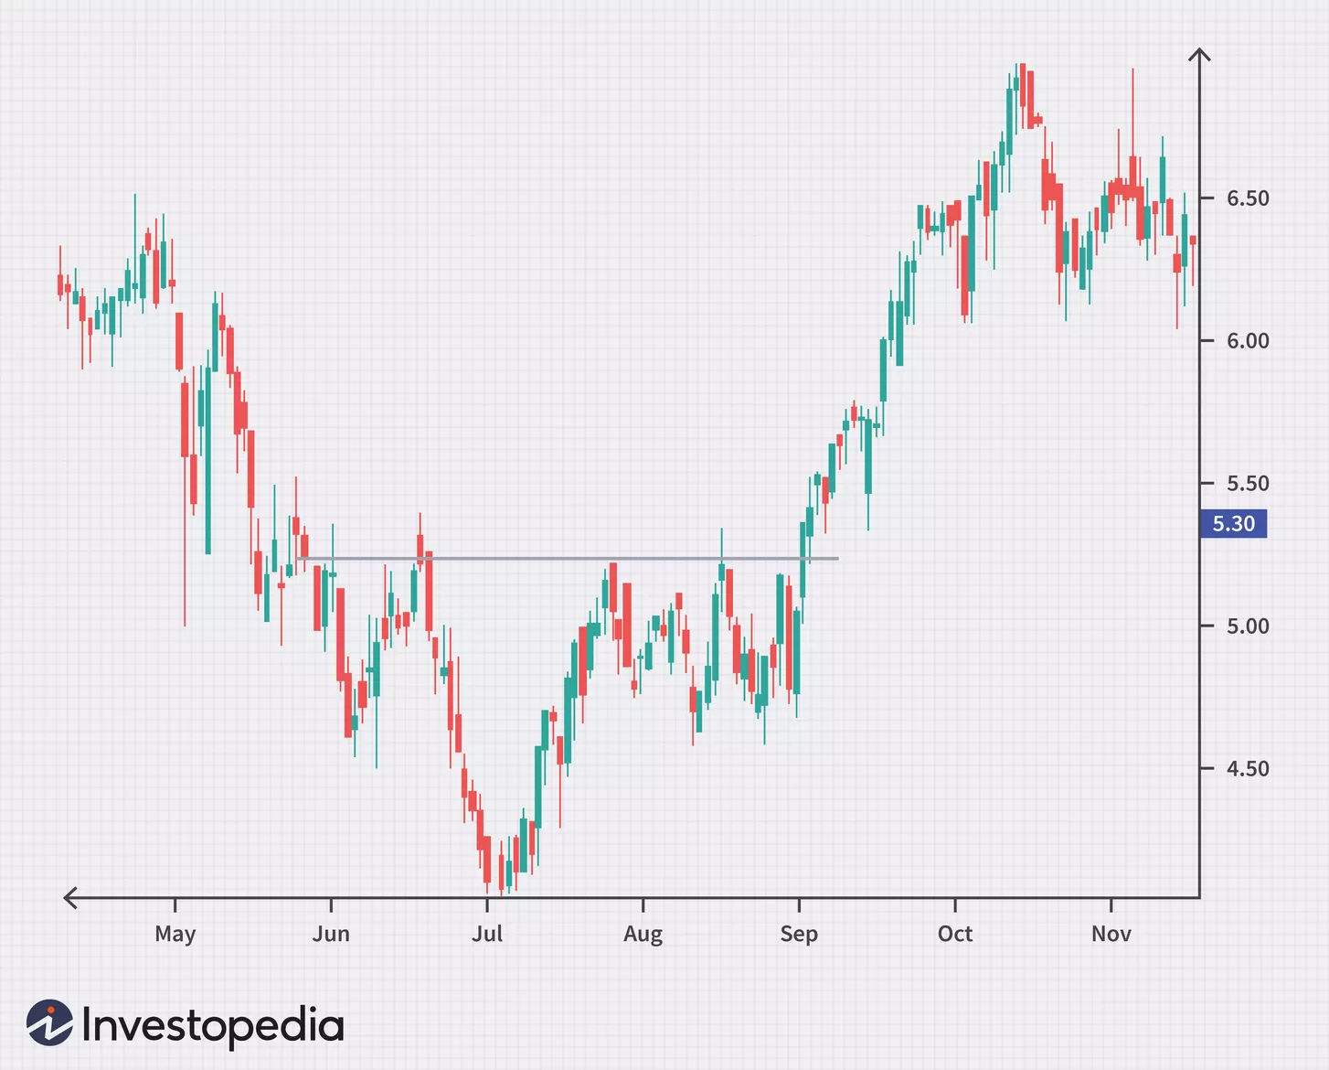
Inverse Head &Shoulder

Slide 26
Triangles
Symmetrical Triangle
Ascending Triangle
Descending Triangle

Slide 27
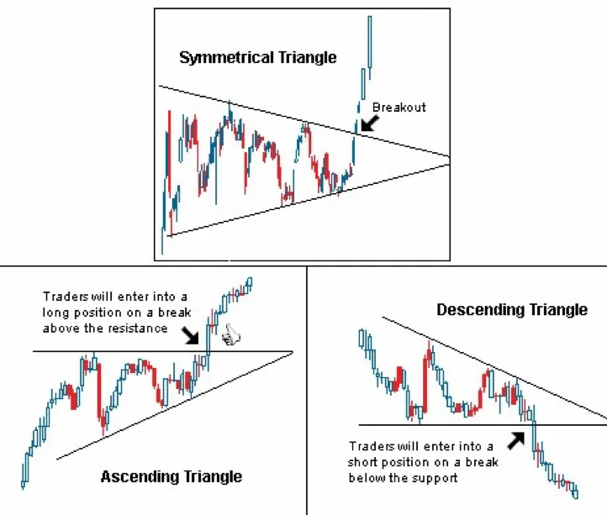

Slide 28
Symmetrical Triangle

Slide 29
Ascending Triangle
Notes:
Bullish trend

Slide 30
Descending Triangle
Notes:
Bearish trend

Slide 31
Moving average
Notes:
Bullish phase

Slide 32
Notes:
Bearish phase

Slide 33
Dow Theory
Dow Theory was first introduced by Charles Dow, who was the founder of Dow Jones and Company and the first editor of the Wall Street Journal
It was the first theory to explain that the market moves in trends.

Slide 34
The market has three trends
Primary trend is the major trend for the market. It indicates how the market moves in the long-term. A primary trend could span many years.
Secondary trends Or Intermediate trend are considered to be corrections to a primary trend. This is like an opposite movement to the primary trend. For example, if the primary trend is upward (bullish), the secondary trend(s) is downward. These trends could last anywhere between a few weeks to a few months.
Minor trends are fluctuations to the market movement on a daily basis. These trends last for less than three weeks and go against the movement of the secondary trend. Some analysts consider minor trends to mirror market chatter.

Slide 35
Primary Trend
The theory says that there are three phases to each primary trend: accumulation phase, public participation phase and panic phase.
The beginning of a primary upward (or downward) trend in a bull (or bear) market is known as the accumulation phase. Here, traders enter the market to buy (or sell) stocks against common market opinions.
In the public participation phase, more investors enter the market as business conditions improve and positive sentiments become evident. This results in higher (or lower) prices in the market.
The panic phase is marked by excessive buying by investors. This could result in great speculation. At this stage, it is ideal for investors to book profits and exit.

Slide 36
Notes:
bullish

Slide 37
Notes:
Bearish

Slide 38
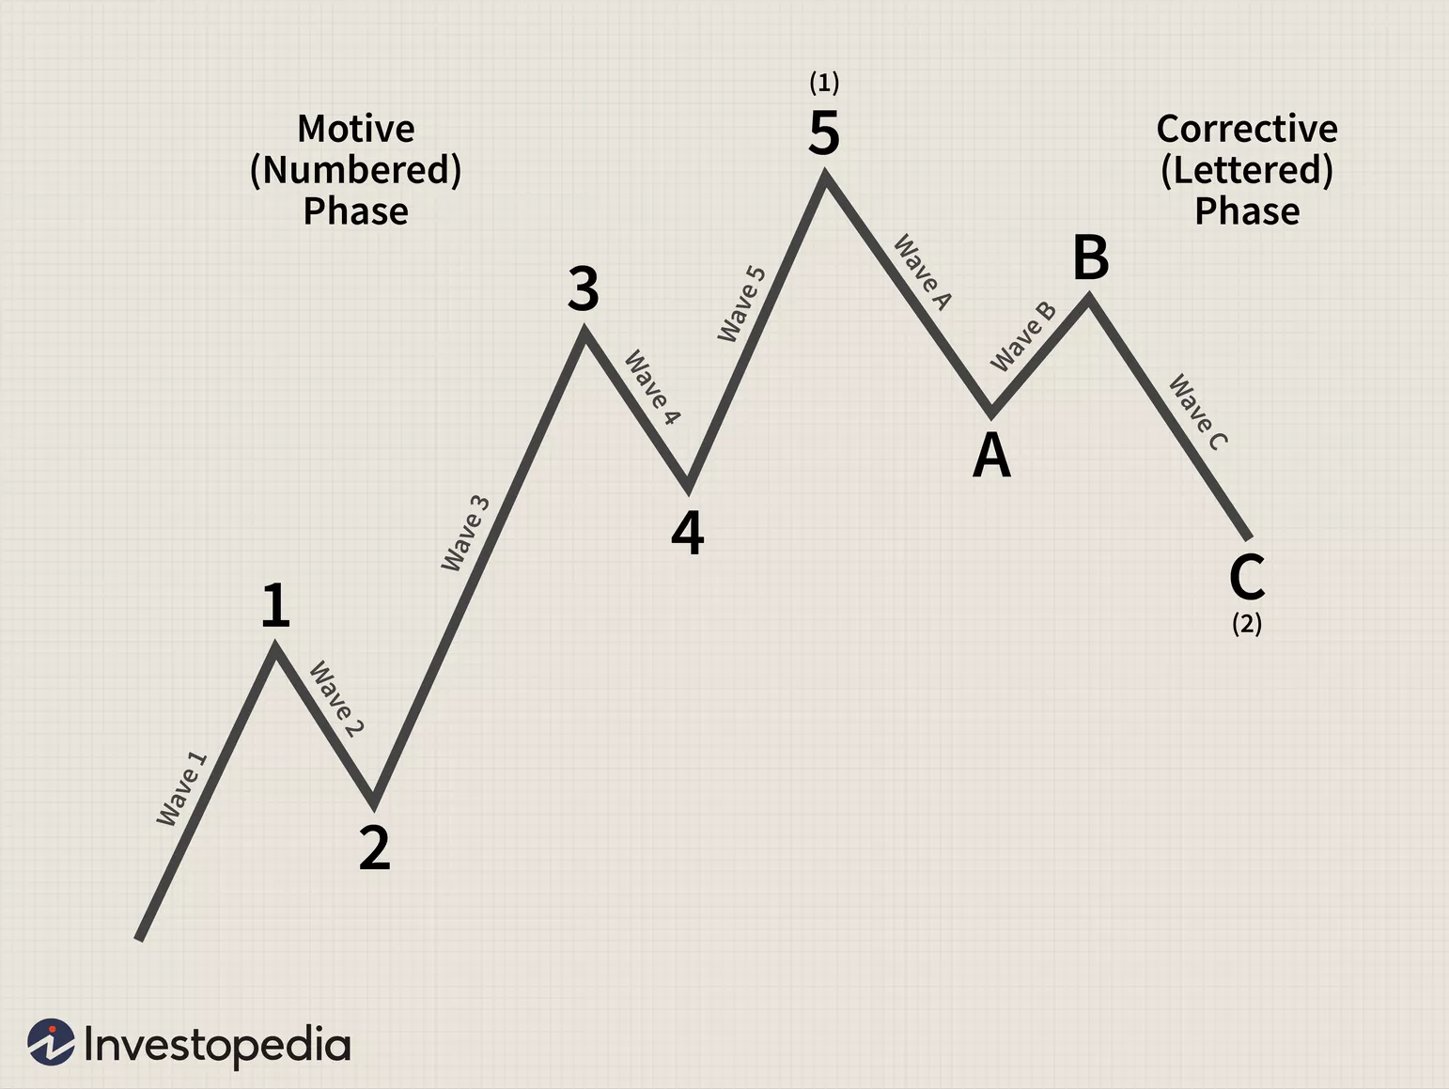
Elliott Wave Theory(R. N. Elliot)

Slide 39
E-I-C Vs Technical analysis
Data
Basis
Purpose
Time horizon
Users

Slide 40
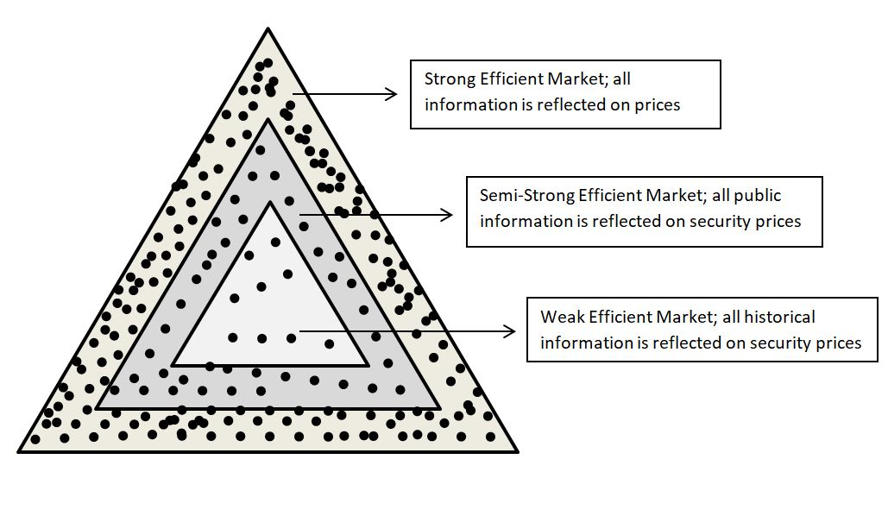
Efficient Market Hypothesis(EMH)

Slide 41
Efficient Market theory
Kendall (1953) – share prices do not have any trend/cycle. Therefore, they are random
Market is a price setter.
Efficient market: fair price setter
Fama(1970); applied tests to study the efficiency of the market
Weak form: Random walk hypothesis

Slide 42
Weak form: Random walk hypothesis
Filter rule:
Serial correlation: t and t+1, t+1 and t+2
Run test: 24,25,27,22,20,23,21,22,23
Runs = ++,--,+,-,++

Slide 43
Semi strong efficiency: stock-split study by Fama, Fischer with Jensen & Roll
Strong form of efficiency: performance of professionally managed funds

Slide 44
Equity valuation
Dividend capitalization approach/model
CAPM
Price-Earning approach
Models:
Walter’s model
Gorden model

Slide 45
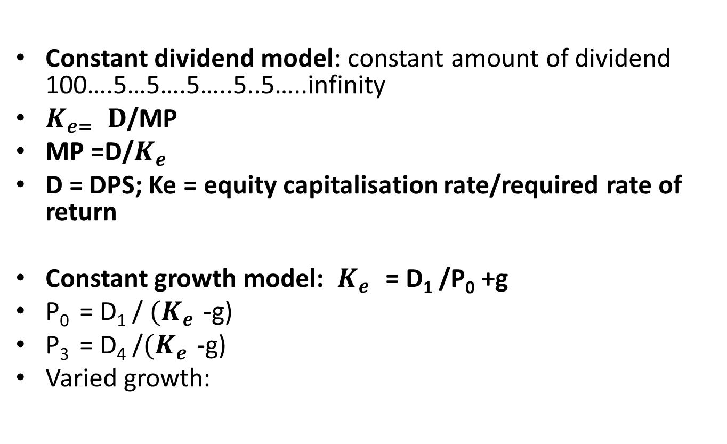
Dividend capitalization approach/model
Constant dividend model: constant amount of dividend 100….5…5….5…..5..5…..infinity
$K_{e= }D$/MP
MP =D/$K_{e }$
D = DPS; Ke = equity capitalisation rate/required rate of return
Constant growth model: $K_{e }$ = D₁ /P₀ +g
P₀ = D₁ / ${(K}_{e }$-g)
P₃ = D₄ /${(K}_{e }$-g)
Varied growth:

Slide 46
Recapitulate
ABC Co. has just paid a dividend of Rs. 2 per share. In view of the rapid growth of the company, the dividend is expected to grow at 10% for next three years. After that the growth process will slow down and the dividend is expected to grow only 8%p.a. infinitely. In view of the risk involved in the investment, a return of 20% is considered appropriate. What is the price an investor should be ready to pay for this share?
Notes:
g1 = 10%, g2 = 8%

Slide 47
Year | dividend | pvif@20% | PV
1 | 2.2 | .833 | 1.83
2 | 2.42 | .694 | 1.68
3 | 2.662 | .578 | 1.54
4 | 2.87
P3(D4 TO Dα) | 23.91 | .578 | 13.81
TOTAL |  |  | 18.8
Notes:
PV(D1 +D2 + D3 + D4 + D5 + ………α)

Slide 48
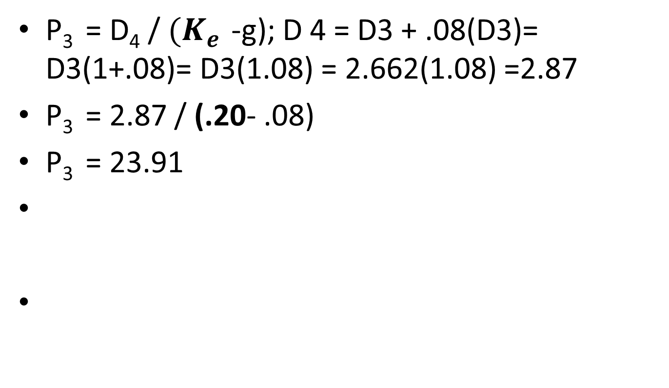
P₃ = D₄ / ${(K}_{e }$-g); D 4 = D3 + .08(D3)= D3(1+.08)= D3(1.08) = 2.662(1.08) =2.87
P₃ = 2.87 / (.20- .08)
P₃ = 23.91

Slide 49
Practice questions
Genset Ltd. is expected to declare dividend of 1.75 per share in the next year. The company is expected to grow at the rate of 8% per annum for ever. If the equity capitalisation rate is 18%, find the intrinsic value of the share. Assuming that the intrinsic value and the actual market price of the share are same, what would the price of the share at the end of next year, capital yield and dividend yield?
Notes:
Value of share = 17.5, P1 = 18.9, div yield = 10%, capital yield =8%

Slide 50
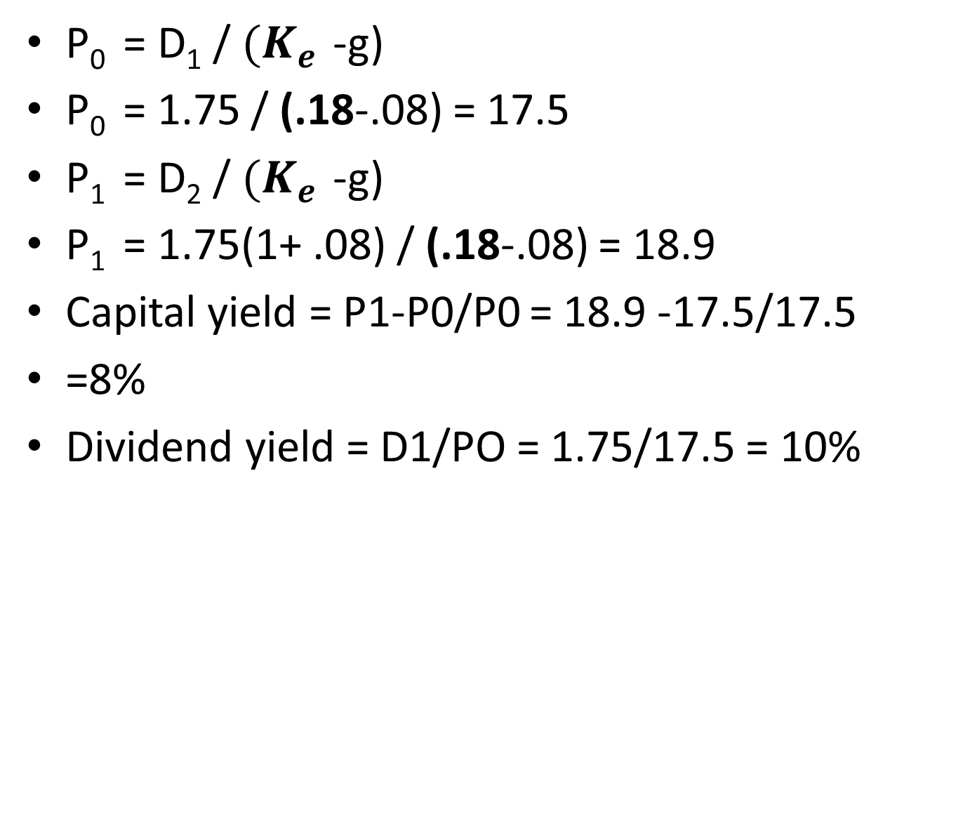
P₀ = D₁ / ${(K}_{e }$-g)
P₀ = 1.75 / (.18-.08) = 17.5
P₁ = D₂ / ${(K}_{e }$-g)
P₁ = 1.75(1+ .08) / (.18-.08) = 18.9
Capital yield = P1-P0/P0 = 18.9 -17.5/17.5
=8%
Dividend yield = D1/PO = 1.75/17.5 = 10%

Slide 51
Dividend approach
The equity share of a company is currently trading at 80 per share. The company is expected to post earning per share (EPS) of Rs. 8 at the end of the year. If the company is expected to grow at 12% per annum perpetually and the investors’ required rate of return is 18%. Find the D/P ratio to be adopted by the company for justifying current market price of its equity shares.
Notes:
DPS = 4.8 ; D/P Ratio = 60%

Slide 52

P₀ = D₁ / ${(K}_{e }$-g)
80 = D₁ / (.18-.12) = 4.8
DPS = 4.8
EPS = 8
D/P Ratio = 4.8/8 = 60%

Slide 53
Price – Earning Approach
Annual turnover | 12,00,000
Operating profits | 30%
Equity share capital(FV=10) | 3,00,000
Capital reserve | 60,000
Preference share capital(14%) | 2,00,000
Long term loans(9%) | 1,00,000
Debentures(12%) | 1,50,000
Tax rate | 50%
Dividend pay out ratio | 30%
Price earning ratio | 15

Slide 54
MP = P/E ratio*EPS
Using the above information, find
(i) EPS
(II) DPS
(III)Expected Market price
(iv) Earning yield
(v) Dividend yield
Notes:
EPS = 4.61, DPS =1.386; P/E ratio =15 = MP/EPS; MP = 69.3; Earning yield = EPS/MP =6.67%; Dividend yield = DPS/MP = 2%

Slide 55
MP/EPS = 15; MP = 15*EPS
Operating profit = 3,60,000
Less: int on loans = 9,000
Less: int on deb = 18,000
PBT = 3,33,000
Less: taxes = 1,66,500
PAT = 1,66,500
Less: Pref divend = 28,000
Earnings for equity = 1,38,500
No. of Equity = 30,000
EPS = 4.61
DPS =.30 *4.61 = 1.383
MP = P/E ratio*EPS = 15 * 4.61 = 69.

Slide 56
Walter’s Model
Use Walter model to determine the value of firm in 3 cases:
(i) 100% (ii) 50% retention (iii) no retention
Cost of capital = 10%
Rate of return on investment =15%
Earning per share =5
The firm has 10 lakh equity share of 10 each.

Slide 57

P = $\frac{D+\frac{r}{Ke}(E−D)}{Ke}$
Notes:
(i) 75/ (75* 10,00,000) = 7,50,00,000 (ii)62.50/ (iii) 50/

Slide 58
Gordon model
Using the following data:
Earning per share(EPS) = 12
Equity capitalisation rate =20%
Internal rate of return = 16%
Find the market price of a share using Gordon Model if retention ratio is (i) 75% (ii)25%
Notes:
P = $\frac{E (1−b)}{Ke −br}$

Slide 59

P = $\frac{E (1−b)}{Ke −br}$
Notes:
(i) 37.5 (ii) 56.25

Slide 60
The company declared dividend of Rs 1.50 last year. The company is likely to have growth rate of 12% in the next two years, 10% in the third year and fourth year and thereafter the growth rate would stabilize at 8%. Find the price at which the share shall be purchased if shareholders’ expect return of 16%?
Notes:
Ans: 22.43 (5.44+16.99)

Slide 61
Year | Dividend | PVF@16% | PV
1(g1) | 1.5(1.12)=1.68 | .862 | 1.44
2(g1) | 1.68(1.12)= 1.88 | .743 | 1.396
3(g2) | 1.88(1.1)=2.07 | .641 | 1.325
4(g2) | 2.07(1.1) =2.27 | .552 | 1.255
5(g3) | 2.27(1.08)=2.45 |  | 5.41
4 | P4 = 30.62 | .552 | 16.90
PO |  |  | 22.31

Slide 62

P₄ = D5/ ${(K}_{e }$-g)
P₄ = 2.45 / (.16-.08)
30.62

Slide 63
The management of a company has just distributed a dividend of Rs. 10 per share. The current growth rate of the company is 5%. Now the company wants to expand its operation overseas and decided not to pay any dividend for the next 4 years. After that the company expects to pay a dividend of Rs. 20 with a growth rate of 10%p.a. forever. If company does not expand its operation then it will continue its dividends and maintain its present growth rate of 5%. The firm’s cost of equity is 15% in both the situations. Calculate the value of the company’s share if (i)company expands (ii) company does not expand.
Notes:
P0 = 228.8’; P0 = 105

