Slide 1
UNIT-2
Fixed Income Securities

Slide 2
UNIT-2
Basics of bond investment
Default risk and credit rating

Slide 3
Basics of bond investment
Concept of bond
Types of bonds
Risk associated with bond returns
Measures of bond returns

Slide 4
Concept of bond
Basics of bond investment
Debentures are not secured by any security Vs bonds are secured by some security
Face value: basic denomination
Redemption value:
Coupon rate: rate of interest
Maturity period:
Bond indenture:
Bond trustee:
Collateral:

Slide 5
Types of bonds
Convertible and non-convertible bonds
Fully Vs partially
Compulsorily Vs optional
Redeemable and Irredeemable
Secured and unsecured bonds
Callable and putable bonds:
Call option: borrower(Company) can redeem after a specified time but before maturity
and put option: bondholder can ask for redemption after a specified time but before maturity
Junk bonds: Examples of Junk bonds: TESLA, FORD and NETFLIX
Secured premium note(SPN):Non-convertible debentures with detachable warrents( right to buy share on a specified date and price)
Lock-in-period : 5 yrs, after 5 years: either get it redeemed or interest plus principal amount in instalments.

Slide 6
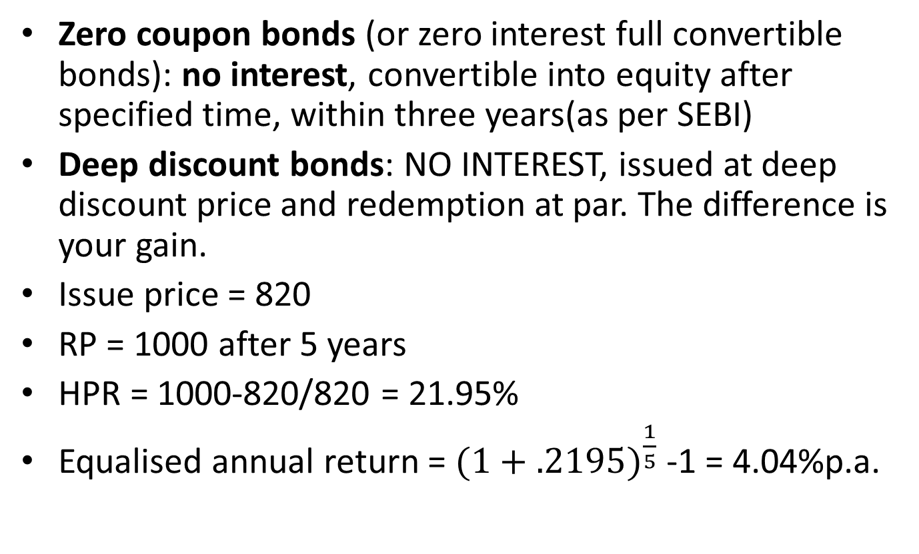
Zero coupon bonds (or zero interest full convertible bonds): no interest, convertible into equity after specified time, within three years(as per SEBI)
Deep discount bonds: NO INTEREST, issued at deep discount price and redemption at par. The difference is your gain.
Issue price = 820
RP = 1000 after 5 years
HPR = 1000-820/820 = 21.95%
Equalised annual return = ${(1+.2195)}^{\frac{1}{5}}$ -1 = 4.04%p.a.
Notes:
1000-970/970 = 3%; ${(1+.03)}^{2 }$-1 = 6.09%p.a.; ${(1+.03)}^{4 }$-1 = 12.55%

Slide 7
Risk associated with bond returns
Default risk
Interest risk
Inflation risk
Call risk: callable bonds
Liquidity risk

Slide 8
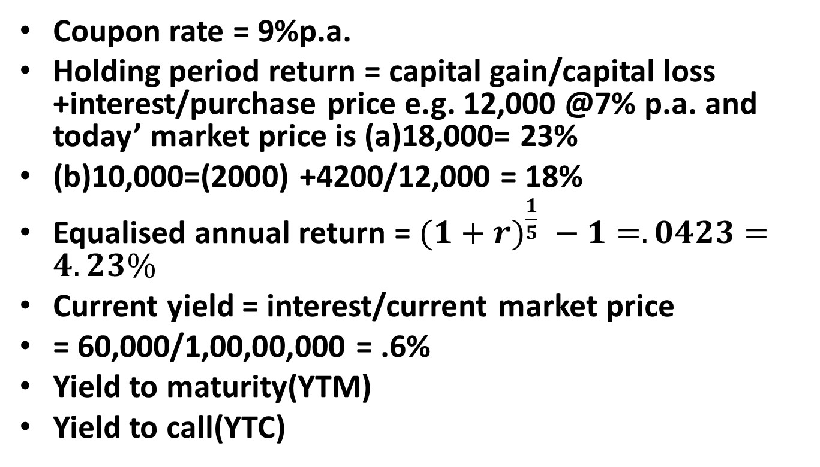
Measures of bond returns
Coupon rate = 9%p.a.
Holding period return = capital gain/capital loss +interest/purchase price e.g. 12,000 @7% p.a. and today’ market price is (a)18,000= 23%
(b)10,000=(2000) +4200/12,000 = 18%
Equalised annual return = $(1+{r)}^{\frac{1}{5}} −1=.0423=4.23\%$
Current yield = interest/current market price
= 60,000/1,00,00,000 = .6%
Yield to maturity(YTM)
Yield to call(YTC)
Notes:
purchase price = 56, FV=100, CR=6%, MP -120, CY = 6/120=5%

Slide 9
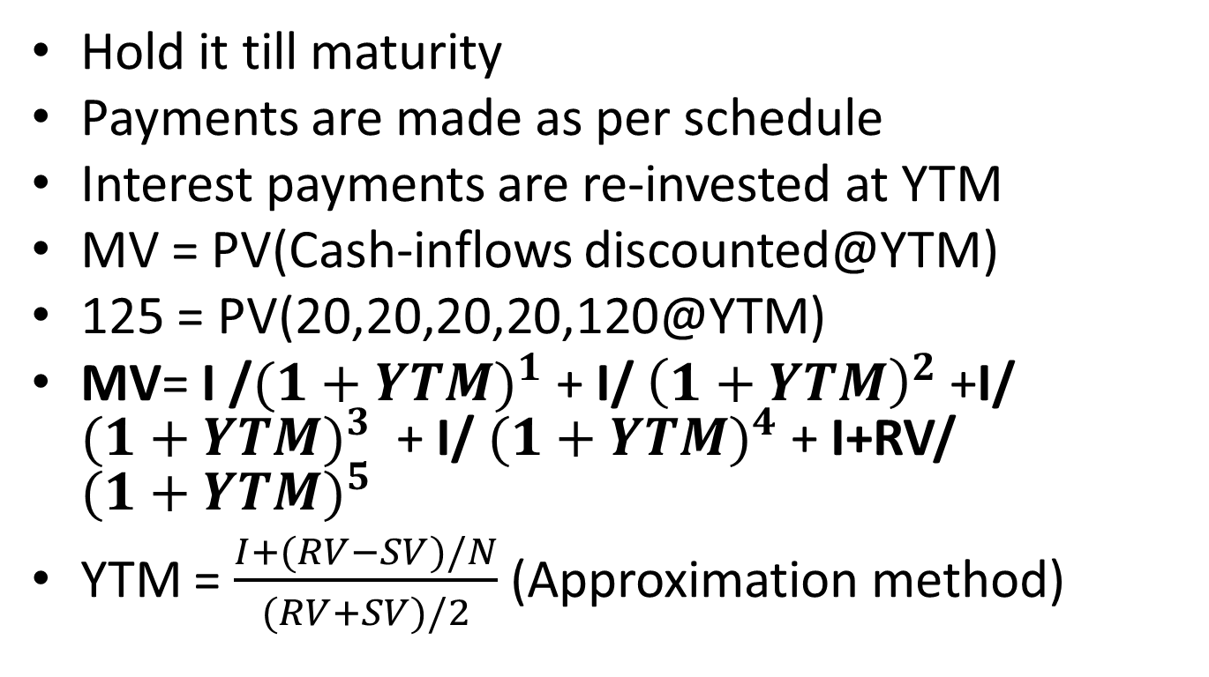
Yield to maturity
(Assumptions)
Hold it till maturity
Payments are made as per schedule
Interest payments are re-invested at YTM
MV = PV(Cash-inflows discounted@YTM)
125 = PV(20,20,20,20,120@YTM)
MV= I /${(1+YTM)}^{1}$ + I/ ${\left(1+YTM\right)}^{2}$ +I/ ${(1+YTM)}^{3}$ + I/ ${(1+YTM)}^{4}$ + I+RV/ ${(1+YTM)}^{5}$
YTM = $\frac{I+(RV−SV)/N}{(RV+SV)/2}$ (Approximation method)
Notes:
YTM = RATE OF DISCOUNT = YTM = $\frac{20+(100−125)/5}{(100+125)/2}$ = 13.3%

Slide 10
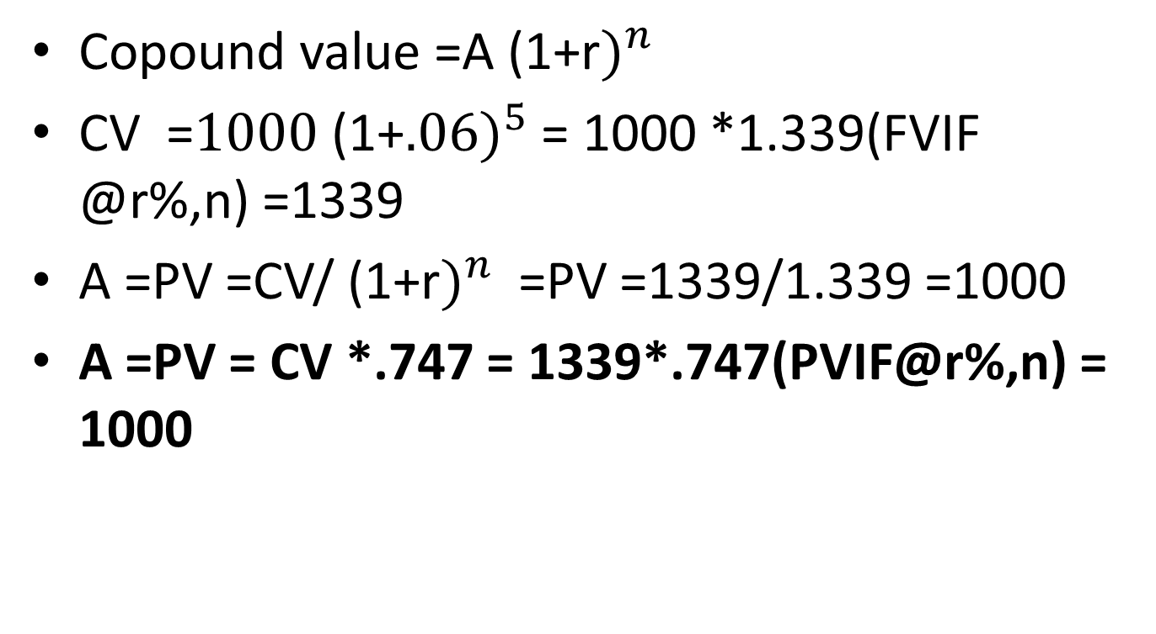
Copound value =${\text{A}\text{ (1+}\text{r})}^{n}$
CV =${\text{1000}\text{ (1+}.06)}^{5}$ = 1000 *1.339(FVIF @r%,n) =1339
A =PV =CV/${\text{ (1+}\text{r})}^{n}$ =PV =1339/1.339 =1000
A =PV = CV *.747 = 1339*.747(PVIF@r%,n) = 1000

Slide 11
ILLUSTRATION
XYZ Ltd’s bonds have 4 years remaining to maturity. Interest is paid annually at the rate of 9 percent. The bond has face value of Rs 1000. find the yield to the maturity of the bond if the market price of the bond is 829.
B) Would you pay Rs 829 for the bond if your required rate of return is 12%?

Slide 12
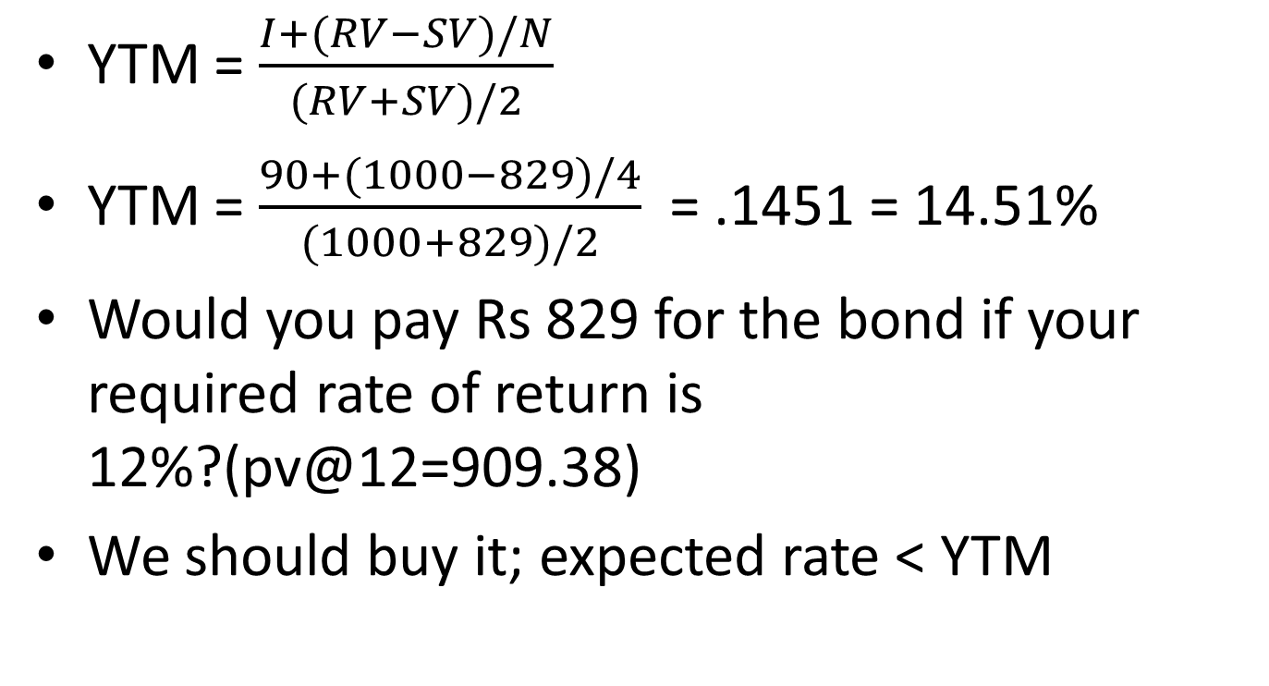
YTM = $\frac{I+(RV−SV)/N}{(RV+SV)/2}$
YTM = $\frac{90+(1000−829)/4}{(1000+829)/2}$ = .1451 = 14.51%
Would you pay Rs 829 for the bond if your required rate of return is 12%?(pv@12=909.38)
We should buy it; expected rate < YTM

Slide 13
Year | Cash-flows | PVF @14% | PV | PVF@16% | PV
1 | 90 | .877 | 78.93 | ..862 | 77.58
2 | 90 | .769 | 69.21 | .743 | 66.87
3 | 90 | .675 | 60.75 | .641 | 57.69
4 | 1090 | .592 | 645.28 | .552 | 601.68
TOTAL |  |  | 854.17 |  | 803.82
NPV |  |  | 25.17 |  | (25.18)
Notes:
PV at 15% = 829.04 ; NPV = PV OF CASHINFLOWS- PV OF CASHOUTFLOW

Slide 14
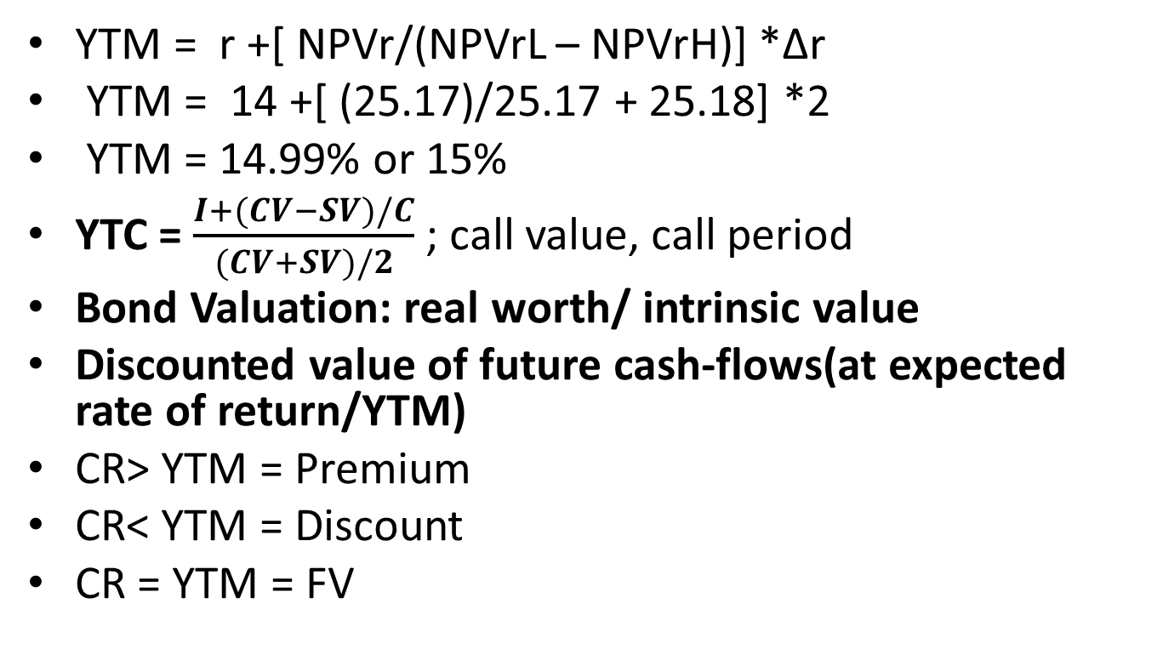
YTM = r +[ NPVr/(NPVrL – NPVrH)] *Δr
YTM = 14 +[ (25.17)/25.17 + 25.18] *2
YTM = 14.99% or 15%
YTC = $\frac{I+(CV−SV)/C}{(CV+SV)/2}$ ; call value, call period
Bond Valuation: real worth/ intrinsic value
Discounted value of future cash-flows(at expected rate of return/YTM)
CR> YTM = Premium
CR< YTM = Discount
CR = YTM = FV
Notes:
NPVr = NPV at r; NPVrL= NPV at lower r: NPVrH= NPV at higher r

Slide 15
Would you pay Rs 829 for the bond if your required rate of return is 12%?
Real worth = PV(90,90,90,90,1090 @12%)
YTM = 15%, real value =829
Buy it as real value will be more than 829.

Slide 16
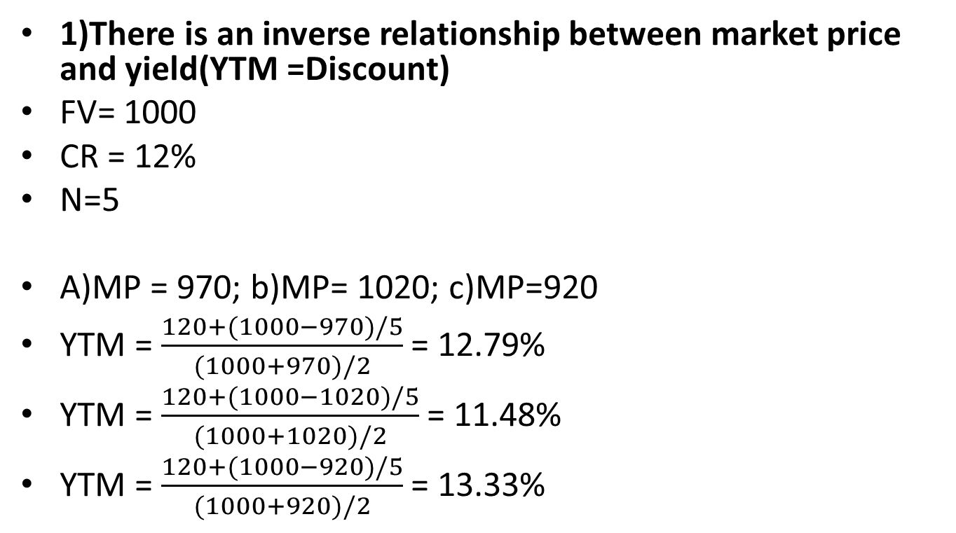
Bond Value Theorems(Malkiel)
1)There is an inverse relationship between market price and yield(YTM =Discount)
FV= 1000
CR = 12%
N=5
A)MP = 970; b)MP= 1020; c)MP=920
YTM = $\frac{120+(1000−970)/5}{(1000+970)/2}$ = 12.79%
YTM = $\frac{120+(1000−1020)/5}{(1000+1020)/2}$ = 11.48%
YTM = $\frac{120+(1000−920)/5}{(1000+920)/2}$ = 13.33%

Slide 17
2)The discount or premium on the bonds having same yield varies with the maturity period of the bonds
Bond (A -2yrs), Bond (B-3yrs); Bond(C-4yrs)
FV = 1000
YTM = 12%(Discount rate)
CR = 14%
Next situation:
YTM =14%
CR=12%

Slide 18
Premium
YEAR | BOND(A) | BOND (B) | BOND© | PVIF@12% | A | B | C
1 | 140 | 140 | 140 | .893 | 125.02 | 125.02 | 125.02
2 | 1140 | 140 | 140 | .797 | 908.58 | 111.58 | 111.58
3 |  | 1140 | 140 | .712 |  | 811.68 | 99.68
4 |  |  | 1140 | .636 |  |  | 725.04
TOTAL |  |  |  |  | 1033.6 | 1048.28 | 1061.32
Premium |  |  |  |  | 33.6 | 48.28 | 61.32

Slide 19
Discount
Bond(A) = 966.52 – 1000 = 33.48
Bond(B) = 953.52 -1000 = 46.48
Bond© = 941.56 -1000= 58.44

Slide 20
3.The amount of premium/discount declines(at increasing rate) as the life of the bond reaches near its maturity
FV = 1000
CR = 10%
YTM = 12%
remaining life = 5; 4 ;3
Situation2:
CR = 12%
YTM = 10%

Slide 21
Remaining life 5 years
Life | CF | PVIF@12% | PV | CF | PVIF@10% | PV
1 | 100 | .893 | 89.3 | 120 | .909 | 109.08
2 | 100 | .797 | 79.7 | 120 | .826 | 99.12
3 | 100 | .712 | 71.2 | 120 | .751 | 90.12
4 | 100 | .636 | 63.6 | 120 | .683 | 81.96
5 | 1100 | .567 | 623.7 | 1120 | .621 | 695.52
TOTAL |  |  | 927.5 |  |  | 1075.8
Discount/premium |  |  | 72.5 |  |  | 75.8

Slide 22
Remaining life 4 years
Life | CF | PVIF@12% | PV | CF | PVIF@10% | PV
1 | 100 | .893 | 89.3 | 120 | .909 | 109.08
2 | 100 | .797 | 79.7 | 120 | .826 | 99.12
3 | 100 | .712 | 71.2 | 120 | .751 | 90.12
4 | 1100 | .636 | 699.6 | 1120 | .683 | 764.96
TOTAL |  |  | 939.8 |  |  | 1063.28
Discount/premium |  |  | 60.2 |  |  | 63.28

Slide 23
Remaining life 3 years
Life | CF | PVIF@12% | PV | CF | PVIF@10% | PV
1 | 100 | .893 | 89.3 | 120 | .909 | 109.08
2 | 100 | .797 | 79.7 | 120 | .826 | 99.12
3 | 1100 | .712 | 783.2 | 1120 | .751 | 841.12
TOTAL |  |  | 952.2 |  |  | 1049.32
Discount/premium |  |  | 47.8 |  |  | 49.32

Slide 24



























Slide 25
Rate of change
Remaining life | 5 | 4 | 3 | 2
Amt of discount | 72.5 | 60.2 | 47.8 | 34
Rate of change | 72.5-60.2/72.5=16.97% | 60.2-47.8/60.2=20.59% | 47.8-34/47.8=28.87%
Amount of premium | 75.8 | 63.28 | 49.32 | 34.2
Rate of change | 75.8-63.28/75.8= 16.51% | 63.28-49.32/63.28= 22.06% | 49.32-34.2/49.32= 30.65%
Notes:
Amount of premium/discount declines at increasing rate

Slide 26













Price
CR>YTM
CR<YTM
Maturity period

Slide 27
4.Decrease in yield results in more changes in market price in comparison to increase in yield
FV = 1000
CR = 10%
YTM = 10%
Time = 5Years; M. P. = 1000
Situation 1: YTM = 8% ; 1080
Situation 2: YTM = 12%; 927.5

Slide 28
Year | CF | PVIF@8% | PV | PVIF@12% | PV
1 | 100 | .926 | 92.6 | .893 | 89.3
2 | 100 | .857 | 85.7 | .797 | 79.7
3 | 100 | .794 | 79.4 | .712 | 71.2
4 | 100 | .735 | 73.5 | .636 | 63.6
5 | 1100 | .681 | 749.1 | .567 | 623.7
TOTAL |  |  | 1080.3 |  | 927.5
Rate of change |  | 1080.3-1000/1000 =8.03% |  |  | 1000-927.5/1000=7.25%

Slide 29
5)For a given change in bond yield, the price variation will be lesser for the bonds having higher coupon rate
FV(A) = 1000
CR = 10%
YTM = 10%
Time = 5; M.P. = 1000
Situation 2;YTM = 12%; MP= 927.5
Situation3; YTM =8% ; MP= 1080.3
FV (B) = 1000
CR =12%
Time = 5;
YTM =10%; MP = 1075.8;
Situation2;YTM = 12%; M.P = 1000
Situation3; YTM =8% ; MP=1160.2

Slide 30
Bond | A(CR=10%) | B(CR=12%)
Situation 1(YTM =10%) | 1000 | 1075.8
Situation2(YTM=12%) | 927.5 | 1000
Rate of change | 1000-927.5/1000= 7.25% | 1075.8-1000/1075.8=7.04%
Situation3(YTM =8%) | 1080.3 | 1160.16
Rate of change | 1080-1000/1000= 8.03% | 1160.16-1075.8/1075.8=7.8%

Slide 31
Impact of taxation on bond valuation
Interest payment on due date; Coupon amt(1-t)
Capital gain/loss at the time of maturity
M P = PV(NetI +Net I +Net I +Net I + RV-tax on CG)
Long term /short term gain of bonds
Long term: more than 12 months for listed bonds and zero coupon
Benefit of indexation : not available
Rate of tax on short term (normal tax slab)/ long term gain(20%)

Slide 32
Practice problems
A Bond having face value of Rs.1000 is available for 800. It carries coupon rate of 14% and has 5-years to maturity. Currently, the interest income is subject to30% rate of tax and capital gain is subject to 10% rate of tax. Advise, if the bond is worth buying for the investors having 18% required rate of return and the bond is held till maturity.

Slide 33
FV = 1000
CR =14%;5 Years
Net interest = 140 (1-.3) = 140*.7 = 98
RV = 1000; SV = 800
Capital gain = 1000-800 =200
Tax on capital gain = .10 * 200 = 20
Net RV = 1000- 20 = 980

Slide 34
Year | CF | PVIF@18% | PV
1 | 98 | .847 | 83.006
2 | 98 | .718 | 70.364
3 | 98 | .609 | 59.682
4 | 98 | .516 | 50.568
5 | 1078(98+980) | .437 | 471.086
Total |  |  | 734.706
Notes:
We should not buy this bond.

Slide 35
Practice problem
A Company is contemplating to issue bonds having face value of Rs 5000 which will be redeemed over a period of 5 years in five equal annual instalments. The bond carries a coupon interest rate of 8%. Find the price at which the bonds should be issued to the investor having expected rate of return of 10%.
Notes:
Ans: 4757.12

Slide 36
Year | RV | Interest | CF | PVIF@10% | PV
1 | 1000 | 400 | 1400 | .909 | 1272.6
2 | 1000 | 320 | 1320 | .826 | 1090.32
3 | 1000 | 240 | 1240 | .751 | 931.24
4 | 1000 | 160 | 1160 | .683 | 792.28
5 | 1000 | 80 | 1080 | .621 | 670.68
TOTAL |  |  |  |  | 4757.12

Slide 37
Default Risk
Bond market in India
Credit rating
Credit rating agencies; CRISIL, CARE
Benefits
Methodology

Slide 38
Bond duration(Macaulay)
Shortcomings of YTM
Reinvestment risk and price risk
Extend to which the price of a bond will react to different interest rate environment
Weighted average of life of a bond
Steps:1) CF * PVIF = PV of CF
2) FINDING WEIGHTS
3)TIME* WEIGHTS

Slide 39
YEAR | CF | PVIF@10% | PV | WEIGHTS | Weights | Time*weights
1 | 90 | .909 | 81.81 | 81.81/962.1 | .085 | .085
2 | 90 | .826 | 74.34 | 74.34/962.1 | .077 | .154
3 | 90 | .751 | 67.59 | 67.59/962.1 | .070 | .210
4 | 90 | .683 | 61.47 | 61.47/962.1 | .064 | .256
5 | 1090 | .621 | 676.89 | 676.89/962.1 | .704 | 3.52
TOTAL |  |  | 962.1 |  |  | 4.225

Slide 40
Properties of bond duration
Larger the coupon rate, less time will be required to recover benefits and lesser the duration of bond
Bond duration increases with the maturity period.
Higher the YTM, lower would be the bond duration
Zero coupon bond: bond duration will be its maturity period.

Slide 41
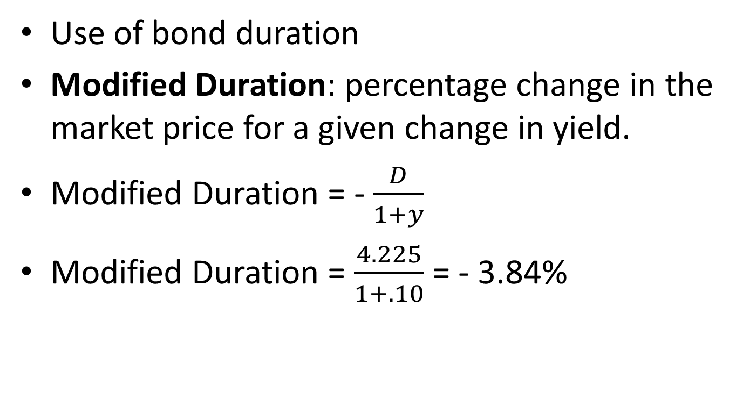
Use of bond duration
Modified Duration: percentage change in the market price for a given change in yield.
Modified Duration = - $\frac{D}{1+y}$
Modified Duration = $\frac{4.225}{1+.10}$ = - 3.84%

Slide 42
Practice problem
1Q) A Company issues a compulsorily partly convertible 10% debentures having face value of Rs 100. It is partially convertible (60% of face value) into three shares of Rs 20 each after five years. The total tenure of the bond is 10 years. the expected share price after 5 years is Rs. 25. calculate the value of this partially convertible debenture if required rate of return on equity is 15% and on debt12%.
Notes:
Ans=94.389

Slide 43
YEAR | INTEREST | SHARES | PVF@12% | PVF@15% | PV | PV
1 | 10 |  | .893 |  | 8.93
2 | 10 |  | .797 |  | 7.97
3 | 10 |  | .712 |  | 7.12
4 | 10 |  | .636 |  | 6.36
5 | 10 | 75 | .567 | .497 | 5.67 | 37.275
6 | 4 |  | .507 |  | 2.028
7 | 4 |  | .452 |  | 1.808
8 | 4 |  | .404 |  | 1.616
9 | 4 |  | .361 |  | 1.444
10 | 44 |  | .322 |  | 14.168
TOTAL |  |  |  |  | 57.114 | 37.275
Interest + shares + interest
Notes:
PV = 57.114 + 37.275 = 94.389

Slide 44
Practice problem
2Q) V.K. Kappor is considering investing in bond currently selling at Rs 8785.07. The bond has 4 years to maturity, Rs. 10000 face value and 8%coupon rate. The next annual interest payment is due one year from today. The appropriate discount factor for investment of similar risk is 10%.
(i) Calculate the intrinsic value of the bond. Should Mr. Kapoor purchase this bond?
(ii) Calculate YTM of the bond
Notes:
Ans= 8789.6

Slide 45
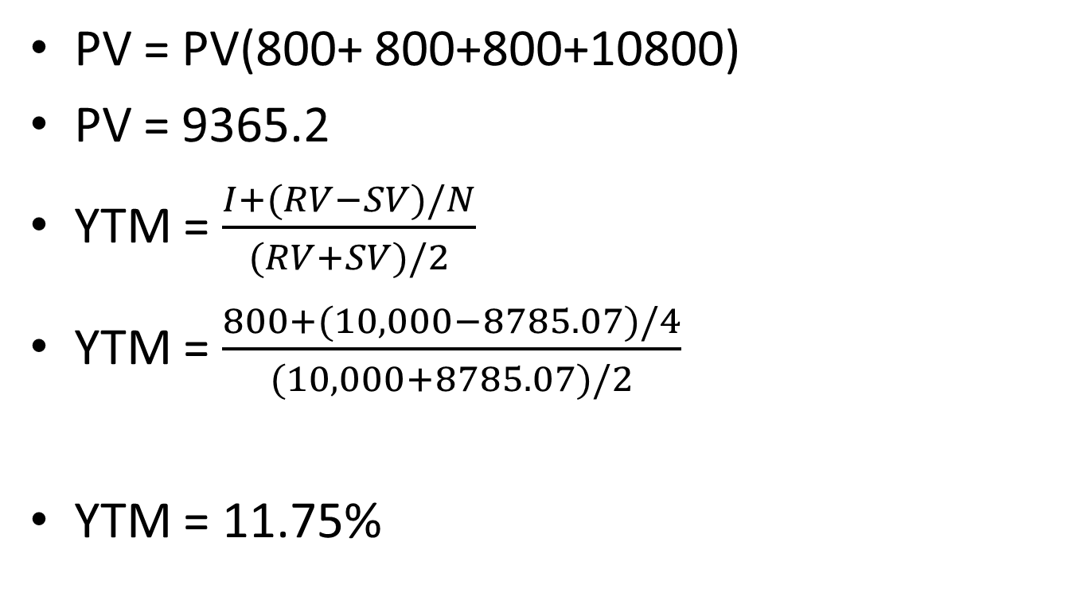
PV = PV(800+ 800+800+10800)
PV = 9365.2
YTM = $\frac{I+(RV−SV)/N}{(RV+SV)/2}$
YTM = $\frac{800+(10,000−8785.07)/4}{(10,000+8785.07)/2}$
YTM = 11.75%

Slide 46
Practice problem
A Company issued 12% bond with 3 years maturity. Bond is redeemable at par at Rs.1000. what would be the value of the bond assuming interest is payable (i) annually (semi-annually. Required rate of return is 14%.

Slide 47
PV= 120(PVAF@14%,3) + 1000(PVIF@14%,3)
PV = 953.52
PV = 60(PVAF@7%,6) + 1000(PVIF@14%,3)
PV = 60(4.767) + 1000(.675)
PV = 286.02+675 = 961.02

Slide 48
Following information is available in respect of a bond: Face value Rs. 1000, Coupon rate; 8%, time to maturity; 10 years, market price = 1140, callable in 6 years at Rs 1100.
Find out YTM & YTC of the bond.
Notes:
YTM = 6.16%, YTC = 6.54%

Slide 49
NPV(6%) = 80*PVAF@6%, 10(A4) + 1000*PVIF@6%,10(A3) = 1146.8-1140
NPV = 6.8
NPV(7%) = 80*PVAF@7%, 10(A4) + 1000*PVIF@7%,10(A3) = 1069.92-1140
NPV(7%) = -70.08
YTM = r +[ NPVr/(NPVrL – NPVrH)] *Δr
YTM = 6% +[ 6.8/(6.8 + 70.08)] *1= 6.09%
Notes:
YTC = 6.52%

Slide 50
Test Questions
Mr. X makes an investment at Rs. 25. The year end price of this investment under different market conditions with probabilities is given below:
i) Find out the expected value of return for one year period and risk of the return.
Ii) Calculate inflation adjusted return if rate of inflation during the tear is 7%.
Iii) also calculate Coefficient of Variation

Slide 51
Conditions | Probabilities | Year end Price(Rs)
Bullish | 30% | 40
Normal | 30% | 30
Bearish | 40% | 20

Slide 52
Mr. Z is considering a purchase of a bond issue by ITC Ltd. which is currently quoting at Rs. 900. The bond has a face value of Rs. 1,000. It carries coupon rate of 12% and has 5 yeas to maturity. Currently, the interest income is subject to 30% rate of tax and capital gain is subject to 10% rate of tax. Advise, if the bond is worth buying for Mr. Z given that his required yield is 18%. Also, calculate the loss of return due to imposition of tax.

Slide 53
OBE -2020
FV = 1000
N = 8 @ 20%
RV = 1200
CR = 10% For 3 years; 9% for 3years; 11 for next 2 years
YTM =11%

Slide 54
Year |  | PVIF@11% | PV
1 | 100
2 | 100
3 | 100
4 | 90
5 | 90
6 | 90
7 | 110
8 | 110+1200

