Slide 1
Fundamentals of Investment
Dr. Saloni Gupta

Slide 2
I lakh
F.D. @8.5%
TAX FREE BONDS@8%
Equity share now at 110(year end 120). Rs 1 divened per share.
30% tax bracket

Slide 3
1) 8.5% of 1,00,000 = 8,500(1-.30) = 5,950
2) 8% of 1,00,000 = 8000
3) 1,00,000/110 = 909.909
Return = (120 -110)+ 1= 11 *909.09 = 9,999.99
9,999,99(1-.3) = 6999.99.
Return = (7)*909.09 +1*909.09 = 7272.72

Slide 4
Syllabus
Unit 1: (a)The Investment(b) Risk &Return
Unit 2: Fixed Income Securities
Unit 3: Equity Analysis
Unit 4: (a) Portfolio Analysis (b) Financial Derivatives, Mutual funds
Unit 5: Investor Protection: SEBI

Slide 5
Books
Security analysis and portfolio Management by Fischer & Jorden
Fundamentals of Investment by
Y.P.Singh
Veenita Tripathi
R.P. Rustagi

Slide 6
Test your memory &understanding
ABC Co. has just paid a dividend of Rs. 2 per share. In view of the rapid growth of the company, the dividend is expected to grow at 10%p.a. for next three years. After that the growth process will slow down and the dividend is expected to grow only at 8%p.a. infinitely. In view of the risk involved in the investment, a return of 20% is considered appropriate. What is the price an investor should be ready to pay for this share?

Slide 7

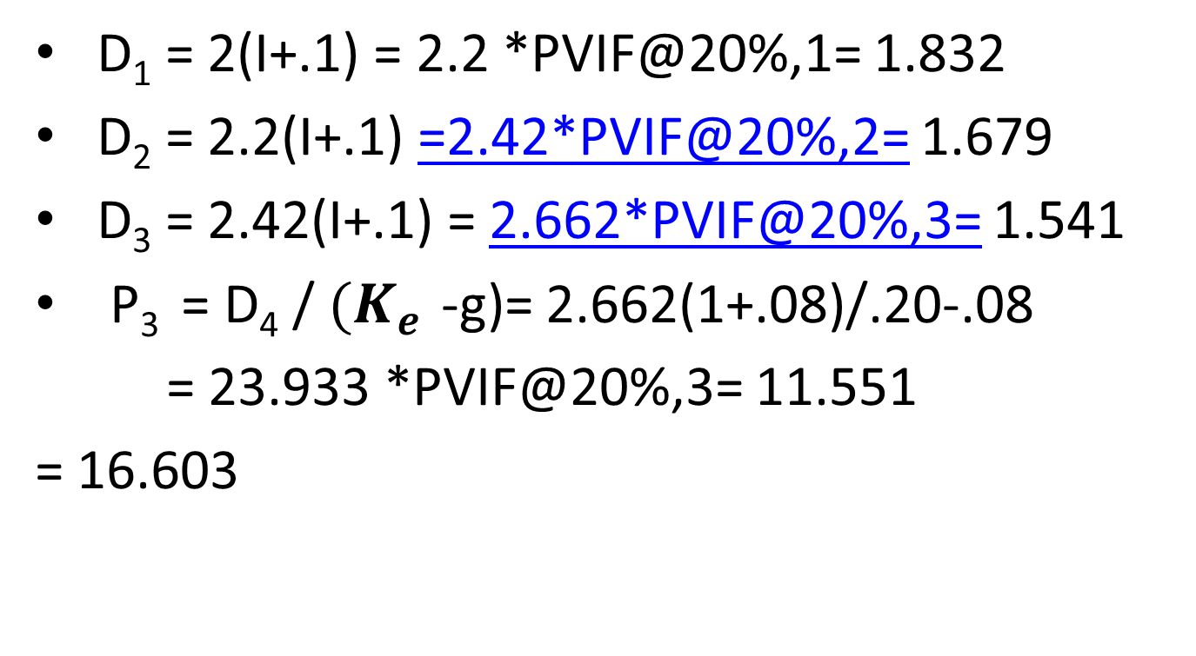
P₃ = D₄ / ${(K}_{e }$-g)
D₁ = 2(I+.1) = 2.2 *PVIF@20%,1= 1.832
D₂ = 2.2(I+.1) =2.42*PVIF@20%,2= 1.679
D₃ = 2.42(I+.1) = 2.662*PVIF@20%,3= 1.541
P₃ = D₄ / ${(K}_{e }$-g)= 2.662(1+.08)/.20-.08
= 23.933 *PVIF@20%,3= 11.551
= 16.603

Slide 8
UNIT -1
Basics of Investments
Security market Structure and Participants
Concept of Risk and Return

Slide 9
Basics of Investments
(chapter-1)
Meaning of investment
Types
Process
Objectives
How it is different from speculation &gambling
Impact of taxation &inflation

Slide 10







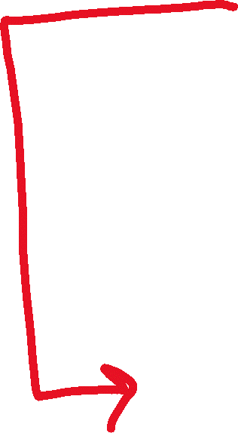

Investment
(Employment of fund to earn return)
Growth of an economy
Capital formation
Investment by household
Savings
Return & Risk
Notes:
Investment is a function of savings.

Slide 11
Types of investment
Financial investments: financial assets
Economic investments: capital assets
Financial investments:
A) financial assets : financial instruments
B) Real estate
C) Commodity assets
d) Cryptocurrency

Slide 12



Investment process
Framing an Investment policy: Amount and
its objective: regular income & capital appreciation
Required rate of return &acceptable level of risk
Analysis of Economy, Industry and Company
(E-I-C): GDP, Inflation, rate of interest
Valuation of securities: current market price Vs intrinsic value
Portfolio construction:
Portfolio appraisal and revision:

Slide 13
financial assets
Are financial CLAIMS
Features:
Monetary value
Divisibility
Convertibility
Reversibility
Liquidity

Slide 14
Real estate:
(a) income properties (b)speculative properties
(i) location of the property(ii)physical properties
(iii)valuation of the property(iv)legal right of the property (v) Timing of deal
Commodity investment:
NCDEX: National Commodity & Derivatives Exchange Limited- 34 commodities mainly agriculture produce &MCX-40 commodities online platform deals in precious metals, base metals and energy..........
FMC: Forward Market Commission- advisory and regulatory body for commodity market and future market

Slide 15
Cryptocurrency
Virtual currency
Only ledger entry and encrypted transaction
Used for Digital payments for fast money transfer
Miners handle the transaction
Highly volatile
Bit coin is just one of them: oldest
Bit coin’s today value= 31 lakh per coin
No regulatory body
Limited supply of Bitcoins: 21 million
Based on block-chain technology

Slide 16
Blockchain technology
Blockchain defined: Blockchain is a shared, immutable ledger that facilitates the process of recording transactions and tracking assets in a business network. An asset can be tangible (a house, car, cash, land) or intangible (intellectual property, patents, copyrights, branding). Virtually anything of value can be tracked and traded on a blockchain network, reducing risk and cutting costs for all involved.
Why blockchain is important: Business runs on information. The faster it’s received and the more accurate it is, the better. Blockchain is ideal for delivering that information because it provides immediate, shared and completely transparent information stored on an immutable ledger that can be accessed only by permissioned network members. A blockchain network can track orders, payments, accounts, production and much more. And because members share a single view of the truth, you can see all details of a transaction end to end, giving you greater confidence, as well as new efficiencies and opportunities.

Slide 17





Risk-return relationship

Slide 18
Objectives of investment
To earn Return
Hedge against inflation
Safety of principal
Reduce risk
Tax-benefits
liquidity

Slide 19
Investment Vs Speculation
TIME
RISK
RETURN
Source of Information
Funds used for investment
Expected return

Slide 20
Speculation Vs gambling
Research /analysis
Risk Vs uncertainty
Purpose

Slide 21
Security market Structure and Participants
(chapter-2)
Structure of the market
Participants
Instruments
Trading in security market
Types of orders
Settlement procedure
Indices
Margin trading

Slide 22
Return & Risk
Return:(a) capital appreciation(b)dividend Income
Capital appreciation: Capital yield
=(Maturity value- value at which investment is made)/ value at which investment is made
= 1,00,000-50,000/50,000 = 100%
=Today’s price –yesterday’s price/yesterday’s price
Capital yield(1) = P₁ – P₀ / P₀
Capital yield(2) = P₂ – P₁ / P₁
Capital yield(3) = P₃ – P₂ / P₂
Capital yield(4) = P₄ – P₃ / P₃
Dividend yield(1) = D₁ / P₀
Dividend yield(2) = D₂ / P₁

Slide 23
Total return
Total yield = capital yield + dividend yield
Total return = P₁ – P₀ / P₀ + D₁ / P₀
= (P₁ – P₀ ) + D₁ / P₀
₌ P₂ – P₁ / P₁ + D₂ / P₁
= (P₂ – P₁ ) + D₂ / P₁

Slide 24
Practice problem
(consider an investment of a share of Rs.100)
Year | Avg Market price | Dividend | Capital yield | Dividend yield | Total return
2015 | 112 | 5 | 112-100/100=.12 | 5/100=.05 | 17%
2016 | 120 | 9 | 120-112/112=.0714 | 9/112=.08 | 15.14%
2017 | 130 | 10 | 130-120/120=0.0833 | 10/120=0.083 | 16.66%
2018 | 116 | 5 | 116-130/130=(.107) | 5/130=0.038 | (6.9%)
2019 | 102 | 8 | 102-116/116=(.12) | 8/116=0.068 | (5.2%)

Slide 25









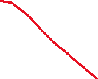




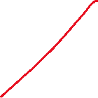


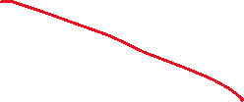




Slide 26












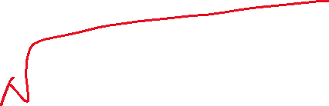







Notes:
Variance = 324.47, S.D= 18.0131%

Slide 27
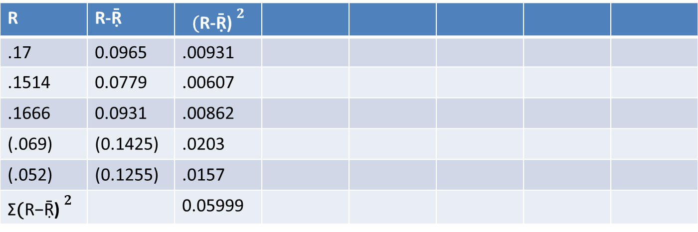
Average return
Average Return = R₁ + R₂ +R₃ +R₄ +R₅ /N
Ṝ = 7.35% =.0735
R | R-Ṝ | $${\text{(}\text{R}\text{−}\text{Ṝ}\text{)} }^{2}$$
.17 | 0.0965 | .00931
.1514 | 0.0779 | .00607
.1666 | 0.0931 | .00862
(.069) | (0.1425) | .0203
(.052) | (0.1255) | .0157
Σ${\text{(}\text{R}\text{−}\text{Ṝ}\text{)} }^{2}$ |  | 0.05999
Notes:
Variance = .05999/5 = .011998, S. D. = .1095 = 10.95%, If the rate of inflation is 3% the what will be the real rate of return?= .04223=4.223%

Slide 28
Expected return(P0=190)on 31/12/2021
Situations | Expected price31/12/2022) | probabilities | Capital yield | Expected dividend | Dividend yield | Total yield(R) | RiPi
1 | 220(P1) | 40%=.4(p1) | 220-190/190=.157 | 15(D1) | 15/190=.0789 | .2359(R1) | 0.09436
2 | 170(P1) | 10%=.1(p2) | 170-190/190=(.1052) | 0(D1) | 0 | (.1052)(R2) | (.01052)
3 | 200(P1) | 50%=.5(p3) | 200-190/190=.0526 | 10(D1) | 10/190=.0526 | .1052(R3) | .0526
E(R) |  |  |  |  |  |  | 0.1364=13.64%

Slide 29
Expected return
E (R)= ΣR_{i} P_{i}
E (R)= R₁ P₁ + R₂ P₂ + R₃ P₃ + R₄ P₄
_{Where 1,2,3……..are situations}

Slide 30
Impact of inflation& Taxation
What is the impact of inflation on return from a security? If nominal rate of return on an investment is 12% and inflation rate is 8%, find real (inflation-adjusted) rate of return.
(1 +K) =(1 +R)/(1+I), R is nominal rate of return
K = (R+1)/(1+I)-1, K is real rate of return & I is rate of inflation
K = (1+.12)/(1+.08) -1 = .037 = 3.7%
Notes:
K = (1+.12)/(1+.08) – 1 = .037 = 3.7%

Slide 31
Purchasing power
Today you deposit 100 @10%p.a.
After one year the amount = 110
Suppose, today’s price of 1 kg sugar =100
Rate of inflation =5%
After one year the price of 1 kg sugar =105
Quantity of sugar one can purchase = 1.047kg
Net gain= 1.047 -1= .047 = 4.7%
K= (1+.10)/(1+.05) – 1 = 0.047 = 4.7%
Notes:
105………….1
1……………….1/105
110……………1/105*110 = 1.047

Slide 32
Taxation
Dividend = 12% (tax-free return)
Interest = 15%(taxable return @30%)
Net Return= .15 - .30*.15 = .105 = 10.5%
Tax free = taxable(1-t)= .15(1-.3) = 10.5%
Taxable return = tax-free/(1-t) = .12/(1-.3)=17.14%

Slide 33
Taxable(A) =13%, tax-free(B)=10%, @20%
Taxable interest income = 2000 @30%
Tax free interest income = 2000 - .30*2000
= 2000(1-t) = 2000(1-.3)= 1400
1400/(1-.3) = 2000
taxable return = .10/(1-.2) = 12.5%
or
Tax-free return = .13(1-.2) = 10.4%

Slide 34
Taxable return = Tax free return/(1-tax rate)
Tax free = 8%
Taxable =12% @ 20%
Taxable return = .08/(1-.20)= 10%
Tax- free = taxable(1-t) =.12(1-.2) = 9.6%

Slide 35
RISK
(deviation of actual return from expected return)
Factors causing risks:
(a)Systematic: Non-diversifiable risk
(i)Market price risk (ii)interest rate risk (iii)purchasing power risk
(b) Unsystematic Risk: diversifiable risk
(i) Business risk (ii) Financial risk

Slide 36
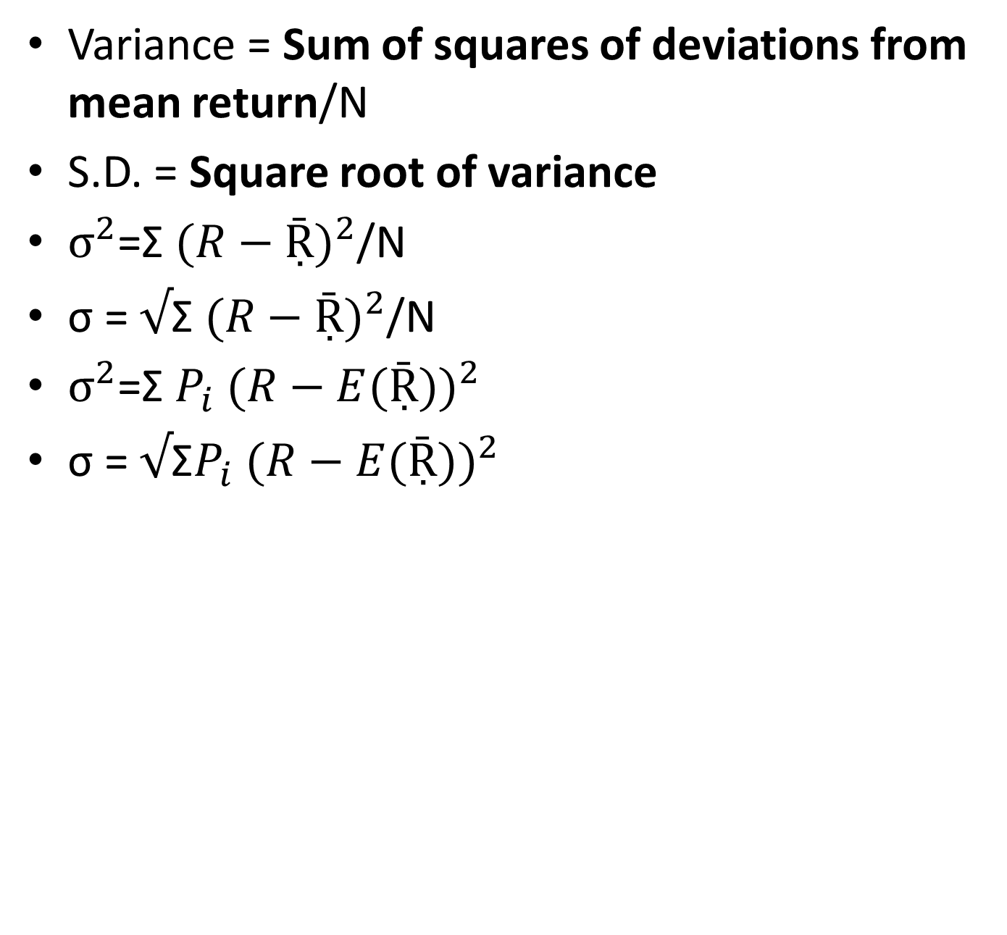
Measurement of risk
Variance = Sum of squares of deviations from mean return/N
S.D. = Square root of variance
$σ^{2}$=Σ ${(R−Ṝ)}^{2}$/N
σ = $√$Σ ${(R−Ṝ)}^{2}$/N
$σ^{2}$=Σ $P_{i}$ ${(R−E(Ṝ))}^{2}$
σ = $√$Σ$P_{i}$ ${(R−E(Ṝ))}^{2}$

Slide 37
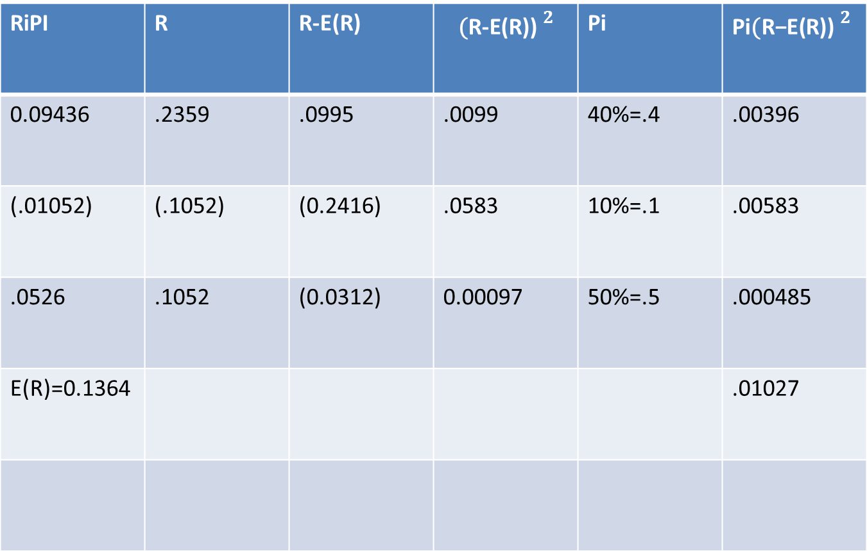
Continued from previous Q
RiPI | R | R-E(R) | $${\text{(}\text{R}\text{−}\text{E}\text{(}\text{R}\text{)}\text{)} }^{2}$$ | Pi | Pi${\text{(}\text{R}\text{−}\text{E}\text{(}\text{R}\text{)}\text{)} }^{2}$
0.09436 | .2359 | .0995 | .0099 | 40%=.4 | .00396
(.01052) | (.1052) | (0.2416) | .0583 | 10%=.1 | .00583
.0526 | .1052 | (0.0312) | 0.00097 | 50%=.5 | .000485
E(R)=0.1364 |  |  |  |  | .01027
Notes:
Variance = .01027, S. D. =.10134 =10.134%

Slide 38
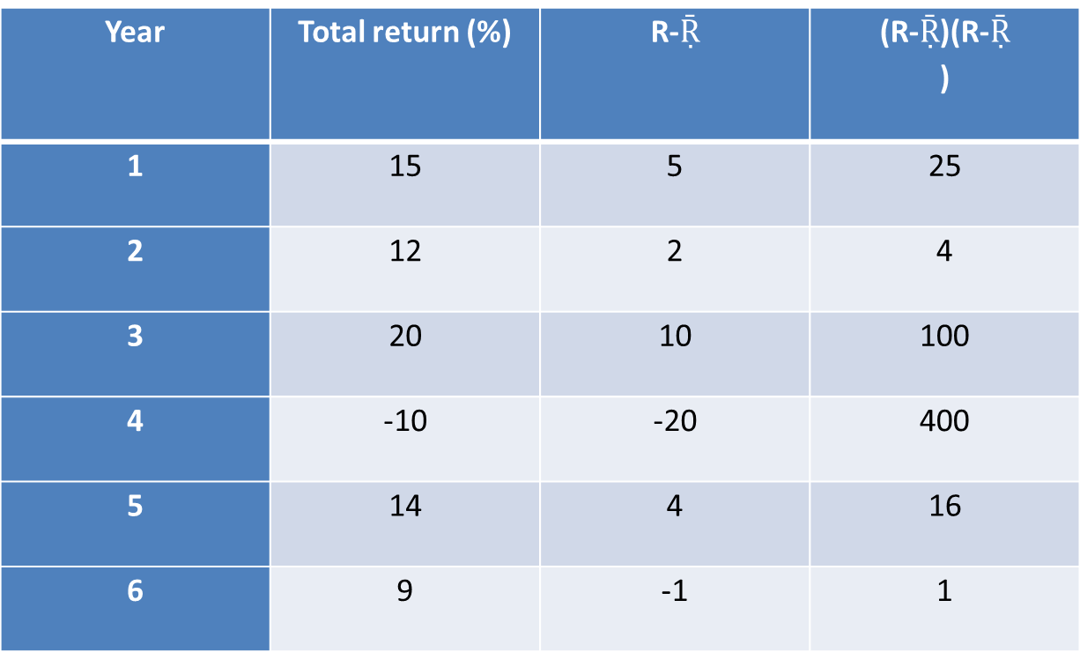
Six years ago, Raman purchased a share of Z Ltd. During the last six years, the share exhibited following return pattern: Find average return and risk on this share.
Year | Total return (%) | R-$Ṝ$ | (R-$Ṝ$)(R-$Ṝ$ )
1 | 15 | 5 | 25
2 | 12 | 2 | 4
3 | 20 | 10 | 100
4 | -10 | -20 | 400
5 | 14 | 4 | 16
6 | 9 | -1 | 1
Notes:
$Ṝ=15+12+20−10+14+$9 = 60/6 =10, SUM OF Squares of deviations =546, variance = 546/6=91, S. D= 9.539%

Slide 39
Calculate expected return and risk of the individual securities A and B. What will be the return if the total investment is allocated in the ratio of 2:3 between A and B respectively?
Situation | Probability | Security A(%) | Security B(%)
Situation 1 | .2 | 10 | 6
Situation 2 | .5 | 14 | 15
Situation 3 | .3 | 20 | 11

Slide 40
Security A
Situation | Probability | Security A(%) R | RiPi | R-E(R) | R-E(R) *R-E(R) | Pi[R-E(R) *R-E(R)]
Situation 1 | .2 | .10 | .02 | (.05) | .0025 | .0005
Situation 2 | .5 | .14 | .07 | (.01) | .0001 | .00005
Situation 3 | .3 | .20 | .06 | .05 | .0025 | .00075
E (R) |  |  | .15=15%
Notes:
Variance = .0013, S.D. = .0360=3.60%

Slide 41
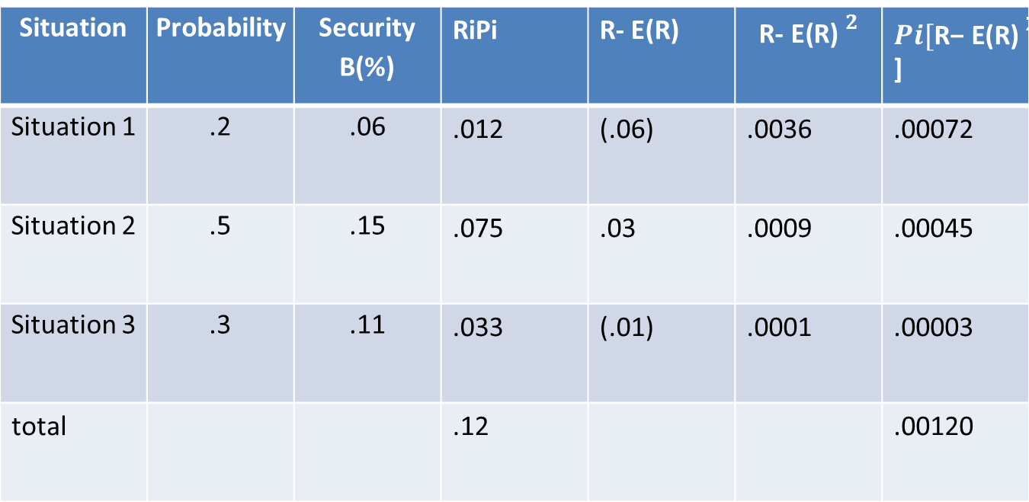
Security B
Situation | Probability | Security B(%) | RiPi | R- E(R) | $${\text{R}\text{− }\text{E}\text{(}\text{R}\text{) }}^{2}$$ | ${Pi[\text{R}\text{− }\text{E}\text{(}\text{R}\text{) }}^{2}$]
Situation 1 | .2 | .06 | .012 | (.06) | .0036 | .00072
Situation 2 | .5 | .15 | .075 | .03 | .0009 | .00045
Situation 3 | .3 | .11 | .033 | (.01) | .0001 | .00003
total |  |  | .12 |  |  | .00120
Notes:
E®= .12=12%, Variance = .00120, S.D. = .0346 = 3.46%

Slide 42

Portfolio return
$R_{P}$ = $R_{A}W_{A}+R_{B}W_{B}$
$R_{P}$ = (.15)(2/5) + (.12)(3/5)
$R_{P}$ = .132 = 13.20%

Slide 43
Mr. Sharma is a risk averse investor. He is considering two investment proposals. The probability distribution of returns on these two stocks in different market conditions is as follows:
State of Economy | Probability of occurrence | Rate of return (%)
 |  | X Ltd. | Y Ltd.
Boom | .3 | .40 | .12
Normal | .4 | .25 | .10
Depression | .3 | -.20 | .05
Notes:
Based on this information, calculate expected risk and return on both the proposals. Also suggest to Mr. Sharma, which investment proposal is better.

Slide 44
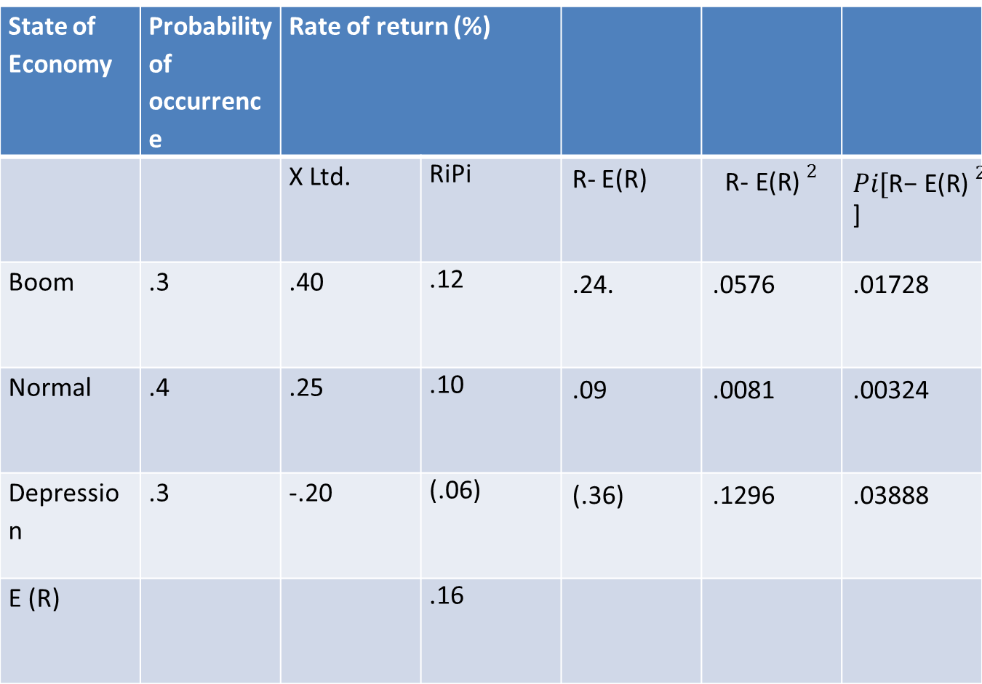
X Ltd
State of Economy | Probability of occurrence | Rate of return (%)
 |  | X Ltd. | RiPi | R- E(R) | $${\text{R}\text{− }\text{E}\text{(}\text{R}\text{) }}^{2}$$ | ${Pi[\text{R}\text{− }\text{E}\text{(}\text{R}\text{) }}^{2}$]
Boom | .3 | .40 | .12 | .24. | .0576 | .01728
Normal | .4 | .25 | .10 | .09 | .0081 | .00324
Depression | .3 | -.20 | (.06) | (.36) | .1296 | .03888
E (R) |  |  | .16
Notes:
E® =.16 =16%, Variance = .0594, S.D = .244 = 24.4%

Slide 45
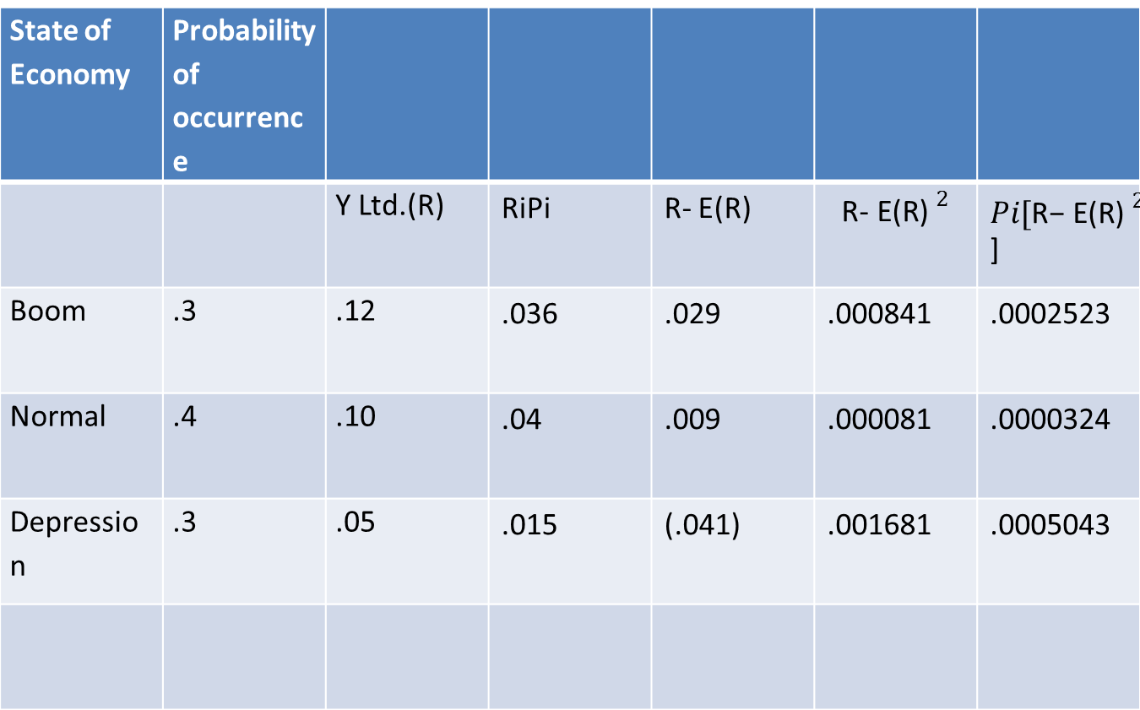
Y Ltd
State of Economy | Probability of occurrence
 |  | Y Ltd.(R) | RiPi | R- E(R) | $${\text{R}\text{− }\text{E}\text{(}\text{R}\text{) }}^{2}$$ | ${Pi[\text{R}\text{− }\text{E}\text{(}\text{R}\text{) }}^{2}$]
Boom | .3 | .12 | .036 | .029 | .000841 | .0002523
Normal | .4 | .10 | .04 | .009 | .000081 | .0000324
Depression | .3 | .05 | .015 | (.041) | .001681 | .0005043
Notes:
E (R)=.091=9.1%, Variance = .000789, S.D. = .0280 = 2.8%

Slide 46
X Ltd = 16%, 24.4%
Y Ltd = 9.1%, 2.8%
Situation 1 = return equal with less risk
Situation 2 = risk equal with more return
Situation 3 = return more with less risk

Slide 47
Coefficient of Variation: Risk
C.V. = (S.D./Expected return)*100
C.V.(X) = (.244/.16)*100 =152.50%
C.V.(Y) = (.0280/.091)*100 = 30.769%

Slide 48
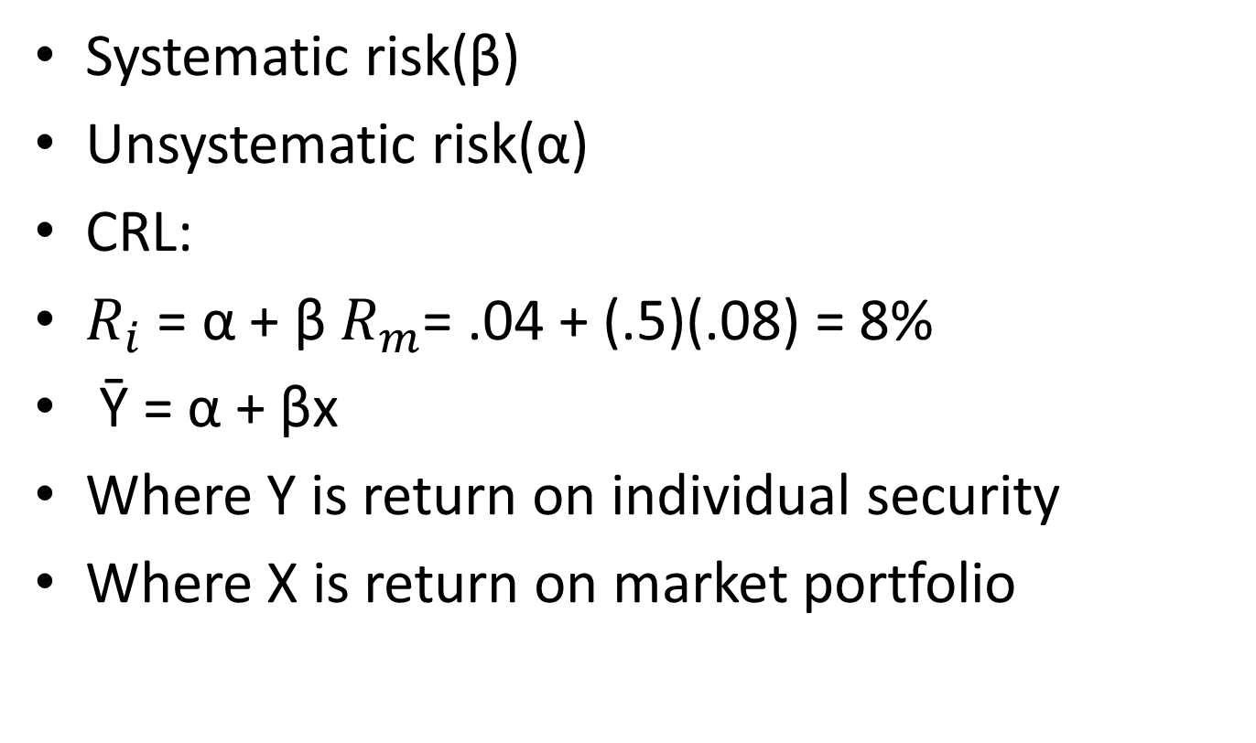
Bifurcation of risk
Systematic risk(β)
Unsystematic risk(α)
CRL:
$R_{i}$ = α + β $R_{m}$= .04 + (.5)(.08) = 8%
Ῡ = α + βx
Where Y is return on individual security
Where X is return on market portfolio

Slide 49



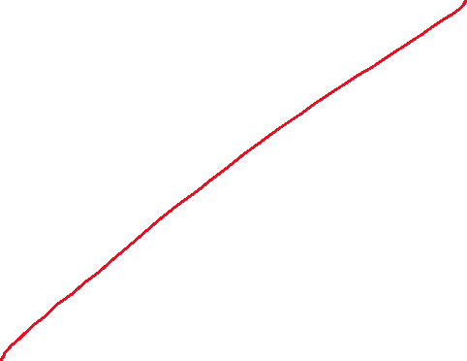


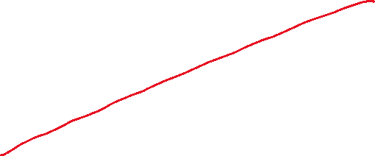




α= Ῡ -βx
Return on stock
return on market index

Slide 50
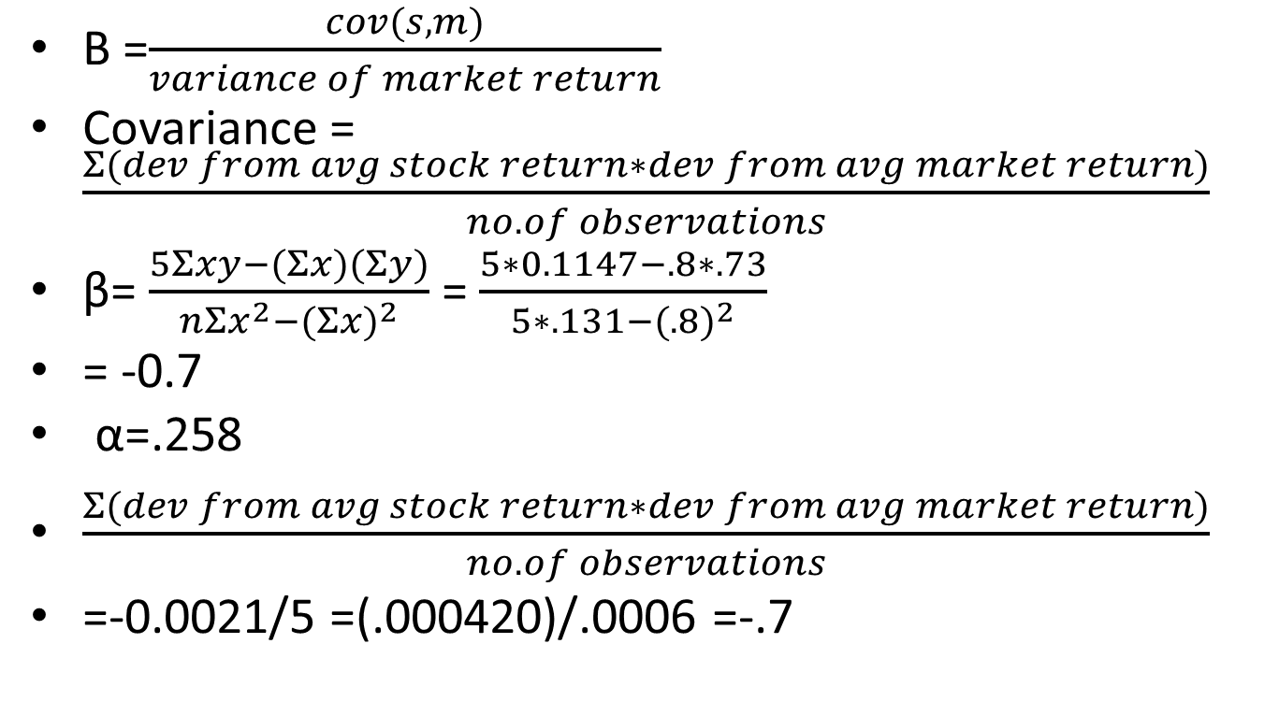

β= $\frac{nΣxy−(Σx)(Σy)}{nΣx^{2}−{(Σx)}^{2}}$
Β =$\frac{cov(s,m)}{variance of market return}$
Covariance = $\frac{Σ(dev from avg stock return∗dev from avg market return)}{no. of observations}$
β= $\frac{5Σxy−(Σx)(Σy)}{nΣx^{2}−{(Σx)}^{2}}$ = $\frac{5∗0.1147−.8∗.73}{5∗.131−{(.8)}^{2}}$
= -0.7
α=.258
$\frac{Σ(dev from avg stock return∗dev from avg market return)}{no. of observations}$
=-0.0021/5 =(.000420)/.0006 =-.7

Slide 51
Period | Ret on stock(%)(Y) | Ret on mkt(%)(X) | Y-mean | X-mean | devX*devY | devX*devX
1 | .10 | .15 | (.046) | (.01) | .00046 | .0001
2 | .18 | .12 | .034 | (.04) | (.00136) | .0016
3 | .14 | .18 | (.006) | .02 | (.00012) | .0004
4 | .20 | .16 | .054 | 0 | 0 | 0
5 | .11 | .19 | (.036) | .03 | (.00108) | .0009
 | .146 | .16 |  |  | (.0021) | .003
Notes:
Avg stock return = 14.6%, Avg market return =16%, Covariance(s,m) = (.0021)/5 =(.00042), variance(X) = .003/5 = .0006, β =(.7)

