Slide 1
Working capital management
Stock / Inventory Management
Cash Management
Receivable Management
Payable Management

Slide 2
Working capital management
Meaning of W.C: (a) Gross w.c. (b) Net w.c.
Part of CA which are financed through LTL is your W.C.
Management of W.C : (a) amount of current assets (b) fianancing of C.A
Risk-return trade-off :
(a) amount of current assets
(b) fianancing of C.A ……LTL …… COST will be high/return will be low…….low risk
………..STL ……..COST will be low/ return will be high ……risk is also high(insolvency)

Slide 3
Balance -sheet
LTL 55 L LTA 50 L
STL 10 L STA 1 5 L

Slide 4
Why does it matter (importance): balancing act of Profitability Vs Liquidity
Concept of W.C.
A) Balance sheet concept
B) Operating cycle concept
Determinants of working capital requirement

Slide 5
OPERATING CYCLE CONCEPT
Operating cycle’ refers to a cyclic flow of vital activities through which a business entity carries out its operations and converts its cash, back to cash, by having the intervening conversions of
a) cash into inventories
b) inventories into (credit) sales
c) sales into cash

Slide 6
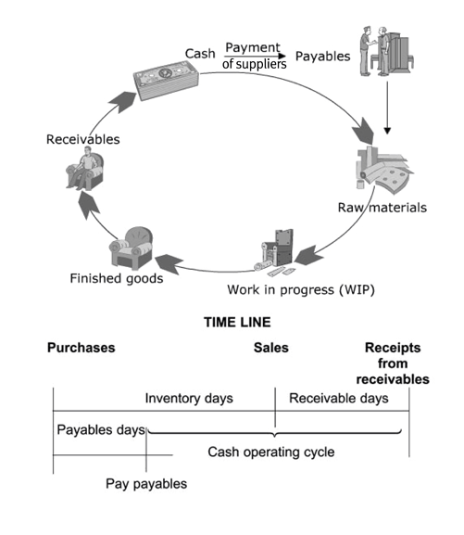
OPERATING CYCLE

Slide 7
Lags in operating cycle
operating cycle of any organisation has 3 lags or ‘waiting periods’. These three lags are:-
1) ‘Work-in-Progress Days’ or Conversion lag, where having paid the cash (in advance) to the supplier, goods are either yet to arrive or have arrived but are yet to be in ‘Ready to sell’ condition. inventories of raw material or work in progress.
2) ‘Inventory Days’ or Sales lag, wherein though goods in ‘Ready to Sell’ condition are available, but there are no ready buyer. operating cycle.
3) ‘Receivable Days’ or Collection lag, wherein though the credit sales have taken place, the cash has not yet been collected.

Slide 8
Measurement of O.C.

Slide 9
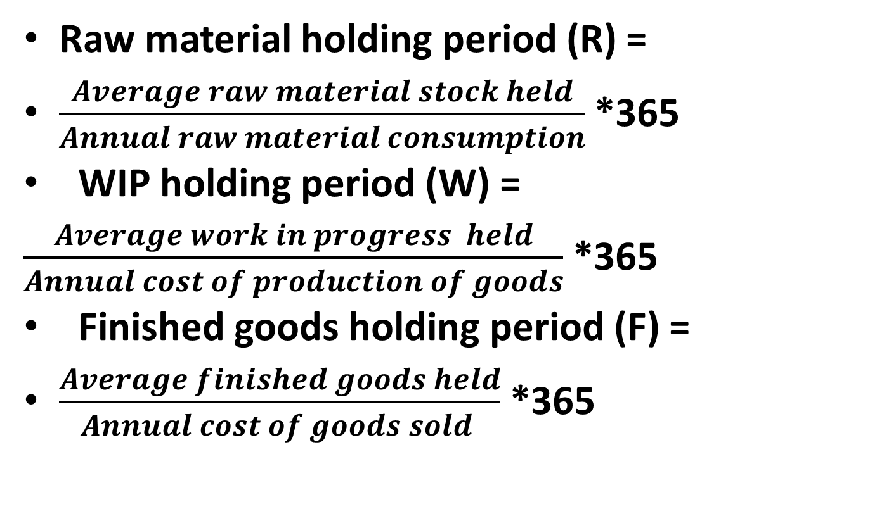
Raw material holding period (R) =
$\frac{Average raw material stock held}{Annual raw material consumption}$ *365
WIP holding period (W) =
$\frac{Average work in progress held}{Annual cost of production of goods}$ *365
Finished goods holding period (F) =
$\frac{Average finished goods held}{Annual cost of goods sold }$ *365

Slide 10
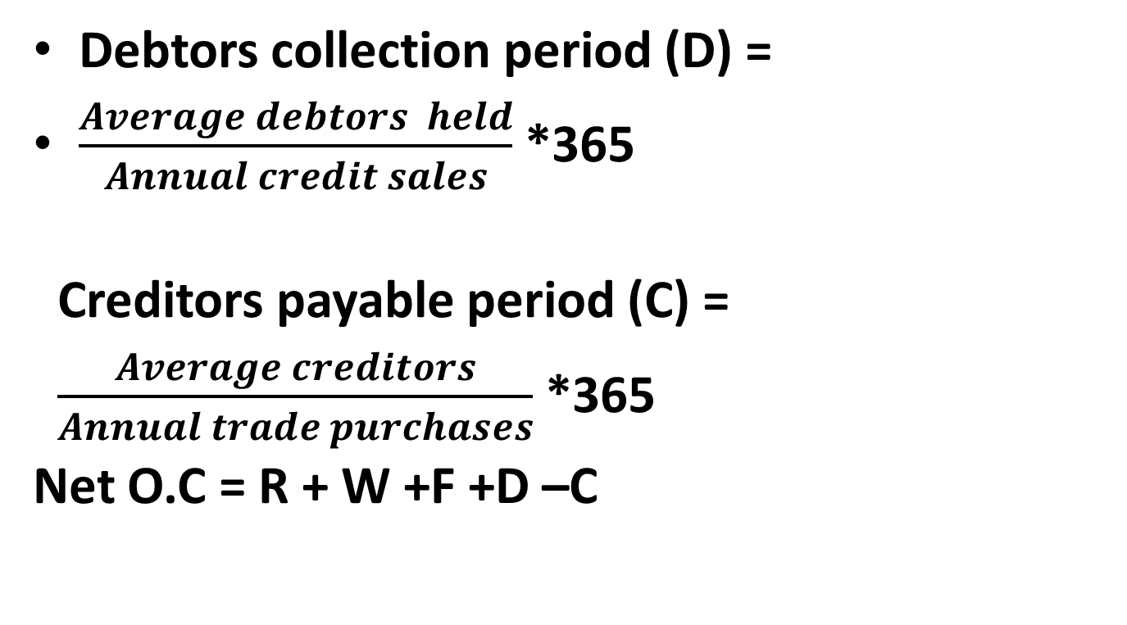
Debtors collection period (D) =
$\frac{Average debtors held}{Annual credit sales}$ *365
Creditors payable period (C) =
$\frac{Average creditors}{Annual trade purchases}$ *365
Net O.C = R + W +F +D –C

Slide 11
Problem
Calculate the O.C. of a company which gives the following details relating to its operations:
Annual raw material consumption 8,42,000
Annual cost of production 14,25,000
Annual cost of sales 15,30,000
Annual sales 19,50,000
Average value of current assets held:
Raw materials 1,24,000
W-I-P 72,000
Finished goods 1,22,000
Debtors 2,60,000
The company gets 30 days credit from its suppliers. All sales made by firm are on credit basis. You may take one year as equal to 365 days.

Slide 12
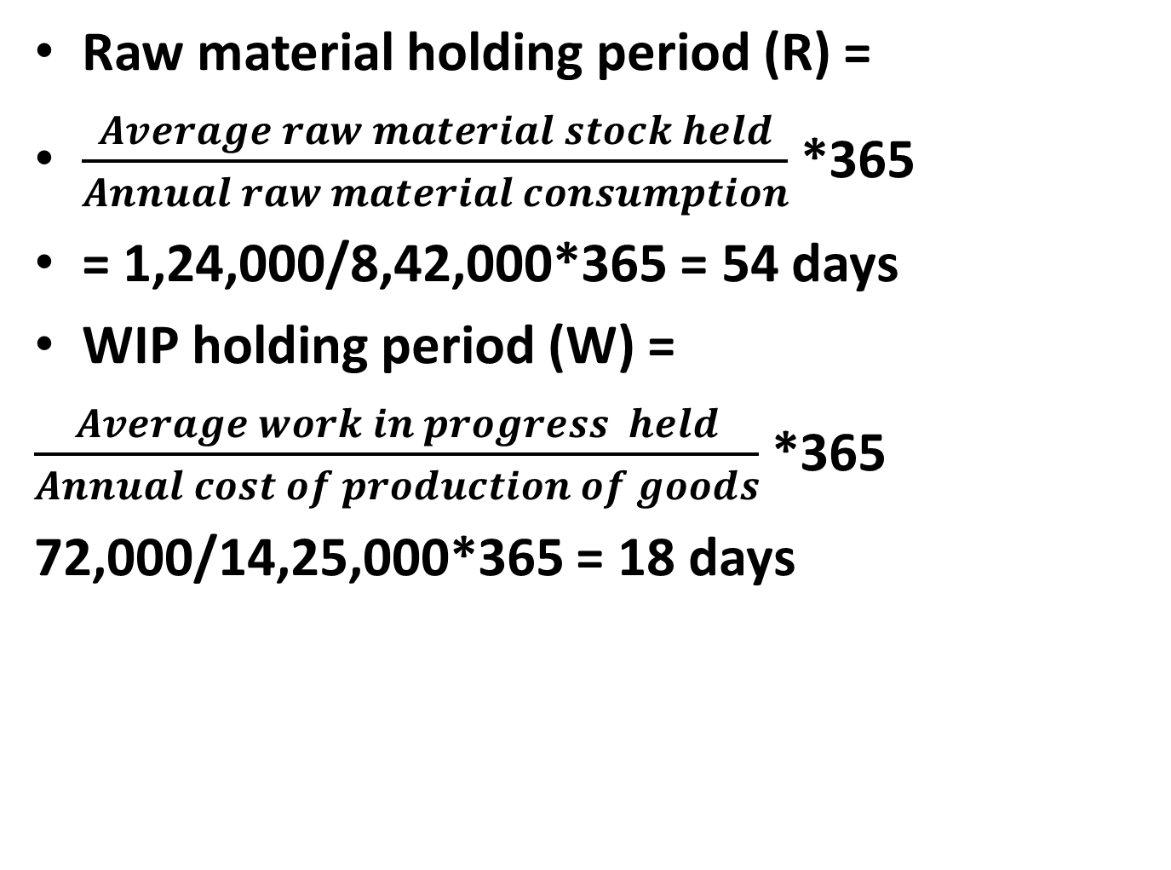
Raw material holding period (R) =
$\frac{Average raw material stock held}{Annual raw material consumption}$ *365
= 1,24,000/8,42,000*365 = 54 days
WIP holding period (W) =
$\frac{Average work in progress held}{Annual cost of production of goods}$ *365
72,000/14,25,000*365 = 18 days

Slide 13
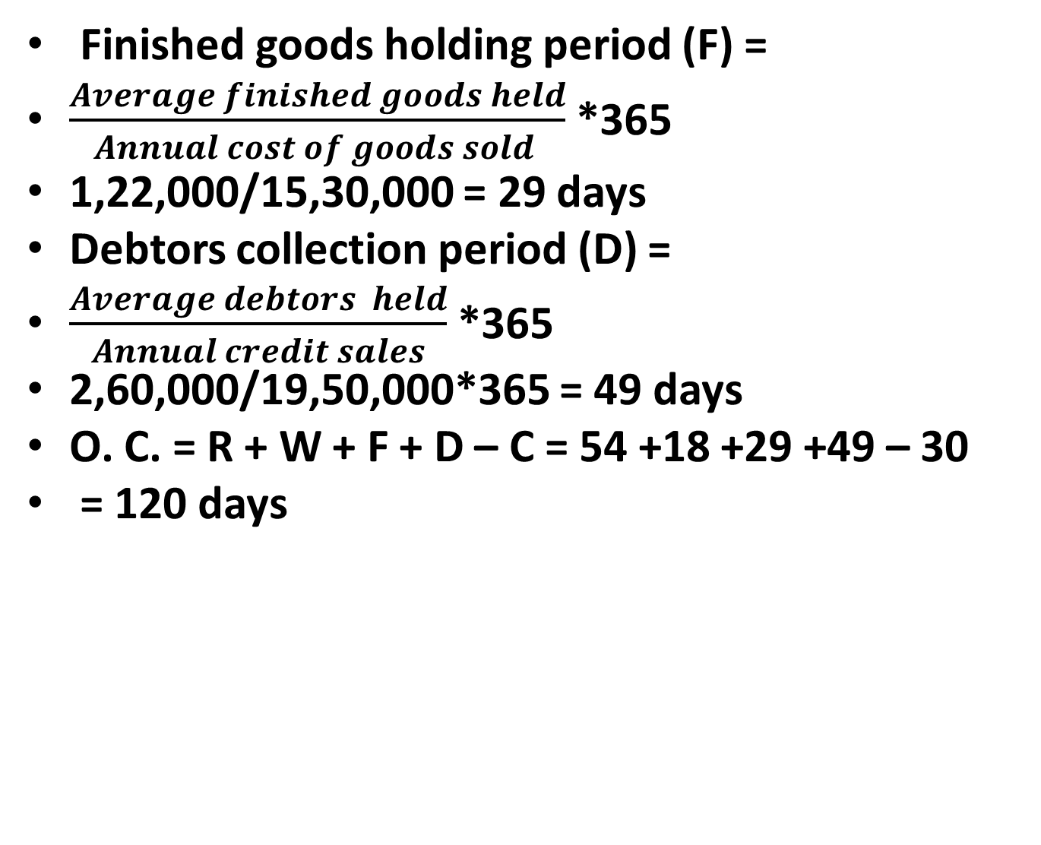
Finished goods holding period (F) =
$\frac{Average finished goods held}{Annual cost of goods sold }$ *365
1,22,000/15,30,000 = 29 days
Debtors collection period (D) =
$\frac{Average debtors held}{Annual credit sales}$ *365
2,60,000/19,50,000*365 = 49 days
O. C. = R + W + F + D – C = 54 +18 +29 +49 – 30
= 120 days

Slide 14
Estimation of W.C.
A Company provides you the following facts. Estimate the net working capital requirement for the project:
Estimated cost per unit of production:
Raw material 80
Direct labour 30
Overheads(including dep Rs 10 p.u.) 70 Total cost 180

Slide 15
Additional information:
(i) selling price: Rs 200 per unit
(ii) Level of activity : 1,56,000 units of production per annum.
(iii) Raw material in stock : 4 weeks
(iv) W-I-P (assume 50% completion stage in respect of conversion costs and 100 completion in respect of material: 2 weeks
(v) Finished goods in stock : average 4 weeks
(vi) Credit allowed by suppliers : average 4 weeks
(vii) credit allowed to debtors : average 8 weeks
(viii)Lag in payment of wages : average 1.5 weeks
(ix) Cash at bank is expected to be Rs 25,000.
You may assume that production is carried on evenly during the year. All sales are on credit basis. Add 10% to your computed figure to allow for contigencies.

Slide 16
Solution
CURRENT ASSETS:
(i) Raw material : (1,56,000*80*4/52) 9,60,000
(ii) W-I-P:RM (1,56,000*80*2/52) 4,80,000
:Lab(1,56,000*30/2*2/52) 90,000
: O.H(1,56,000*60/2*2/52) 1,80,000
(iii)Finished goods(1,56,000*170*4/52) 20,40,000
(iv) Debtors: (1,56,000*170*8/52) 40,80,000
(v) Cash 25,000
Gross working capital 8,55,7000
CURRENT LIABILITIES:
(i) Creditors: (1,56,000*80*4/52) 9,60,000
(ii) Wages: (1,56,000*30*1.5/52) 1,35,000
Total current liab 10,95,000
Net working capital 67,60,000
Add :10% contigencies 6,76,000
Net w.c. requirement 74,36,000

Slide 17
Practice problem
The data for ABC Ltd is as under:
Production for the year: 69,000units
Finished goods inventory: 3 months
Raw material inventory: 2 months
Production process: 1 month
Credit allowed by creditors: 2 months
Credit given to debtors: 3 months
Selling price per unit: Rs. 50 each
Raw material: 50% of selling price
Direct wages: 10% of selling price
Overheads: 20% of selling price

Slide 18
Additional information:
There is a regular production and sales cycle, and wages and overheads accrue evenly. Wages are paid in the next month of accrual. Material is introduced in the beginning of production cycle. W-I-P involves use of full unit of raw materials in the beginning of manufacturing process and other conversion costs equivalent to 50%.
You are required to find out working capital requirement of ABC Ltd

Slide 19
Solution
CURRENT ASSETS:
(i) Raw material : (69,000*25*2/12) 2,87,500
(ii) W-I-P:RM (69,000*25*1/12) 1,43,750
:Lab(69,000*5/2*1/12) 14,375
: O.H(69,000*10/2*1/12) 28,750
(iii)Finished goods(69,000*40*3/12) 6,90,000
(iv) Debtors: (69,000*40*3/12) 6,90,000
Gross working capital 18,54,375
CURRENT LIABILITIES:
(i) Creditors: (69,000*25*2/12) 2,87,500
(ii) Wages: (69,000*5*1/12) 28,750
Total current liab 3,16,250
Net working capital (CA-CL) 15,38,125

