Slide 1
Cash Management

Slide 2
Cash management
Motives :
(i)Transaction motive:
(ii)Precautionary motive:
(iii)Speculative motive:
(iv)Compensation motive: Commercial banks; compensating balance
Liquidity Vs Profitability
Float management
Models : Baumol model & Miller –Orr

Slide 3
(A cash budget is a financial plan)
)
A Ltd. has given the following information for the four quarter of the year 2012-13, as anticipated as on 31st March 2012.(Rs. in '000)
 | Q_{­1} | Q₂ | Q₃ | Q₄
Sales | 7,500 | 10,500 | 18,000 | 10,500
Production cost | 7,000 | 10,000 | 8,000 | 8,500
Selling & distribution costs | 1,000 | 2,000 | 2,900 | 1,600
Purchase of Assets | 100 | 1,100 | 2,100 | 2,100
Notes:
75,00,000: 50,00,000 & 25,00,000: q2 -1,05,00,000: 70,00,000&35,00,000:Q3- 1,80,00,000: 1,20,00,000& 60,00,000

Slide 4
Opening Cash (Rs) : 6,50,000
Opening Debtors (Rs) : 30,00,000
Debtors at the end of each quarter are one-third of the sales of that quarter.
The company wants that a cash balance of Rs. 5,00,000 must be kept at all times to meet the precautionary and speculative requirements.
Borrowings can be made in the multiples of Rs.10,000 at the beginning of any quarter and borrowings once made can only be returned at quarter end.
Required: Prepare a cash budget for the year 2012-13 and state the amount of loan outstanding as on 31/03/13.

Slide 5
Cash-budget for year 2012-13
 | Q1 | Q2 | Q3 | Q4
Opening balance | 6,50,000 | 5,50,000 | 5,00,000 | 5,00,000
Receipts:
Cash sales | 50,00,000 | 70,00,000 | 1,20,00,000 | 70,00,000
Collection from debtors | 30,00,000 | 25,00,000 | 35,00,000 | 60,00,000
loan |  | 35,50,000
Payments:
Production cost | 70,00,000 | 1,00,00,000 | 80,00,000 | 85,00,000
S &D COST | 10,00,000 | 20,00,000 | 29,00,000 | 16,00,000
Purchase of assets | 1,00,000 | 11,00,000 | 21,00,000 | 21,00,000
Payment of loan |  |  | 25,00,000 | 8,00,000
Closing balance | 5,50,000 | 5,00,000 | 5,00,000 | 5,00,000
Notes:
Balnce loan amount =10,50,000 – 8,00,000 =2,50,000;;;;;(30,50,000)

Slide 6
The following sales forecasts for the first five months of the next financial year of Max and Associates are available:
MONTHS Rs
April 40,000
May 45,000
June 55,000
July 60,000
August 50,000

Slide 7
Other data are as follows:
(i) debtors and creditors’ balances at the beginning of the year are Rs 30,000 and 14,000 respectively. The balances of other relevant assets and liabilities are:
Cash balance 7,500
Stock 51,000
Accrued sales commission 3,500
(ii)40% sales are on cash basis. Credit sales are collected in the month following sale.
(iii) cost of sales is 60% of sales
(iv) the only other variable cost is a 5% commission to sales agent. The sales commission is paid in the month after it is accrued.
(v) inventory/stock is kept equal to two months’ budgeted sales.
(vi)trade creditors are paid in the following month after purchases
(vii) fixed costs are 5,000 per month, including 2,000 depreciation.
Prepare a cash budget for the first three months of next financial year.

Slide 8
 | April | May | June
Opening balance | 7,500 | 33,000 | 37,000
Receipts:
Cash sales | 16,000 | 18,000 | 22,000
Collection from debtors | 30,000 | 24,000 | 27,000
Total | 46,000 | 42,000 | 49,000
Payments:
Fixed costs | 3000 | 3000 | 3000
Sales commission | 3,500 | 2000 | 2250
Payment to creditors | 14,000 | 33,000 | 36,000
Total payments | 20,500 | 38,000 | 41,250
Surplus/deficiency | 33,000 | 37,000 | 44,750
Notes:
Opening stock + purchases – cost of sales = closing stock; 51,000 +x – 24,000 = 60,000; x=33000 ; 60,000 +x – 27,000 = 69,000

Slide 9
Inventory Management
Baumol model
ABC Analysis
A firm purchases 2000 units of a particular item per year at a unit cost of Rs. 20. the ordering cost is Rs 50 per order and inventory carrying cost is 25%.
(i)Determine the optimal order quantity and minimum total cost including purchase cost.
(ii)if a 3% discount is offered by the supplier for purchases in a lot of 1000 or more, should the firm accept the offer?

Slide 11
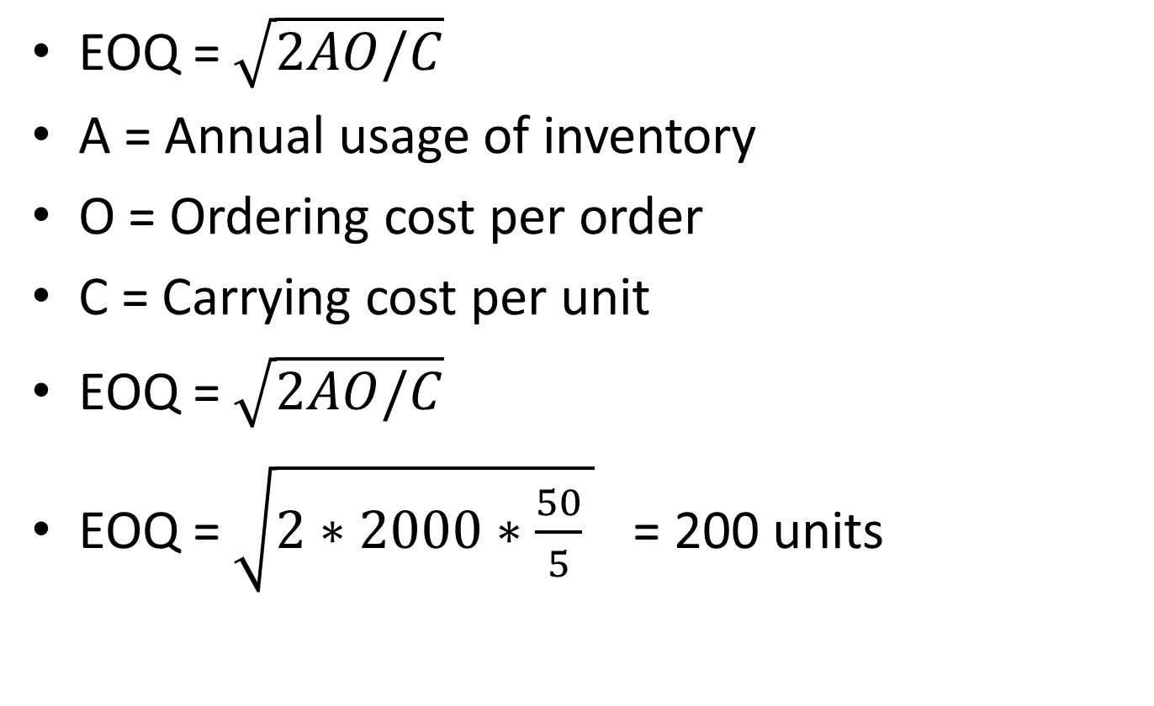
Solution
EOQ = $\sqrt{2AO/C}$
A = Annual usage of inventory
O = Ordering cost per order
C = Carrying cost per unit
EOQ = $\sqrt{2AO/C}$
EOQ = $\sqrt{2∗2000∗\frac{50}{5} }$ = 200 units

Slide 12
comparison
EOQ Offer
(200 units) (1000units)
No. of orders 10 2
Ordering cost(p.a) 500 100
Avg. inventory 100 500
Inventory cost(p.u) 5 4.85
Carrying cost(p.a.) 500 2425
Purchase price(p.u) 20 19.4
Purchase cost(p.a.) 40,000 38,800
Total cost(2000) 41000 41325
Notes:
Average inventory = order size/2; carrying cost per unit = purchase price = 19.4 *.25 = 4.85

Slide 13
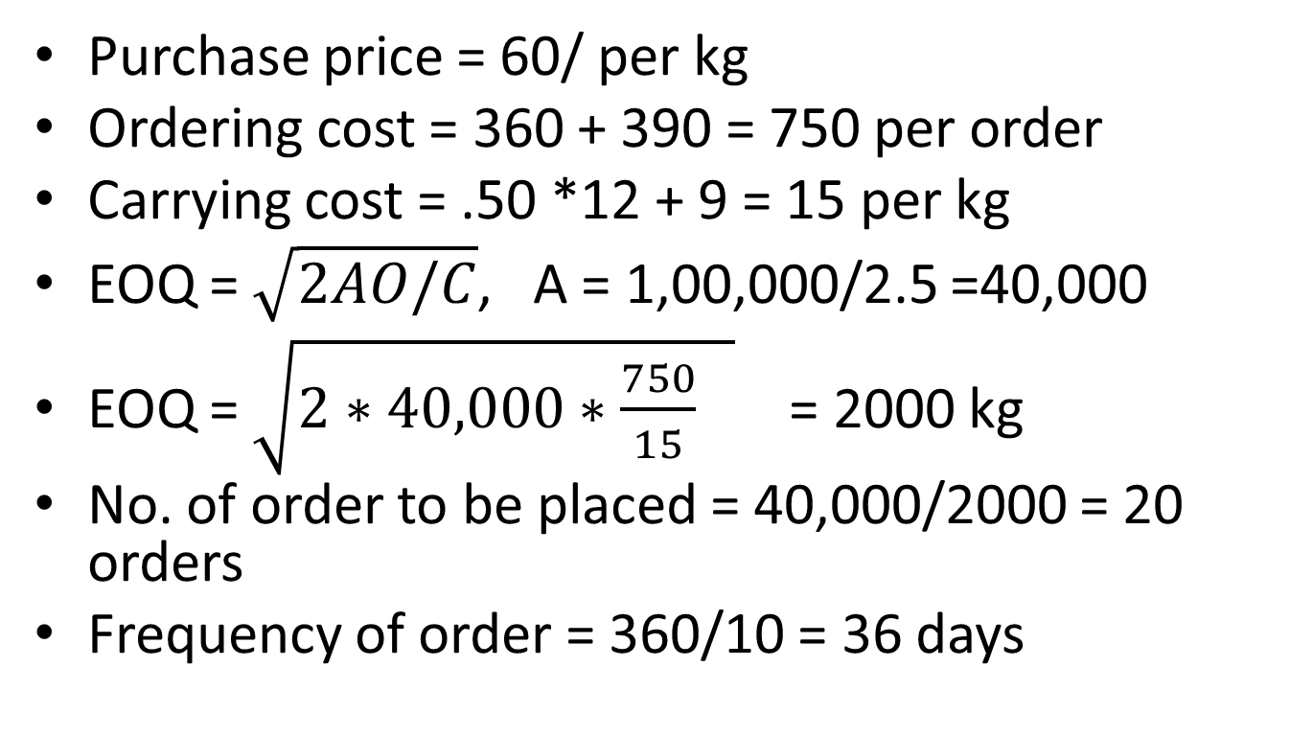
Solution
Purchase price = 60/ per kg
Ordering cost = 360 + 390 = 750 per order
Carrying cost = .50 *12 + 9 = 15 per kg
EOQ = $\sqrt{2AO/C}$, A = 1,00,000/2.5 =40,000
EOQ = $\sqrt{2∗40,000∗\frac{750}{15} }$ = 2000 kg
No. of order to be placed = 40,000/2000 = 20 orders
Frequency of order = 360/10 = 36 days
Notes:
2 5 unit …………1kg; 1 unit……….1kg/2.5: 1,00,000……………1/2.5*1,00,000

Slide 14
Comparison
EOQ Offer
(2000 Kg) (10,000Kg)
No. of orders 20 4
Ordering cost 750/ 750/
Ordering cost(p.a) 15,000 3000
Avg. inventory 1000kg 5000
Inventory cost(p.u) 15/ 15/
Carrying cost(p.a.) 15,000 75,000
Purchase price(p.u) 60/ 58.8
Purchase cost(p.a.) 24,00,000 23,52,00
Total cost(2000) 24,30,000 24,30,000
Notes:
% of discount = 60-58.8/60*100 = 2%

