Slide 1
DIVIDEND DECISION
DIVIDEND POLICY
DIVIDEND AND VALUATION

Slide 2
Share of profit distributed to shareholders
Whether to distribute or not
Cash or stock dividend
How much(% of earnings to be distributed as dividend): D/P Ratio = DPS/EPS
= Divided/Earnings available for shareholders
Retention ratio = 1- D/P Ratio
Time : annual/interim
Notes:
2,00,000/10,00,000 = 20%; no. of shares =10,000; DPS = 2,00,000/10,000 = 20, EPS = 10,00,000/10,000 = 100; 20/100 = 20%

Slide 3
Stability of dividend
Constant DPS(5/)
Constant D/P ratio
Constant DPS with extra dividend

Slide 4
Constant DPS

Slide 5
Constant D/P ratio

Slide 6
Constant DPS with extra dividend

Slide 7
Advantages of stability
Reduce uncertainty: market price
Regular incomes
Institutional investors
Additional funds

Slide 8
Determinants of dividend policy
Earnings
Dilution of Control
Age of the company
Growth needs of the firm
Taxation policy
Shareholders’ preference
Liquidity position
Inflation
Contractual and legal requirements

Slide 9
Valuation of firm and dividend
Relevance theories:
A) Walter’s Model
B) Gorden’s Model
C) Lintner’s Model: not in syllabus
Irrelevance theories: MM Approach
Residual theory

Slide 10
Walter model
No external financing
Business risk remains constant: Current ROI(r) will remain constant, Ke will also remain constant
Infinite life
Conclusion:
when r > Ke(growth firm) : prefer retained earnings: 100% -retention; 0% D/P Ratio(optimal)
When r < Ke (declining firm) : prefer divided: 0%-retention, 100% D/P Ratio(optimal)
When r = Ke (normal firm) : indifferent

Slide 11
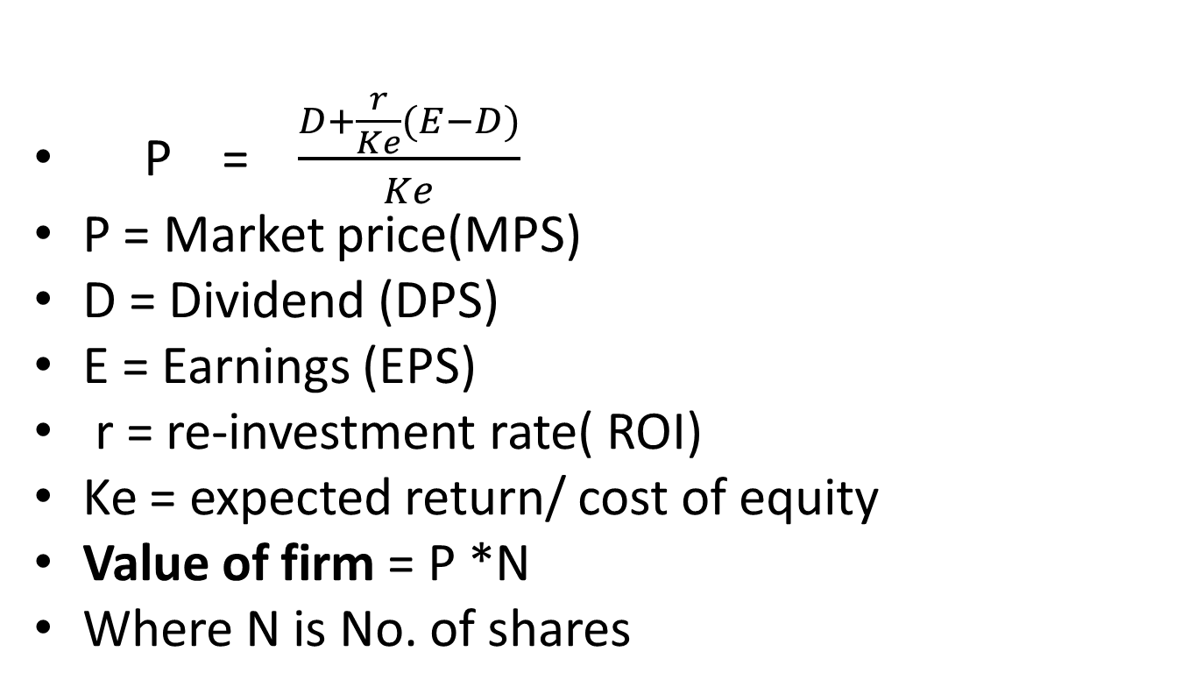
Walter’s Model
P = $\frac{D+\frac{r}{Ke}(E−D)}{Ke}$
P = Market price(MPS)
D = Dividend (DPS)
E = Earnings (EPS)
r = re-investment rate( ROI)
Ke = expected return/ cost of equity
Value of firm = P *N
Where N is No. of shares

Slide 12
Practical problem
ABC Ltd was started a year ago with a paid-up equity capital of Rs 40,00,000.The other details are as under:
Earnings of the company: 4,00,000
Dividend paid 3,20,000
Price-earning ratio: 12.5
Number of shares: 40,000
(i) Find the company’s dividend pay-out ratio. Find the market price of a share of the company at this payout ratio, using Walter’s model.
(ii) Is the company’s dividend payout ratio optimal as per Walter’s model? Why?
(iii) What is the market price of a share of the company at the “optimal dividend payout ratio as per the Walter’s model?

Slide 13
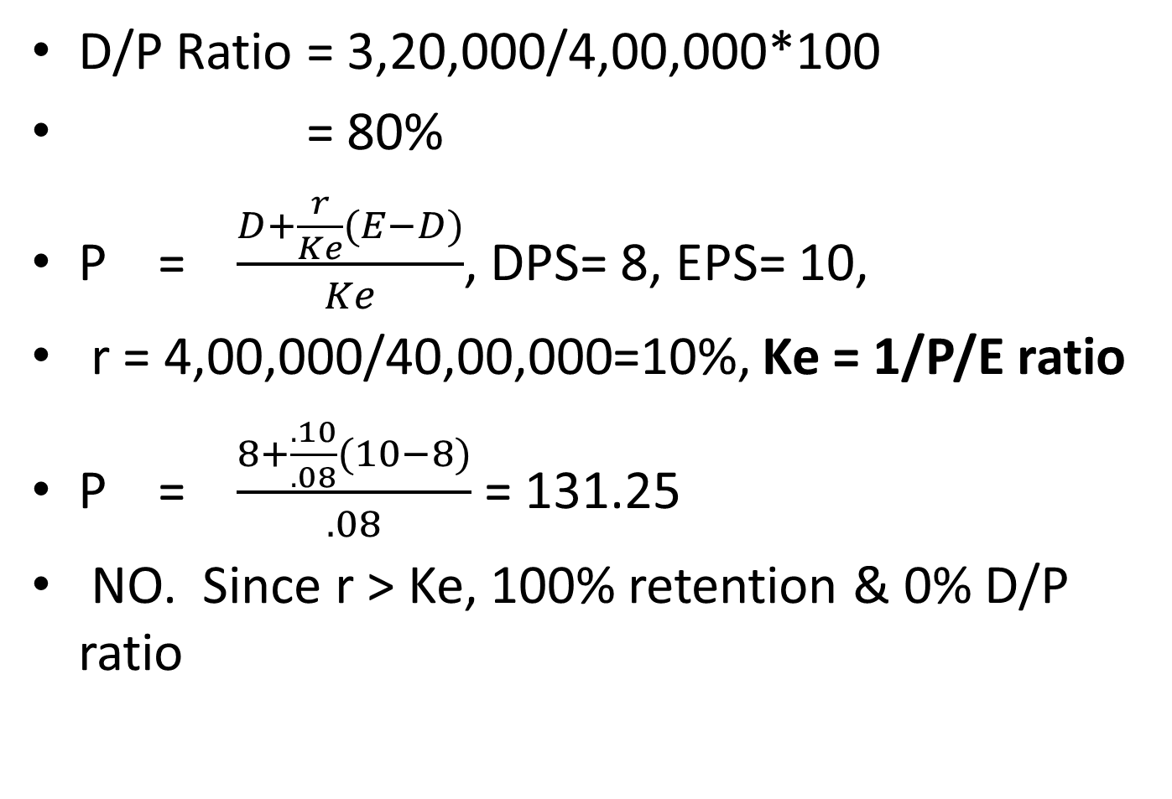
Solution
D/P Ratio = 3,20,000/4,00,000*100
= 80%
P = $\frac{D+\frac{r}{Ke}(E−D)}{Ke}$, DPS= 8, EPS= 10,
r = 4,00,000/40,00,000=10%, Ke = 1/P/E ratio
P = $\frac{8+\frac{.10}{.08}(10−8)}{.08}$ = 131.25
NO. Since r > Ke, 100% retention & 0% D/P ratio
Notes:
Ke = EPS/MPS, P/E Ratio = MPS/EPS ; Ke = 1/ P/E ratio, 1/12.5 = .08 = 8%

Slide 14
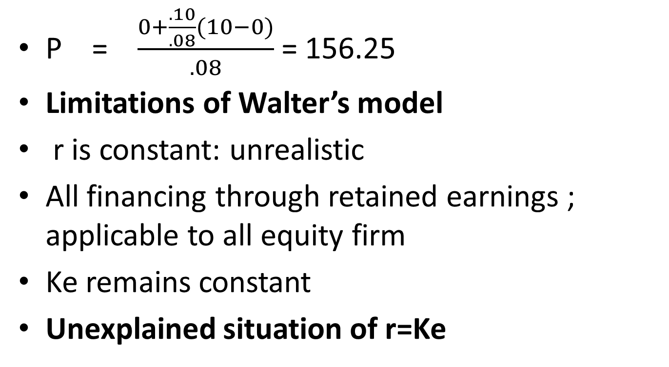
100% -retention &0%D/P ratio
P = $\frac{0+\frac{.10}{.08}(10−0)}{.08}$ = 156.25
Limitations of Walter’s model
r is constant: unrealistic
All financing through retained earnings ; applicable to all equity firm
Ke remains constant
Unexplained situation of r=Ke

Slide 15
Gorden’s Model
Similar to Walter’s relevance theory:
Average investor is an risk- aversers and prefers dividend distribution
Growth rate (g) of the firm is the product of retention ratio(b) and rate of return (r); hence g=br =.2 *.1 = .02 = 2%
Cost of capital is constant and Ke> g

Slide 16
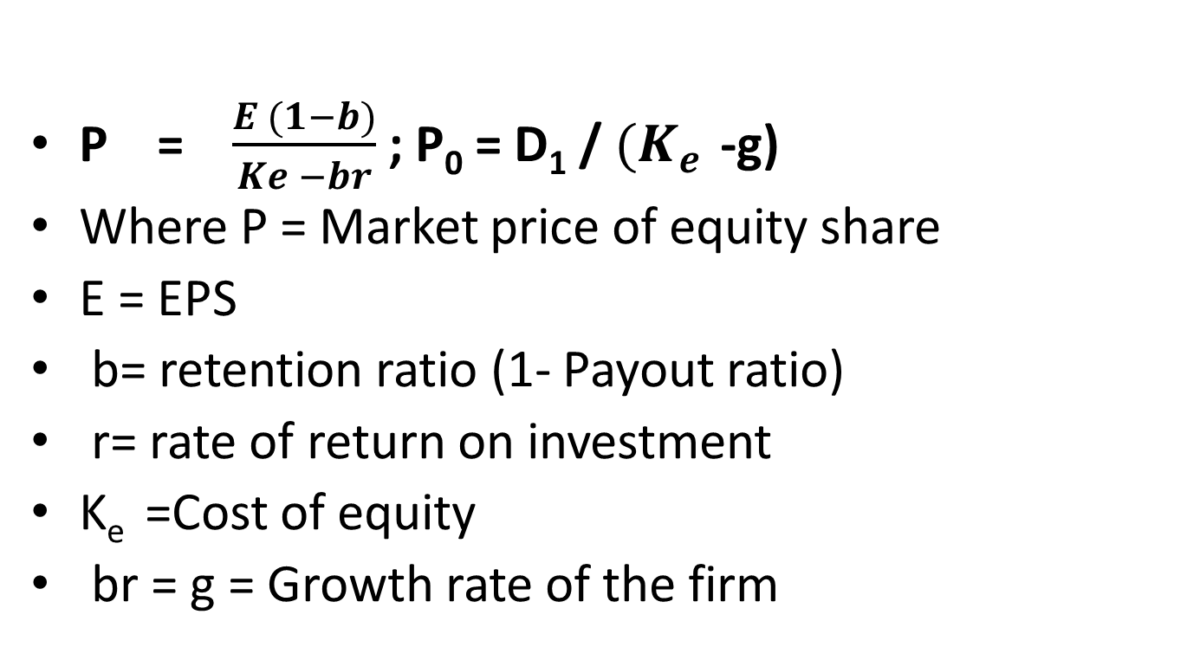
Gorden’s Model
P = $\frac{E (1−b)}{Ke −br}$ ; P₀ = D₁ / ${(K}_{e }$-g)
Where P = Market price of equity share
E = EPS
b= retention ratio (1- Payout ratio)
r= rate of return on investment
K_{e} =Cost of equity
br = g = Growth rate of the firm

Slide 17
Practical problem
Using the following, find the price of a share and value of the firm using Gorden’s Model:
EPS Rs 12
Equity capitalisation rate 20%
Internal rate of return 16%
Retention rate 75%
Number of shares outstanding 1,00,000
What will the price and value of the firm if equity capitalisation rate and internal rate of return are reveresed?

Slide 18
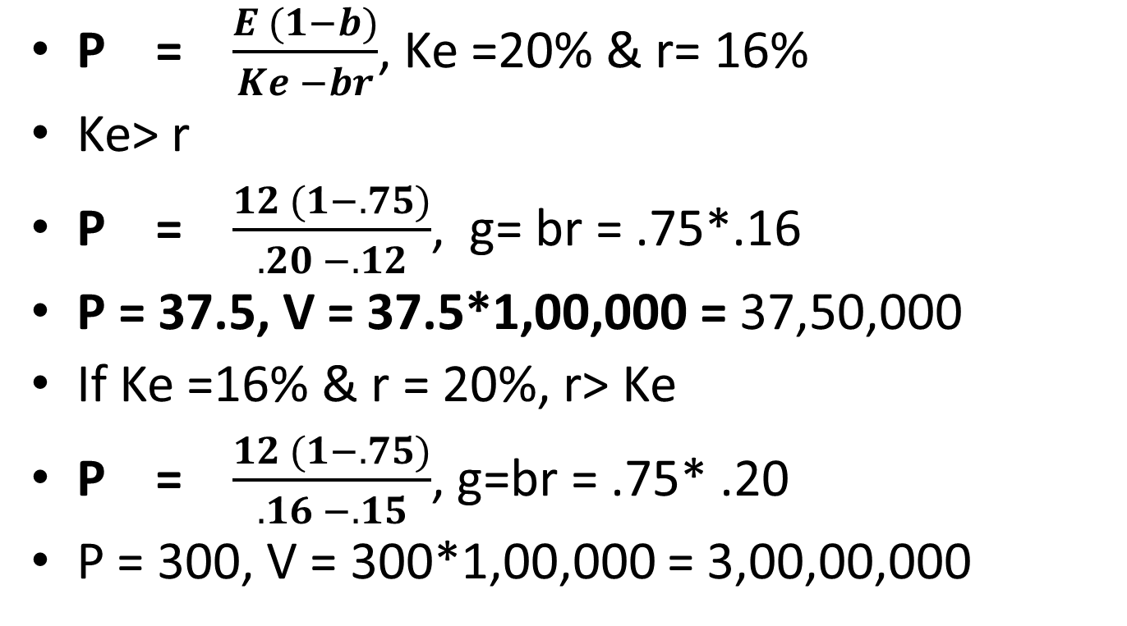
Solution
P = $\frac{E (1−b)}{Ke −br}$, Ke =20% & r= 16%
Ke> r
P = $\frac{12 (1−.75)}{.20 −.12}$, g= br = .75*.16
P = 37.5, V = 37.5*1,00,000 = 37,50,000
If Ke =16% & r = 20%, r> Ke
P = $\frac{12 (1−.75)}{.16 −.15}$, g=br = .75* .20
P = 300, V = 300*1,00,000 = 3,00,00,000

Slide 19
MM Approach
(Theory of irrelevance)
Assumptions:
Perfect capital market: rationality; uniform expectations; dissemination of information
Absence of taxes or indifference b/w capital gain tax and dividend tax
Investment decision is given and independent
No floatation costs
Arbitrage process: Behavioural justification

Slide 20
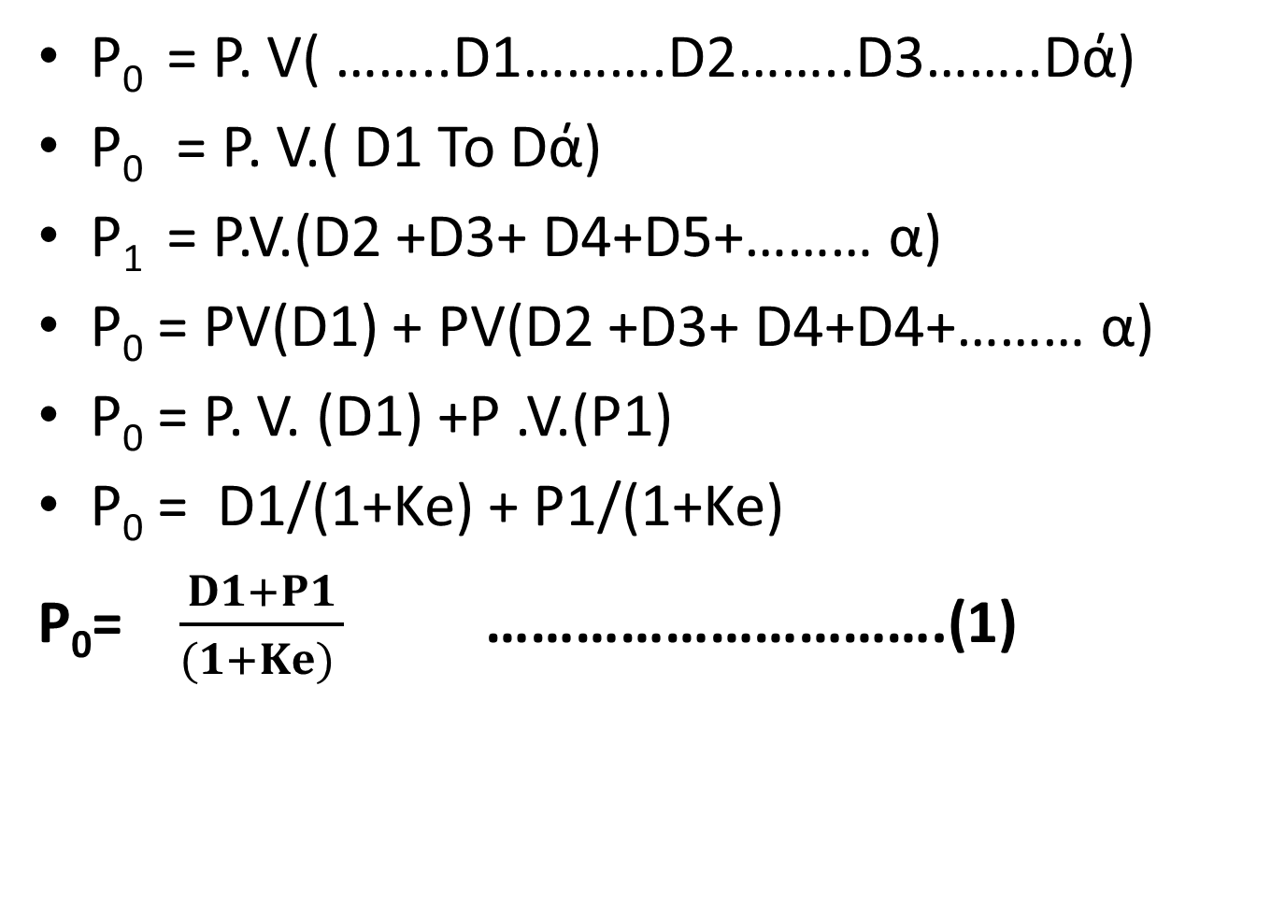
Mathematical derivation
P₀ = P. V( ……..D1……….D2……..D3……..Dά)
P₀ = P. V.( D1 To Dά)
P₁ = P.V.(D2 +D3+ D4+D5+……… α)
P₀ = PV(D1) + PV(D2 +D3+ D4+D4+……… α)
P₀ = P. V. (D1) +P .V.(P1)
P₀ = D1/(1+Ke) + P1/(1+Ke)
P₀= $\frac{D1+P1}{(1+Ke) }$ ………………………….(1)

Slide 21
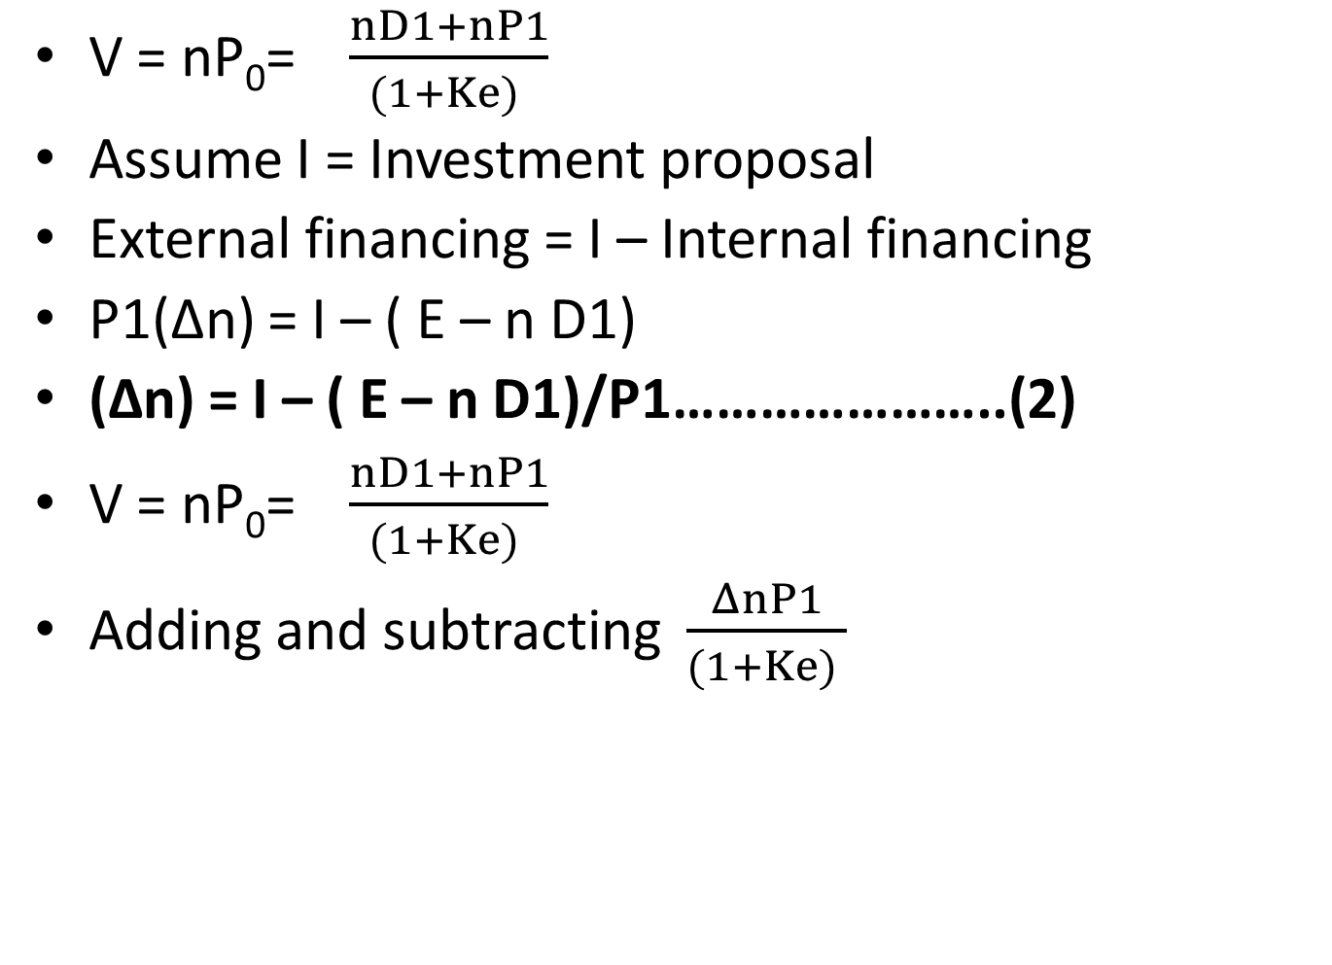
V = nP₀= $\frac{nD1+nP1}{(1+Ke) }$
Assume I = Investment proposal
External financing = I – Internal financing
P1(Δn) = I – ( E – n D1)
(Δn) = I – ( E – n D1)/P1…………………..(2)
V = nP₀= $\frac{nD1+nP1}{(1+Ke) }$
Adding and subtracting $\frac{ΔnP1}{(1+Ke) }$
Notes:
I = 5,00,00,000: 5,00,00,000- ( 10,00,00,000- 8,00,00,000); 5,00,00,000- 2,00,00,000: nd1 = total amount of dividend ; Δn = no. of shares to be issued

Slide 22
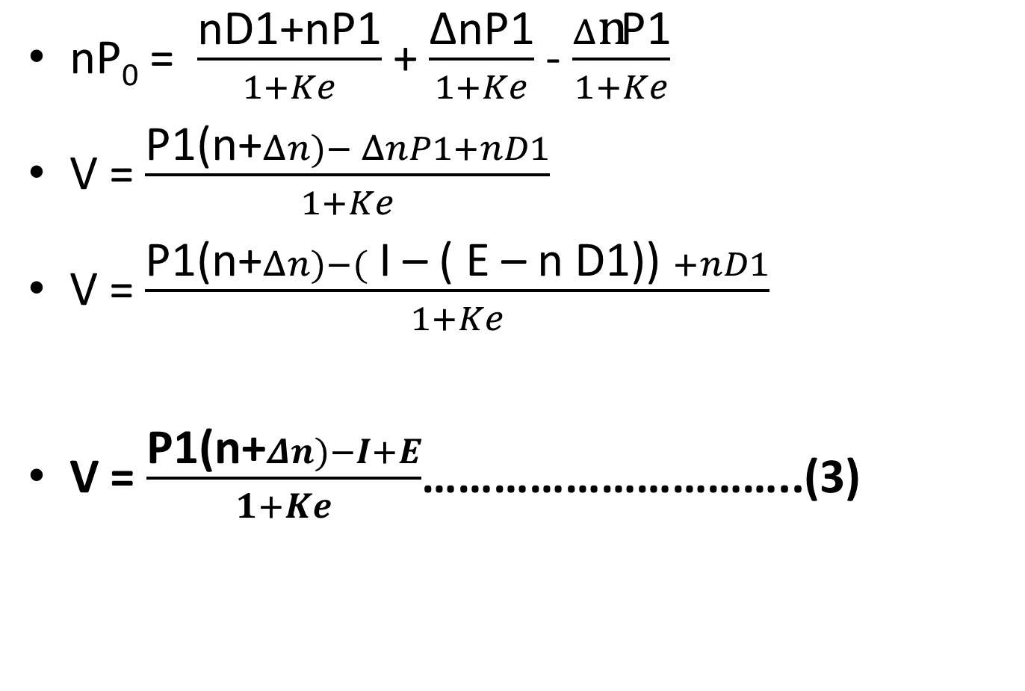
nP₀ = $\frac{\text{nD}\text{1+}\text{nP}\text{1}}{1+Ke}$ + $\frac{\text{ΔnP}\text{1}}{1+Ke}$ - $\frac{Δ\text{n}\text{P}\text{1}}{1+Ke}$
V = $\frac{\text{P}\text{1(}\text{n}\text{+}Δn)− ΔnP1+nD1}{1+Ke}$
V = $\frac{\text{P}\text{1(}\text{n}\text{+}Δn)−( \text{I}\text{ – ( }\text{E}\text{ – }\text{n} \text{D}\text{1)) }+nD1}{1+Ke}$
V = $\frac{\text{P}\text{1(}\text{n}\text{+}Δn)−I+E}{1+Ke}$…………………………..(3)

Slide 23
X Ltd has equity capitalisation rate of 10% and overall cost of capital is 8%. Present capital is 25,000 equity shares of Rs 100 each.
EBIT= 2,50,000
Dividend anticipated to be declared is Rs 5 per share. At the end of current FY , the Co. has an expansion plan requiring 5 Lacs. Through MM hypothesis show that Co. should not bother what dividend it actually pays.

Slide 24
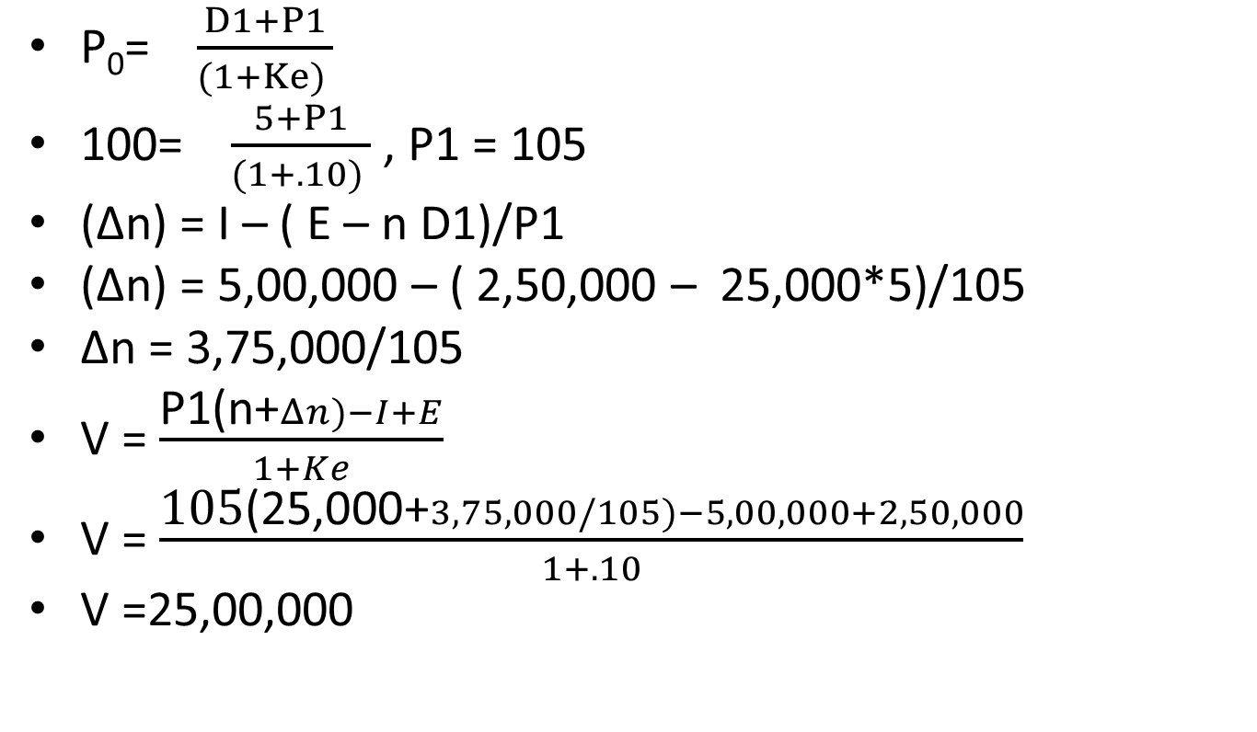
When dividend is declared
P₀= $\frac{D1+P1}{(1+Ke) }$
100= $\frac{5+P1}{(1+.10) }$ , P1 = 105
(Δn) = I – ( E – n D1)/P1
(Δn) = 5,00,000 – ( 2,50,000 – 25,000*5)/105
Δn = 3,75,000/105
V = $\frac{\text{P}\text{1(}\text{n}\text{+}Δn)−I+E}{1+Ke}$
V = $\frac{\text{105}\text{(}\text{25,000}\text{+}3,75,000/105)−5,00,000+2,50,000}{1+.10}$
V =25,00,000

Slide 25
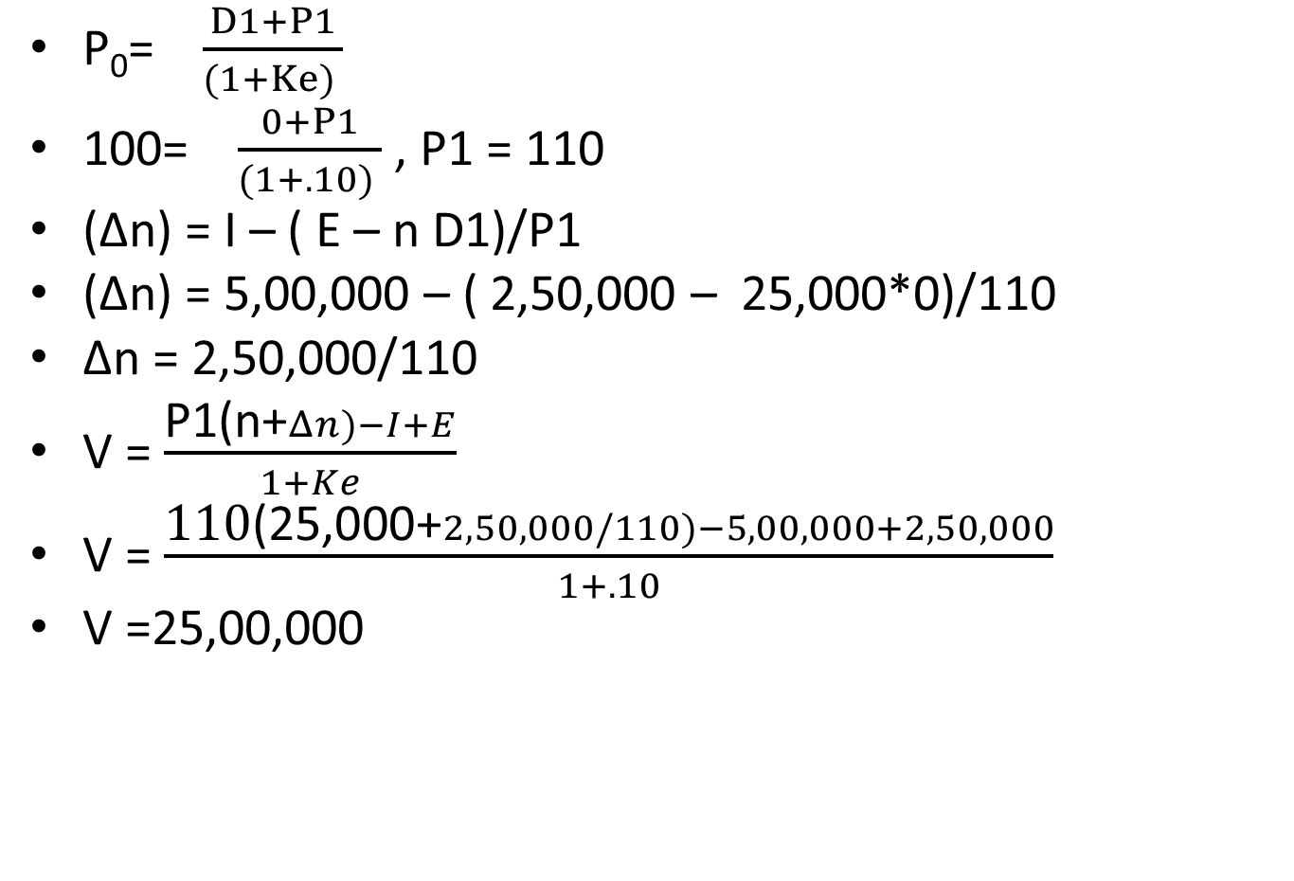
When dividend is not declared, D1 =0
P₀= $\frac{D1+P1}{(1+Ke) }$
100= $\frac{0+P1}{(1+.10) }$ , P1 = 110
(Δn) = I – ( E – n D1)/P1
(Δn) = 5,00,000 – ( 2,50,000 – 25,000*0)/110
Δn = 2,50,000/110
V = $\frac{\text{P}\text{1(}\text{n}\text{+}Δn)−I+E}{1+Ke}$
V = $\frac{\text{1}\text{10}\text{(25,000+}2,50,000/110)−5,00,000+2,50,000}{1+.10}$
V =25,00,000

Slide 26
Problem
Z Ltd has 10 lakh equity shares outstanding at the beginning of the year 2006. the current market price of the share is Rs 150 each. The company recommended Rs 8 per share as dividend. The capitalisation rate is 12%.
(i) Based on MM approach, calculate the market price of the share of the company when the recommended dividend is(a) declared and (b) not declared
(ii) How many new shares are to be issued by the company at the end of the accounting year on the assumption that the net income for the year is Rs 2 crores and the investment budget is Rs 4 crores when dividends are distributed? What will be the market value of shares at the end of accounting year?

Slide 27
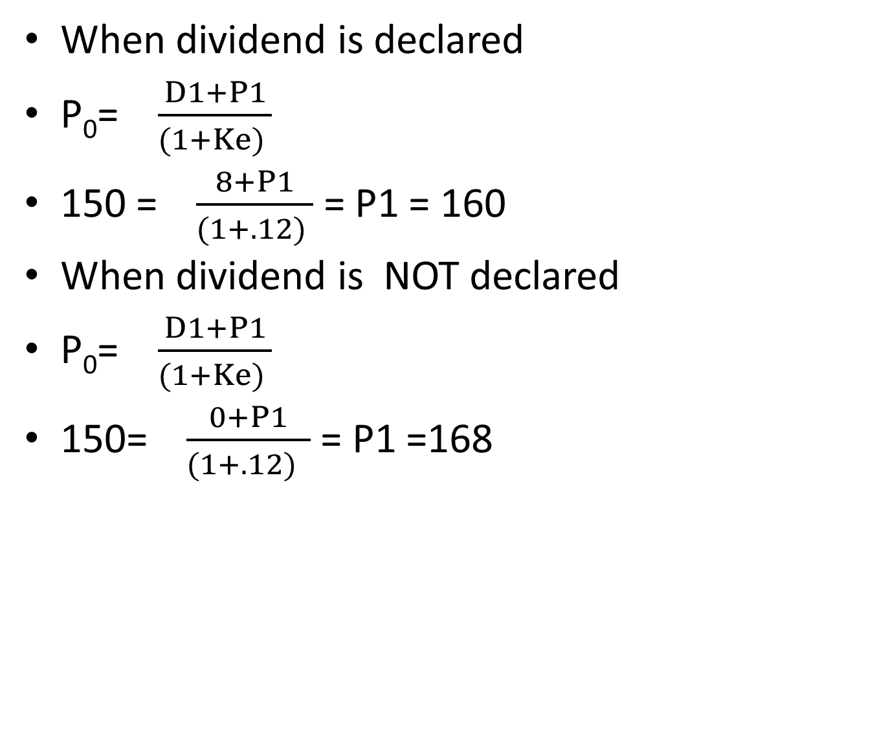
Solution
When dividend is declared
P₀= $\frac{D1+P1}{(1+Ke) }$
150 = $\frac{8+P1}{(1+.12) }$ = P1 = 160
When dividend is NOT declared
P₀= $\frac{D1+P1}{(1+Ke) }$
150= $\frac{0+P1}{(1+.12) }$ = P1 =168

Slide 28
When dividend is declared
(Δn) = I – ( E – n D1)/P1
(Δn) = 4,00,00,000 – ( 2,00,00,000 – 10,00,000*8)/160
(Δn) = 2,80,00,000/160 = 1,75,000
Market value of shares = (n + Δn)*P1 (10,00,000+1,75,000)*160 = 18,80,00,000

