Slide 1
UNIT-3
FINANCING DECISION

Slide 2
Interdependence & inter-relationship
Investment decision Financing decision
(DEBT-EQUITY MIX)

Slide 3
FINANCING DECISION/ CAPITAL STRUCTURE
COST OF CAPITAL EARNINGS &VALUATION
(MINIMISE) RISK (MAXIMISE)
Concept & Measurement of Cost of Capital
Operating, Financial and Combined Leverage
Capital structure, cost of capital and valuation
Planning and designing of Capital structure

Slide 4
Cost of Capital
Discount rate
Required rate of return
Hurdle rate/ cut-off/bench mark
Weighted average cost of capital(WACC)

Slide 5
Cost of DEBT
Features of a debt instrument:
Fixed financial obligation
No share in profit
Creditors of the company
Cant participate in management
Interest is a tax-deductible expense/tax-shield

Slide 6
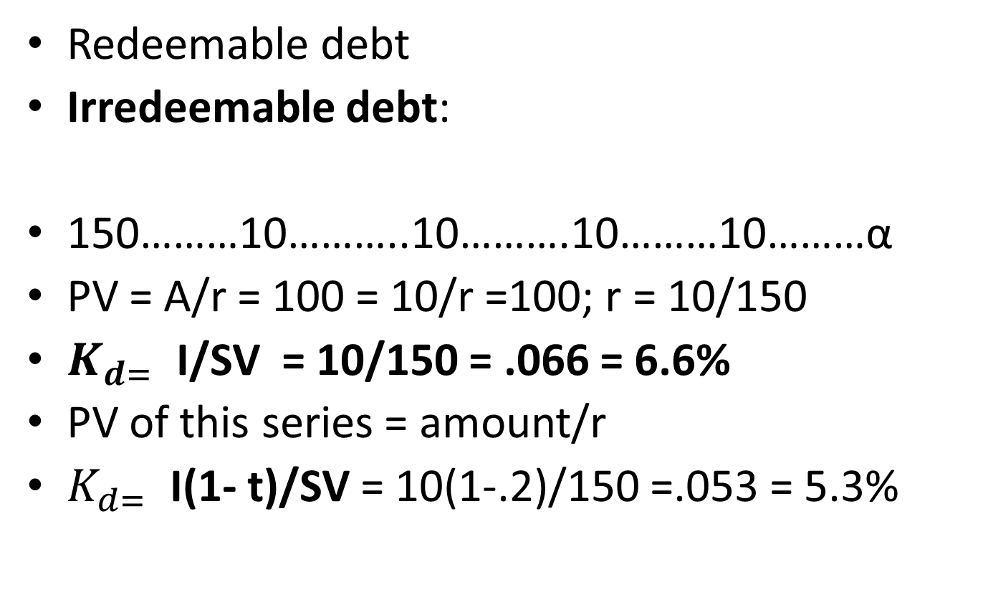
Cost of Debt
Redeemable debt
Irredeemable debt:
150………10………..10……….10………10………α
PV = A/r = 100 = 10/r =100; r = 10/150
$K_{d= }$I/SV = 10/150 = .066 = 6.6%
PV of this series = amount/r
$K_{d= }$I(1- t)/SV = 10(1-.2)/150 =.053 = 5.3%
Notes:
I = amount of interest and SV = sales Value

Slide 7
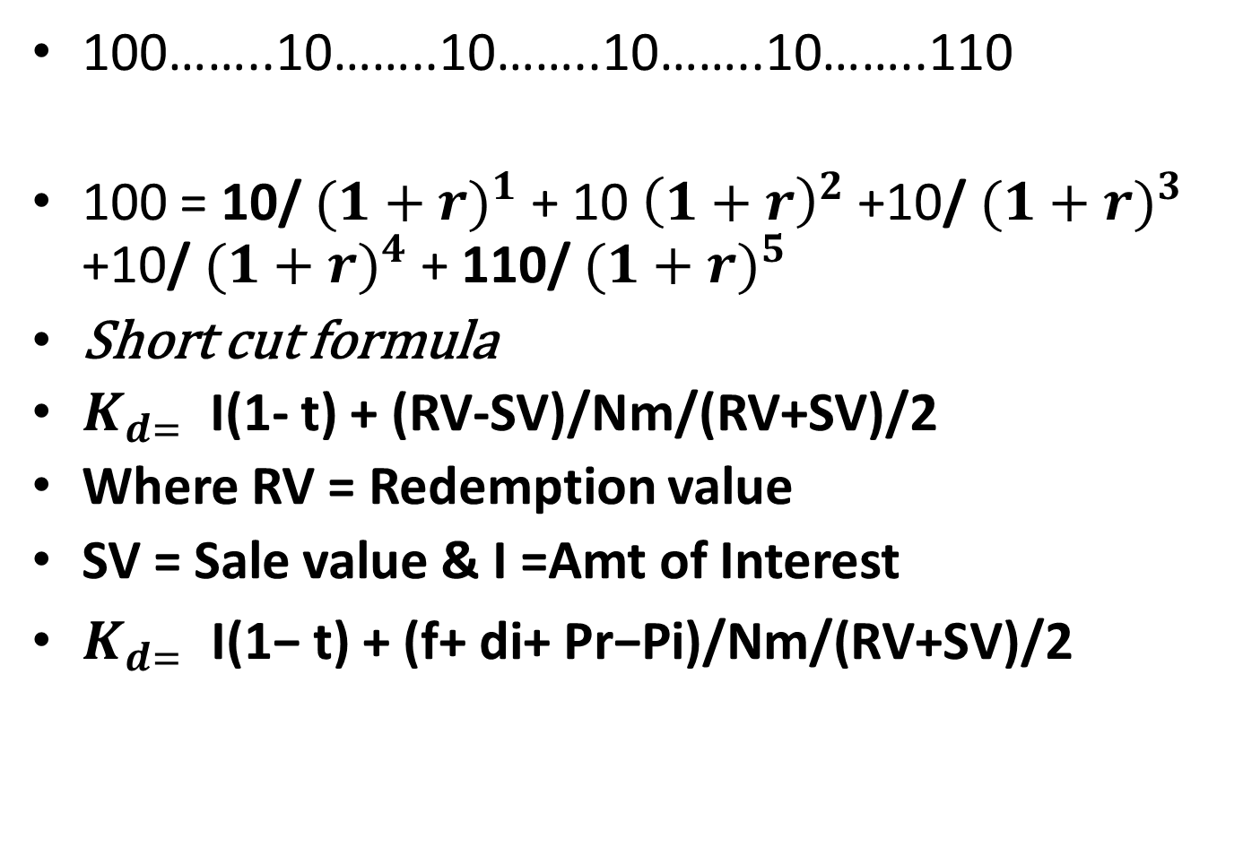
Redeemable debt
100……..10……..10……..10……..10……..110
100 = 10/ ${(1+r)}^{1}$ + 10 ${\left(1+r\right)}^{2}$ +10/ ${(1+r)}^{3}$ +10/ ${(1+r)}^{4}$ + 110/ ${(1+r)}^{5}$
Short cut formula
$K_{d= }$I(1- t) + (RV-SV)/Nm/(RV+SV)/2
Where RV = Redemption value
SV = Sale value & I =Amt of Interest
$K_{d= }\text{I}\text{(1− }\text{t}\text{) + (}\text{f}\text{+ }\text{di}\text{+ }\text{Pr}\text{−}\text{Pi}\text{)/}\text{Nm}\text{/(}\text{RV}\text{+}\text{SV}\text{)/2}$
Notes:
T=20%, Kd = 8.02%; SV= 90, RV = 105

Slide 8
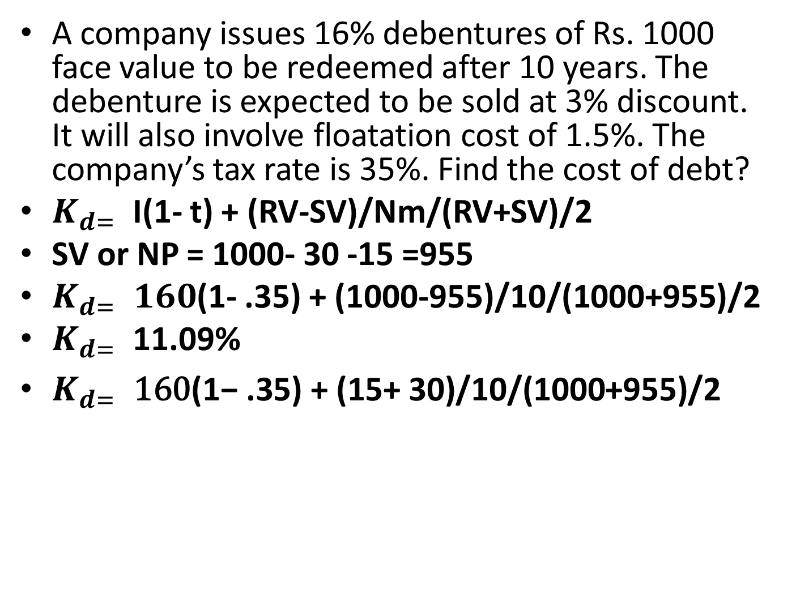
Practice problems
A company issues 16% debentures of Rs. 1000 face value to be redeemed after 10 years. The debenture is expected to be sold at 3% discount. It will also involve floatation cost of 1.5%. The company’s tax rate is 35%. Find the cost of debt?
$K_{d= }$I(1- t) + (RV-SV)/Nm/(RV+SV)/2
SV or NP = 1000- 30 -15 =955
$K_{d= }160$(1- .35) + (1000-955)/10/(1000+955)/2
$K_{d= }$11.09%
$K_{d= }\text{160}\text{(1− }\text{.35}\text{) + (}\text{15}\text{+ }\text{30}\text{)/}\text{10}\text{/(}\text{1000}\text{+}\text{955}\text{)/2}$
Notes:
NOTE: FLOATATION COST IS TO BE CONSIDERED AT FACE VALUE

Slide 9
Practice problems
X Ltd, issued irredeemable/ perpetual debentures of Rs 5,00,000 carrying interest rate of 14%. The company is in 35%tax bracket. Find the cost of debt (before tax & after tax) in the following situations:
When debentures are issued at par= 70,000/5,00,000=14% & 14(1-.35)=9.1%
When debentures are issued at discount of 15%=70,000/4,25,000=16.47% & 16.47(1-.35)=10.71%
When debentures are issued at premium of 15%= 70,000/5,75,000 = 12.17% & 12.17(1-.35) = 7.91%

Slide 10
Redeemable in installments
A company issued 10% debentures aggregating Rs. 1,00,000. The floatation cost is 5%.the company has agreed to repay the debentures at par in 5 equal annual installments starting at the end of year 1. The company’s rate of tax is 50%. Find the cost of debt.
Solution: Cash-inflow =1,00,000-5,000=95,000
Fake PB = Initial Cash-inflow/Avg CFAT
95,000/23,000 =4.13(A4)

Slide 11
Solution
YEAR | Principal | Interest | After tax int. | CFAT | PVIF@7% | PV CFAT
1 | 20,000 | 10,000 | 5,000 | 25,000 | .935 | 23,375
2 | 20,000 | 8000 | 4000 | 24,000 | .873 | 20,952
3 | 20.000 | 6000 | 3000 | 23,000 | .816 | 18,768
4 | 20,000 | 4000 | 2000 | 22,000 | .763 | 16.786
5 | 20,000 | 2000 | 1000 | 21,000 | .713 | 14,973
 |  |  |  |  |  | 94,854
Notes:
@6% = 97,366

Slide 12
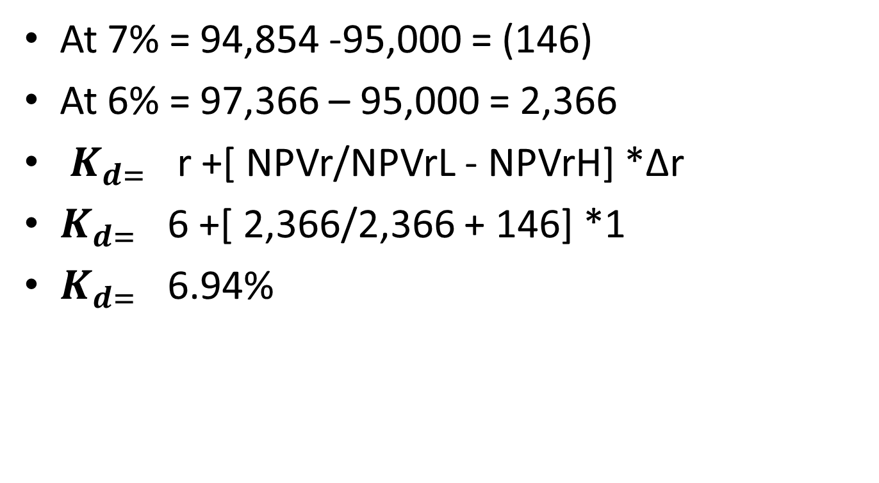
At 7% = 94,854 -95,000 = (146)
At 6% = 97,366 – 95,000 = 2,366
$K_{d= }$ r +[ NPVr/NPVrL - NPVrH] *Δr
$K_{d= }$ 6 +[ 2,366/2,366 + 146] *1
$K_{d= }$ 6.94%

Slide 13
Debt is the cheapest source of finance
Expectation of return depends on the amount of risk taken by investor. And risk is variation in return. Expectation of return determines the cost of fund.
Assured and regular income from interest, investors expect minimum return
Assured redemption at the time of liquidation.
Interest is a tax- deductible expense: tax-shield

Slide 14
Cost of Preference share capital
Hybrid kind of source/fund
Fixed amount of dividend
No ownership rights
Preferential rights over equity for the payment of dividend and redemption of capital
Not tax-deductible payment.

Slide 15
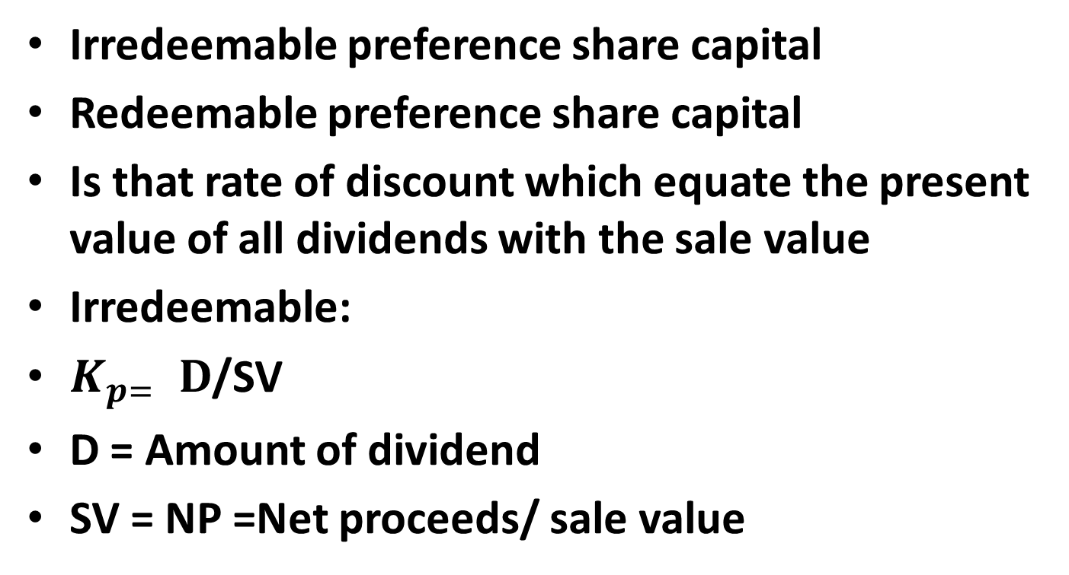
Cost of Preference share capital
Irredeemable preference share capital
Redeemable preference share capital
Is that rate of discount which equate the present value of all dividends with the sale value
Irredeemable:
$K_{p= }D$/SV
D = Amount of dividend
SV = NP =Net proceeds/ sale value
Notes:
Note: as per SEBI guidelines floatation cost (underwriting commission etc) is to be calculated on Issued price(not on face value)

Slide 16
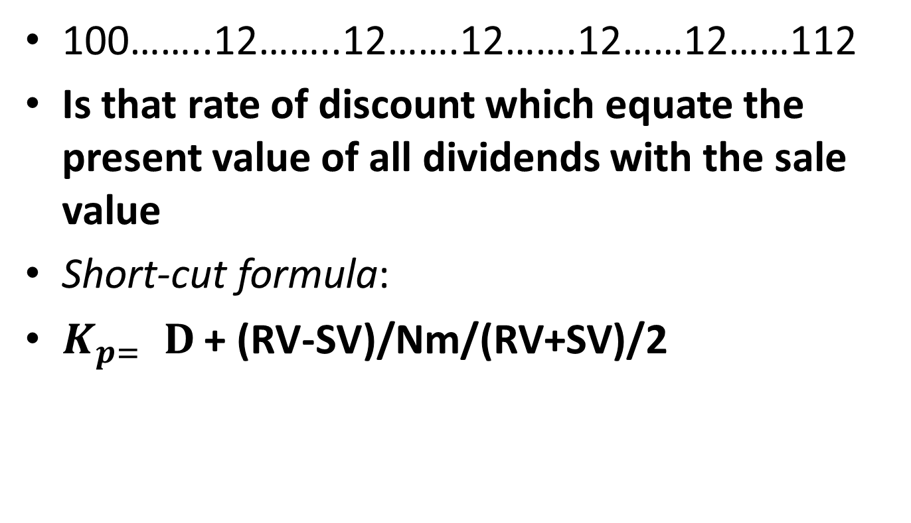
Redeemable preference share capital
100……..12……..12…….12…….12……12……112
Is that rate of discount which equate the present value of all dividends with the sale value
Short-cut formula:
$K_{p= }D$ + (RV-SV)/Nm/(RV+SV)/2

Slide 17
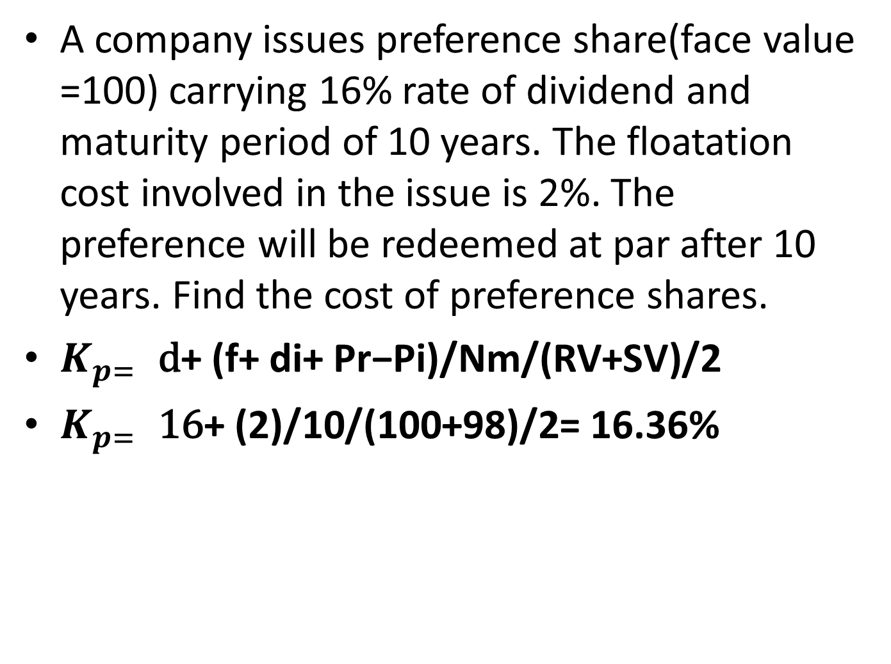
Practice problems
A company issues preference share(face value =100) carrying 16% rate of dividend and maturity period of 10 years. The floatation cost involved in the issue is 2%. The preference will be redeemed at par after 10 years. Find the cost of preference shares.
$K_{p= }\text{d}\text{+ (}\text{f}\text{+ }\text{di}\text{+ }\text{Pr}\text{−}\text{Pi}\text{)/}\text{Nm}\text{/(}\text{RV}\text{+}\text{SV}\text{)/2}$
$K_{p= }\text{16}\text{+ (}\text{2}\text{)/}\text{10}\text{/(}\text{100}\text{+}\text{98}\text{)/2}$= 16.36%

Slide 18
Practice problems
A company issues 16 % irredeemable preference shares having face value of Rs 100 each. Floatation costs are 3% of sale value. Find the cost of preference shares, if preference shares are issued at (i) par value(ii)10% discount and (iii) 10%premium. What will be your answer if dividend tax is assumed to be 10%.
(i) 16.49(1+Dt)% (ii)18.32(1+.1)% (iii) 14.99(1.1)%
Notes:
(i) 16/97 (ii) 16/90-2.7 (iii)16/110-3.3

Slide 19
Cost of equity share capital
Ownership capital
No fixed amount of dividend
Highest risk –takers : variation in return is maximum
Expectation of return is highest
Irredeemable source of funds
Cost of equity is decided by the expectations of the fund provider.(Expected dividend)
Cost of equity is that rate of return that a company must earn/provide to its shareholders so that value of shares remains unchanged.

Slide 20
Approaches for cost of equity
Dividend Approach
Earning- price Approach
CAPM (Capital Asset Pricing Model) Approach
100……..expected0…estimated10……12….0…15

Slide 21
Dividend approach
Cost of equity is that rate which equate the present value of (Estimated )dividend with net proceeds.
Assumptions: (estimated dividend)
Constant dividend model: constant amount of dividend 100….5…5….5…..5..5…..infinity
Constant growth model
Varied growth model

Slide 22
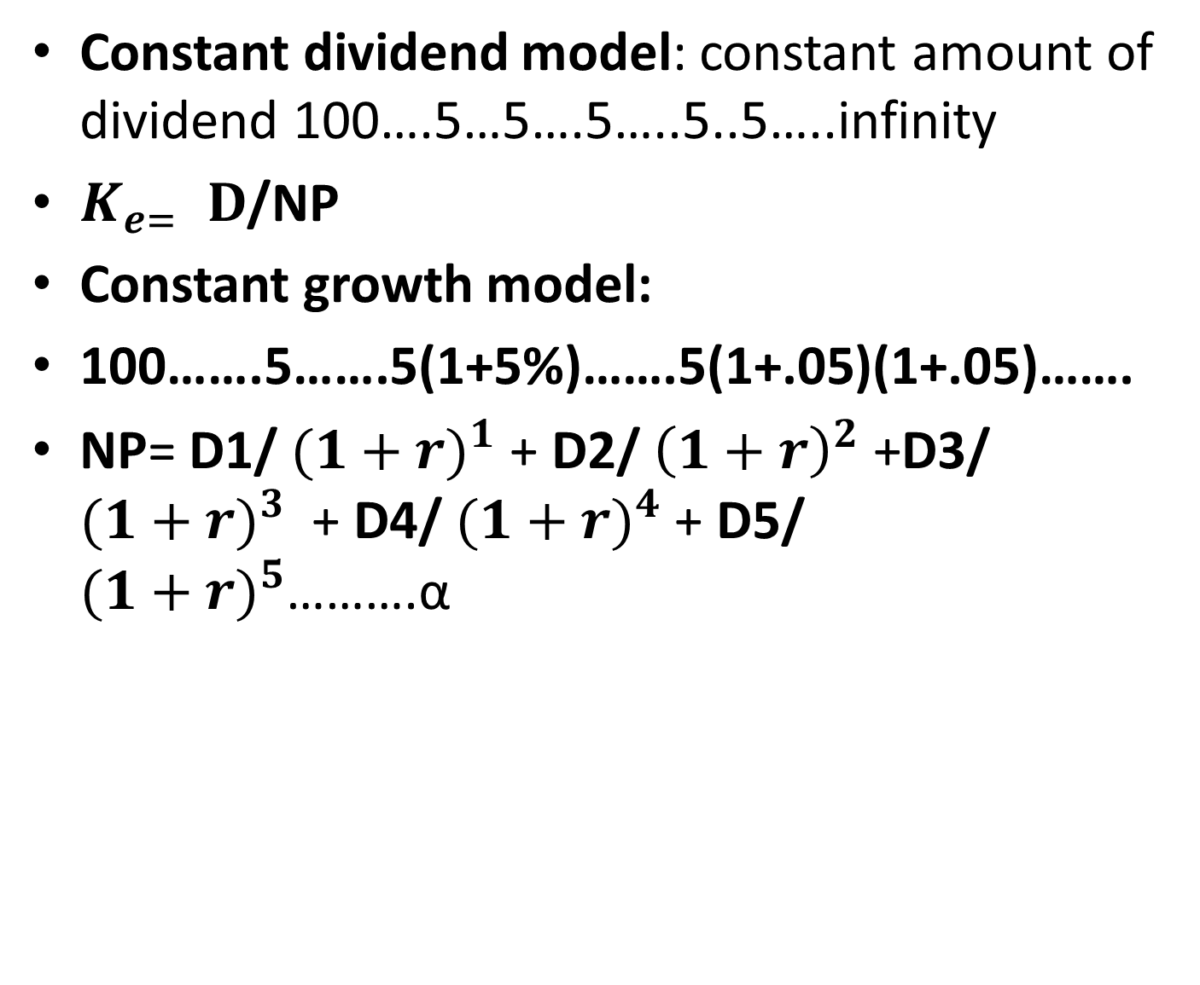
Constant dividend model: constant amount of dividend 100….5…5….5…..5..5…..infinity
$K_{e= }D$/NP
Constant growth model:
100…….5…….5(1+5%)…….5(1+.05)(1+.05)…….
NP= D1/ ${(1+r)}^{1}$ + D2/ ${\left(1+r\right)}^{2}$ +D3/ ${(1+r)}^{3}$ + D4/ ${(1+r)}^{4}$ + D5/ ${(1+r)}^{5}$……….α

Slide 23
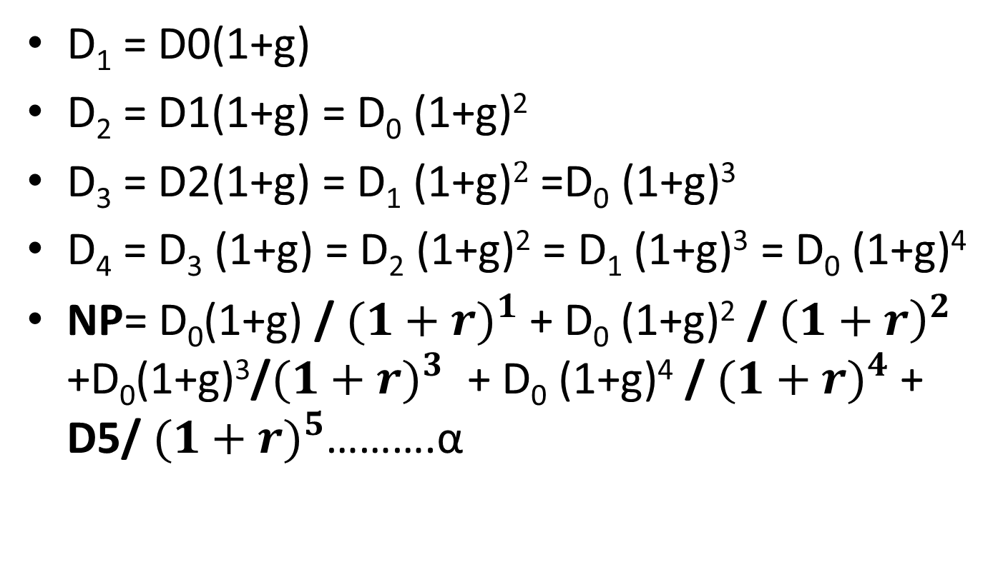
Constant growth rate is g
D₁ = D0(1+g)
D₂ = D1(1+g) = D₀ (1+g)²
D₃ = D2(1+g) = D₁ (1+g)$2$=D₀ (1+g)³
D₄ = D₃ (1+g) = D₂ (1+g)² = D₁ (1+g)³ = D₀ (1+g)⁴
NP= D₀(1+g) / ${(1+r)}^{1}$ + D₀ (1+g)² / ${\left(1+r\right)}^{2}$ +D₀(1+g)³/${(1+r)}^{3}$ + D₀ (1+g)⁴ / ${(1+r)}^{4}$ + D5/ ${(1+r)}^{5}$……….α

Slide 24
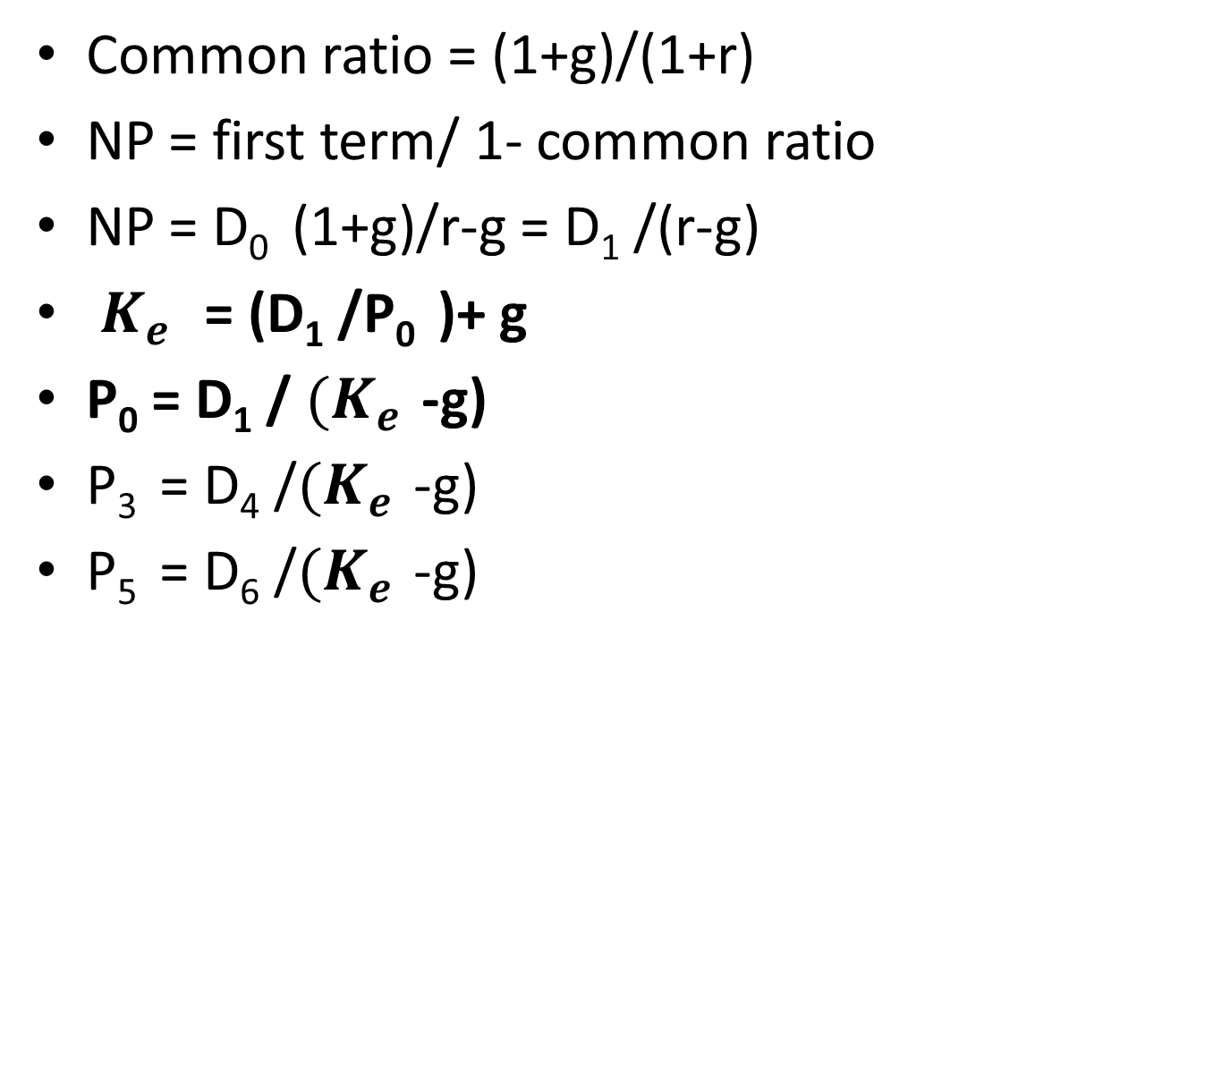
Constant growth model
Common ratio = (1+g)/(1+r)
NP = first term/ 1- common ratio
NP = D₀ (1+g)/r-g = D₁ /(r-g)
$K_{e }$ = (D₁ /P₀ )+ g
P₀ = D₁ / ${(K}_{e }$-g)
P₃ = D₄ /${(K}_{e }$-g)
P₅ = D₆ /${(K}_{e }$-g)
Notes:
D₆ = D0${(1+g)}^{6}$ ; D1${(1+g)}^{5}$

Slide 25
Practice Problem
A company is contemplating to declare dividend of Rs.20.15 next year. The company has shown growth rate of 6% and currently its shares are being traded at the market price of Rs 125 per share. Find the cost of equity share. Also find the price of the share of the company at the end year2.

Slide 26
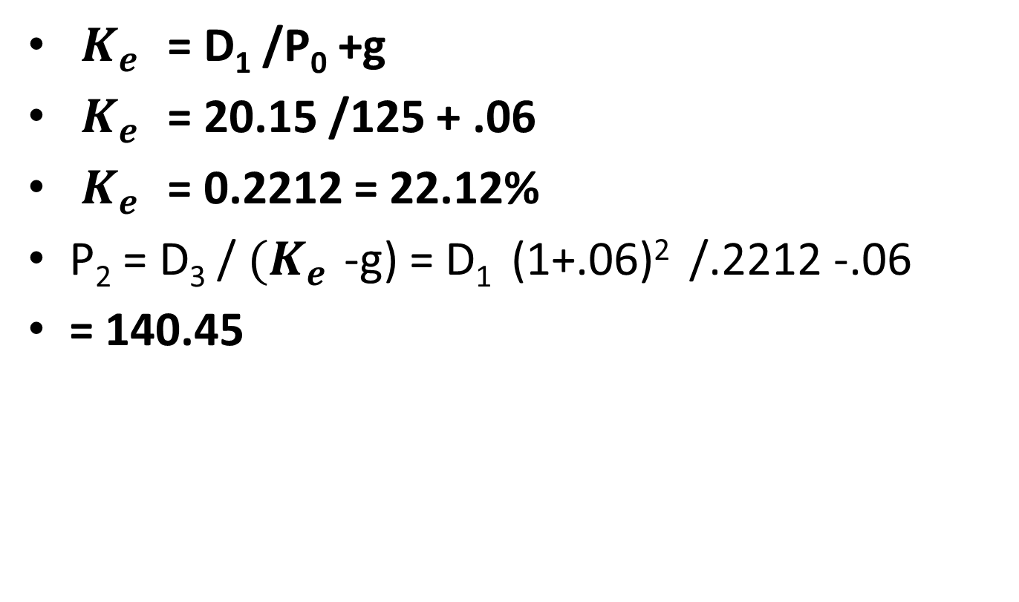
Solution
$K_{e }$ = D₁ /P₀ +g
$K_{e }$ = 20.15 /125 + .06
$K_{e }$ = 0.2212 = 22.12%
P₂ = D₃ / ${(K}_{e }$-g) = D₁ (1+.06)² /.2212 -.06
= 140.45

Slide 27
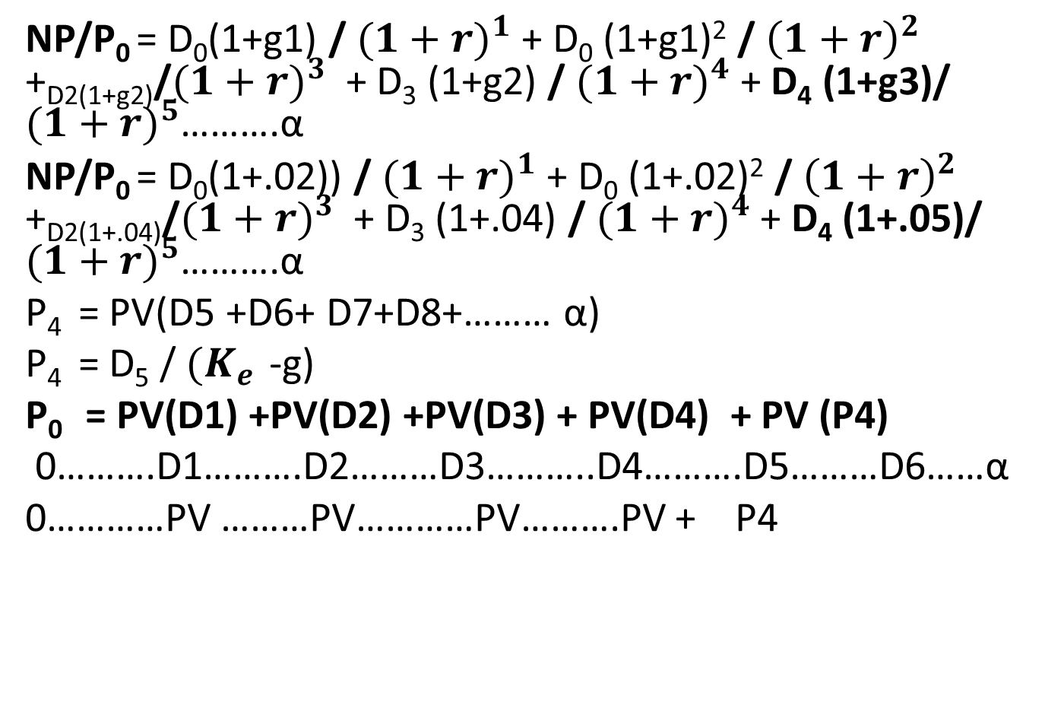
Varied growth model(g1=2%(2yrs),g2=4%(2yrs) &g3=5% forever)
NP/P₀ = D₀(1+g1) / ${(1+r)}^{1}$ + D₀ (1+g1)² / ${\left(1+r\right)}^{2}$ +_{D2(1+g2)}/${(1+r)}^{3}$ + D₃ (1+g2) / ${(1+r)}^{4}$ + D₄ (1+g3)/ ${(1+r)}^{5}$……….α
NP/P₀ = D₀(1+.02)) / ${(1+r)}^{1}$ + D₀ (1+.02)² / ${\left(1+r\right)}^{2}$ +_{D2(1+.04)}/${(1+r)}^{3}$ + D₃ (1+.04) / ${(1+r)}^{4}$ + D₄ (1+.05)/ ${(1+r)}^{5}$……….α
P₄ = PV(D5 +D6+ D7+D8+……… α)
P₄ = D₅ / ${(K}_{e }$-g)
P₀ = PV(D1) +PV(D2) +PV(D3) + PV(D4) + PV (P4)
0……….D1……….D2………D3………..D4……….D5………D6……α
0…………PV ………PV…………PV……….PV + P4

Slide 28
Practical problem
P0=PV(D1 +D2 +D3 + D4+ P4)
Q. A Ltd has following track record of dividend payments in the last five years:
Year | Dividend per share
1(D-4) | 14
2(D-3) | 14.70
3(D-2) | 15.44
4 (D-1) | 16.22
5 (D0) | 17.02

Slide 29
Practical problem
Using the above information, calculate
Growth rate in dividend
Cost of outstanding equity share if the current market price is Rs 135 per share
Cost of new equity shares if the floatation cost is 3%.

Slide 30
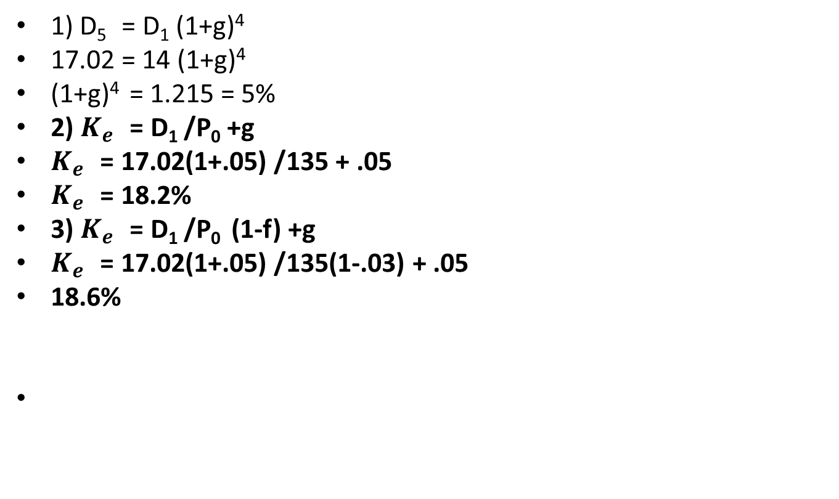
solution
1) D₅ = D₁ (1+g)⁴
17.02 = 14 (1+g)⁴
(1+g)⁴ = 1.215 = 5%
2) $K_{e }$ = D₁ /P₀ +g
$K_{e }$ = 17.02(1+.05) /135 + .05
$K_{e }$ = 18.2%
3) $K_{e }$ = D₁ /P₀ (1-f) +g
$K_{e }$ = 17.02(1+.05) /135(1-.03) + .05
18.6%

Slide 31
Varied growth rate
X Ltd declares dividend of Rs 2 per share last year. The company to maintain growth rate as per schedule given below:
Year | Growth rate
1 to 2 | 10%
3 | 8%
4 | 10%
5th onwards | 8%

Slide 32
The shareholders expected rate of return is 16%. Advise whether the share is worth buying at Rs.30?
Year | dividend | PVIF@16% | PV
1 | 2(1+.1)=2.2 | .862 | 1.89
2 | 2.2(1+.1)=2.42 | .743 | 1.79
3 | 2.42(1+.08)=2.61 | .641 | 1.67
4 | 2.61(1+.1)=2.87 | .552 | 1.58
TOTAL |  |  | 6.93

Slide 33
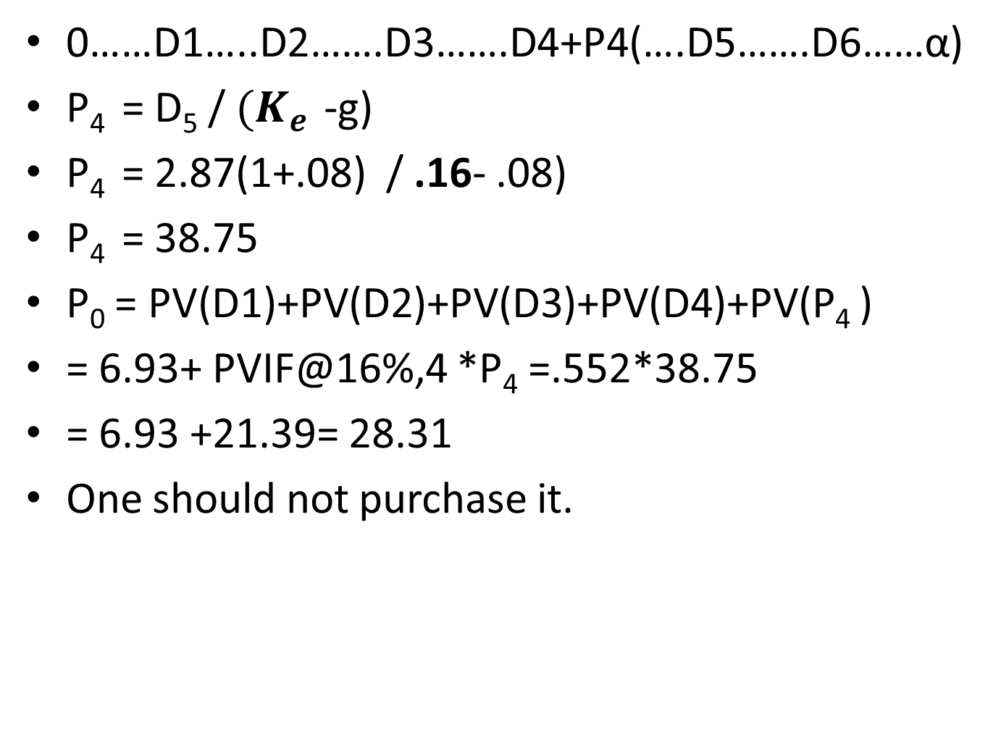
0……D1…..D2…….D3…….D4+P4(….D5…….D6……α)
P₄ = D₅ / ${(K}_{e }$-g)
P₄ = 2.87(1+.08) / .16- .08)
P₄ = 38.75
P₀ = PV(D1)+PV(D2)+PV(D3)+PV(D4)+PV(P₄ )
= 6.93+ PVIF@16%,4 *P₄ =.552*38.75
= 6.93 +21.39= 28.31
One should not purchase it.

Slide 34
M Ltd is likely to maintain growth rate of 9% for next four years and thereafter a constant rate of 7%. The company declared dividend of Rs 3.50 per share last year. If the shareholders expected rate of return is 16%, would you advise to buy the share at Rs 50?
P₀ = 44.21
SHOULD NOT BUY

Slide 35
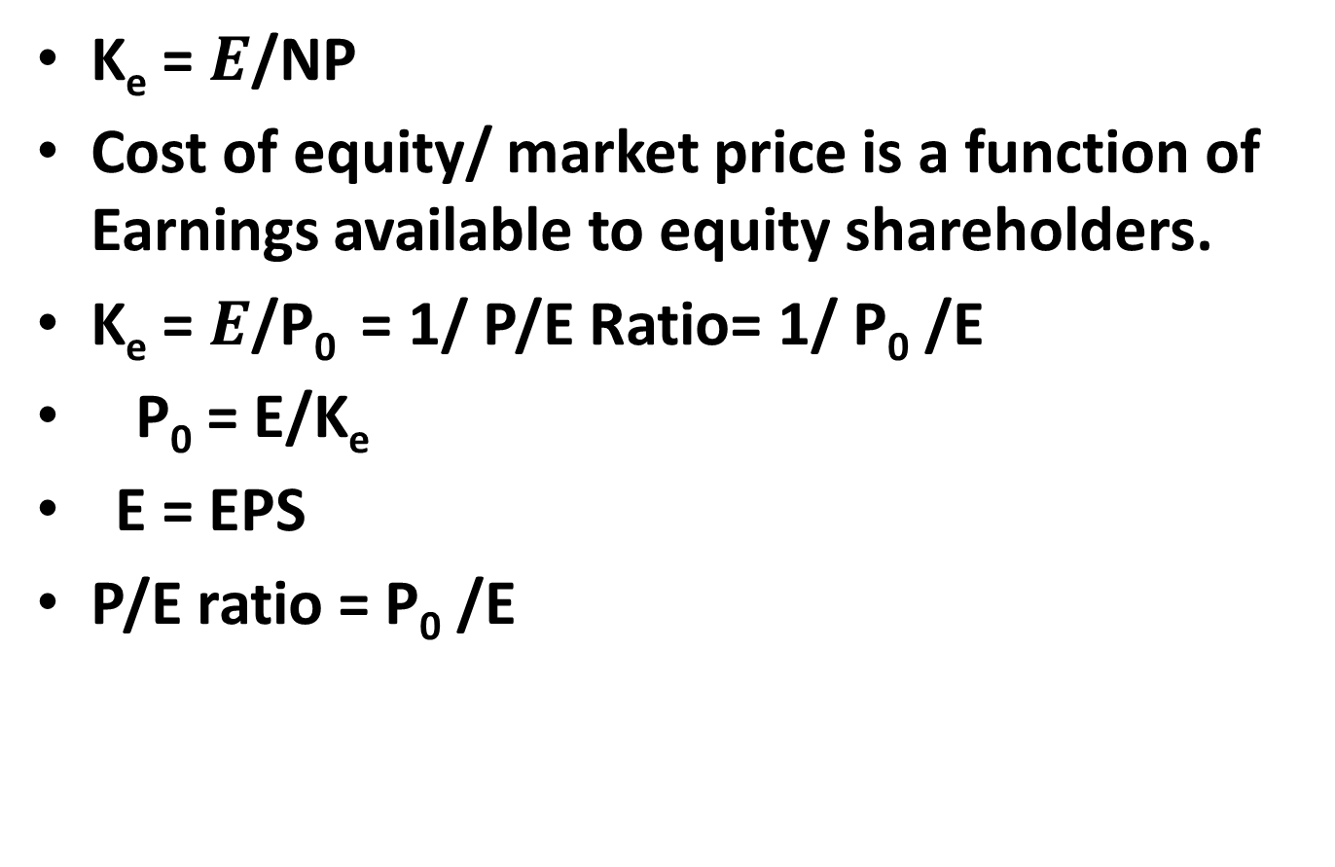
EARNING-PRICE APPROACH
K_{e} = $E$/NP
Cost of equity/ market price is a function of Earnings available to equity shareholders.
K_{e} = $E$/P₀ = 1/ P/E Ratio= 1/ P₀ /E
P₀ = E/K_{e}
E = EPS
P/E ratio = P₀ /E

Slide 36
Capital Asset Pricing Model(CAPM)
Pricing(expected) of any capital asset
Return (expected) of equity = cost of equity
RETURN depends on Risk (i) systematic risk (β) (ii)unsystematic risk
R_{e} = R_{f} + β(R_{m} –R_{f} )
K_{e} = K_{f} + β(K_{m} –K_{f} )

Slide 37
Cost of Retained Earnings
Free of cost ? NO
implicit cost/ opportunity cost
Amount of dividend foregone by the equity shareholders
Expectation from retained earnings are same as expectations from equity. Cost of retained earnings = cost of equity K_{r} = K_{e}
External yield criteria: 5000 -500 =4,500-500=4000@20% =800 =800/5000 =16%

Slide 38
Cost of retained earnings is always less than cost of equity
K_{r} = K_{e} (1-T) (1-B)
T stands for dividend tax
B stands for brokerage cost

Slide 39
Weighted average cost of capital(WACC) = K₀
K₀ = W_{d} (K_{d}) + W_{p} (K_{p} ) + W_{e} ( K_{e} ) + W_{r} (K_{r} )
Types of weights:
Historical weights: actual or existing proportions of different sources of funds
Book value: as per financial statements
(b) Market value weights
(ii) Marginal weights: proportion intend to raise
Notes:
(.2) (.10) + (.2)(.12) + (.6)(.15)=.134 = 13.4%; (.6)(.10)+ (.2)(.12)+ (.2)(.15)= .114 = 11.4%

Slide 40
Practice problems
S ltd has the following capital structure as on Dec31,2019
Equity Share Capital(60,000 shares of 10 each) 6,00,000
12%Preference share 6,00,000
10% Debentures 3,00,000
Total Capital 15,00,000
The equity shares of the company are quoted at Rs102 and the company is expected to declare a dividend of Rs 9 per share for the next year. The company has registered a dividend growth rate of 5%which is expected to be maintained. Assuming the tax rate applicable to the company at 50%.calculate the Weighted Average Cost of Capital
Notes:
MV = 61,20,000 + 24,00,000 + 7,50,000 = 92,70,000; 61,20,000/92,70,000; 24,00,000/92,70,000;7,50,000/92,70,000

Slide 41
Solution
K_{d} = I (1-t) = .10(1-.5) = .05 = 5%
K_{e} = D₁ /P₀ + g = 9/102 + .05 = 13.82%
K_{p} = 12%
cost | Cost of each fund | weights | Cost*weights
K_{d} | .05 | 3/15=.2 | .01
K_{e} | .1382 | 6/15=.4 | .055
K_{p} | .12 | 6/15 = .4 | .048
Total(WACC) |  |  | .113 =11.3%

Slide 42
Practical problem
The capital structure of Falcon Company Ltd as on 31-12-2018 is as follows:
Equity share capital: 10,000 shares of Rs 100 each 10,00,000
10%Preference shares of Rs 100 each 4,00,000
12% Debentures 6,00,000
The market price of the company’s share is Rs110 and it is expected that a dividend of Rs 10 per share would be declared after one year. The dividend growth rate is 6%.
If the company is in 40%tax bracket, calculate weighted average cost of capital.
The company needs to borrow a fund of Rs.10 Lacs for its expansion plan, the rate of interest is 14%, what will be the company’s revised weighted average cost of capital? This financing decision is expected to increase dividend from Rs 10 to Rs 12 per share. However, the market price of equity share is expected to decline from Rs 110 to Rs 105 per share.

Slide 43
Solution
K_{d} = I (1-t) = .12(1-.4) = .072 = 7.2%
K_{e} = D₁ /P₀ + g = 10/110 + .06 = 15.09%
K_{p} = 10%, Book value weights:
 | Cost | Weights | Cost* weights
K_{d} | .072 | 6/20= .3 | .0216
K_{e} | .1509 | 10/20=.5 | .075
K_{p} | .10 | 4/20 = .2 | .02
Total(WACC) |  |  | .1166=11.66%

Slide 44
Market value weights
 | Cost | weights | Cost*weights
K_{d} | .072 | 6/21= .28 | .02016
K_{e} | .1509 | 11/21=.52 | .07847
K_{p} | .10 | 4/21=.19 | .019
Total(WACC) |  |  | .1176=11.76%

Slide 45
Expansion plan of 10,00,000
K_{lt} = I (1-t) = .14(1-.4) = .084 = 8.4%
K_{e} = D₁ /P₀ + g = 12/105 + .06 = 17.43%
K_{p} = 10%, Book value weights:
 | Value | cost | weights | Cost*weights
K_{d} | 6,00,000 | .072 | 6/30 =.2 | .0144
K_{e} | 10,00,000 | .1743 | 10/30=.333 | .0575
K_{p} | 4,00,000 | .10 | 4/30=.133 | .013
LT Loan | 10,00,000 | .084 | 10/30=.333 | .02772
total | 30,00,000 |  |  | .1126=11.26%

Slide 46
Wacc= 11.45%

Slide 47
Practical problem of retained earnings
A Company has following amount and specific cost of each type of capital.
Type of Capital | Book Value | Market value | Specific Cost
Preference share | 2,00,000 | 2,50,000 | 10%
Equity shares | 10,00,000 | 18,00,000 | 15%
Retained earnings | 2,00,000 | ----- | ------
debt | 5,00,000 | 7,20,000 | 8%

Slide 48
Solution
Determine the Weighted average cost of capital using (a) book value weights(b)Market value weights.
Type of capital | Book value | weights | cost | Weights*cost
Preference | 2,00,000 | 2/19=.1052 | .10 | .0105
Equity | 10,00,000 | 10/19=.526 | .15 | .0789
Retained | 2,00,000 | 2/19=.1052 | .15 | .0157
debt | 5,00,000 | 5/19=.2631 | .08 | .0210
total | 19,00,000 |  |  | .1261=12.61%

Slide 49
Market value weights
Type of capital | Market value | weights | cost | Weights*cost
Preference | 2,50,000 | 25/277=.0902 | .10
Equity | 15,00,000 | 150/277=.5415 | .15
Retained | 3,00,000 | 30/277=.1083 | .15
debt | 7,20,000 | 72/277=.2599 | .08
total | 27,70,000 |  |  | 12.70%
Notes:
Market value of equity represents combined value of equity & retained earnings:18,00,000 is to be divided in 10:2

Slide 50
Exam problem-2004
From the following information, calculate average cost of capital(WACC) before tax for ABC Ltd:
Shareholders funds: Rs in Lacs
equity 500
preference 100
reserves 300
Borrowed Funds:
Secured loans 800
unsecured loans(including intercorporate deposits) 700
Total funds 2400
Additional information:
(i) Normal yield on equity shareholders fund is 15%
(ii) Dividend rate on preference shares 12%
(iii)Interest on secured loans is 16.25%
(iv) Interest on unsecured loans is 20%
(iv)Tax rate for ABC Ltd is 40%

Slide 51
Solution
Ke =.15/(1-.4)=.25=25%
Kp = .12/(1-.4)=.20 =20%
Type of capital | Book value | weights | Specific cost
Equity | 500 | .208 | .25
Preference | 100 | .041 | .20
Reserve | 300 | .125 | .25
Secured loans | 800 | .333 | .1625
Unsecured loans | 700 | .291 | .2000
 | 2400 |  |  | 20.42%

