Slide 1
Fundamentals of Financial Management
BY
Dr. Saloni Gupta

Slide 3
References:
Van Horne…..basic
Surender Singh and Rajeev Kaur
J.K SINGH
Veenita Tripathi
Rustagi
Khan and Jain
I.M. Pandey

Slide 4
INTRODUCTION
How to finance your requirement: Financing: Procurement…WHEN, FROM WHERE, HOW MUCH
How to utilise the fund so procured: Investment……..WHERE,HOW MUCH, WHEN

Slide 5
Decision Areas
Investment Decision
Investment Decision
Short-term(ST Assets)
Long-term (LT Assets)
Financing Decision
Short-term (ST Liab)
Long-term (LT Liab)
Working Capital Decision
Financing Decision

Slide 6
Financing Decision
Internal Financing Vs External Financing
Dividend Decision

Slide 7
Structure of syllabus
Introduction of Financial Management (Unit-1): Dr. Rajni & Dr. Saloni Gupta
Investment Decision/ Capital Budgeting(Unit-2) : Dr. Saloni Gupta
Financing Decision (Unit-3): Dr. Rajni
Dividend Decision (Unit-4): Dr. Rajni
Working Capital Decision(Unit-5): Dr. Kamini

Slide 8
MAJOR AREAS
CAPITAL BUDGETING/Investment Decision
CAPITAL STRUCTURE/Financing Decision
DIVIDEND Decision
WORKING CAPITAL Decision

Slide 9
OBJECTIVES
Profit Maximisation
Wealth Maximisation….CASH FLOW Approach

Slide 10
Ezra Solomon
Technical and moral objections to profit maximisation
Technical Objections:
(1) Vague, not clear
(2) Ignores the time value of money
(3) incorporation of risk
Moral objections:
(1) Social welfare
(2) profit Vs profitability: 100-60= 40

Slide 11
Wealth maximisation
Precise and clear
Takes into account time value of money
Takes into account risk and uncertainty
Social welfare
Resources of economy
Problem of agency:

Slide 12
TIME VALUE OF MONEY
Relevance of Time value of money
5000…………………5000………………….5000
-10…………………….0……………………..10
10g…………………..1kg………………….0.5g
Uncertainty in future
Preference for present consumption
Opportunity for reinvestment

Slide 13
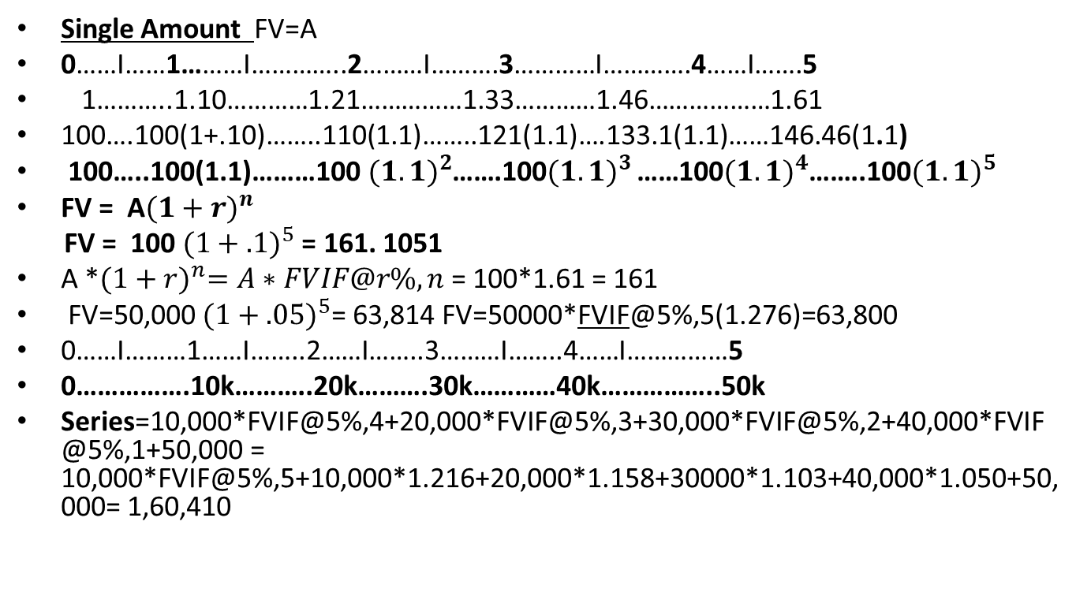
Future Value(Compounding process)
Single Amount FV=A
0……I……1………I…………..2………I……….3…………I………….4……I…….5
1………..1.10…………1.21……………1.33…………1.46………………1.61
100….100(1+.10)……..110(1.1)……..121(1.1)….133.1(1.1)……146.46(1.1)
100…..100(1.1)………100${(1.1)}^{2}$…….100${(1.1)}^{3 }$……100${(1.1)}^{4}$……..100${(1.1)}^{5}$
FV = A${(1+r)}^{n}$
FV = 100 ${(1+.1)}^{5}$ = 161. 1051
A *${(1+r)}^{n}=A∗FVIF@r\%,n$ = 100*1.61 = 161
FV=50,000 ${(1+.05)}^{5}$= 63,814 FV=50000*FVIF@5%,5(1.276)=63,800
0……I………1……I……..2……I……..3………I……..4……I……………5
0…………….10k………..20k……….30k…………40k……………..50k
Series=10,000*FVIF@5%,4+20,000*FVIF@5%,3+30,000*FVIF@5%,2+40,000*FVIF@5%,1+50,000 = 10,000*FVIF@5%,5+10,000*1.216+20,000*1.158+30000*1.103+40,000*1.050+50,000= 1,60,410

Slide 14
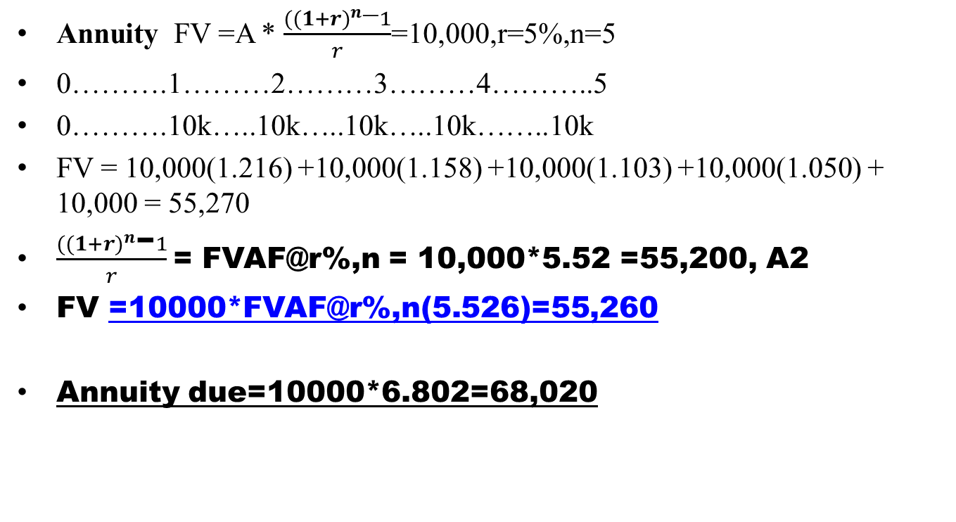




Future value
Annuity FV =A * $\frac{{((1+r)}^{n}\text{−}1}{r}$=10,000,r=5%,n=5
0……….1………2………3………4………..5
0……….10k…..10k…..10k…..10k……..10k
FV = 10,000(1.216) +10,000(1.158) +10,000(1.103) +10,000(1.050) + 10,000 = 55,270
$\frac{{((1+r)}^{n}\text{−}1}{r}$= FVAF@r%,n = 10,000*5.52 =55,200, A2
FV =10000*FVAF@r%,n(5.526)=55,260
Annuity due=10000*6.802=68,020

Slide 15
PROBLEM
A person deposits 5000 every year on his daughter’s birthday, starting from her first birthday. What will the total amount on her 25 th birthday, if the rate of interest is 6@p.a. Suppose, he forgot to deposit 14th and 23rd instalments.
5000*FVAF@6%,25 (A2) = 2,74,325 Ans: 2,74,325- 5,000*(FVIF@6%,11)-5,000*(FVIF@6%,2)
0……22…..23……24…….25
Ans= 2,74,325- 9490 – 5620 = 2,59,215

Slide 16
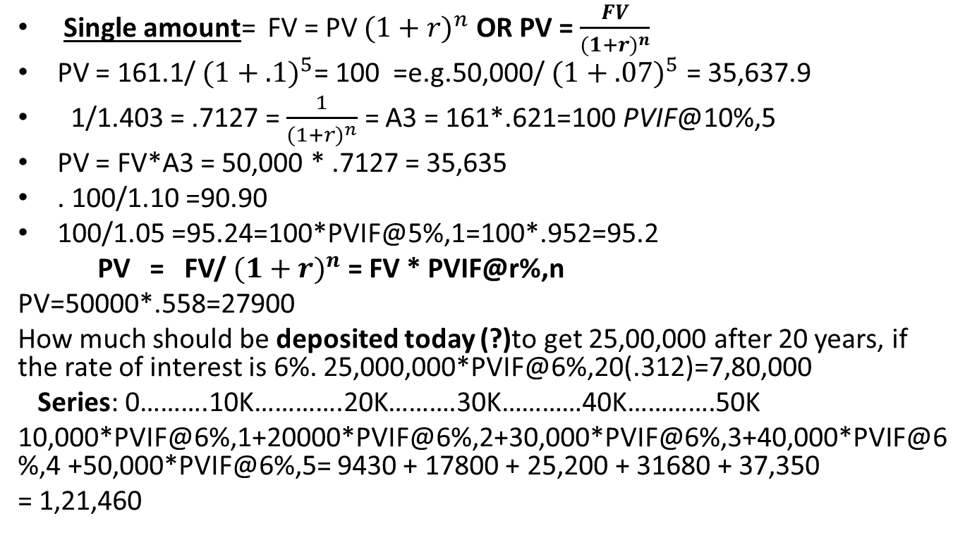
PRESENT VALUE(Discounting Process)
Single amount= FV = PV ${(1+r)}^{n}$ OR PV = $\frac{FV}{{(1+r)}^{n}}$
PV = 161.1/ ${(1+.1)}^{5}$= 100 =e.g.50,000/ ${(1+.07)}^{5}$ = 35,637.9
1/1.403 = .7127 = $\frac{1}{{(1+r)}^{n}}$ = A3 = 161*.621=100 PVIF@10%,5
PV = FV*A3 = 50,000 * .7127 = 35,635
. 100/1.10 =90.90
100/1.05 =95.24=100*PVIF@5%,1=100*.952=95.2
PV = FV/ ${(1+r)}^{n}$ = FV * PVIF@r%,n
PV=50000*.558=27900
How much should be deposited today (?)to get 25,00,000 after 20 years, if the rate of interest is 6%. 25,000,000*PVIF@6%,20(.312)=7,80,000
Series: 0……….10K………….20K……….30K…………40K………….50K
10,000*PVIF@6%,1+20000*PVIF@6%,2+30,000*PVIF@6%,3+40,000*PVIF@6%,4 +50,000*PVIF@6%,5= 9430 + 17800 + 25,200 + 31680 + 37,350
= 1,21,460
Notes:
If all these are 10,000 = 42,120

Slide 17
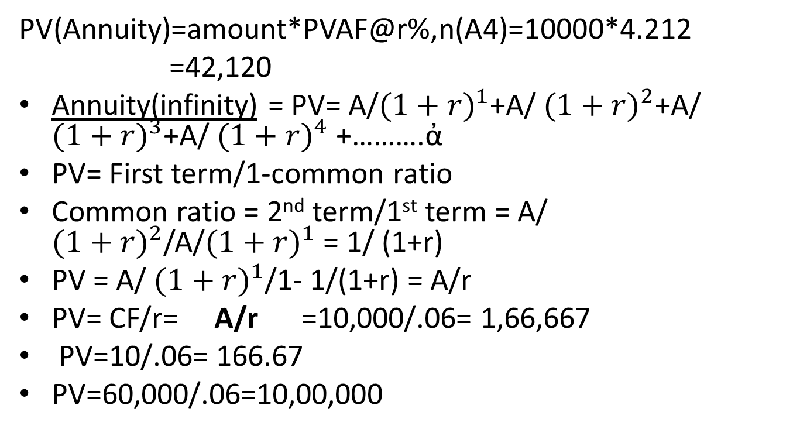
Present value
PV(Annuity)=amount*PVAF@r%,n(A4)=10000*4.212
=42,120
Annuity(infinity) = PV= A/${(1+r)}^{1}$+A/ ${(1+r)}^{2}$+A/ ${(1+r)}^{3}$+A/ ${(1+r)}^{4}$ +……….ἀ
PV= First term/1-common ratio
Common ratio = 2nd term/1st term = A/ ${(1+r)}^{2}$/A/${(1+r)}^{1}$ = 1/ (1+r)
PV = A/ ${(1+r)}^{1}$/1- 1/(1+r) = A/r
PV= CF/r= A/r =10,000/.06= 1,66,667
PV=10/.06= 166.67
PV=60,000/.06=10,00,000

Slide 18
Illustration
Family members of covid death can opt for
(1) 50,000
(2) 2500 p.m. forever, if the rate of inflation is 8% = 2500*12 =30,000, 8%
PV = 30,000/.08 = 3,75,000

Slide 19
practice
Q1: A Company offers investment proposal under which a person would get Rs 1000 for indefinite number of years and the rate of interest is 15%. Find the present value of the investment. Ans:6666.67
Q2:Aperson deposits Rs 1000 at the end of each of the next 10 years. What will be the total cumulative deposits at the end of 10 years from today, if the rate of interest is (a)9% (b)11%
Ans: 15,193, 16,722……..Hints:A2

Slide 20
0…….A……..A……..A……..50,000
How much amount to be deposited every year so that u will be having 50,000 after 10 years, if the rate of interest is 6%?
50,000 = A* FVAF@6%,10 = 3,793.34
3793is to be deposited every year so that u will be having 50,000 after 10 years, what is the rate of interest ?
50,000=3793*FVAF@r%,10=13.18217

Slide 21
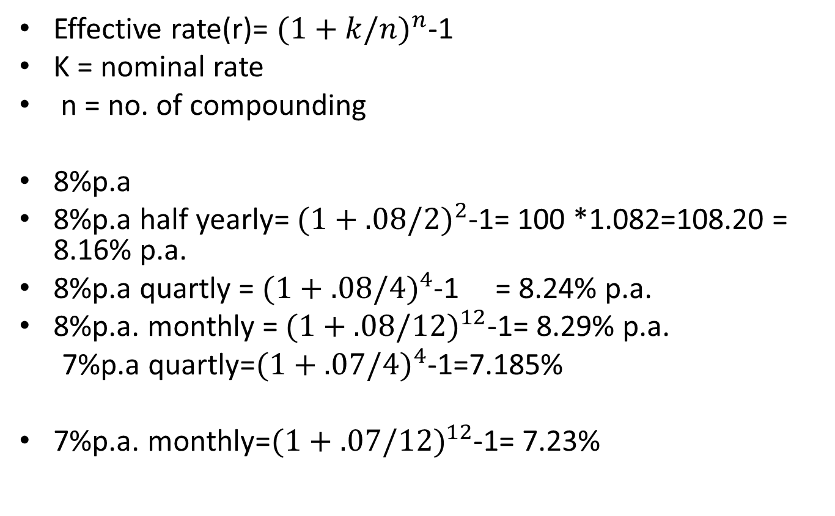
Effective rate Vs Nominal rate
Effective rate(r)= ${(1+k/n)}^{n}$-1
K = nominal rate
n = no. of compounding
8%p.a
8%p.a half yearly= ${(1+.08/2)}^{2}$-1= 100 *1.082=108.20 = 8.16% p.a.
8%p.a quartly = ${(1+.08/4)}^{4}$-1 = 8.24% p.a.
8%p.a. monthly = ${(1+.08/12)}^{12}$-1= 8.29% p.a.
7%p.a quartly=${(1+.07/4)}^{4}$-1=7.185%
7%p.a. monthly=${(1+.07/12)}^{12}$-1= 7.23%

Slide 22
Practice implications
A company borrowed a loan of Rs.10,00,000 at the compounding rate of 14%.Find the size of each installment to be repaid in 10 equal installments starting from end of 1st year.
Hint…10,00,000 (PV) = A * PVAF@14%,10
=1,91,717 = FV= 37,07,000 = A*FVAF@14%,10
A company borrowed a loan of Rs 5,00,000 at the rate of 18%. However, the payment is to start only at the end of second year from now. What should be the annual payment if the total loan and interest is to be paid in six installments.

Slide 23
10,00,000=pv= A*PVAF@14%,10(A4)
A=1,91,717
Installments=1,50,000
r =
10,00
10,00,000=1,50,000*PVAF@r%,10(A4)
r=8%

Slide 24
0…….1…….2…….3……4…5……6……7
……….0……..1……2……3….4…..5…..6
CV = 5,00,000*(1+.18) = 5,90,000
5,90,000 = A*PVAF@18%,6(A4)
A= 1,68,667

Slide 25
VERIFICATION (5,00,000)
Year | installment | interest | Principal | Principal o/s
1 |  | 90,000 |  | 5,00,000
2 | 1,68,667 | 1,06,200 | (27533) | 5,00,000
3 | 1,68,667 | 94,956 | 46,178 | 4,53,822
4 | 1,68,667 | 81,688 | 86,979 | 3,66,843
5 | 1,68,667 | 66,031 | 1,02,636 | 2,64,207
6 | 1,68,667 | 47,557 | 1,21,110 | 1,43,097
7 | 1,68,667 | 25,757 | 1,42,910 | 187
total | 10,12,002

